Slide 1
Browser
Server
Django Core
Database
Python
Template Engine
HTML
Static Files
CSS, JS, Images

Slide 2



Payments
Robot Detection
Email, SMS

Slide 3
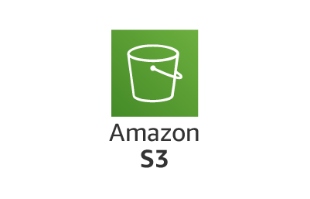





Scalable App Servers
Backend Services
Application Load Balancer
Internet
Email, SMS
Orchestration

Slide 4
Forms
Model
Model
URLs
View
Template
Template
View
Template Tags

