Slide 1
Cyber Engineering Pilot
Senior Capstone 2012
Louisiana Tech University
May 4, 2012

Slide 2
Outline
Objective
Related Work
Our Approach
Management
Labs
Conclusion

Slide 3
Objective
Develop introductory curriculum for new Cyber Engineering program
12 labs split across two classes
Android with Java

Slide 4
Related Work
California Polytechnic State University
  Android Labs
  Not CS specific

Slide 5
Our Approach
Focused on teaching fundamentals with Android as framework
Android framework provides students with practical application of the concepts they learn

Slide 6
Project Management
Agile process model
Considerations
  Group organization
  Modular nature of project
  Regular feedback

Slide 7
Configuration Management
Github
  Free online code repository
  Version control

Slide 8
Risk Management
Risk: Missed Deadline
  2 people per lab
  Labs completed in two sets of 6
Risk: Wasted Effort / Rejection
  Pilot course provides feedback and direction
  Ensures less time spent in revision

Slide 9
Quality Assurance
Pilot course (closed beta)
Review process at end of implementation
Black box testing
  Ensure labs perform as intended
  Students do not get poor directions
White box testing
  Not completely applicable
  Problem solution is of average complexity

Slide 10
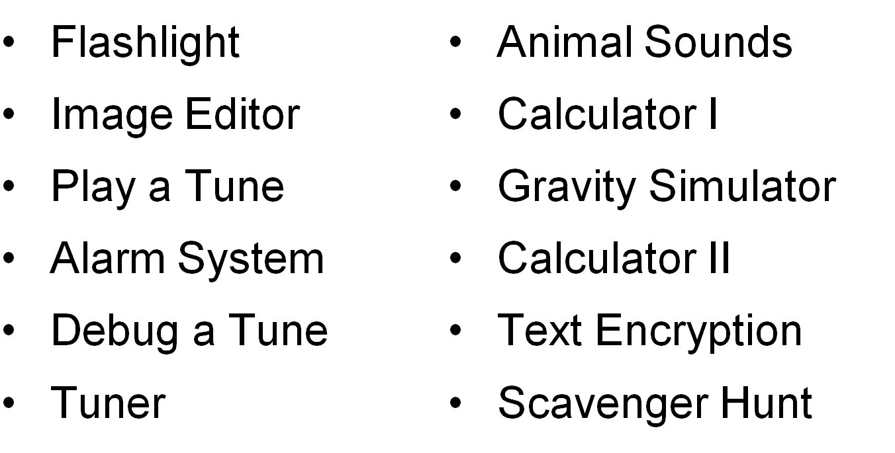
Lab Topics

Slide 11
Flashlight
A switch that turns camera LED on and off
First lab
Reinforces
  Proper class and method construction
  Basic Android programming practices

Slide 12
Image Editor
Captures and edits an image
Uses instances of camera object and editor object to get desired image
Reinforces
  Object interaction

Slide 13
Play a Tune
Plays musical notes stored in an array
Reinforces
  Basic data structures (arrays)
  Iteration (loops)

Slide 14
Alarm System
Plays alarm if it detects sounds above certain decibel
Students must find Android APIs to play and listen for sound
Reinforces
  Android APIs

Slide 15
Debug a Tune
Continuation of Play a Tune
Compiler, linker, runtime errors
Reinforces
  Different types of errors during development
  Use of debugger to correct errors

Slide 16
Chromatic Tuner
Analyzes input sound
Displays nearest note and octave
Reinforces
  Prior material
  Loops, control structures, data structures, APIs, etc.

Slide 17
Animal Sound System
Students given animal pictures and sounds
Maps pictures to sounds
Touching picture plays corresponding sound
Reinforces
  Inheritance
  Polymorphism

Slide 18
Calculator 1
Student given mostly complete GUI
Implement functionality behind the GUI
Reinforces
  Working with GUIs
  Use of API’s
  Programming logic

Slide 19
Gravity Simulator
Touching screen creates planets
Planets interact with each other using gravity and other physical laws
Reinforces
  Creating a GUI
  Touch handling
  Animation rendering

Slide 20
Calculator 2
Students start with completed Calculator 1
Add order of operations and recursive mathematical operations
Reinforces
  Recursion
  Complex use of data structures

Slide 21
Text Encryption
User enters text and uses buttons to encrypt or decrypt the text
App displays encrypted/decrypted text
Reinforces
  Error checking/handling
  Try, catch, and throw blocks for exceptions
  Development of robust software

Slide 22
GPS Scavenger Hunt
A “scavenger hunt” that uses NFC and GPS
Search for locations on campus
Reinforces
  Everything learned so far
  APIs, GUIs, methods/classes, inheritance, etc.

Slide 23
Conclusion
12 labs will form core of introductory curriculum for new Cyber Engineering major
Labs may eventually migrate to Computer Science curriculum

