Slide 1




Detecting the Moment of Learning
Ryan S.J.d. Baker
Adam B. Goldstein
Neil T. Heffernan

Slide 2
Talk Outline
Introduction
Data
P(J) model
Labeling Process
Features
ML Procedure
Results
Spikiness Models
Conclusions

Slide 3
In recent years…
There has been work towards developing better and better models that can predict if a student has learned a skill up to a certain time
[Corbett & Anderson, 1995; Martin & VanLehn, 1995; Shute, 1995; Conati et al, 2002; Beck et al, 2007, 2008; Pardos et al, 2008; Baker et al, 2008, 2010; Pavlik et al, 2009]

Slide 4
E.g.
W R W W R W W R R W R R R
The student has a 84% chance of now knowing the skill

Slide 5
In this paper…
We go a step further, and try to assess not just
Whether a student knows the skill
But also
When the student learned it

Slide 6
E.g.
The student probably learned the skill at
W R W W R W W R R W R R R

Slide 7
Why is this useful?
Better understand the conditions and antecedents of learning
May be possible to change style of practice after these inflection points, from focusing on learning skill to focusing on gaining fluency

Slide 8
Why is this useful?
Better understand the conditions and antecedents of learning
May be possible to change style of practice after these inflection points, from focusing on learning skill to focusing on gaining fluency
Even if we’re just catching an inflection point in the strength of association rather than an actual “eureka” moment, this still might be relevant and useful

Slide 9
How do we do it?
Very much like the models that detected contextual probability of guessing and slipping (Baker, Corbett, & Aleven, 2008)

Slide 10
How do we do it?
We take an action, and the probability the student knows the skill at that point, according to Bayesian Knowledge Tracing (Corbett & Anderson, 1995)
We look at the next two actions
We apply Bayes’ Theorem
This gives us training labels; we then develop a model that uses only features from the current action and the past

Slide 11
High-Level
5% probability student knew skill
W W W
Skill was probably not learned at red action

Slide 12
High-Level
90% probability student knew skill
R R R
Skill was probably not learned at red action

Slide 13
High-Level
30% probability student knew skill
R R R
Skill was quite possibly learned at red action (or previous action)

Slide 14
High-Level
30% probability student knew skill
W R R
Skill was quite possibly learned at red action (or next action)

Slide 15
High-Level
30% probability student knew skill
W W R
Skill was probably not learned at red action

Slide 16
Now, for more details…
My co-author, Adam Goldstein

Slide 17
Talk Outline
Introduction
Data
P(J) model
Labeling Process
Features
ML Procedure
Results
Spikiness Models
Conclusions

Slide 18
Data used
232 students’ use of CMU’s Middle School Cognitive Tutor
Math classes in one middle school in Pittsburgh suburbs during 2002-2003
Used tutor twice a week as part of their regular curriculum
581,785 transactions
171,987 problem steps over 253 skills

Slide 19
Talk Outline
Introduction
Data
P(J) model
Labeling Process
Features
ML Procedure
Results
Spikiness Models
Conclusions

Slide 20
Labeling P(J)
Bear with me, it’s worth it
Primarily considered with this statement:
P(J) = P(~L_{n} ^ T | A₊₁₊₂ )
*Note how it is distinct from T
P(T) = P(T | ~L_{n})
P(J) = P(~L_{n} ^ T)

Slide 21
P(J) is distinct from P(T)
Bear with me, it’s worth it
Primarily considered with this statement:
P(J) = P(~L_{n} ^ T | A₊₁₊₂ )
*Note how it is distinct from T
P(T) = P(T | ~L_{n})
P(J) = P(~L_{n} ^ T)

Slide 22
Labeling P(J)
We can better understand P(~L_{n} ^ T | A₊₁₊₂ ) with an application of Bayes’ rule
P(~L_{n} ^ T | A₊₁₊₂ ) =
P(A₊₁₊₂ | ~L_{n} ^ T) * P(~L_{n} ^ T)
P (A₊₁₊₂ )

Slide 23
Labeling P(J)
Base probability P(~L_{n} ^ T ) computed using a student’s current P(~L_{n}) and P(T) from BKT
P(A₊₁₊₂ ) is a function of the only three relevant scenarios, {L_{n}, ~L_{n} ^ T, ~L_{n} ^ ~T}, and their contingent probabilities
P(A₊₁₊₂ ) = P(A₊₁₊₂ | L_{n})P(L_{n})
+ P(A₊₁₊₂ | ~L_{n} ^ T) P(~L_{n} ^ T)
+ P(A₊₁₊₂ | ~L_{n} ^ ~T) P(~L_{n} ^ ~T)

Slide 24
Labeling P(J)
And finally: Probability of actions at N+1 and N+2 is a function of BKT’s probabilities for guessing (G), slipping (S), and learning the skill (T)
(Correct answers are notated with a C and incorrect answers are notated with a ~C)
(A full list of equations is available in the paper)
P(A₊₁₊₂ = C, C | L_{n} ) = P(~S)P(~S)
P(A₊₁₊₂ = C, ~C | L_{n} ) = P(S)P(~S)
P(A₊₁₊₂ = ~C, C | L_{n} ) = P(S)P(~S)
P(A₊₁₊₂ = ~C, ~C | L_{n} ) = P(S)P(S)

Slide 25

Labeling P(J)
P(A₊₁₊₂ = C, C | L_{n} ) = P(~S)²
P(A₊₁₊₂ = C, ~C | L_{n} ) = P(S)P(~S)
P(A₊₁₊₂ = ~C, C | L_{n} ) = P(S)P(~S)
P(A₊₁₊₂ = ~C, ~C | L_{n} ) = P(S)²
Future data is used only in training.

Slide 26
Labeling P(J)
</torture>
But don’t forget:
P(J) = P(~L_{n} ^ T | A₊₁₊₂ )

Slide 27
Talk Outline
Introduction
Data
P(J) model
Labeling Process
Features
ML Procedure
Results
Spikiness Models
Conclusions

Slide 28
Features of P(J)
Used log information on data from already completed student usage of the tutor
Defined behavior that may be indicative of knowledge acquisition
Developed a means to quantify or observe that behavior
Used same set of features as seen in [Baker, Corbett, and Aleven 2008]

Slide 29
Features of P(J)
In training
The label P(J) uses future data from logs
We machine learn weights for each feature to predict P(J), using only past/present data
In test
To predict P(J) we calculate these features and apply the learned weights using only information available at run time

Slide 30
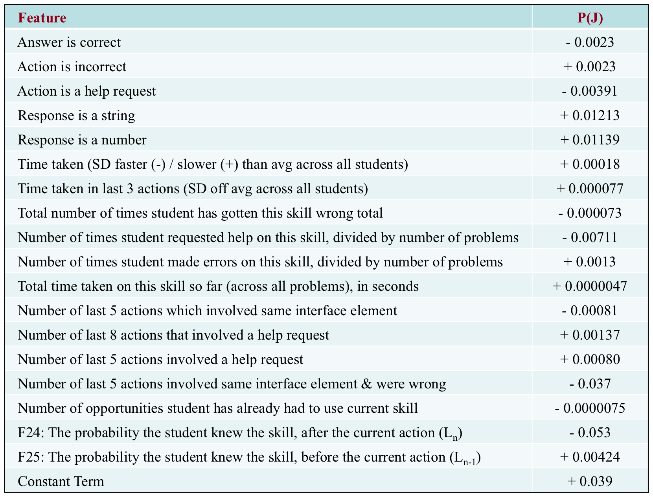
Example Features
All features use only first actions

Slide 31
What some of those numbers mean
P(J) is higher following incorrect responses
[Citation]
P(J) decreases as the total number of times student got this skill wrong increases
Might need intervention not available in the tutor

Slide 32
What some of those numbers mean
P(J) is lower following help requests
Stands out in contrast to [Beck et al 2008]
P(J) is higher when help has been used recently, i.e. in the last 5 and/or 8 steps

Slide 33
Talk Outline
Introduction
Data
P(J) model
Labeling Process
Features
ML Procedure
Results
Spikiness Models
Conclusions

Slide 34
Features of P(J)
In RapidMiner, ran linear regression to make a model for correlation between our features and the P(J) label
Two feature sets run through 6-fold student-level cross validation
25 including L_{n} and L_{n-1}: .446 correlation to labels
23 not including L_{n} and L_{n-1}: .301 correleation

Slide 35
Features of P(J)
Argument could be made that using BKT probabilities (L_{n}) in the definition of the label (~L_{n} ^ T) is wrong
We consider this to be valid - Interesting part is the T, not the L_{n}
Even if you don’t buy it, a .301 correlation coefficient is certainly still something

Slide 36
Back to Ryan
For some discussion of analysis of P(J)

Slide 37
Talk Outline
Introduction
Data
P(J) model
Labeling Process
Features
ML Procedure
Results
Spikiness Models
Conclusions

Slide 38
Research question
Does learning in intelligent tutors have more of a character of gradual learning (such as strengthening of a memory association [cf. Pavlik & Anderson, 2008]) or learning given to “eureka” moments, where a skill is understood suddenly? [Lindstrom & Gulz, 2008]
Does this vary by skill?

Slide 39
To answer this
We can plot P(J) over time, and see how “spiky” the graph is
Note that this is effectively the derivative of the more standard theoretical learning curve (cf. Corbett & Anderson, 1995; Koedinger et al, 2008)

Slide 40
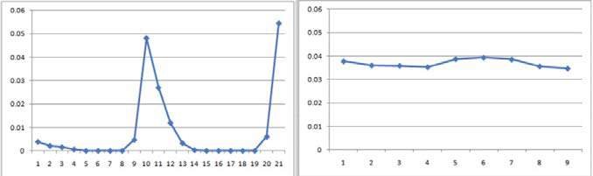
Real Data for One Student (Two different skills)
P(J)
OPTOPRAC

Slide 41
Real Data for One Student (Two different skills)
P(J)
OPTOPRAC

Slide 42
As you can see…
One skill was learned gradually, the other skill was learned suddenly
Note that the first graph had *two* spikes
This was actually very common in the data, even more common than single spikes

Slide 43
As you can see…
One skill was learned gradually, the other skill was learned suddenly
Note that the first graph had *two* spikes
This was actually very common in the data, even more common than single spikes
I would very much appreciate hypotheses for why this happens, as I don’t have a good theoretical explanation for this

Slide 44
We can quantify the difference between these graphs
We can quantify the degree to which a learning sequence involves a “eureka” moment, through a metric we call “spikiness”
For a given student/skill pair, spikiness =
Max P(J)/Avg P(J)
Scaled from 1 to infinity

Slide 45
Looking at spikiness
We only consider action sequences at least 6 problem steps long
(Shorter sequences tend to more often look spiky, which is a mathematical feature of using a within-sequence average)
We only consider the first 20 problem steps
After that, the student is probably floundering

Slide 46
Spikiness by skill
Min: 1.12
Max: 113.52
Avg: 8.55
SD: 14.62
Future work: What characterizes spiky skills and gradually-learned skills?

Slide 47
Spikiness by student
Min: 2.22
Max: 21.81
Avg: 6.81
SD: 3.09
Students are less spiky than skills

Slide 48
Interestingly
The correlation between a student’s spikiness, and their final average P(Ln) across skills is a high 0.71, statistically significantly different than chance
Suggests that learning spikes may be an early predictor of whether a student is going to achieve good learning of specific material
May someday be the basis of better knowledge tracing

Slide 49
One of…
One of many analyses potentially enabled by this model

Slide 50
Worth Noting
Generally across all actions on a skill, P(J) levels don’t quite add up to a total of 1 across all actions
In general, our model is representative of P(J) at lower levels but tends to underestimate the height of spikes
May be a result of using linear modeling approach for a fundamentally non-linear phenomenon
May also be that P(J) is actually too high in the training labels (where it often ends up significantly above a total of 1)
Could be normalized, for the purposes of spikiness analyses, we believe the model biases towards seeing less total spikiness

Slide 51
Talk Outline
Introduction
Data
P(J) model
Labeling Process
Features
ML Procedure
Results
Spikiness Models
Conclusions

Slide 52
In this paper
We have advanced a new model that is able to infer with moderate accuracy exactly when a student learns a skill
We’ve now gotten the model to correlate about twice as well to the training labels, by looking at more than just the first attempt at the problem step
For more details, see our poster at EDM2010

Slide 53
In this paper
We have used this model to analyze the differences in spikiness of different skills (and different students)
Discovering that double-spikes are common (a finding we don’t yet understand)
And that student spikiness predicts the post-test

Slide 54
Other future work
Why are some skills spikier than others?
How can we use spikiness to improve student knowledge modeling?
What are the conditions and antecedents of learning spikes?

Slide 55
Tools sharing
We would be very happy to share the spreadsheets and code that we used to calculate the P(J) labels with any interested colleague
Please email us

Slide 56
Thanks!
Any Questions?

