Slide 1









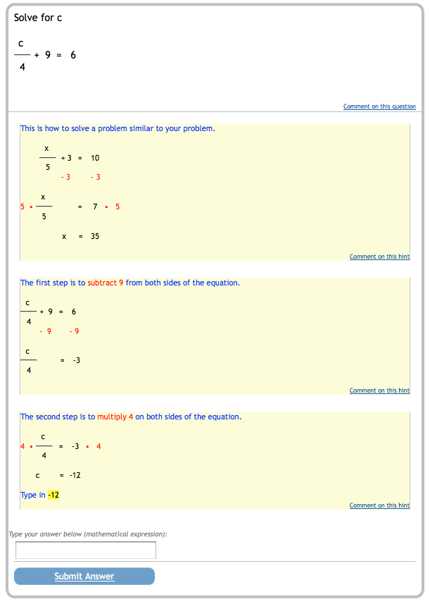
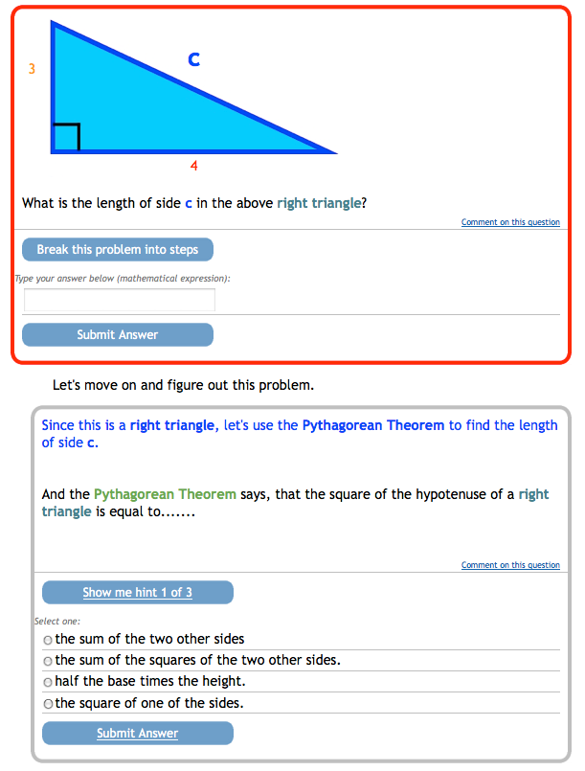
Collaborators
Pinpointing Learning Moments
Adam B. Goldstein, Ryan S.J.d Baker,, and Neil T. Heffernan
Sponsors
Introduction
Labeling P(J)
Subsequent action features
In recent work (Baker, Goldstein, & Heffernan, 2010), we created a model for P(J), the probability a student JustLearned a given Math skill from the problem they just completed in an Intelligent Tutoring system. Analysis of P(J) model can:
Help predict eventual L_{n} values
Help identify learning spikes
Allow for biasing ITS’s intelligently
Our original model was constructed with data from CMU’s Cognitive Tutor. We now present a second model that uses data from ASSISTments. Previously our features ignored what specifically happened in actions subsequent to the first response on each skill; by paying attention to that information, we hope to gain significant additional variance about P(J).
Probability student learned skill at step N, given N+1, N+2:
P(J) = P(~L_{n} ^ T | A₊₁₊₂ )
We find P(J) with a function using Bayes’ Rule:
P(~L_{n} ^ T | A₊₁₊₂ ) =
P(A₊₁₊₂ | ~L_{n} ^ T) * P(~L_{n} ^ T)
P (A₊₁₊₂ )
Probability of N+1, N+2, i.e. P(A₊₁₊₂ ) is a function of each case (~L, ~L_{n} ^ T, ~L_{n} ^ ~T) and contingent probabilities:
P(A₊₁₊₂ ) = P(A₊₁₊₂ | ~L_{n})P(L_{n})
+ P(A₊₁₊₂ | ~L_{n} ^ T) P(~L_{n} ^ T)
+ P(A₊₁₊₂ | ~L_{n} ^ ~T) P(~L_{n} ^ ~T)
Probability next two steps are one of those cases described above:
P(A₊₁₊₂ = C, C | ~L_{n} ^ ~T ) =
P(G)P(~T)P(G) + P(G)P(T)P(~S)
P(A₊₁₊₂ = C, C | ~L_{n} ^ ~T ) =
P(G)P(~T)P(G) + P(G)P(T)P(~S)
P(A₊₁₊₂ = C, C | ~L_{n} ^ ~T ) =
P(G)P(~T)P(G) + P(G)P(T)P(~S)
P(A₊₁₊₂ = C, C | ~L_{n} ^ ~T ) =
P(G)P(~T)P(G) + P(G)P(T)P(~S)
Image 1: Subsequent action hints
Image 2: Scaffolding/subsequent actions
Features based on subsequent actions | P(J)
Problem is not a scaffolding of another problem | + 0.000652610
Problem ends by using the bottom out hint | - 0.003014376
Total hints used in subsequent actions | - 0.022396538
Correct subsequent action made after a non-bottom out hint taken | + 0.002203126
Percent of subsequent actions made so far that were wrong | - 0.000660796
Second to last hint was used | - 0.002062003
Number of past 8 problems that ended by using the bottom out hint | + 0.007902543
Percent of subsequent actions made so far that were wrong | - 0.001880299
Number of wrong subsequent actions made on the current problem | - 0.011745058
Sum time taken on all subsequent actions for this problem | + 0.044285092
Sum time taken for subsequent actions in last 3 problems (SD faster/slower than avg.) | + 0.007127507
Sum time taken for subsequent actions in last 5 problems (SD faster/slower than avg.) | + 0.001634996
Time taken on subsequent actions divided actions that were wrong | + 0.007024973
Total amount of time spent on subsequent actions for this skill | + 0.000352056
Fastest hint taken in this problem’s subsequent actions | - 0.027911942
Slowest hint taken in this problem’s subsequent actions | + 0.003435371
Slowest action made in this problem’s subsequent actions after taking a hint | + 0.007156309
Slowest wrong action made in this problem’s subsequent actions | + 0.006461017
Total subsequent actions taken on subsequent actions for this skill | + 0.001885819
Problem ends with system forcing student into scaffolding | - 0.002765517
Time taken to make a first response on a scaffolding problem | - 0.007198452
Time taken on subsequent actions for this problem which is scaffolding | - 0.018700453
Sum time taken for subsequent actions in last 3 problems which were scaffolding | + 0.116682849
Total time spent on subsequent actions on this skill in scaffolding | + 0.000495459
Number of hints taken in subsequent actions on this scaffolding problem | - 0.043473845
Data
Our new data set was drawn from the ASSISTments tutoring system (Razzaq et al, 2007). The logs cover use by 4187 students from New England middle and high school students using the system between 2008 and 2010. The data includes 55 unique skills and 418,513 logged actions.
First action features
Feature based on first responses | P(J)
Time taken to make a first response | - 0.001866942
Time taken in last 3 problems (SD faster/slower than avg) | + 0.002143767
First response is correct | - 0.005400395
First response is a hint request | - 0.002059471
Total number of hints available | + 0.011859572
First response is a scaffolding request | - 0.003479485
Number of past 5 first responses was any sort of help request | - 0.082785845
Percent of first responses made so far that were wrong | + 0.002275054
Number of wrong first responses made so far | - 0.010977774
Number of past 5 first responses that were wrong | - 0.065882371
Total amount of time spent on first responses for this skill | - 0.008231347
Time passed since this skill was last seen | - 0.010421386
Problem was begun during school (M-F 9:00 AM – 3:00 PM) | - 0.000354078
Total problems attempted so far (Familiarity with the system) | + 0.001544751
L_{n-1} | - 0.005014120
Results and Conclusions
Previously we achieved a correlation coefficient of 0.446 with data from the Cognitive Tutor. We achieved 0.429 with ASSISTments, using subsequent actions on a step as well as first actions. However, we achieved 0.398 using the first actions only, suggesting that effective models of P(J) can be achieved without the additional effort to distill features for subsequent actions.

