Slide 1
What To Wear Weather
Created by Andrew Gordon, Tommy Hoffman,
Daniel Zurawski, and Connor McGuinness

Slide 2
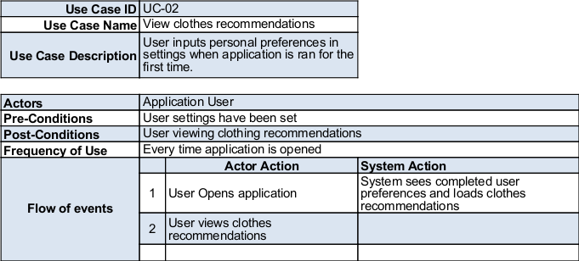
Use Case 02
Notes:
1:00 minute
-- Important use case that defines base functionality

Slide 3
Video Demo
Link or direct file of video
Notes:
2:00 minutes

Slide 4
How the app talks to the Database
Notes:
1:00 minute
--

Slide 5
How weather and forecast are fetched
Notes:
1:00 minute

Slide 6
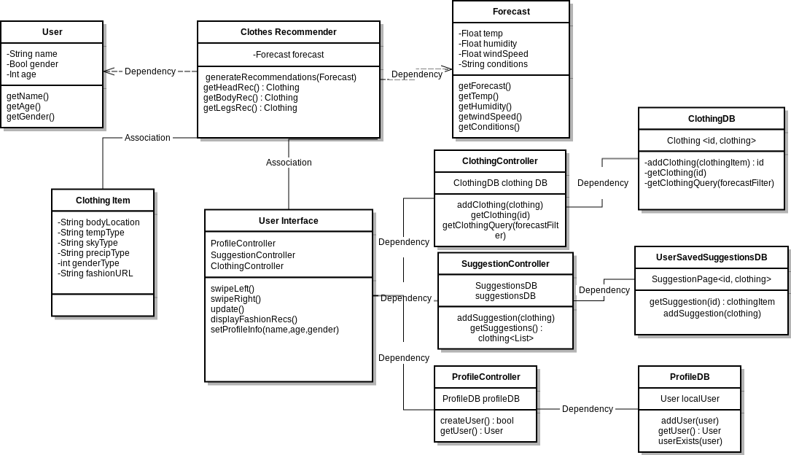
Class Diagram
Notes:
1:00 minute

Slide 7
Thank You

