Slide 1
What To Wear
Created by Andrew Gordon, Tommy Hoffman,
Daniel Zurawski, and Connor McGuinness

Slide 2
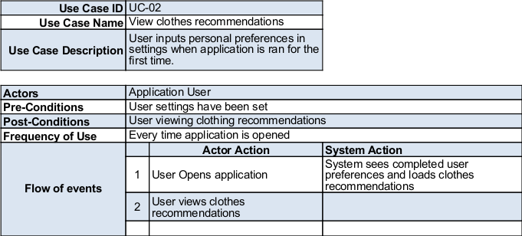
Use Case 02

Slide 3
Video Demo
Link or direct file of video

Slide 4
How the app talks to the Database

Slide 5
How weather and forecast are fetched

Slide 6
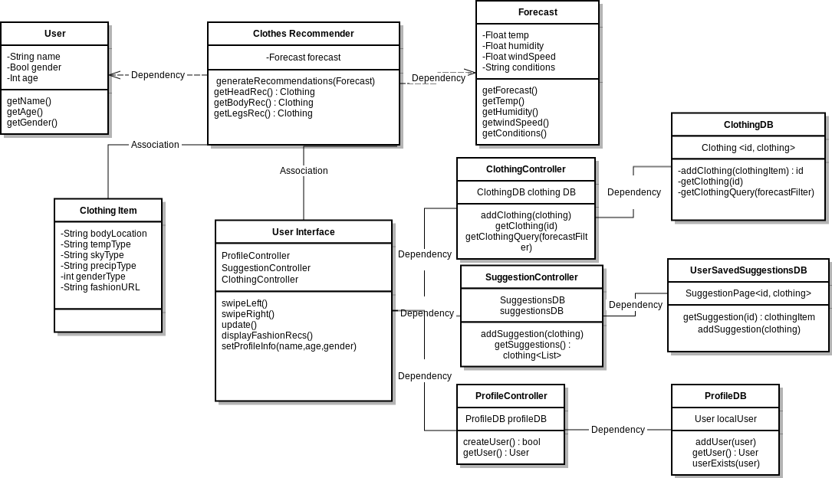
Class Diagram

Slide 7
Any Questions?

