Slide 1













WiGEM : A Learning-Based Approach for Indoor Localization
Abhishek Goswami, Luis Ortiz, Samir R. Das
Stony Brook University.

Slide 2
Goal :
Localize a wireless client in an indoor environment based on the signal strength of its transmitted packets.
Existing Approaches:
Most of the existing approaches require a substantial ‘pre-deployment’ effort usually involving creation of RF signal maps for the target area
Such ‘Training’ (a.k.a Supervised Learning) based approaches have several limitations.
Limitations of the existing ‘Training’-based approaches
Makes the RF-map device specific. This in turn leads to the hardware variance problem which can causes significant degradation in accuracy.
The offline ‘pre-deployment’ phase is labor-intensive. Moreover localization accuracy depends significantly on the granularity of the training locations.
Leads to static RF-maps which are difficult to update and maintain.

Slide 3
Root cause of all the above limitations :
Training i.e. the ‘offline’ pre-deployment phase.
Proposal :
To develop an algorithm that eliminates ‘Training’. We do this by using two key ingredients :
A standard radio propagation model
The typical constraints that exist between the received signal strengths for different power levels at the same location
What do we have finally ?
An Learning (a.k.a Unsupervised Learning) based localization solution which has the following advantages –
Addresses the hardware-variance problem
Requires zero ‘pre-deployment’ effort
An online algorithm where the model parameters get updated and modified based on real-time RSS observations.
Localization accuracy is at par or better than Existing approaches under typical conitions.

Slide 4
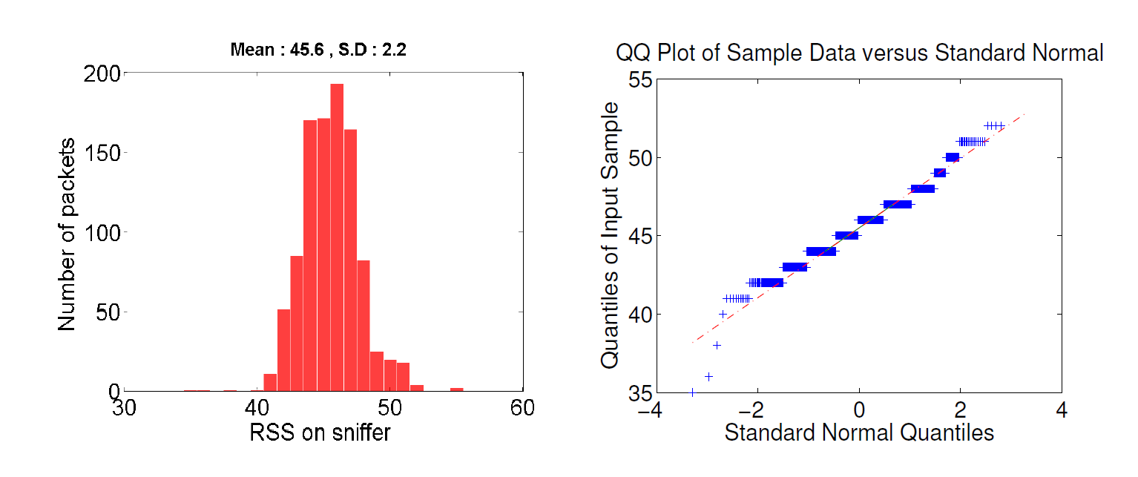
Problem Formulation :
Assume the target space is discretized into ‘J’ locations
There are ‘N‘ sniffer devices / Access Points(APs) , each of which report the RSS of the target device to a central server. The location of the sniffers are assumed to be known with respect to the ‘J’ locations
Problem : Given a vector of RSS sniffed at the set of sniffers, estimate the most likely target location out of the ‘J’ possibilities.
Distribution of RSS observed on a sniffer :
(from a stationary sniffer transmitting at a fixed power level)
Gaussian ! ( This observation has been made in literature before)

Slide 5
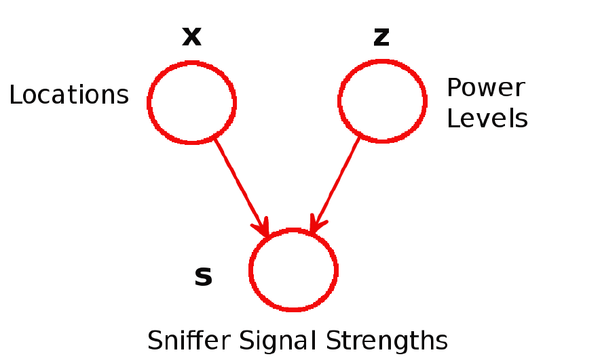
An additional subtlety for Power Levels
The same device, at the same location but with a different transmit power will generate a different Gaussian.
Thus, in addition to ‘Location’, we have an additional latent variable for ‘Power Levels’
Our Model
x is J-dimensional binary random variable representing possible target locations.
z is K-dimensional binary random variable representing possible power levels.
s is the N-dimensional vector representing the RSSI observed by the ‘N’ sniffers in the target area.

Slide 6

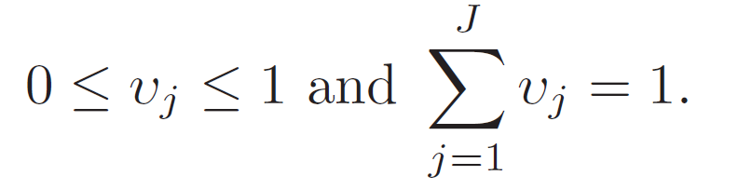
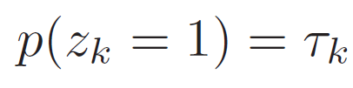
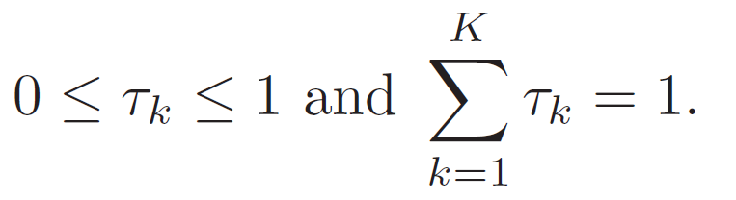
Probability Distributions for Location and Power-Level
The probability distribution over x can be specified as a multinomial. x has 1-of-J representation, in which only one element equals 1 and all other elements are 0.
where
The probability distribution over z can be specified as a multinomial. z has 1-of-K representation, in which only one element equals 1 and all other elements are 0.
where

Slide 7
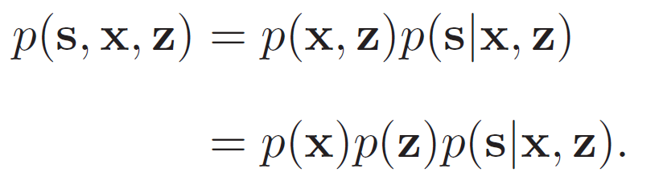
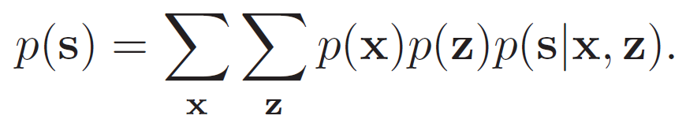
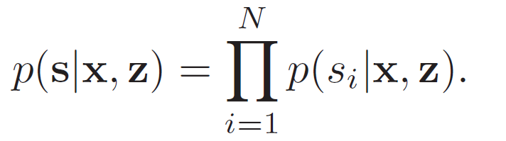
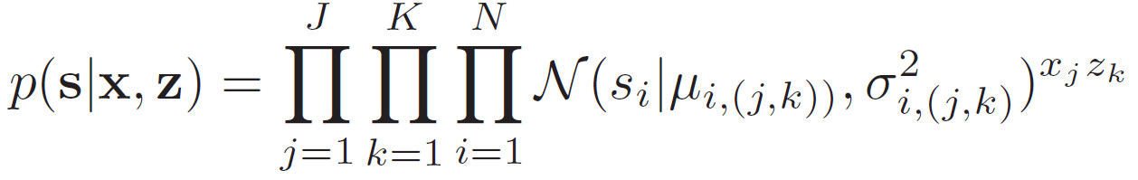
Simplifying the Probability Distribution for RSSI
Step 1 : x and z are independent random variables. Corresponding to our graphical model, we have
Step 2 : Thus, the marginal over s can be represented as
Step 3 : Assuming RSS observed at different sniffers are independent
Step 4 : RSSI at a sniffer can be modeled as a Gaussian determined by the (location, power-level) pair. i.e.
So
Note: For any given x and z, only one term in the product is actually active for all i.
x_{j}z_{k} = 1 for exactly one index pair (j, k) and equals 0 for all others.

Slide 8
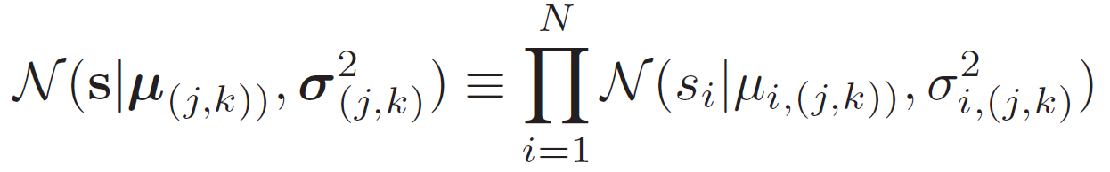
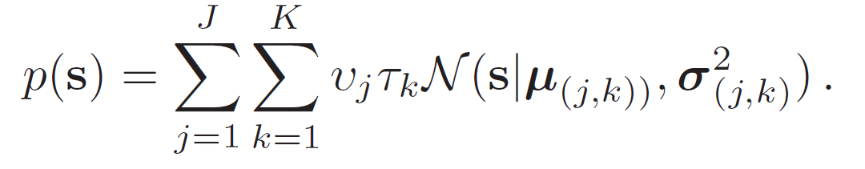
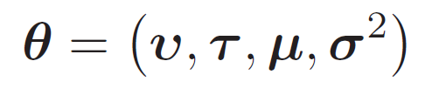
Step 5 : For notational convenience,
Which finally gives us the distribution of RSSI
Thus we have modeled the distribution of RSSI as a Gaussian mixture with ‘Location’ and ‘Power-Level’ as the latent variables. The parameters for our model are :
We now use the Expectation-Maximization algorithm to estimate the parameters of our model

Slide 9
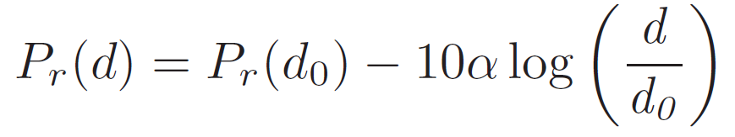
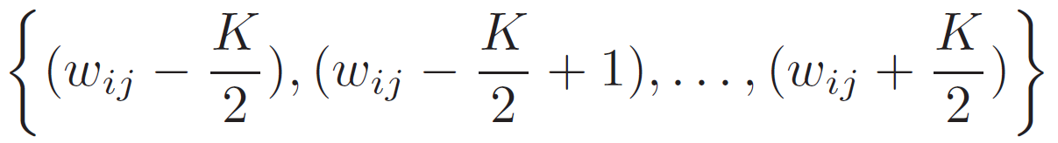
Initializing the Model parameters
A uniform distribution is used for initializing and
For initializing the means parameter we use a simple radio propagation model given by
is assumed to be 60 (in dB) at d₀ = 1 meter
is assumed to be 2
Now, for a location
, the above equation gives a value
at sniffer
We consider K values :
And use these values to initialize the means of the K components representing power levels ( for location and sniffer ). We do this for each (location, sniffer) pair. This effectively initializes parameter in our model
The standard deviation was initialized to 5 for each component.

Slide 10

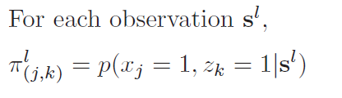
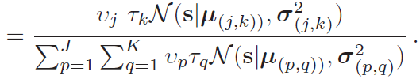




The EM Steps
Suppose we have a data-set of observations at the sniffers from the target device :
The E-step corresponds to finding the expected value of the latent component (x and z) values given the observed data and the current parameter estimates. For each observation, we calculate the posterior probability for each component as follows :
The M-step corresponds to maximizing the expected log-likelihood of the observed data. We re-estimate the parameters based on the posterior calculated in the E-step of the algorithm.
where
The variance parameter can be updated accordingly. Though we kept it fixed in our experiments to reduce computation time

Slide 11
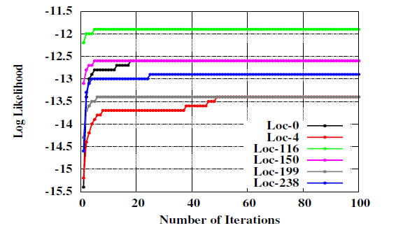
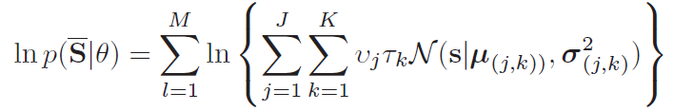



Convergence of Log Likelihood
Each update of the parameters resulting from an E-step followed by an M-step is guaranteed to increase the log likelihood function
Final location estimate
Given a real-time received RSSI vector we now find the location with the highest probability :

Slide 12
Test bed Details and Data Collection Methodology

Slide 13
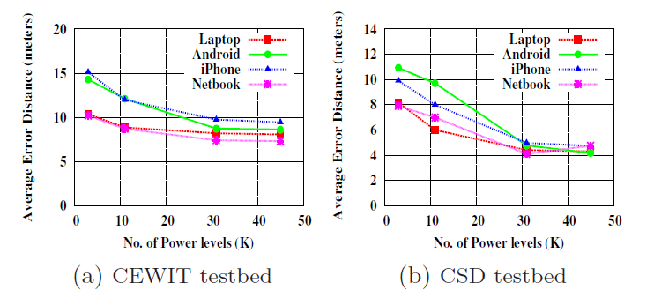
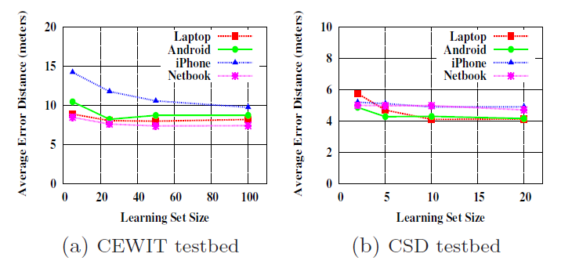
Evaluation
Number of Power-Levels (K) necessary for modeling
Effect of learning set size

Slide 14
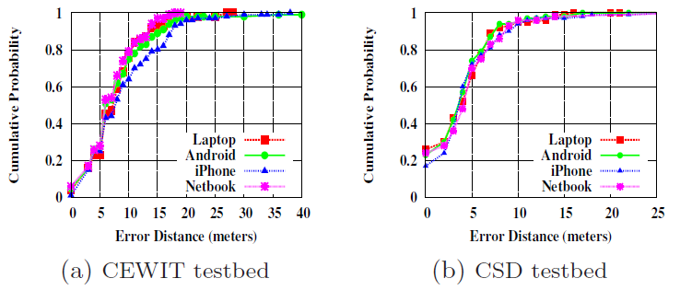
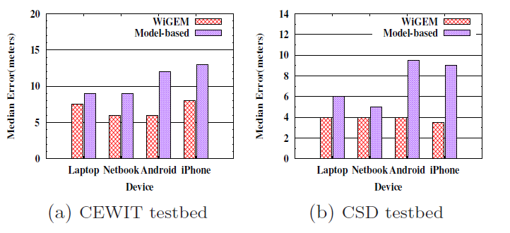
WiGEMs accuracy for multiple devices :
WiGEM vs. Model-based scheme (baseline)

Slide 15
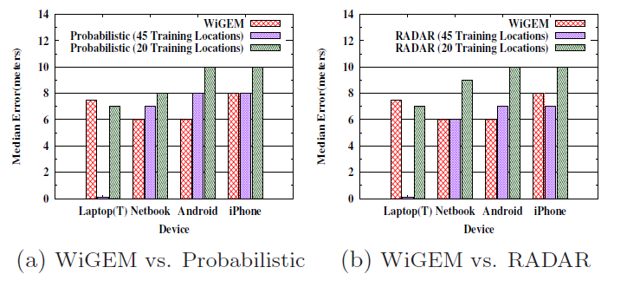
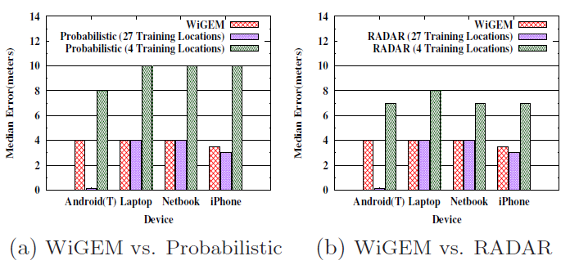
Comparisons with schemes which build RF signal maps

Slide 16
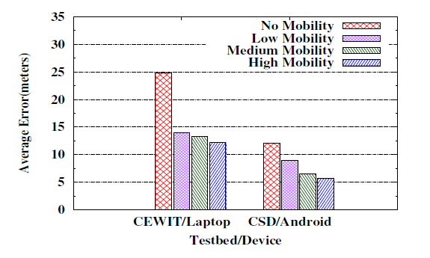
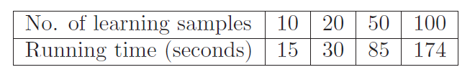
Impact of Mobility
Running Time (CEWIT test bed, single server)

Slide 17
Future Work
The number and location of sniffers, the size of grid and their impact on localization accuracy
Enforcing power-level constraints during run-time to see if accuracy improves.
Adaptive localization by doing learning and using the adjacency of the location as information to track how motion could evolve

