Slide 1

LARS-Enterprise – Milestone Update
September – October 2024
Significant RAG + Citations Accuracy Improvement – BM25 Indexing Comes to LARS
LARS Can Now “See”: Multimodal Vision-LLMs Now Supported by HF-Waitress & LARS
LARS Can Now “Show”: Image Generation Models Now Supported by HF-Waitress & LARS

Slide 2
1. Indexed & Re-Ranked RAG

Slide 3
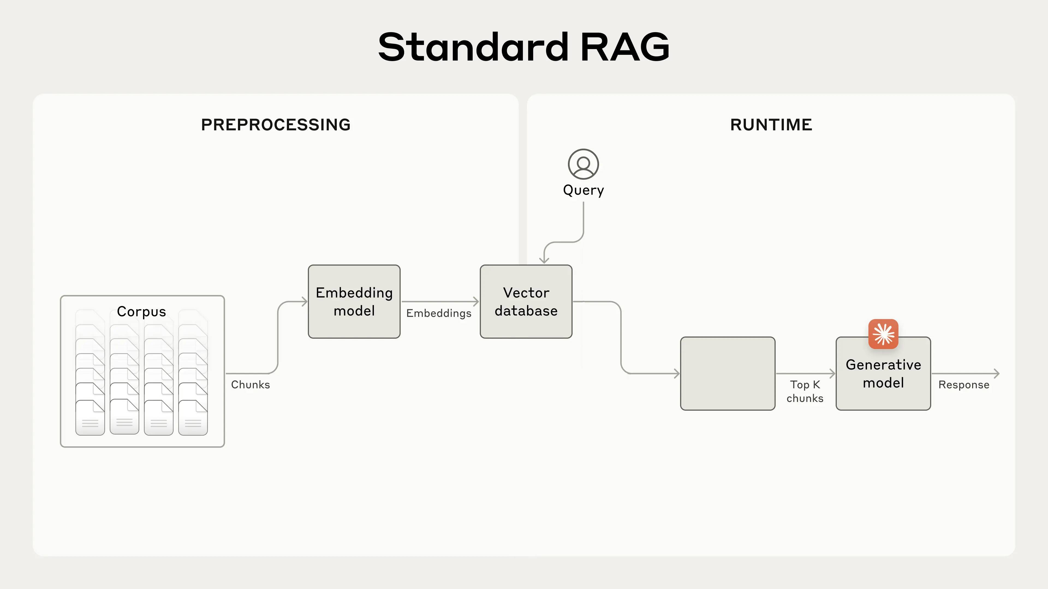
Retrieval

Slide 4
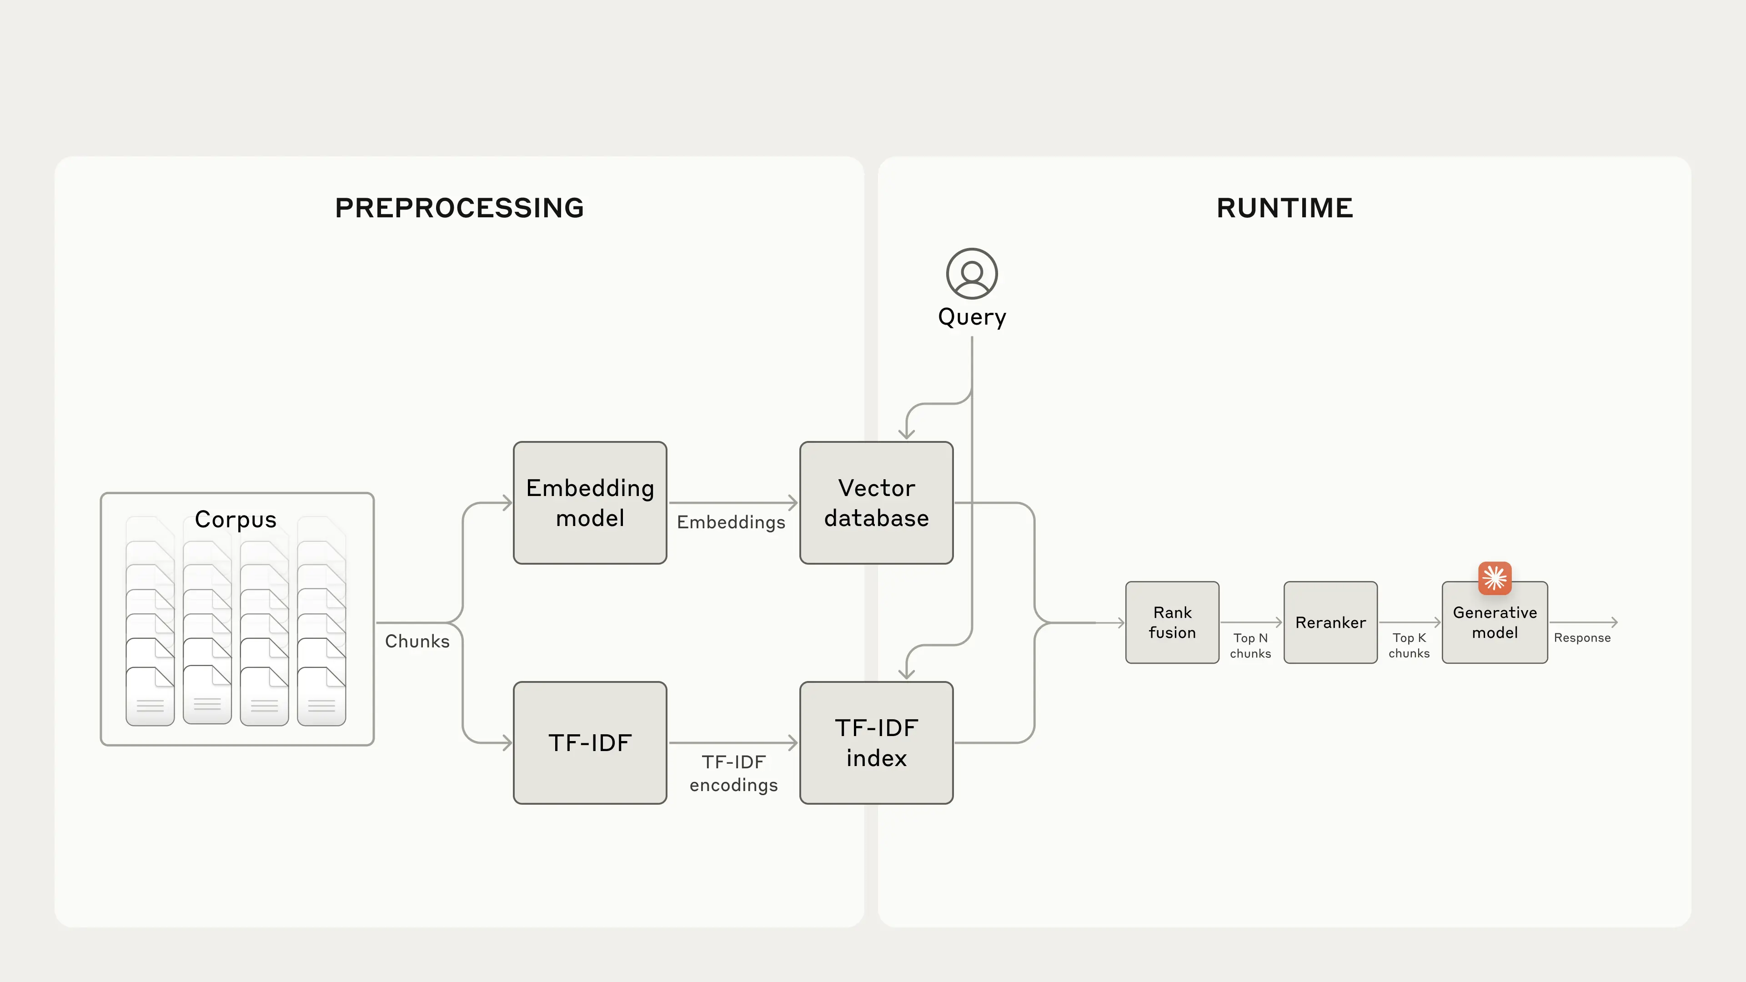
Lexical-Indexing + Semantic Retrieval + Re-Ranking

Slide 5
2. LARS Gets Eyes: Vision Update

Slide 6
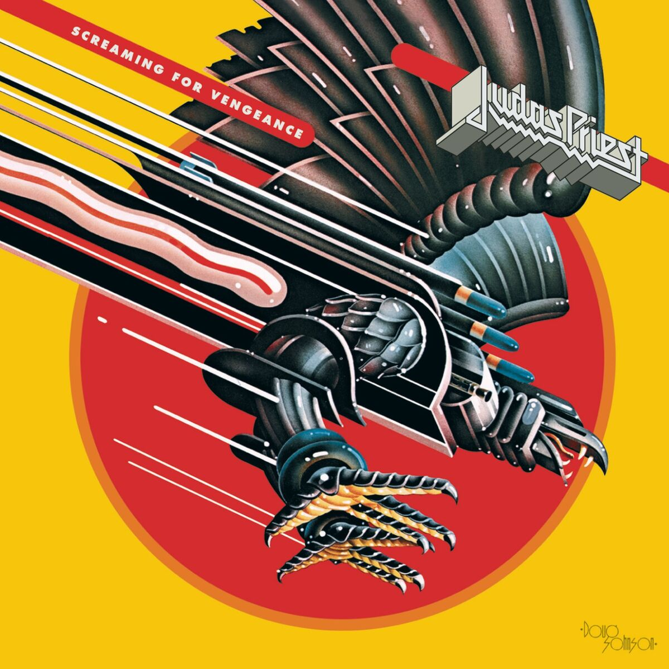
Up here in space I'm looking down on you My laser's trace Everything you do
You think you've private lives, think nothing of the kind There is no true escape, I'm watching all the time
I'm made of metal My circuits gleam I am perpetual I keep the country clean
I'm elected electric spy I'm protected electric eye

Slide 7
3. LARS Can Show: Image Generation

Slide 8
