Slide 1
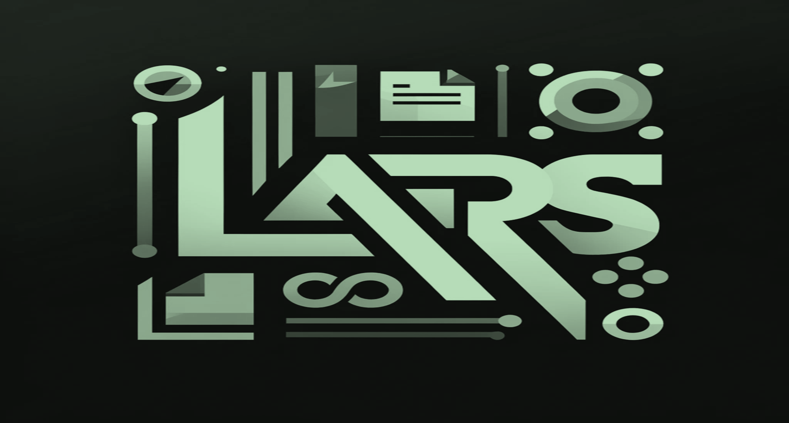
LARS has continued to Improve and Evolve
Google Drive Integration – Load documents and folders located in Google Drive
Works for any Google account
Filter, sort, and synchronize documents right from within the LARS application interface
Support for new LLMs – Mistral Nemo, Llama-3.1, Google Gemma2, DeepSeek v2
Improved citation accuracy via major updates and refinements to backend server:
The LLM can now incorporate and specify document names & page-numbers in the response
“Re-ranking” & filtering of citations by specialized AI models resulting in higher accuracy LLM-generated responses and page-number citations
User experience enhancements: Tabbed browser for citation documents
Deployment and maintenance made easier:
Major refactoring to Python & JavaScript codebases
Deployment enhancements for Docker container infrastructure environments

Slide 2
Major Feature Incoming: New LLM Server
Significantly eases LARS installation – no more LLM-server specific compilation & setup
Run new LLMs the day they’re released – addresses major pain-point with current LLM server
No longer necessitates:
Manually downloading LLMs
Converting LLMs to a specific, specialized format
Selecting prompt-templates
Manual updates to LARS to support new model architectures and prompt-templates
Significantly eases deployment, maintenance and portability of LARS while enabling greater flexibility

