Slide 1
NEW YORK SUBWAY STATION CLUSTERING
Capstone project

Slide 2
Business Problem
There are several businesses/POIs around each of the subway stations in New York.
Similar businesses might be present across stations or around the same station.
Identifying which area to focus for starting specific business around subway station is difficult.
A model to categorize the subway stations in different groups so as to make better business decisions

Slide 3
MODELLING APPROACH
Gathered subway station information from NYC Open Data.
Identified businesses/POI using Foursquare APIs
As no historical data is available for training a model, used K-Means clustering for creating a model.
Grouped the subway stations into four clusters based on the most common business/POI in that cluster

Slide 4
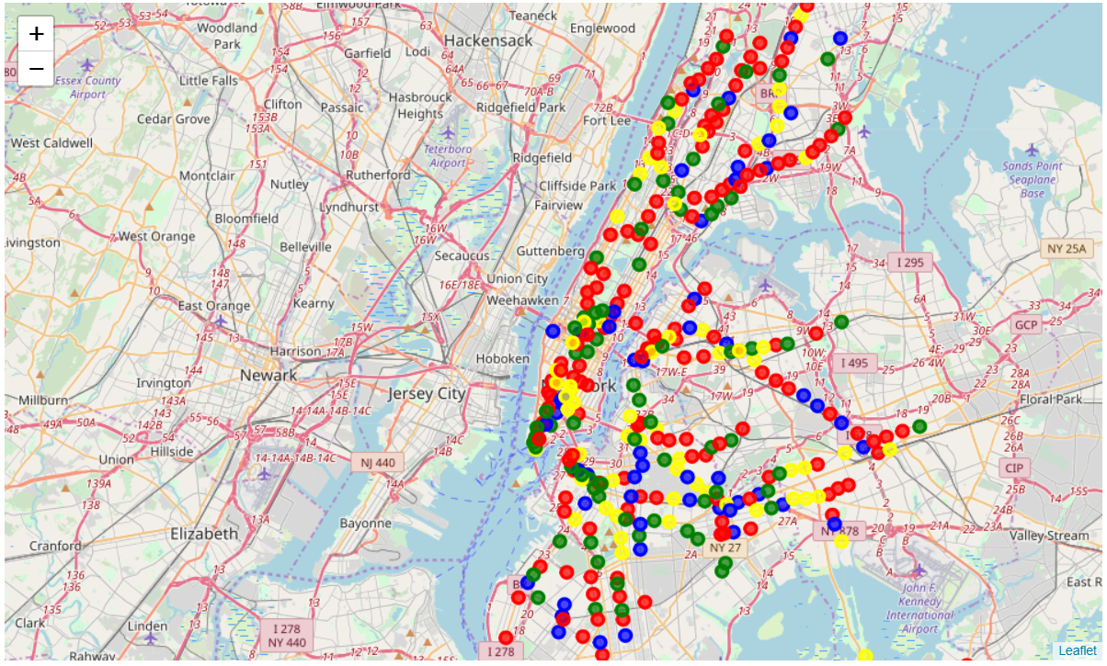
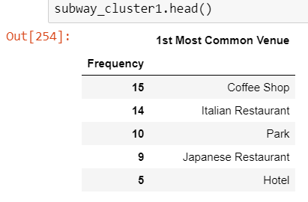
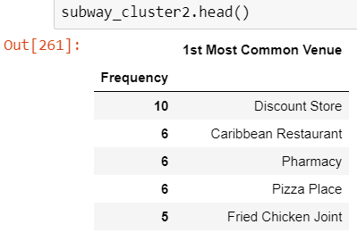
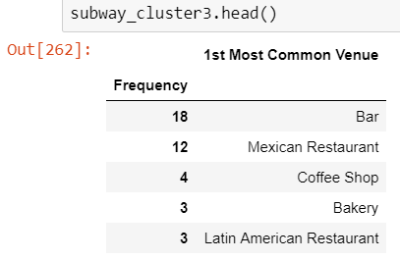
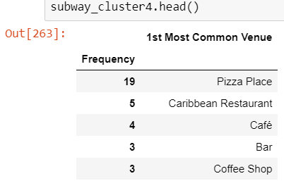
Results
Gathered subway station information from NYC Open Data.
Identified businesses/POI using Foursquare APIs
As no historical data is available for training a model, used K-Means clustering for creating a model.
Grouped the subway stations into four clusters based on the most common business/POI in that cluster
CLUSTER 1
CLUSTER 2
CLUSTER 3
CLUSTER 4

Slide 5
CONCLUSION
Using K-Means clustering, the stations have been grouped into meaningful categories
The categorization should help business investors to identify potential zones for their businesses.
Model can be fine tuned to improve the grouping.

