Slide 1
PROJECT PRESENTATION
SentinelShield
Adaptive DDoS monitoring prototype
Architecture, datasets, dashboard and measured results
Presented By:
Abhishek Yennam (24BIT0603)
Aarav Gupta (24BIT0245)
Notes:
Introduce SentinelShield as a local, research-oriented monitoring prototype. It processes authorized captures or a local synthetic demonstration.
The core presentation is the packet-window pipeline and its real evaluation evidence.
Source: D:/Project/DDOS project/docs/REVIEW_BRIEF.md

Slide 2
OBJECTIVE
02
The problem
DDoS traffic can exhaust a service by flooding/overwhelming it with requests or connection attempts.
The challenge
A traffic spike can be legitimate. A high packet rate alone cannot prove an attack.
SentinelShield measures short traffic windows and shows the reason behind each alert.
Notes:
Explain the practical objective: monitor patterns, flag unusual windows, and provide reasons to investigate.
The labels are signals rather than ground truth about an attack.
Source: D:/Project/DDOS project/README.md

Slide 3
SYSTEM DESIGN
03
From packets to an alert
01
02
03
04
Capture
Window
Rule
Review
Synthetic demo, authorized file or opt-in live capture
Packet metadata grouped into five-second windows
Adaptive packet-rate and TCP SYN signals
Charts, reasons and SQLite aggregate alerts
Temporary blocks are simulated; no firewall rule changes.
Notes:
The user chooses one of three input modes. Live capture must be explicitly started and is bounded; no packet capture is needed for the synthetic demo.
The project stores aggregate windows and alerts. Temporary block entries are simulation only and do not modify firewall rules.
Sources: D:/Project/DDOS project/README.md and docs/REVIEW_BRIEF.md

Slide 4
FEATURE EXTRACTION
04
What a five-second window contains
21 numeric features summarize each window without using packet payloads.
01
Traffic volume
Packet count, total bytes, packet rate and byte rate
02
TCP behavior
SYN, SYN-ACK, ACK, FIN and RST counts; initial SYN ratio
03
Traffic spread
Unique sources, destinations, ports and flows
Notes:
The feature window contains 21 ordered numeric columns. Packet rate means packet_count divided by the five-second window duration.
SYN ratio helps distinguish connection-attempt patterns from general traffic growth. It is still only a signal.
Source: D:/Project/DDOS project/docs/FEATURES.md

Slide 5
DETECTION LOGIC
05
How the rules decide
Rate baseline
SYN signal
After five normal-looking windows, a rolling median and median absolute deviation adapt the packet-rate threshold.
The rule checks the share and rate of initial TCP SYN packets. Defaults include 0.70 SYN ratio and 20 SYN packets/s.
Window labels
Normal • Unusual Traffic • Suspicious TCP SYN Pattern • Potential DDoS Activity
These thresholds are starting values, not validated attack cutoffs.
Notes:
The floor for unusual traffic is 100 packets/s by default. A warm-up of normal-looking windows establishes a rolling baseline.
The combined high-rate and SYN condition receives Potential DDoS Activity. Rule reasons are visible per window.
Source: D:/Project/DDOS project/docs/DETECTION.md

Slide 6
MODEL DESIGN
06
Where machine learning fits
Packet-window ML
Offline flow experiment
A Random Forest uses the same 21 window features. The dashboard comparison is trained on generated examples to exercise the pipeline.
A separate Random Forest uses 21 CICFlowMeter flow statistics from labeled CSV files and tests transfer to other datasets.
Different feature schemas prevent the flow model from being used in the live dashboard.
Notes:
The synthetic trainer defaults to 200 trees and a fixed seed. Its perfect four-class holdout score comes from hand-designed, separable examples and is not real-world accuracy.
The real-data flow model was evaluated separately. Its features are different from packet-window features, so it is not connected to live decisions.
Source: D:/Project/DDOS project/docs/ML_EVALUATION.md

Slide 7
DATASETS
07
Data used in this project
01
CIC-DDoS2019
431,371 supplied flow rows for the first training experiment
02
CIC-IDS2017
Friday flow CSV: 225,745 labeled rows for external evaluation
03
CSE-CIC-IDS2018
A separate 2018 flow file for a second transfer check
04
LUCID PCAPs
Five packet-capture excerpts for window extraction; benign capture count is too small for a valid holdout
Notes:
The supplied Friday file is a flow CSV despite 'pcap' in its filename. The local audit matched its hash and label counts to the existing evaluation report.
The CIC-DDoS2019 CSV provenance has not been independently verified. The 2018 mirror completeness has not been verified against the original release.
The five LUCID PCAP excerpts produce 567 windows but include only one benign capture, so no independent packet-window performance estimate was issued.
Sources: D:/Project/DDOS project/docs/ML_EVALUATION.md; results/review-dataset-audit.json; https://www.unb.ca/cic/datasets/ids-2017.html; https://www.unb.ca/cic/datasets/ids-2018.html

Slide 8
EVALUATION
08
How performance was checked
Flow experiment A
Flow experiment B
Train on 2019. Evaluate on the separate Friday 2017 file.
Train on 2019 and 2017. Evaluate on a separate 2018 file.
Packet-window ML
A capture-aware evaluator exists. The current excerpts have only one benign capture, so it correctly reports no holdout score.
Notes:
External files test whether the model transfers between traffic distributions. Randomly splitting neighboring windows could inflate performance.
The 2018 file was later inspected to diagnose failure, so any future adjusted model needs a new untouched evaluation capture.
Source: D:/Project/DDOS project/docs/ML_EVALUATION.md

Slide 9
MEASURED RESULT A
09
2019 model on Friday 2017 flows
36.4%
24.8%
DDoS recall
Benign false-alarm rate
46,592 of 128,025 labeled DDoS flows detected. 24,241 of 97,686 benign flows flagged.
The model misses many attacks and raises too many false alarms for live use.
Notes:
The evaluation uses 225,711 valid rows after 34 non-finite rows were excluded.
Confusion matrix: actual benign [73,445 predicted benign, 24,241 predicted DDoS]; actual DDoS [81,433 predicted benign, 46,592 predicted DDoS]. Accuracy was 53.2% on this attack-heavy file.
Source: D:/Project/DDOS project/results/cic-flow-baseline.json

Slide 10
MEASURED RESULT B
10
2019 + 2017 model on 2018 flows
26
DDoS flows detected
out of 687,742 labeled DDoS flows
0.0038% recall
The model generalized poorly to the 2018 traffic pattern. It remains an offline experiment.
Notes:
The second model trained on 657,082 valid 2019 and 2017 flows. On the 2018 file, it produced 312 false alarms among 360,833 benign flows.
The source distributions differ. Inspection found zero median forward/backward byte totals for 2018 DDoS flows, unlike the earlier sources. That is an observed difference, not proof of one specific cause.
Source: D:/Project/DDOS project/results/cic-multisource-flow.json

Slide 11
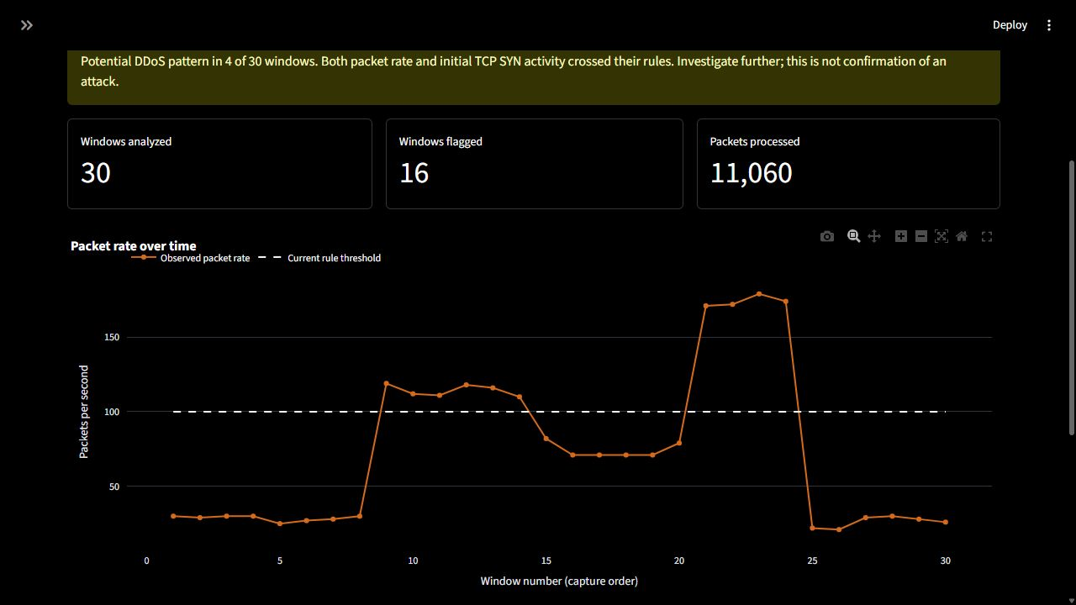
DEMONSTRATION
11
The working dashboard
Notes:
This is a screenshot from the running Streamlit app using the Mixed demonstration synthetic scenario.
Read the alert explanation, window counts, and orange packet-rate line against the dashed threshold. The scenario is generated locally and is not a real attack benchmark.
Source: D:/Project/DDOS project/sentinelshield/dashboard/app.py

Slide 12
PROJECT STATUS
12
What the prototype delivers
01
Monitoring
Offline and bounded live inputs produce packet-window measurements
02
Explanation
Rule labels, chart, per-window reasons and SQLite alert history
03
Safe response
Temporary block simulation records expiring decisions without changing firewall rules
Current claim: a demonstrable monitoring prototype with measured limitations.
Notes:
The dashboard is ready for a live review using locally generated synthetic traffic. It also supports authorized PCAP/PCAPNG and bounded opt-in live capture.
A temporary block is an expiring SQLite simulation entry. The program does not block traffic in the operating system firewall.
Source: D:/Project/DDOS project/docs/REVIEW_BRIEF.md

Slide 13
NEXT RESEARCH STEP
13
What remains before a deployment claim
The main gap
No independent, capture-held-out packet-window benchmark yet measures live precision, recall or false alarms.
01
Collect
More independently labeled benign and attack captures
02
Verify
Capture timing, labels and feature alignment
Notes:
Then evaluate on whole held-out captures, tune thresholds or redesign the model, and repeat on another untouched source before claiming deployment readiness.
The current LUCID excerpts lack a second benign capture and therefore cannot support this benchmark.
Sources: D:/Project/DDOS project/docs/ML_EVALUATION.md and docs/REVIEW_BRIEF.md

Slide 14
SENTINELSHIELD
Thank you
Notes:
Invite questions about the rule baseline, where ML is used, cross-dataset results, and the gap before deployment.

