Slide 1
Is federal contract money going to fewer companies?
Market concentration in civilian agency contracts, FY2008 to FY2025
Suchitra Hole, Shivram Nekkanti and Andy Hannah
DS 5500 capstone, presentation 2, November 2026
Notes:
On the slide
Title, team and course.
Points to make
• Our question is whether federal contract money goes to fewer companies.
• We look at civilian agencies, every agency except Defense, from FY2008 to FY2025.
• Last time we showed the data and the measure. Today we show results.

Slide 2
In one VA market, a single firm gets 98% of the money
Veterans Affairs (VA) managed health care, FY2025: $22.8 billion
Mostly the networks of private doctors that treat veterans outside VA hospitals
UnitedHealth (Optum) 98%
74 other firms share 2%
Figure 1. VA managed health care contract dollars by firm, FY2025. Source: USAspending.gov.
Why one firm with most of a market matters
$
Less price pressure
No rival bid to compare against
1
No fallback
No quick way to replace the firm
↺
Fewer bidders next time
Few firms can take on a whole market
Our question How much civilian money sits in markets like this, and is it growing?
Notes:
On the slide
One bar splits VA's $22.8 billion managed health care market by firm. Three reasons it matters sit below.
Points to make
• In FY2025 VA spent $22.8 billion on managed health care contracts.
• This is mostly the networks of private doctors that treat veterans outside VA hospitals.
• UnitedHealth, through Optum, got 98%. 74 other firms shared 2%.
• One firm with most of a market means less price pressure, no quick fallback and fewer bidders next time.
• Concentration is not wrongdoing. Some work only one firm can do.
• Civilian agencies spent $301 billion on contracts in FY2025. Defense studies its own suppliers. We found no comparable measure for civilian agencies.
• Our question is how much civilian money sits in markets like this, and whether that is growing.

Slide 3
Six terms we use throughout
HHI
Herfindahl-Hirschman Index
A concentration score from near 0, money spread out, to 10,000, one firm has it all
Example: VA managed health care scores 9,680
Market
also called a segment
One agency buying one kind of product in one year
Example: VA buying managed health care in FY2025
Highly concentrated
from U.S. merger guidelines
A market whose HHI is above 2,500
Example: One firm at 80% and four at 5% scores 6,500
Civilian agencies
our focus
Every federal agency except the Department of Defense
Example: Veterans Affairs, NASA and Homeland Security
Fiscal year (FY)
the government's budget year
Runs from October 1 to September 30
Example: FY2025 ran from October 1, 2024 to September 30, 2025
Competed
how a contract is awarded
Other firms could bid. Sole source means one firm was chosen directly
Example: VA's managed care contract with UnitedHealth was fully competed
What this means Each market gets one HHI score. We track how much money sits in markets above 2,500.
Notes:
On the slide
Six terms, each with a definition and an example in orange.
Points to make
• HHI is the standard concentration score the Justice Department and the FTC use for mergers.
• A market is one agency buying one kind of product in one year. Our files call it a segment.
• Above 2,500 is highly concentrated.
• Civilian means every agency except Defense.
• The fiscal year runs October 1 to September 30.
• Competed means other firms could bid. Sole source means the agency picked one firm.

Slide 4
Our score: square each firm's share, then add them up
HHI = s₁² + s₂² + ... + s_{n}²
s = each firm's percent of the market's dollars
Runs from near 0 to 10,000
Example market
Each block is one firm
Calculation
Score
A
Five equal firms
5 × 20² =
2,000
B
Four equal firms
4 × 25² =
2,500
C
One at 80%, four at 5%
80² + 4 × 5² =
6,500
D
VA managed health care (real)
98.4² + tiny shares ≈
9,680
A
B
C
D
Each score on the scale
competitive
moderate
highly concentrated, above 2,500
10,000 means one firm has it all
0
1,500
2,500
10,000
Figure 2. Four worked examples, A to D, and where each lands on the scale. Lines from the 2010 federal merger guidelines.
What this means Squaring makes big firms count most. Above 2,500 is highly concentrated.
Notes:
On the slide
The HHI formula, four worked examples and the 0 to 10,000 scale.
Points to make
• Take each firm's percent of the market, square it and add them up.
• Five equal firms score 2,000. Four equal firms score 2,500, right at the line.
• One firm at 80% scores 6,400 by itself. The four small firms add 100.
• Squaring makes big shares dominate the score.
• The real VA market scores 9,680. Its 74 small firms barely move it.
• We use 2,500 from the 2010 merger guidelines. The 2023 guidelines use 1,800, so anything above 2,500 meets both.

Slide 5
We built 365,000 markets from 88.8 million contract actions
1 Start with every contract action
2 Group the actions into markets
Date
2025-07-31
Agency
Veterans Affairs
Who bought
Veterans Affairs
Product
Managed health care
What
Managed health care
From whom
UnitedHealth (Optum)
Year
FY2025
How much
$857 million
= one market, one HHI score
Competed?
Yes, full and open
Firms count under their parent company, so a subsidiary is not a rival.
Cleaning matters. One bad entry made a market of 1,039 firms look like a monopoly. Its HHI fell from 4,282 to 167 after cleaning.
Figure 3. One real contract action, and how actions group into markets. Source: USAspending.gov, FY2008 to FY2025.
What this means Our yearly totals match the Government Accountability Office's within 0.2%.
Notes:
On the slide
One real contract action on the left. How actions group into a market on the right.
Points to make
• USAspending.gov records every federal contract action. One row is one action.
• The example is a real $857 million VA payment to UnitedHealth, fully competed.
• We use all 88.8 million rows from FY2008 to FY2025 and check each one against 62 rules.
• A market is one agency, one product and one year. That gives 365,000 markets, each with its own HHI.
• Firms count under their parent company.
• Our yearly totals match GAO's published figures within 0.2%.
• Cleaning matters. One bad entry made a market of 1,039 firms look like a monopoly, with an HHI of 4,282. Cleaned, it scores 167. The appendix has the full example.

Slide 6
How we tested each finding
The question
The method
In plain words
Is the concentrated share rising?
Yearly share
Add up the dollars in markets above 2,500 each year. Compare years with the same product codes.
1
Did single markets rise more than chance?
Shuffle test, market by market
Shuffle each market's yearly scores 20 times and count how many still rise.
2
Is the overall rise real, and is it VA?
Shuffle test on the yearly share
Shuffle the 18 yearly shares 20,000 times, with and without VA.
3
Is it just contract timing?
Spreading
Spread each contract's money evenly over the days it ran, then score again.
4
Why did VA concentrate?
Breakdown and case study
Split the change into each agency's part. Match VA's jump to the law and the contracts.
5
Table 1. The questions, the method behind each and what the method does.
What this means Each test asks whether the pattern is bigger than chance or one big contract would produce.
Notes:
On the slide
Five questions, the method behind each, and what the method does in plain words.
Points to make
• This is the map for the results that follow.
• The yearly share shows whether more money sits in concentrated markets.
• Two shuffle tests check that the rise is more than chance. One works market by market. The other works on the yearly share.
• Spreading checks whether contracts that pay several years at once cause the swings.
• The breakdown by agency and the VA case study show where the change came from.

Slide 7
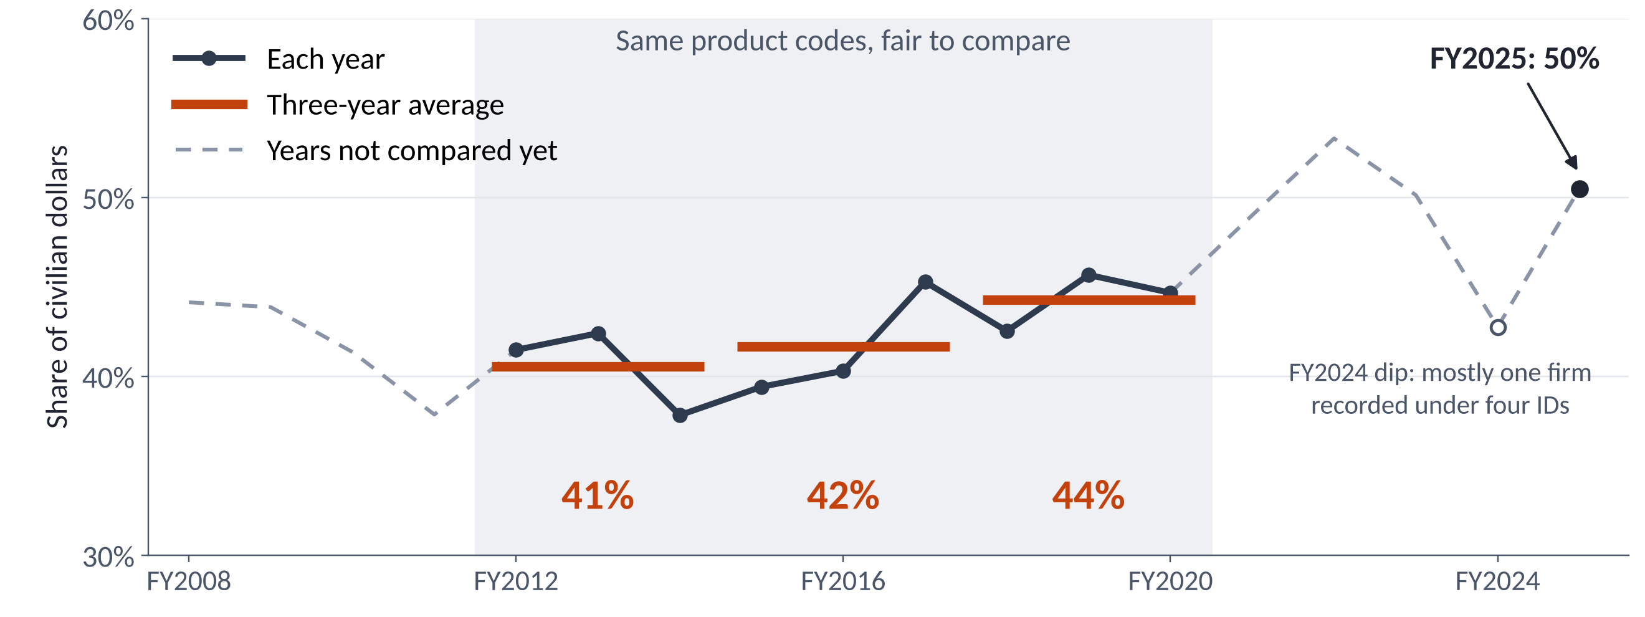
Half of civilian contract dollars are highly concentrated
Figure 4. Share of civilian contract dollars in markets scoring above 2,500, by fiscal year.
What this means In the years we can compare fairly, the share rose from 41% to 44%.
Notes:
On the slide
The yearly share of civilian dollars in highly concentrated markets, with three-year averages in orange.
Points to make
• Each point is the share of civilian contract dollars in markets above 2,500 that year.
• In FY2025 it was about half.
• FY2012 to FY2020 use the same product codes, so those years compare fairly.
• Over those years the three-year average went from 41% to 42% to 44%.
• Four other ways of counting all end the period 3 to 6 points higher.
• VA drives much of it. Without VA the same averages go from about 41% to 42%.
• The FY2024 dip is mostly Honeywell recorded under four vendor IDs. Counted as one firm, the dip mostly closes.

Slide 8
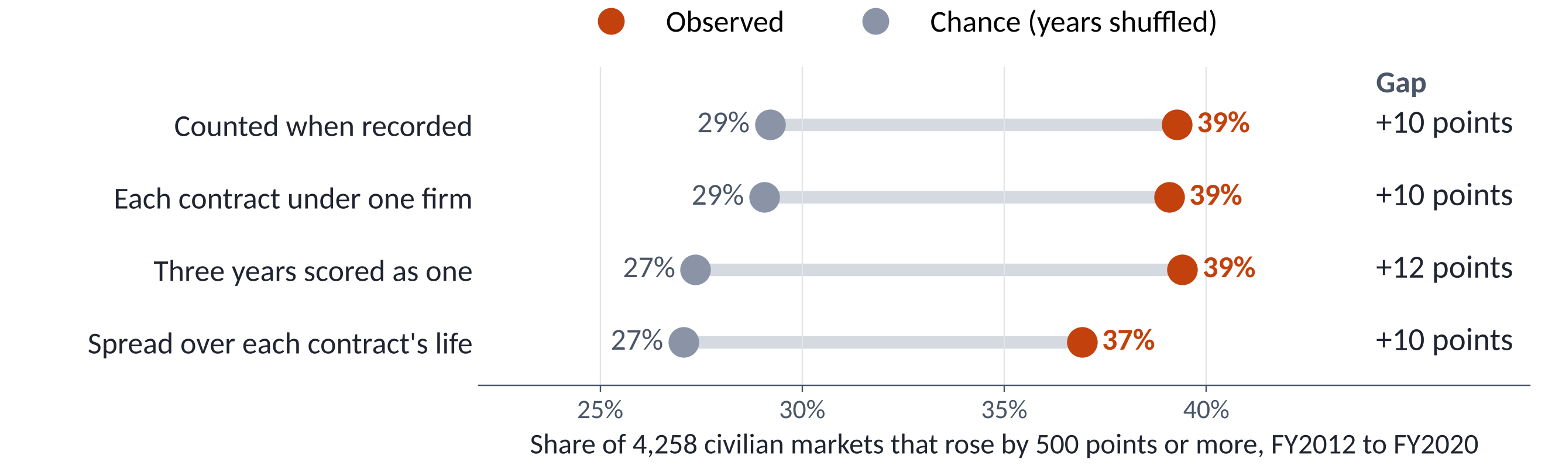
More markets rose than chance alone would produce
Rose: a market's last three years average at least 500 points above its first three
Chance: the same yearly scores in random order, which keeps the ups and downs but removes any trend
Figure 5. 4,258 civilian markets, FY2012 to FY2020. Each row counts the money a different way.
What this means About 10 more markets in every 100 rose than chance would produce.
Notes:
On the slide
Four ways of counting the money. Each row compares civilian markets that rose with markets that rose by chance.
Points to make
• We follow each civilian market from FY2012 to FY2020. There are 4,258 of them.
• A market rose if its last three years average at least 500 points above its first three.
• Chance means shuffling each market's yearly scores into random order, 20 times. That keeps the swings and removes any trend.
• Counted as recorded, 39% of civilian markets rose. Chance gives 29%.
• The gap stays between 10 and 12 points every way we count. It also holds by dollars.
• Spreading contracts over their lives removes about a quarter of the swings. The gap still holds.
• Defense on its own shows a smaller gap, about 8 to 9 points.

Slide 9
Across all 18 years, the rise beats chance, and VA drives it
Shuffle test: put the 18 yearly shares in random order 20,000 times and refit the trend each time. A real trend is steeper than almost all of them.
All civilian agencies
44% → 50% A real rise
Only 0.2% of shuffled orders give a trend this steep
Without Veterans Affairs
45% → 42% No real trend
47% of shuffled orders give a trend this steep
Figure 6. Share of civilian contract dollars in highly concentrated segments, each year.
What this means Without VA the share is flat. The years after FY2020 still carry code and ID changes.
Notes:
On the slide
The civilian share each year with and without VA, and the result of an 18-year shuffle test for each.
Points to make
• This is a second test of the rise, on the yearly share of dollars across all 18 years.
• We shuffled the 18 yearly values 20,000 times and refit the trend each time.
• All civilian agencies go from 44% to 50%. Only about 0.2% of shuffles give a trend this steep.
• Without VA the share goes from 45% to 42%. 47% of shuffles are as steep, so there is no real trend.
• Both tests say the rise is more than chance. This one adds that VA drives it.
• This test runs across the FY2021 code change and the FY2024 ID split. The years after FY2020 are provisional.

Slide 10
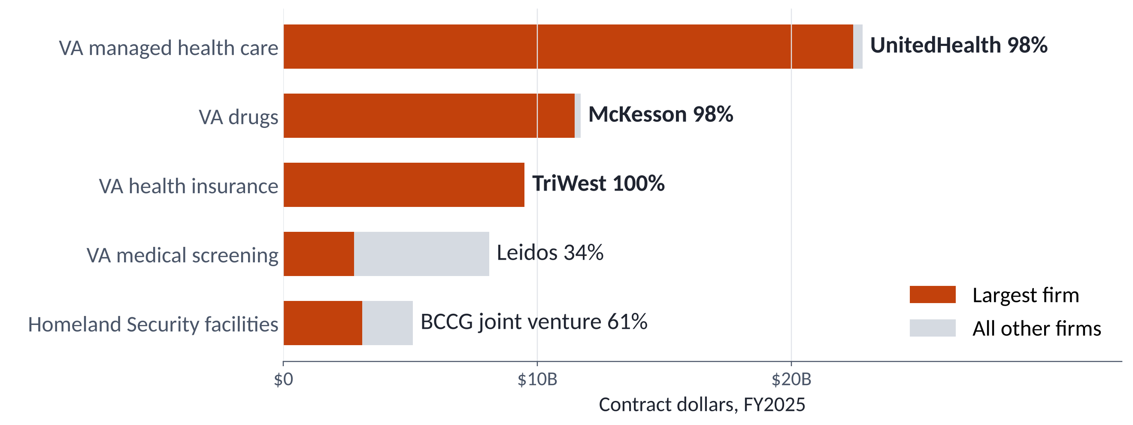
Three VA health markets are each held by one firm
Figure 7. The five largest civilian markets scoring above 2,500, FY2025. McKesson distributes drugs made by many firms.
What this means Together the three VA markets hold $44 billion, about 15% of civilian contract dollars.
Notes:
On the slide
The five largest highly concentrated civilian markets in FY2025, with the largest firm's share in orange.
Points to make
• Three of the five are VA health markets.
• UnitedHealth has 98% of managed health care. It runs most of VA's community care network.
• McKesson has 98% of VA drugs. It is the distributor, and the drugs come from many makers.
• TriWest has essentially all of VA health insurance.
• Together the three hold $44 billion, about 15% of civilian contract dollars.
• Leidos leads VA medical screening with 34%. A few other large firms hold most of the rest.

Slide 11
VA gave each region of its care network to one firm
Community care: VA pays private doctors to treat veterans. In each region, one firm runs the doctor network and pays the bills.
'18
A new law, the MISSION Act, merges VA's outside-care programs
'18
Optum (UnitedHealth) and TriWest win the regional contracts
'19
The regions start up from Dec 2019 to Jun 2021
'21
New product codes also move other VA money into this code
+
By dollars, VA added more than the whole civilian rise since FY2012
Figure 8. VA managed health care: money spent (bars) and the largest firm's share (line).
What this means Each region was competed, but each win handed a whole region to one firm.
Notes:
On the slide
VA managed health care dollars by year as bars, the largest firm's share as a line, and four dated events.
Points to make
• Community care is when VA pays private doctors to treat veterans.
• In each region one firm builds the doctor network and pays the bills.
• The MISSION Act in June 2018 merged VA's outside-care programs.
• VA competed the regional contracts. Optum, part of UnitedHealth, and TriWest won them.
• The regions started up from December 2019 to June 2021.
• In 2019 the code held about $400 million and the largest firm had 19%. By 2025 it held $22.8 billion and UnitedHealth had 98%.
• New product codes in FY2021 also moved other VA money into this code. Part of the jump is relabeling.
• 99.6% to 100% of these dollars are marked competed. Each win covered a whole region.
• Comparing FY2012 to FY2014 with FY2023 to FY2025, VA added 11.6 points. The whole civilian rise was 7.2 points.

Slide 12
Watch one-firm markets before they are competed again
We found
So oversight can
Half of civilian dollars sit in concentrated markets
Track these markets every year
That money was still competed
Ask how many firms bid next time
One firm can hide under several IDs
Roll firms up by parent and by contract
Table 2. Findings and what oversight offices, such as GAO and agency competition advocates, can do.
What this means A high score is not wrongdoing. What matters is who bids next time.
Notes:
On the slide
Three findings on the left and what oversight offices can do on the right.
Points to make
• Half of civilian dollars sit in concentrated markets. GAO and agency competition advocates could track these markets every year.
• The money was still competed. 85% of concentrated dollars against 86% of other dollars, among dollars with a competition code.
• Competition happens once for a whole market. The winner then holds it for years.
• The moment that matters is the next competition and how many firms bid.
• One firm can show up under several IDs. Roll firms up by parent and by contract.
• A high score is not wrongdoing.

Slide 13
Our firmest trend claim covers FY2012 to FY2020
Older product codes
Same codes: rise tested
New codes: provisional
FY2008 to FY2011
FY2012 to FY2020
FY2021 to FY2025
Figure 9. What our trend claim covers, by fiscal year.
Other limits
1
Prime contracts only
Money passed on to subcontractors is not counted
2
Each agency is its own buyer
A firm selling to many agencies is scored in each one
3
A high score is not proof of a problem
Some work only one firm can do
What this means Concentration is high and rose through FY2020. Later years need more work.
Notes:
On the slide
Which years our firmest trend claim covers, and three other limits.
Points to make
• Our firmest trend claim covers FY2012 to FY2020, where the product codes stay the same.
• The share since FY2020 is higher, and the 18-year test agrees. The codes changed in FY2021 and some firms changed IDs, so those years are provisional.
• Our data covers prime contracts only. Money passed on to subcontractors is not counted.
• Each agency is its own buyer. A version that pools all civilian agencies still rose.
• A high score is not proof of a problem.

Slide 14
Next: make the years since FY2020 comparable
1
Link old and new product codes
So markets from FY2021 on line up with earlier years
2
Count each firm once, even when its ID changes
The FY2024 dip was one firm recorded under four IDs
3
Separate two kinds of change
Money moving into concentrated markets, or markets becoming concentrated
Goal Say whether concentration kept rising after FY2020.
Notes:
On the slide
Three next steps, each with its reason.
Points to make
• Link old and new product codes. About half of the FY2021 jump comes from IT codes splitting into finer ones.
• Count each firm once, even when its ID changes. The FY2024 dip was one firm under four IDs.
• Separate money moving toward concentrated markets from markets becoming concentrated. They mean different things for policy.
• With these done we can say whether concentration kept rising after FY2020.

Slide 15
Thank you
Questions?
Three things to remember
1
Half of civilian contract dollars sit in highly concentrated markets.
2
That share rose from FY2012 to FY2020, more than chance would produce.
3
In VA health care, each regional competition handed a whole region to one firm.
Suchitra Hole, Shivram Nekkanti and Andy Hannah
Notes:
On the slide
Thank you, questions, and three things to remember. Leave it up during questions.
Points to make
• Half of civilian contract dollars sit in highly concentrated markets.
• The share rose from FY2012 to FY2020, more than chance would produce.
• VA health care shows how one competition can hand a whole region to one firm.
• The appendix covers likely questions.

Slide 16
Appendix
Details for questions
Notes:
On the slide
Appendix divider.
Points to make
• Slides 17 to 29 answer likely questions.

Slide 17
Backup: one bad entry can fake a monopoly
Army construction, FY2008: a market of 1,039 firms. One $13.9 billion entry was reversed the next year.
Emerson's share of the market
Raw data
Emerson 65%
All other firms 35%
Cleaned data
Emerson 0.2%
All other firms 99.8%
The market's HHI score
Cleaned data: 167
Raw data: 4,282
0 to 10,000
competitive
moderate
highly concentrated, above 2,500
0
1,500
2,500
10,000
Figure B1. Emerson's share of the market and the market's HHI, in the raw data and after cleaning. Army construction, FY2008.
What this means Without cleaning, one bad entry makes a market of 1,039 companies look like a monopoly.
Notes:
On the slide
Emerson's share of one Army construction market, and the market's HHI, in the raw data and after cleaning.
Question it answers
Why does cleaning matter?
Points to make
• In FY2008 the Army recorded a $13.9 billion entry for Emerson Construction and reversed it the next year.
• The real contract was about $16 million.
• With the entry left in, Emerson holds 65% of a market of 1,039 firms. The market scores 4,282.
• Netted against its reversal, Emerson holds 0.2%. The market scores 167.
• This one is a Defense market. The same checks run on every row.
• We found five issues like this. The next slide lists each one and the rule we propose.

Slide 18
Backup: the data decisions, in plain words
The issue | What we do (as proposed) | Why
A $13.9B entry reversed the next year, and four similar pairs | Replace each pair with its real net | Otherwise one company looks dominant
Two $10B US Mint rows | Leave out of the score until confirmed | They look like contract ceilings, which are spending limits
Money returned makes some company totals negative | Score only companies with a positive total | A negative share has no meaning
One name, MISCELLANEOUS FOREIGN AWARDEES, covers many firms | Leave out of the score, report its share | It is not one company
Rows with no company ID | Leave out of the score, report their share | Under 0.01% of dollars
A placeholder funding agency in FY2008 to FY2010 | Use the buying (awarding) agency | Complete in every year
Table B2. The proposed data decisions. With these rules, 3,241 of 357,284 markets (0.9%) change concentration band. The team still has to confirm each rule.
Notes:
On the slide
A table of the six proposed data decisions, with what we do and why.
Question it answers
How did we clean the data?
Points to make
• Each row is one issue, what we do about it and why.
• Together the rules move 0.9% of markets across a concentration band.
• The team still has to confirm each rule.

Slide 19
Backup: how we turned 18 zip files into a trusted dataset
1
2
3
4
Download and lock
Convert and prove
Check quality
Build tables
18 zips checked against their digital fingerprints, then made read-only
88.8M rows copied to a fast format. Two programs agree on rows, dollars to the cent, every field
62 rules run on every row: duplicates, bad dates, placeholder names, outliers
7.85M company-by-segment totals. 116 checks confirm they add up
Figure B3. The pipeline. Nothing is deleted: problems are flagged beside the data.
✓
Our yearly totals match GAO's official figures within 0.2% (FY2022 to FY2025)
What this means Every number traces back to the published files, and the totals agree with the government's official figures.
Notes:
On the slide
The four-step data pipeline and the GAO check.
Question it answers
How do we know the data is right?
Points to make
• We checked all 18 files against their digital fingerprints and locked them.
• Two separate programs agree on row counts, dollars to the cent and every field.
• 62 quality rules run on every row.
• Our yearly totals match GAO within 0.2% for FY2022 to FY2025.

Slide 20
Backup: the HHI for the real VA market, worked through
1. Take each company's share of the money 2. Square it 3. Add them up
Two simple markets
VA managed healthcare, FY2025 | Share | Share²
UnitedHealth Group | 98.39% | 9,679.70
Valor Healthcare | 0.65% | 0.42
STG International | 0.25% | 0.06
All other 72 companies | 0.71% | 0.05
HHI (the sum) | 100% | 9,680
Five equal companies
20%
20%
20%
20%
20%
20² + 20² + 20² + 20² + 20² = 2,000
One company with 80%
80%
80² + 5² + 5² + 5² + 5² = 6,500
Figure B4. HHI worked through: two simple markets, and a real one from the data.
What this means Squaring makes big shares count much more: one company with 98% scores almost 10,000 on its own.
Notes:
On the slide
The HHI calculation for the real VA market, firm by firm, next to two simple markets.
Question it answers
How exactly do you get 9,680?
Points to make
• UnitedHealth has 98.39%. Squared, that is 9,680 by itself.
• The next two firms add less than half a point.
• The other 72 firms together add 0.05.

Slide 21
Backup: what counts as a rising market
The rule
Compare a market's average HHI in its last 3 years with its first 3 years. A gain of 500 points or more counts as rising: the rule in our proposal.
437 → 8,742
A gain of 8,305 points: this market is rising
Averaging 3 years softens one big contract. Single years still swing a lot, so we test each rise against chance.
Figure B5. One trend line: VA managed healthcare, FY2008 to FY2025.
What this means A trend line follows one market for up to 18 years. Rising means its score climbed by at least 500 points.
Notes:
On the slide
One market's yearly HHI from FY2008 to FY2025, with its first and last three-year averages.
Question it answers
What counts as a rising market?
Points to make
• Compare the average of a market's last three years with its first three.
• A gain of 500 points or more counts as rising.
• VA managed health care went from 437 to 8,742.
• Averaging three years softens one big contract. Single years still swing a lot.

Slide 22
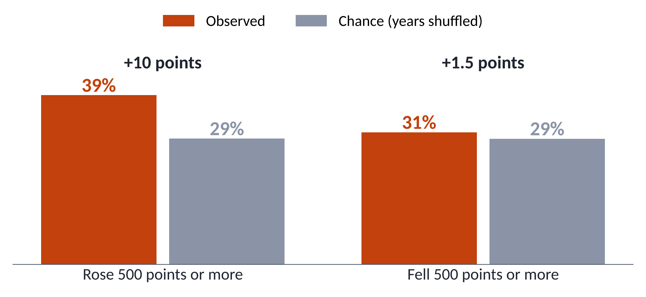
Backup: rising beats chance clearly, falling only slightly
Figure B6. Share of 4,258 civilian markets that rose or fell by 500 points or more, FY2012 to FY2020, as recorded.
Notes:
On the slide
Bars for civilian markets that rose and fell by 500 points or more, observed against chance.
Question it answers
Did some markets become less concentrated?
Points to make
• Counted as recorded, 39% of civilian markets rose against 29% by chance.
• 31% fell against 29% by chance.
• With contracts spread evenly over their lives, falling beats chance by about 4 points and rising by about 10.
• Markets move both ways. More of them rise.

Slide 23
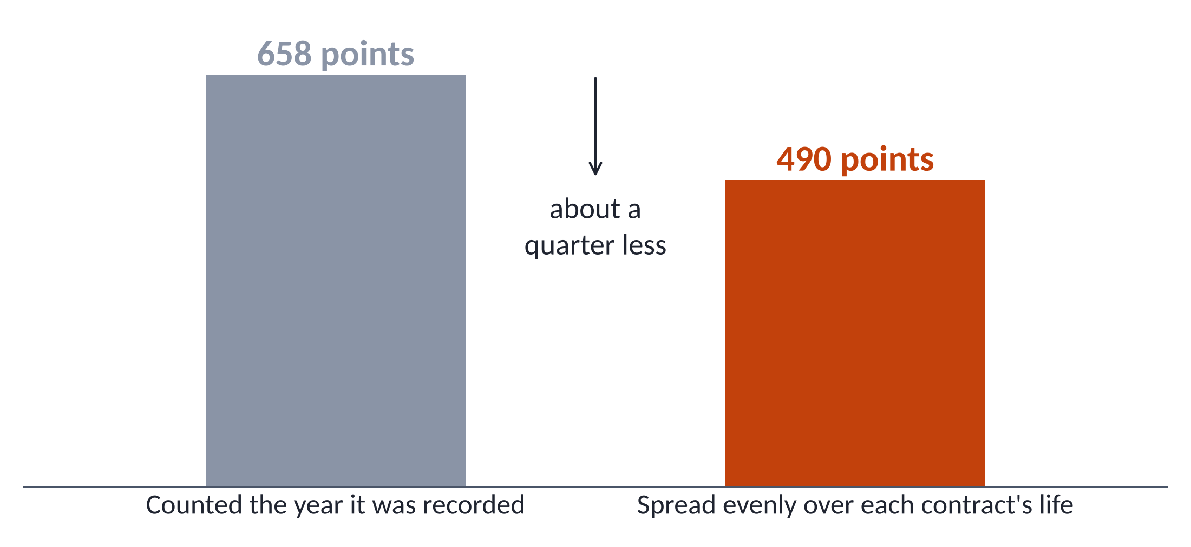
Backup: spreading contracts calms swings by a quarter
Figure B7. Typical yearly change in a civilian market's HHI, FY2012 to FY2020. Each contract counts under one firm.
Notes:
On the slide
The typical yearly change in a market's HHI, as recorded and with contracts spread over their lives.
Question it answers
Are the swings just contract timing?
Points to make
• Some contracts record several years of money at once.
• We spread each contract's total evenly over the days it ran.
• The typical yearly change falls from 658 points to 490, about a quarter.
• Most of the swing remains. The rise still beats chance.
• We can only spread contracts that start and end inside our data.

Slide 24
Backup: half the FY2021 jump came from new IT codes
4.34 points
2.31 points
IT codes as recorded
IT codes grouped back
Figure B8. Rise in the civilian share above 2,500 from FY2020 to FY2021.
Notes:
On the slide
The FY2020 to FY2021 rise in the civilian share, with IT codes as recorded and grouped back.
Question it answers
Why the jump in FY2021?
Points to make
• The FY2021 code manual split broad IT codes into many finer ones.
• Splitting a market makes each piece look more concentrated, even with the same firms.
• Grouping IT back into one services and one products market per agency cuts the jump from 4.34 points to 2.31.
• That is why the trend claim stops at FY2020 for now.

Slide 25
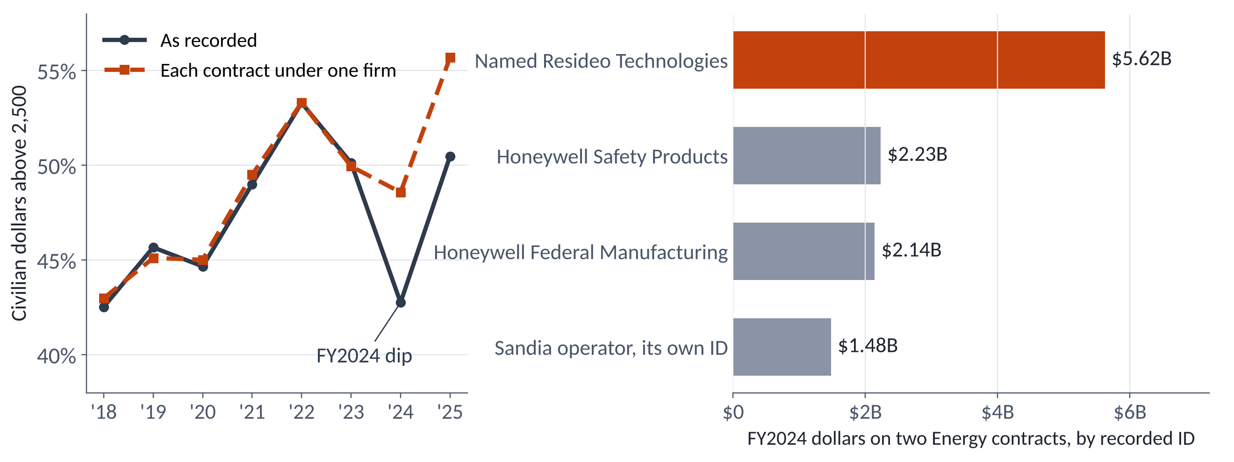
Backup: the FY2024 dip was one firm split across four IDs
Figure B9. Left: civilian share above 2,500, two ways. Right: Honeywell's FY2024 money on two Energy contracts, by ID.
Notes:
On the slide
The civilian share from FY2018 to FY2025 two ways, and Honeywell's FY2024 money by recorded ID.
Question it answers
What caused the FY2024 dip?
Points to make
• Honeywell runs Sandia National Laboratories and the Kansas City site for Energy.
• In FY2024 the parent field changes partway through the year. The same contracts show up under four IDs.
• One of them is named Resideo, a company Honeywell spun off in 2018.
• Split four ways, the market falls below 2,500.
• This one market gives 5.41 of the 5.82 point dip. Nothing changed in who runs those sites.

Slide 26
Backup: by dollars, VA accounts for the change
How we found it
1
Compare FY2012 to FY2014 with FY2023 to FY2025
2
Each market: its concentrated $ ÷ all civilian $, then and now
3
The difference is its part. Add the parts by agency
What a point is
40.5% → 47.8% = +7.2 points
One point = one percentage point of the civilian share
+11.6
12
points from VA alone
markets make half of all the rise
Figure B10. Each agency's part of the change in the civilian share. Orange adds to it, grey takes away.
What this means By dollars, VA added more than the whole change. This window crosses the FY2021 code change, so some of VA's gain may be relabeling.
Notes:
On the slide
Each agency's part of the change in the civilian share between FY2012 to FY2014 and FY2023 to FY2025.
Question it answers
Which agencies drove the change?
Points to make
• The share went from 40.5% to 47.8%, up 7.2 points.
• VA alone added 11.6 points, more than the whole change.
• Other agencies, led by NASA, took some away.
• The two windows sit on either side of the FY2021 code change. Some of VA's gain may be relabeling.

Slide 27
Backup: concentrated, but competed
How we found it
1
Read each contract action's competition field
2
Group the dollars: competed or sole source
3
Compare concentrated markets with all the others
The same rate
Concentrated civilian money was competed as often as the rest of civilian money.
Exception: NASA, 37% sole source
Mostly space research, where few organizations can do the work.
Figure B11. How civilian contract dollars were awarded, FY2025.
What this means Concentration mostly comes from competed contracts that give one winner the whole market. Agencies did not skip competition.
Notes:
On the slide
How FY2025 civilian dollars were awarded, in concentrated markets and in all others.
Question it answers
Is concentrated money simply not competed?
Points to make
• In FY2025, 90% of dollars in concentrated markets were competed. All other markets were also about 90%.
• Over all 18 years it is 85% against 86%.
• NASA is the exception, with about 37% of its concentrated dollars sole source, mostly space research.
• Orders under umbrella contracts may carry the umbrella's competition code.

Slide 28
Backup: Defense and civilian follow a similar path
Figure B12. Share of dollars in highly concentrated segments, Defense and civilian.
Notes:
On the slide
The share of dollars in highly concentrated markets each year, civilian against Defense.
Question it answers
What about Defense?
Points to make
• Defense follows a similar path.
• Defense rose more over FY2012 to FY2020, from about 40% to 46% by three-year averages.
• The Defense FY2024 dip comes from combat ships and fixed-wing aircraft. They come back in FY2025.
• We have not checked whether ID splits explain part of the Defense dip.

Slide 29
Backup: civilian services are where concentration grew
Civilian dollars | FY2008 | FY2025
Services | $96.9B | $229B
Products | $31.3B | $52.1B
Research | $15.0B | $19.9B
Figure B13. Civilian dollars in highly concentrated segments, by kind of purchase. Right: total civilian dollars by kind.
Notes:
On the slide
The concentrated share by kind of purchase in FY2008 and FY2025, with total dollars.
Question it answers
Which kinds of purchase grew more concentrated?
Points to make
• Services went from 37% to 48% concentrated while service spending more than doubled.
• Research stays highly concentrated throughout.
• Products barely moved.

