Slide 1
A Data-Driven Analysis of Factors Affecting Student Absenteeism in Nebraska Schools
Course
DSCI / STAT 8750 – Data Science Capstone Team Members
Abhinav Adhikari
Nilesh Purnekar Instructor
Dr. Lochana Palayangoda Institution
University of Nebraska at Omaha
Date 02-03-2026

Slide 2
Introduction – Abhinav
Abhinav, go by Abhi/avi, just had a daughter and have the time of my life right now.
MS in data Science and currently work here for the university as a Business Analyst, primarily focusing on business needs for student enrollment.

Slide 3
My Role in the Project – Abhinav
Data Support, coding and model implementation.

Slide 4
Introduction – NileshPurnekar
Education: M.S. in Data Science, University of Nebraska at Omaha
Jobs:
IT Intern, Interpublic Group (IPG)
Personal Trainer & Weight Room Supervisor, H&K
Interests: Data analytics, machine learning, real-world problem solving
Hobbies: Fitness, travel
Fun Fact: Balancing tech and training is hard

Slide 5
My Role in the Project Nilesh
Lead the problem formulation and refinement of project objectives.
Analyze socioeconomic factors related to student absenteeism.
Interpret Free & Reduced Lunch (FRL) data as a key socioeconomic indicator.
Conduct and summarize literature review on socioeconomic influences.
Support integration of socioeconomic insights into the final analysis.

Slide 6
Problem Statement
Student absenteeism remains a critical challenge in K–12 education.
Attendance patterns vary significantly between grade-level school categories (elementary vs secondary).
Socioeconomic conditions may influence absenteeism differently across school types.
There is limited analysis that jointly examines school type and socioeconomic factors.
Understanding these patterns is essential for targeted educational interventions.

Slide 7
Project Objectives (SMART)
S (Specific): Analyze absenteeism patterns across grade-level school categories (elementary vs secondary).
M (Measurable): Compare absenteeism using attendance counts and socioeconomic indicators.
A (Achievable): Use publicly available Nebraska K–12 school-level data (2020 - 2021).
R (Relevant): Support data-driven insights for educational planning and intervention.
T (Time-bound): Complete analysis and reporting within the semester timeline.

Slide 8
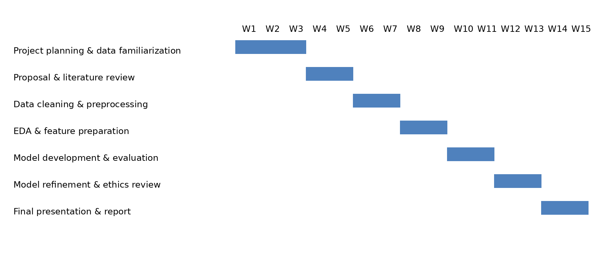
Proposed Project Timeline- Grantt Chart
This timeline outlines the planned project phases across the semester, aligned with course milestones and allowing flexibility for iterative analysis.

Slide 9
Dataset Overview
Source: Nebraska Department of Education (2020–2021).
Data Level: School-level data.
Datasets Used:
Student absenteeism counts.
Free & Reduced Lunch (FRL) counts.
School membership by grade.
Numbers of districts and schools.
State education statistics (Stats & Facts).
Final Structure: Rows: One row per school.
Columns: Attendance metrics, socioeconomic indicators,
grade-level attributes, and school characteristics.

Slide 10
Dataset – Absenteeism Data
Student Absenteeism Data (2020–2021)
Total enrollment and absence counts
Primary outcome variable
Used to calculate district-level absenteeism rate
What we get from this dataset: Overall patterns of absenteeism that serve as the target outcome for analysis.

Slide 11
Dataset – Socioeconomic Data
Socioeconomic Data (FRL)
Free & Reduced Lunch counts
Proxy for economic disadvantage
Widely used in education research
What we get from this dataset:
Ability to study how economic disadvantage relates to absenteeism patterns.

Slide 12
Dataset Description – School Structure & Context
School Structure & Context
Grade-level enrollment
Elementary vs secondary classification
District validation & statewide context
What we get from these datasets: Structural classification, validation, and statewide context to support analysis.

Slide 13
Proposed Methodology
Merge datasets using consistent identifiers
Feature engineering
Exploratory data analysis
Supervised ML models
Compare separate vs combined predictors
Emphasis on interpretability

Slide 14
Dataset Details & Data Preparation
Review and validate datasets for completeness and consistency.
Align datasets using school identifiers and reporting year.
Verify attendance and enrollment values for logical consistency.
Derive school-type labels (elementary vs secondary) from grade membership.
Structure the final dataset for exploratory analysis and modeling.

Slide 15
Methodology Details & Feature Handling
Define absenteeism measures as the target variable.
Use Free & Reduced Lunch proportions as key socioeconomic features.
Aggregate grade-level enrollment to derive school-type indicators.
Treat grade-level and socioeconomic variables as separate analytical dimensions.
Select interpretable features to support meaningful insights.

Slide 16
Socioeconomic status and school absenteeism: A systematic review and narrative synthesis - Sosu et al. (2021)
Systematic review synthesizing findings from 50+ empirical studies.
Examines how socioeconomic status (SES) relates to student absenteeism.
Covers multiple countries, education systems, and grade levels (primary to secondary education).
Compares different approaches to measuring SES, including financial and non-financial indicators.

Slide 17
Literature Survey - Key Findings & Relevance
Key Findings:
Lower socioeconomic status is consistently linked to higher absenteeism.
Financial indicators (e.g., Free & Reduced Lunch) show stronger associations.
Effect sizes are small to moderate but consistent.
Relevance to Project:
Justifies using FRL % as a key predictor.
Supports district-level socioeconomic analysis.

Slide 18
Using Data Mining To Predict Secondary School Student Performance Cortez & Silva (2008)
Demonstrates how machine learning techniques can be applied to educational data.
Uses student-level demographic, family, behavioral, and attendance variables.
Analyzes data collected from two public secondary schools in Portugal.
Explores how different feature groups contribute to predictive performance.
Models Used:
Decision Trees, Random Forests, Neural Networks, SVM.

Slide 19
Literature Survey – Key Findings & Relevance
Key Findings:
Absences are an important predictive feature.
Tree-based models perform well and are interpretable.
Attendance strongly influences outcomes.
Relevance to Project:
Supports ML-based analysis of attendance.
Justifies use of interpretable ML models at district level.

Slide 20
Missing as little as 10% of school can impact test scores and the odds of attending college, study finds — Nebraska Public Media News
Chronic absenteeism (missing ≥10% of school days) increased significantly in Nebraska following the COVID-19 pandemic.
Approximately 20% of Nebraska students are chronically absent, with higher rates persisting even after schools reopened.
Chronic absenteeism is associated with lower standardized test scores and reduced likelihood of college enrollment.
Significant demographic disparities exist:
Students of color and Indigenous students experience substantially higher absenteeism rates.
Absenteeism increases with grade level, peaking in high school.
Relevance to This Project:
Demonstrates that absenteeism in Nebraska is not evenly distributed across demographic groups.
Justifies analyzing race and grade-level composition as predictors of district-level absenteeism.

Slide 21
A randomized experiment using absenteeism information to “nudge” attendance.
Intervention Evidence for Attendance Responsiveness
Rogers et al. (2017) conducted a randomized controlled trial testing whether providing attendance information to parents could reduce student absences.
A single low-cost postcard intervention reduced absences by approximately 2.4%, demonstrating that absenteeism is behaviorally responsive and policy-relevant.
The intervention effect did not differ significantly between elementary (grades 1–8) and secondary (grades 9–12) students.
The study controlled for demographic and socioeconomic characteristics, supporting their relevance in attendance analysis.
Relevance to This Project:
Establishes absenteeism as a measurable outcome that can be influenced through targeted actions.
Motivates predictive modeling to identify districts at higher absenteeism risk prior to intervention.

Slide 22
Literature Insight
Integrated Findings
Absenteeism varies by demographic and grade-level factors.
Attendance is responsive to targeted intervention.
Predictive modeling can identify high-risk districts early.

Slide 23
Project Impact and Scalability
Project Impact
Integrates demographic, socioeconomic, and structural data to model district-level absenteeism risk.
Shows absenteeism risk emerges from combined contextual factors, not single variables.
Identifies high-risk district profiles to support data-driven planning and intervention.
Scalable Future Work
Extend analysis across multiple years to capture trends.
Apply the framework at school or student level with approved access.
Incorporate additional contextual features and deploy early-warning dashboards.
Adapt the approach to other states or districts for broader policy use.

Slide 24
High level AI/ML Approach
Combine attendance, student demographics, socioeconomic, and district information into one dataset.
Create clear and meaningful indicators related to absenteeism.
Use data-driven methods to study how these factors relate to absenteeism.
Compare different modeling approaches to understand patterns and trends.
Use results to highlight districts with higher absenteeism risk and inform planning efforts.

Slide 25
Conclusion & Integrated Outcome
Integrates attendance, socioeconomic, and grade-level information.
Combines insights from separate analyses to understand absenteeism patterns.
Highlights how different factors contribute to absenteeism across school types.
Findings aim to support data-informed educational planning and interventions.

Slide 26
Links to literature survey
https://www.education.ne.gov/wp-content/uploads/2023/09/A-randomized-experiment.pdf
https://nebraskapublicmedia.org/en/news/news-articles/missing-as-little-as-10-of-school-can-impact-test-scores-and-the-odds-of-attending-college-study-finds/
https://www.academia.edu/49142840/Using_data_mining_to_predict_secondary_school_student_performance
https://bera-journals.onlinelibrary.wiley.com/doi/full/10.1002/rev3.3291

