Slide 1
Big Data Applications Symposium - Spring 2018
Project Name: Where’s all the crime coming from?
Team:
Ankit Bhagat and Praneeth Yenugutala
Abstract:
The 311 call data is rich and provides good insight into the pattern and kinds of crimes occurring at any time of the day. In this project, we examined the New York City’s Open 311 dataset to find out certain insights and correlation between the Motor Vehicle Collisions Dataset and 311’s gold mine. We use demographics data to normalize insights across different geographies in NYC in relation to the number of calls or parking violations.

Slide 2
Where’s all that crime coming from?
Motivation
Who are the users of this application?
The users of this application would be NYPD, the legislators creating policies in the city, people living or planning to settle in New York, New York.
Who will benefit from this application?
NYPD, Department of Transportation and people living in New York City.
Why is this application important?
This application would help people to get insights on how the 311 calls (minor problems in our day to day life) are related to the major problems faced (like Motor Vehicle Collisions). This would help agencies like NYPD and Department of Transportation to work efficiently in areas of major/frequent mishaps.

Slide 3
Where’s all that crime coming from?
Goodness
What steps were taken to assess the ‘goodness’ of the analytic?
< Short description of why you believe the results of your analytic are correct and can be trusted >

Slide 4
Where’s all that crime coming from?
Remediation
What actuation(s) or remediation actions are performed by the application?
<Short description of actuation(s) taken as a result of actionable insight derived from processing the data.>

Slide 5
Where’s all that crime coming from?
Data Sources
Name: 311 Service Dataset
Description: Contains all 311 service requests from 2010 to present.
Size of data: This dataset has 9.32M rows and 53 columns. It is around 1.28 GB in size.
Name: American Community Service (ACS) Demographics Dataset
Description: Contains the demographic statistics for the Zip codes within New York City for various categories including age, sex, etc.
Size of data: This has 1795 rows and 340 columns. It is around 5 MB in size.
Name: Motor Vehicle Collisions Dataset
Description: This dataset contains the breakdown of every collision in NYC by location and injury.
Size of data: This dataset has 1.25M rows and 29 columns. It is around 288 MB in size.
Name: Parking Violations Dataset
Description: Contains all the parking violations issued in NYC in the year 2017.
Size of data: This dataset has around 8M rows and 43 columns. It is around 2 GB in size.
Name: NYC Zip code Boundary Shape Files
Description: Contains the shapes of the Zip codes in the form of polygons representing their boundaries in NYC.
Size of data: It is around 3 MB of Polygon data in size.

Slide 6
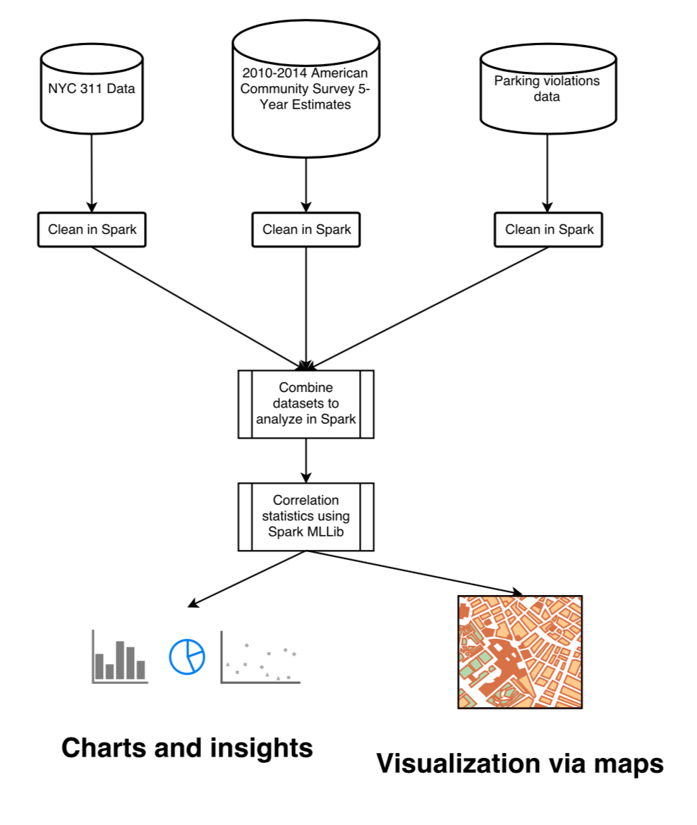
Where’s all that crime coming from?
Design Diagram
Platform(s) on which the application runs:
Dumbo Cluster and Cloudera Quickstart VM

Slide 7
Where’s all that crime coming from?
Experiments/Results
1. <Result 1>
<Tell us about experimental results, insights, or other key observations.>
2. <Result 2>
3. <Result 3>

Slide 8
Where’s all that crime coming from?
Obstacles
1. <Obstacle1>
< Tell us up to two obstacles you experienced in developing this application. >
2. <Obstacle 2>
3. <Obstacle 3>

Slide 9
Where’s all that crime coming from?
Summary
<Brief wrap-up!>
Acknowledgements
<
If you used an Amazon AWS voucher for this work, thank Amazon here.
If you had help from HPC, thank them for their support here.
If you received data from some source that was kind enough to share their data with you, thank them here.
If you worked with a domain expert, you know what to do…
>

Slide 10
Where’s all that crime coming from?
References
<List papers you read and data sources you used.>

Slide 11
<Your project name>
Thank you!

