Slide 1
Season & Soil-Based Crop Planning
with Price-Aware Profitability Forecasting
A Machine Learning Decision Support Tool for Farmers in the Vidarbha/Chandrapur Cotton Belt
Ankur Uttam Bhagat | AAI-590 Capstone | University of San Diego

Slide 2
The Problem
Farmers face two connected decisions each season — usually treated separately.
What to plant?
When to sell?
Soil-based crop recommendation systems exist, but they ignore expected market return.
Price forecasting tools exist, but they assume the crop choice has already been made.
Our contribution: connect both into a single profitability-oriented tool — specific to the Vidarbha/Chandrapur belt.
Bhagat | AAI-590 Capstone | 2

Slide 3
Data Sources — Three Real Datasets
Crop Recommendation
Chandrapur, Maharashtra
Sehore, Madhya Pradesh
2,200 records, 22 crops (100 each)
PRIMARY dataset — on-scope
SECONDARY — larger-sample check
7 features: N, P, K, temperature,
26 real months (Sept 2014–Oct 2016)
364 daily observations
humidity, pH, rainfall
Soybean modal price, aggregated
27.5% missing-day rate, interpolated
No missing values (verified)
across 8 reporting APMCs
Comparable soybean-growing region
Source: Kaggle (Ingle, n.d.)
Source: Govt. of Maharashtra mandi data
Source: Agmarknet (Govt. of India)
Bhagat | AAI-590 Capstone | 3

Slide 4
Methods
Module 1 — Crop Recommendation
Module 2 — Price Forecasting
Feed-forward neural network (MLP):
Feed-forward NN on sliding price windows
2 hidden layers (64, 32), ReLU
Differenced autoregression (AR) baseline
Random Forest baseline (200 trees)
Chronological split (no shuffling —
70/15/15 stratified split, Adam optimizer,
time series)
early stopping
Trained on BOTH real datasets
STATUS: fully trained, real results
STATUS: fully trained, real results
Note: TensorFlow/Keras were unavailable in the development sandbox; both neural networks were implemented via scikit-learn (genuine backpropagation-trained). Keras templates for exact reproduction are included in the notebook.
Bhagat | AAI-590 Capstone | 4

Slide 5
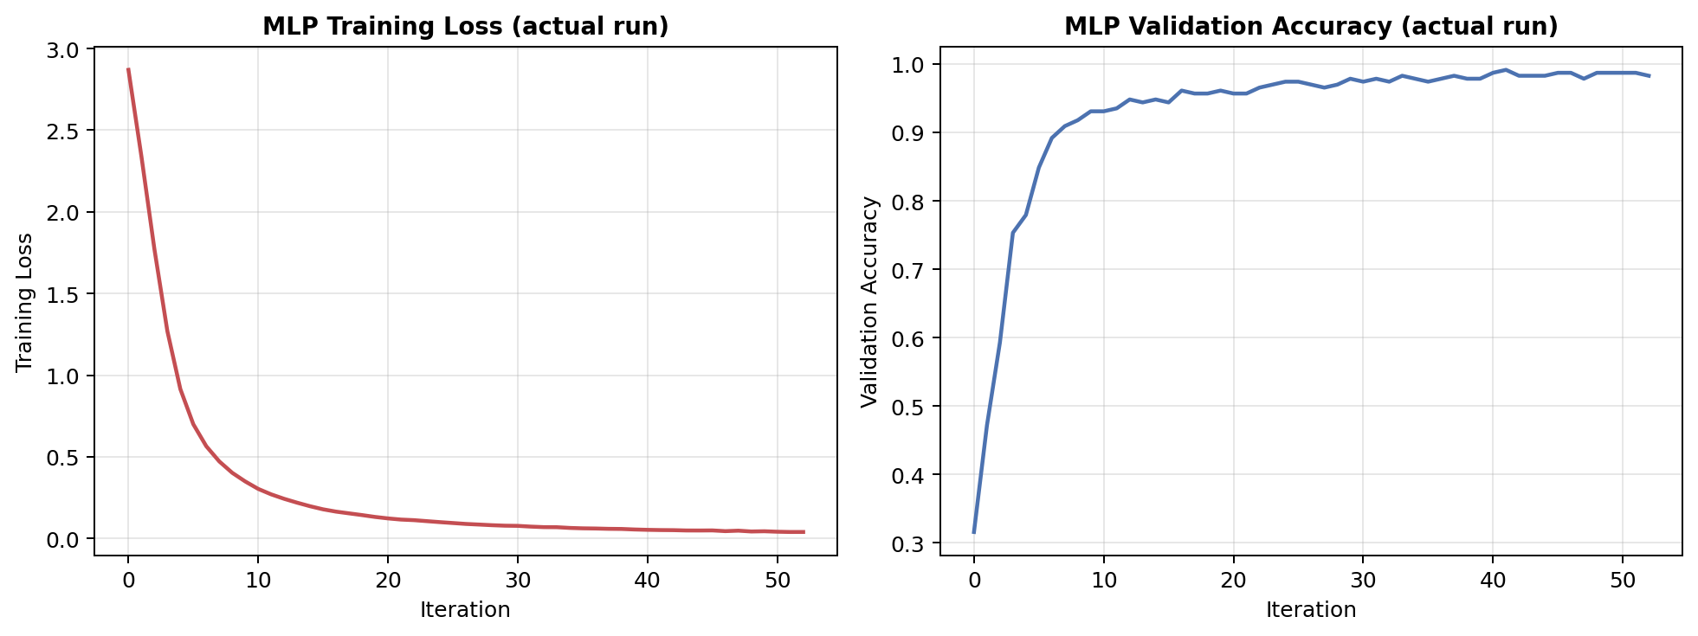
Results: Crop Recommendation
98.79%
MLP test accuracy (macro F1 = 0.988)
99.70%
Random Forest test accuracy
4 / 330
misclassifications — all agronomically similar crops
Feature importance (rainfall, humidity) independently reproduced a published finding (Gupta et al., 2022) despite a completely different train/test split.
Bhagat | AAI-590 Capstone | 5

Slide 6
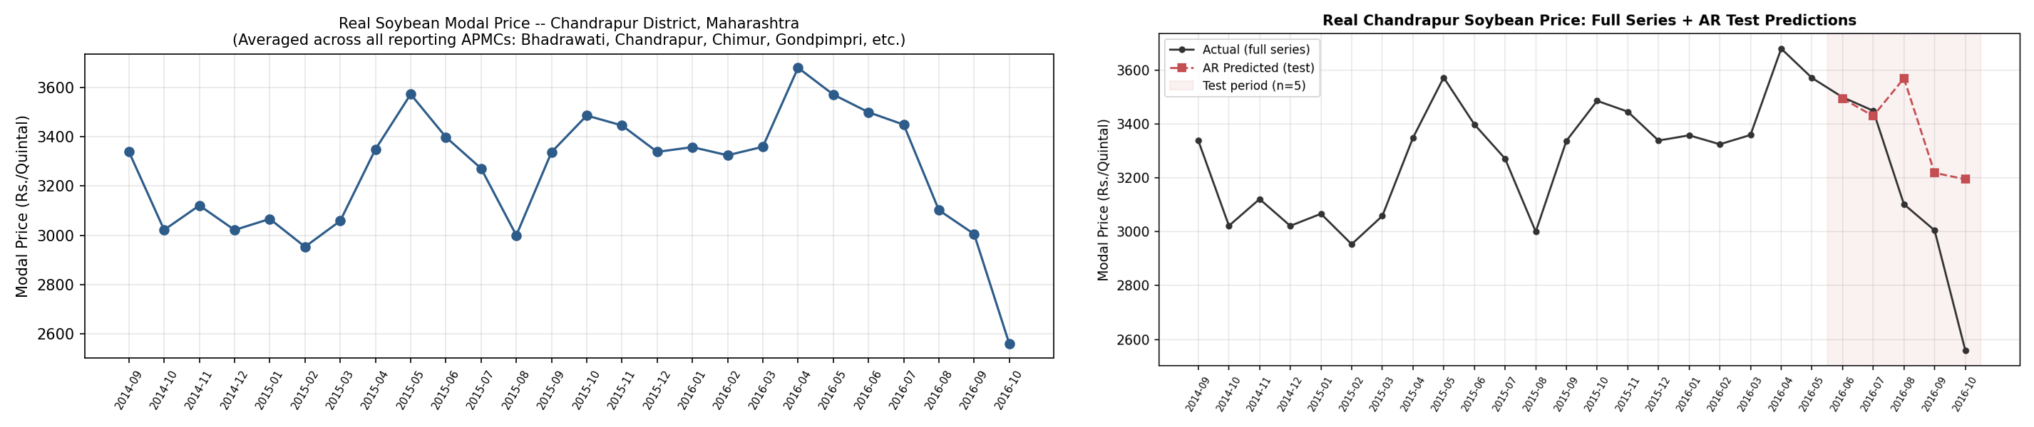
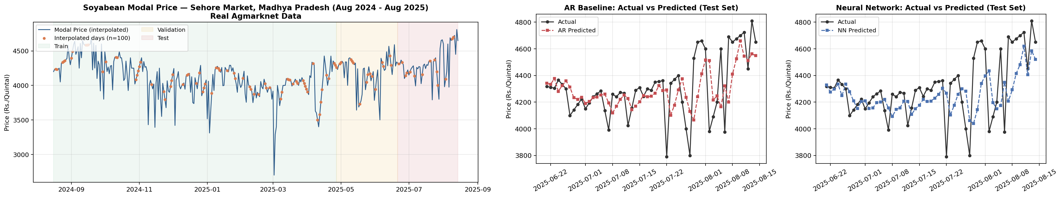
Results: Price Forecasting
Primary: Chandrapur, Maharashtra (n=5 test months)
Secondary: Sehore, Madhya Pradesh (n=55 test days)
Naive: 287.59 | AR: 365.49 | NN: 382.34 (RMSE)
Naive baseline wins — honest small-sample finding.
Naive: 246.79 | AR: 204.09 | NN: 213.87 (RMSE)
Both trained models beat the naive baseline here.
Reported transparently: with only 5 real Chandrapur test points, this isn't evidence either model is flawed — it's an honest finding about the limits of modeling on 26 months of real, on-scope data. The larger-sample Sehore result shows the approach works when given more data.
Bhagat | AAI-590 Capstone | 6

Slide 7
Conclusion & Next Steps
The crop recommendation half is strongly supported; the price-forecasting half now has a genuinely real, on-scope result. The most interesting outcome: independent replication of a published feature-importance finding gave real confidence in the approach.
1
Combine both modules into the single profitability-ranking output originally proposed
2
Reproduce both neural networks in Keras/PyTorch for full course-library compliance
3
Continue accumulating real Chandrapur-specific price history
4
Explore risk-and-cost-adjusted recommendations (Ramakumar et al., 2017)
Thank you.
Bhagat | AAI-590 Capstone | 7

