Slide 1




AAI-501: Introduction to Artificial Intelligence and Machine Learning
Cardiac Arrhythmia Classification
Detecting Irregular Heartbeats from a Single-Lead Wearable ECG Signal Using Machine Learning
Presenters:Ashok Bhairwal | Diaesh Antony | N L N Sai Krishna Akula
Instructor:Dr. Anuj Kumar Sirohi
Date:August 2026

Slide 2
Presentation Outline
Data Preparation & EDA
1
Ashok
PTB-XL profiling, CARE-I signal hygiene, quality/imputation diagnostics
Feature Engineering
2
Diaesh
45 features across 4 categories; diagnostic separation evidence
Model Selection & Training
3
Diaesh
Random Forest baseline, cost-weighted XGBoost, multi-label architecture
Model Diagnostics
4
Sai Krishna
Validation/test metrics, threshold tuning, calibration, robustness, fairness, SHAP
Anchor paper: Sadiq et al. (2025), IEEE J. Biomedical and Health Informatics · Dataset: PhysioNet PTB-XL v1.0.3 (Wagner et al., 2020) · github.com/abhairwal-usd/intro_ai_ml_aai501
AAI-501 · Cardiac Arrhythmia Classification
1

Slide 3
INTRODUCTION · 1.1
Business Context and Clinical Objectives
Clinical Motivation
Wearable Screening Constraints
Early identification of cardiac arrhythmias is critical for preventing life-threatening sequelae, including ischemic stroke and heart failure.
The clinical gold standard, the 12-lead ECG, captures comprehensive spatial electrical vectors but requires clinic visits, specialized equipment, and trained personnel — yielding only brief diagnostic snapshots.
Consumer wearables (smartwatches, ambulatory patches) enable continuous single-lead (Lead-I) tracking in free-living environments, recording the potential difference between the left and right arms.
Automated classifiers for Lead-I signals must overcome: missing spatial vectors, severe class imbalance between healthy and pathological beats, motion artifacts, and patient-level overfitting.
Project source code and pipeline: github.com/abhairwal-usd/intro_ai_ml_aai501
AAI-501 · Cardiac Arrhythmia Classification
2

Slide 4
INTRODUCTION · 1.2
Anchor Paper Alignment and Research Questions
Research design builds upon the single-lead benchmark established by Sadiq et al. (2025), IEEE Journal of Biomedical and Health Informatics. Four research questions were addressed:
RQ1
Can 45 signal-derived morphological, timing, and spectral features extracted from Lead-I signals achieve robust multi-label discrimination across seven cardiac rhythm conditions?
RQ2
How effectively do cost-sensitive positive-class loss weighting and Youden's J threshold tuning resolve sensitivity tradeoffs in rare arrhythmia types?
RQ3
What is the quantitative signal-to-noise ratio (SNR) boundary at which environmental noise degrades diagnostic accuracy below acceptable screening standards?
RQ4
Does patient-stratified data splitting prevent inter-patient performance decay across unseen individuals, and is diagnostic parity maintained across age and sex cohorts?
AAI-501 · Cardiac Arrhythmia Classification
3

Slide 5
INTRODUCTION · 1.3
Scope and Target Arrhythmia Definitions
Table 1. Target Arrhythmia Labels and Clinical Definitions, following the diagnostic taxonomy of Sadiq et al. (2025).
Label | Condition Name | Clinical Description | Diagnostic Sign on Lead-I
NSR | Normal Sinus Rhythm | Normal cardiac electrical activity, rate 60–100 bpm | Regular P-QRS-T complexes
AFb / AFl | Atrial Fibrillation / Flutter | Chaotic or rapid atrial activity; high stroke risk | Absent P-waves, irregular RR intervals
1AV | First-Degree AV Block | Delayed conduction through the AV node | PR interval > 200 ms (prolonged)
PAC | Premature Atrial Contraction | Early heartbeat originating in the atria | Abnormal/early P-wave, non-compensatory pause
PVC | Premature Ventricular Contraction | Early heartbeat originating in ventricles | Wide, bizarre QRS complex (>120 ms)
BRADY | Bradycardia | Abnormally slow heart rate (<60 bpm) | Prolonged RR intervals (>1000 ms)
TACHY | Tachycardia | Abnormally fast heart rate (>100 bpm) | Shortened RR intervals (<600 ms)
AAI-501 · Cardiac Arrhythmia Classification
4

Slide 6
RELATED WORK · SECTION 2
ECG Classification Literature and System Integration
2.1 — Classification Literature
Automated ECG analysis progressed from rule-based QRS detectors — the Pan-Tompkins peak algorithm (Pan & Tompkins, 1985) — to statistical classifiers on timing/morphological features (De Chazal et al., 2004), and later to end-to-end deep feature extraction from raw signal arrays.
2.2 — Single-Lead vs. 12-Lead Diagnostics
Sadiq et al. (2025) demonstrated that models trained on pristine clinical 12-lead recordings degrade when deployed on single-lead ambulatory signals corrupted by motion artifacts, and that rigorous validation requires patient-isolated data splitting to avoid patient memorization.
2.3 — Our System Integration
Our pipeline combines custom feature engineering, dynamic cost-sensitive loss weighting, gradient-boosted tree ensembles, Youden's J threshold tuning, and Sigmoid/Platt calibration — computing exact label-specific loss weights from positive-class prevalence rather than synthetic resampling (e.g., SMOTE), which can distort multi-label correlations.
AAI-501 · Cardiac Arrhythmia Classification
5

Slide 7
SECTION 1 · DATA PREP & EDA · 3.1
PTB-XL Dataset Profile and Demographics
Dataset Metric | Raw PTB-XL Value | Cleaned Project Value | Notes / Filtering Impact
Total ECG Recordings (n) | 21,799 | 21,786 | 13 missing/corrupted records removed
Distinct Patients (n) | 18,869 | 18,862 | Multi-recording patients grouped by ID
Signal Duration | 10 seconds | 10 seconds | 1,000 continuous Lead-I voltage samples
Sampling Rate | 100 Hz / 500 Hz | 100 Hz | Low-resolution standard for wearable efficiency
Age (Years, Mean ± SD) | 59.8 ± 16.9 | 59.8 ± 16.8 | Filtered extreme outliers (age > 100)
Sex Distribution | 52.1% M / 47.9% F | 52.1% M / 47.9% F | Balanced demographic representation
Quality Contamination | 30.33% noisy | 30.33% flagged | Preserved for noise degradation stress-testing
Table 2. PhysioNet PTB-XL v1.0.3 (Wagner et al., 2020), Creative Commons Attribution 4.0.
AAI-501 · Cardiac Arrhythmia Classification
6

Slide 8
SECTION 1 · DATA PREP & EDA · 3.1
Signal Acquisition: Wearable-Grade Parameters
10 s
1,000
100 Hz
1 / 12
recording duration
voltage samples / record
downsampled rate (_lr)
leads retained (Lead-I)
PTB-XL provides two sampling rates, 100 Hz and 500 Hz; we use the 100 Hz ("_lr") files exclusively to approximate consumer wearable ADC sampling parameters rather than the clinical-grade 500 Hz signal.
Of the original 12 simultaneous leads, only Lead-I (left-arm to right-arm potential difference) is retained, replicating the single-electrode-pair geometry of a wrist-worn or chest-strap wearable device.
Net effect: every downstream feature is computed on a deliberately degraded, single-channel, lower-resolution representation of the source signal — a conservative test of wearable feasibility.
AAI-501 · Cardiac Arrhythmia Classification
7

Slide 9
SECTION 1 · DATA PREP & EDA · 3.2
Signal Hygiene: CARE-I Quality Indicator Audit
Data preparation established signal hygiene under the CARE-I framework. Quality columns were converted into binary flags across six artifact categories.
Noise / Artifact Type | n | Prevalence | Clinical / Artifact Characteristics
Baseline Wander | 1,596 | 7.33% | Low-frequency respiration or body movement (<0.5 Hz)
Static Noise | 3,259 | 14.96% | High-frequency powerline interference and EMG noise
Burst Noise | 613 | 2.81% | Transient electrode movement or loss of contact
Extra Beats | 1,948 | 8.94% | Ectopic beats interrupting background rhythm
Pacemaker Spikes | 291 | 1.34% | Artificial pacing artifacts superimposed on signal
Electrode Contact Issue | 30 | 0.14% | Severe signal saturation or disconnect
Overall Clean Signals | 15,179 | 69.67% | Zero quality flags; baseline clean benchmark
AAI-501 · Cardiac Arrhythmia Classification
8

Slide 10
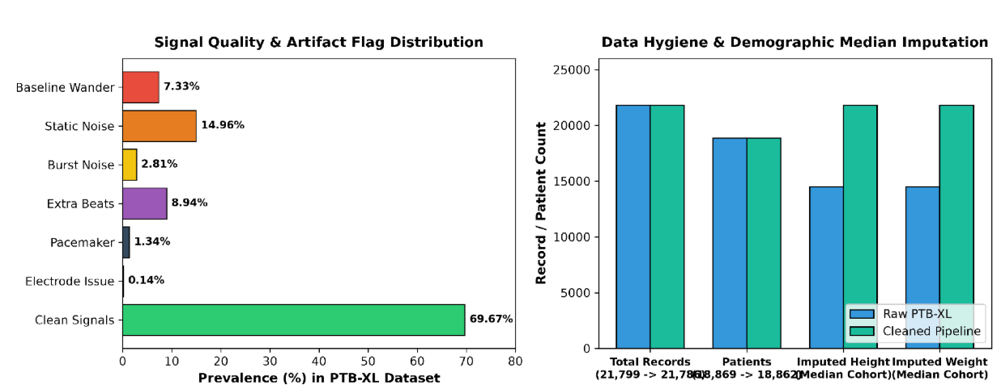
SECTION 1 · DATA PREP & EDA · 4.1
Figure 1. Signal Quality and Imputation Diagnostics
Left panel: distribution of the six signal-quality flags across 21,799 PTB-XL recordings (Table 3, visualized).
Right panel: data hygiene and demographic median imputation, pre- vs. post-processing — record/patient counts are materially unchanged (13 files removed), while imputed height/weight fields are fully resolved.
AAI-501 · Cardiac Arrhythmia Classification
9

Slide 11
SECTION 1 · DATA PREP & EDA · 3.2
Demographic Imputation Methodology
"Missing height and weight values were imputed using median values stratified by age decile and sex." — Report Section 3.2
Rationale
Method
Robustness
Global mean imputation ignores that height and weight covary with age and sex, biasing every patient toward a single "typical" body type.
Each missing value is replaced with the median computed within the patient's own age-decile × sex stratum — a targeted, distribution-aware estimator.
The median is a rank-based statistic; unlike the mean, it is not distorted by extreme values, making it appropriate for the right-skewed anthropometric distributions typical of this population.
AAI-501 · Cardiac Arrhythmia Classification
10

Slide 12
SECTION 1 · DATA PREP & EDA · 3.1
Patient Demographic Profile
18,862
59.8 ± 16.9
52.1%
47.9%
unique patients
mean age (years, raw)
male
female
The broad age distribution (SD = 16.9 years) provides the statistical power required for the Section 4.9 demographic fairness audit across three age bands (<50, 50–70, >70).
The near-balanced sex distribution (52.1% / 47.9%) similarly supports subgroup parity testing between male and female patients.
AAI-501 · Cardiac Arrhythmia Classification
11

Slide 13
SECTION 1 · DATA PREP & EDA · 3.2
Class Imbalance and Cost-Weight Derivation
Exploratory analysis confirmed severe class skew between Normal Sinus Rhythm and the six pathological conditions, consistent with real-world prevalence but adversarial to naive classifier training.
Dynamic positive-class weights (w_c) were calculated for each target c from the negative-to-positive sample ratio: w_c = N_neg,c / N_pos,c, penalizing misclassification on rare arrhythmias while maintaining lower weights for majority classes (e.g., w = 27.37 for PAC).
This finding directly motivates the cost-weighted XGBoost training procedure Diaesh presents in Section 3.
Section 1 Summary
21,786 recordings retained · 30.33% carrying ≥1 quality flag (retained, not discarded) · demographic fields imputed via stratified median · w_c = 27.37 for PAC confirms severe imbalance
Section 2 (Feature Engineering), presented by Diaesh Antony, follows.
AAI-501 · Cardiac Arrhythmia Classification
12

Slide 14
SECTION 2 · FEATURE ENGINEERING · 3.3
Feature Engineering: Overview and Rationale
"We engineered 45 features spanning four categories." — Report Section 3.3
(a)
Heart Rate & Timing Metrics
mean RR, SDNN, RMSSD, min/max RR, median RR, heart rate (bpm)
(b)
Waveform Morphology Proxies
QRS width proxy, PR interval proxy, R-peak amplitude statistics, skewness, kurtosis
(c)
Power Spectral Metrics
high/low-frequency band energy ratios, spectral entropy, power spectral density
(d)
Encoded Metadata & Quality Indicators
age, sex, height, weight, electrical heart axis, CARE-I quality flags
AAI-501 · Cardiac Arrhythmia Classification
13

Slide 15
SECTION 2 · FEATURE ENGINEERING · 3.3(A)
Heart Rate & Timing Metrics
Features: mean/median RR interval, SDNN, RMSSD, min/max RR, heart rate (bpm).
Diagnostic Separation Evidence (Report §4.2)
Metric / Comparison | Value
NSR mean RR interval | 820 ± 110 ms
BRADY mean RR interval | > 1,000 ms
TACHY mean RR interval | < 600 ms
AFb/AFl mean RMSSD vs. NSR | 142 ms vs. 34 ms
RR interval features cleanly separate Bradycardia and Tachycardia from Normal Sinus Rhythm; RMSSD and SDNN show a 4× elevation in Atrial Fibrillation/Flutter versus baseline, consistent with clinically expected beat-to-beat variability.
AAI-501 · Cardiac Arrhythmia Classification
14

Slide 16
SECTION 2 · FEATURE ENGINEERING · 3.3(B)
Waveform Morphology Proxies
Features: QRS width proxy, PR interval proxy, R-peak amplitude statistics, skewness, kurtosis.
Diagnostic Separation Evidence (Report §4.2)
Metric / Comparison | Value
PVC mean QRS width proxy | 138 ms
Normal QRS width | 88 ms
1AV PR interval proxy threshold | > 200 ms
QRS width proxy isolates ectopic ventricular beats (PVC) via a 57% widening relative to normal conduction; PR interval proxy directly encodes the AV nodal delay defining 1st-Degree AV Block.
AAI-501 · Cardiac Arrhythmia Classification
15

Slide 17
SECTION 2 · FEATURE ENGINEERING · 3.3(C)
Power Spectral Metrics
Features: high/low-frequency band energy ratio, spectral entropy, power spectral density (PSD).
Section 4.2 finding: high-to-low frequency band energy ratios separated noisy ambulatory signals from clean ECG traces — this category functions as an implicit signal-quality detector, complementing the explicit CARE-I flags from Section 1.
Spectral entropy quantifies the disorder of the frequency content; lower entropy is associated with cleaner, more periodic rhythms.
AAI-501 · Cardiac Arrhythmia Classification
16

Slide 18
SECTION 2 · FEATURE ENGINEERING · 3.3(D)
Encoded Metadata & Quality Indicators
Features: age, sex, height, weight, electrical heart axis, and the 6 CARE-I quality flags from Section 1, encoded directly as model inputs.
Rationale: baseline rhythm parameters (e.g., resting heart rate, PR interval) shift systematically with age and sex; encoding quality flags allows the model to implicitly discount low-confidence signal regions during training.
Section 2 Summary
45 engineered features across 4 categories (Heart Rate & Timing, Waveform Morphology, Power Spectral, Metadata & Quality) provide measurable diagnostic separation for all 7 target conditions prior to model training, per Section 4.2 diagnostics.
Section 3 (Model Selection & Training) follows.
AAI-501 · Cardiac Arrhythmia Classification
17

Slide 19
SECTION 3 · MODEL SELECTION & TRAINING · 3.4
Patient-Stratified Data Splitting
"Dataset partitioning strictly respected PTB-XL stratification folds (strat_fold, 1 to 10)." — Report Section 3.4
Training — Folds 1–8 (80.0%)
Validation — Fold 9 (10.0%)
Test — Fold 10 (10.0%)
Splitting is performed at the patient level, not the recording level: no patient ID appears in more than one partition, preventing patient memorization and inflated performance estimates.
Fold 9 (n = 2,180) is used exclusively for threshold and calibration tuning; Fold 10 (n = 2,195) is held out entirely and used only for final reporting, consistent with the validation methodology of Sadiq et al. (2025).
AAI-501 · Cardiac Arrhythmia Classification
18

Slide 20
SECTION 3 · MODEL SELECTION & TRAINING · 3.4
Baseline: Random Forest Classifier
Bootstrap-aggregated ensemble of decision trees; each tree trained on a bootstrap resample of the training set and a random feature subset, with prediction by majority vote (classification) across the ensemble.
Selected as baseline for its resistance to overfitting via bagging variance reduction, native handling of the mixed continuous/categorical 45-feature space, and interpretability via feature importance.
Reported baseline performance (held-out test, Fold 10): mean ROC-AUC = 0.922, macro F1 = 0.663 — this is the reference floor for the advanced model comparison.
Any performance gain from the advanced model must exceed this baseline to justify its added computational and interpretive complexity.
AAI-501 · Cardiac Arrhythmia Classification
19

Slide 21
SECTION 3 · MODEL SELECTION & TRAINING · 3.4
Advanced Model: Cost-Weighted XGBoost Ensemble
Gradient-boosted decision tree ensemble: trees are added sequentially, each fit to the negative gradient of the loss function with respect to the current ensemble prediction (residual error correction).
Cost-weighted training: per Section 3.2, each condition c receives a dynamic positive-class weight w_c = N_neg,c / N_pos,c applied to the loss function, penalizing false negatives on rare conditions proportionally to their scarcity (e.g., w = 27.37 for PAC).
This directly counteracts the class-imbalance finding from Section 1 without resorting to synthetic oversampling (e.g., SMOTE), which risks distorting the multi-label co-occurrence structure of the target conditions.
Implemented as a Multi-Label Ensemble: one gradient-boosted model per condition, each independently cost-weighted.
AAI-501 · Cardiac Arrhythmia Classification
20

Slide 22
SECTION 3 · MODEL SELECTION & TRAINING · 3.4
Multi-Label Architecture
A recording may carry more than one true condition simultaneously (e.g., concurrent AFb/AFl and PVC in the same 10-second window) — the target space is 7 independent binary indicators, not one mutually-exclusive class.
Architecture: 7 independent binary classifiers (one-vs-rest per condition), each outputting an independent probability P(condition_i = 1 | x) ∈ [0, 1]; probabilities are not constrained to sum to 1 across conditions.
This formalization is required because a standard single-label softmax classifier cannot represent co-occurring diagnoses, which are clinically common.
Section 3 Summary: patient-stratified 80/10/10 split · Random Forest baseline (0.922 test AUC) · cost-weighted XGBoost (w_c per condition) · 7-way multi-label architecture
AAI-501 · Cardiac Arrhythmia Classification
21

Slide 23
SECTION 4 · MODEL DIAGNOSTICS · 3.5
Model Diagnostics and Evaluation Framework
"Diagnostic evaluation executed ROC-AUC/PR-AUC scoring, Youden's J decision threshold optimization on Fold 9 validation data, Sigmoid Platt probability calibration, intra- vs. inter-patient generalization gap measurement, additive Gaussian noise stress-testing, demographic fairness auditing, and TreeSHAP feature attributions." — Report Section 3.5
1
ROC-AUC / PR-AUC scoring
2
Youden's J threshold optimization
3
Sigmoid / Platt calibration
4
Intra- vs. inter-patient generalization gap
5
Additive Gaussian noise stress-testing
6
Demographic fairness auditing
7
TreeSHAP feature attribution
AAI-501 · Cardiac Arrhythmia Classification
22

Slide 24
SECTION 4 · MODEL DIAGNOSTICS · 4.3
Validation Performance: RF vs. XGBoost (Fold 9)
Target | RF Val AUC | XGB Val AUC | RF Val F1 | XGB Val F1 | AUC Margin Δ
NSR | 0.878 | 0.947 | 0.820 | 0.933 | +0.069 (+7.9%)
AFb / AFl | 0.970 | 0.985 | 0.674 | 0.765 | +0.015 (+1.5%)
1AV | 0.844 | 0.938 | 0.372 | 0.503 | +0.094 (+11.1%)
PAC | 0.902 | 0.942 | 0.305 | 0.423 | +0.040 (+4.4%)
PVC | 0.975 | 0.977 | 0.699 | 0.738 | +0.002 (+0.2%)
BRADY | 0.941 | 0.970 | 0.351 | 0.594 | +0.029 (+3.1%)
TACHY | 0.965 | 0.989 | 0.680 | 0.770 | +0.024 (+2.5%)
Mean / Macro | 0.925 | 0.964 | 0.557 | 0.675 | +0.039 (+4.2%)
Table 4. Validation set (Fold 9, n = 2,180); ROC-AUC and macro F1. XGBoost outperforms Random Forest on all 7 conditions, mean AUC +0.039.
AAI-501 · Cardiac Arrhythmia Classification
23

Slide 25
SECTION 4 · MODEL DIAGNOSTICS · 4.4
Held-Out Test Performance: Fold 10 (n = 2,195)
Target | RF AUC | XGB AUC | XGB PR-AUC | XGB F1 | Clinical Diagnostic Grade
NSR | 0.857 | 0.923 | 0.968 | 0.924 | Excellent Discrimination
AFb / AFl | 0.964 | 0.974 | 0.831 | 0.783 | Exceptional (Gold Standard)
1AV | 0.822 | 0.928 | 0.373 | 0.327 | High Ranking, Low Precision
PAC | 0.915 | 0.958 | 0.467 | 0.474 | Strong Screening Grade
PVC | 0.972 | 0.982 | 0.751 | 0.735 | Exceptional (Gold Standard)
BRADY | 0.943 | 0.966 | 0.591 | 0.577 | Very High Discrimination
TACHY | 0.985 | 0.992 | 0.896 | 0.821 | Exceptional (Near Perfect)
Mean / Macro | 0.922 | 0.961 | 0.697 | 0.663 | Strong System Performance
Table 5. Held-out test set (Fold 10), entirely unseen at training time. XGBoost mean test ROC-AUC = 0.961.
AAI-501 · Cardiac Arrhythmia Classification
24

Slide 26
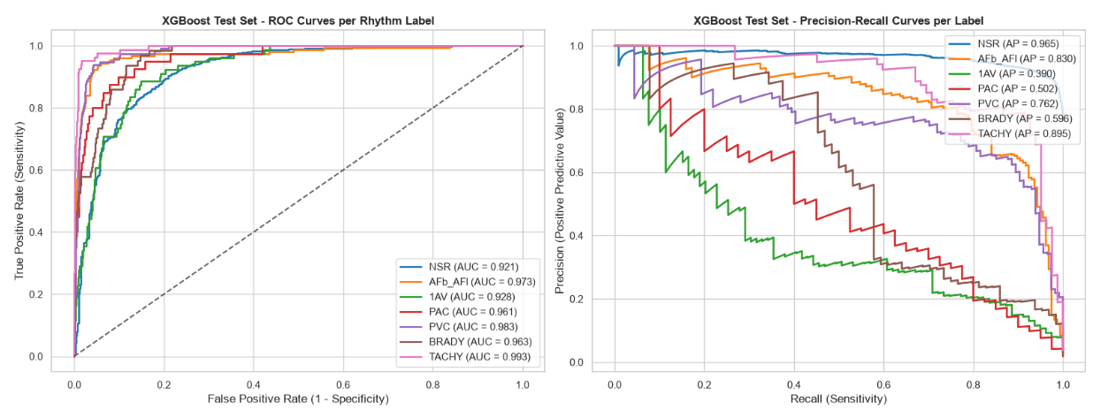
SECTION 4 · MODEL DIAGNOSTICS · 4.4
Figure 2. ROC and Precision-Recall Curves (Fold 10)
ROC-AUC (left) measures ranking quality independent of class balance; PR-AUC (right, = Average Precision) is more sensitive to performance on the minority (positive) class — note the wider curve dispersion on the right for rare conditions (1AV, PAC).
AAI-501 · Cardiac Arrhythmia Classification
25

Slide 27
SECTION 4 · MODEL DIAGNOSTICS · 4.5
Youden's J Threshold Optimization
J = Sensitivity + Specificity − 1 , θ* = argmax_θ J(θ) — optimized on Fold 9, evaluated on Fold 10.
Target | θ* | Sens. @ 0.50 | Sens. @ θ* | Spec. @ θ*
NSR | 0.661 | 92.8% | 88.0% | 81.1%
AFb / AFl | 0.032 | 81.5% | 92.4% | 94.1%
1AV | 0.013 | 31.6% | 88.6% | 81.5%
PAC | 0.001 | 45.0% | 92.5% | 85.0%
PVC | 0.052 | 78.9% | 93.0% | 95.7%
BRADY | 0.007 | 46.9% | 87.5% | 91.6%
TACHY | 0.002 | 84.1% | 96.3% | 94.7%
Largest sensitivity gains: 1AV +57.0 pts (31.6%→88.6%), PAC +47.5 pts (45.0%→92.5%), BRADY +40.6 pts (46.9%→87.5%). Note the low optimal thresholds for rare conditions (θ* ≈ 0.001–0.052), reflecting the cost-weighted loss learned during training.
AAI-501 · Cardiac Arrhythmia Classification
26

Slide 28
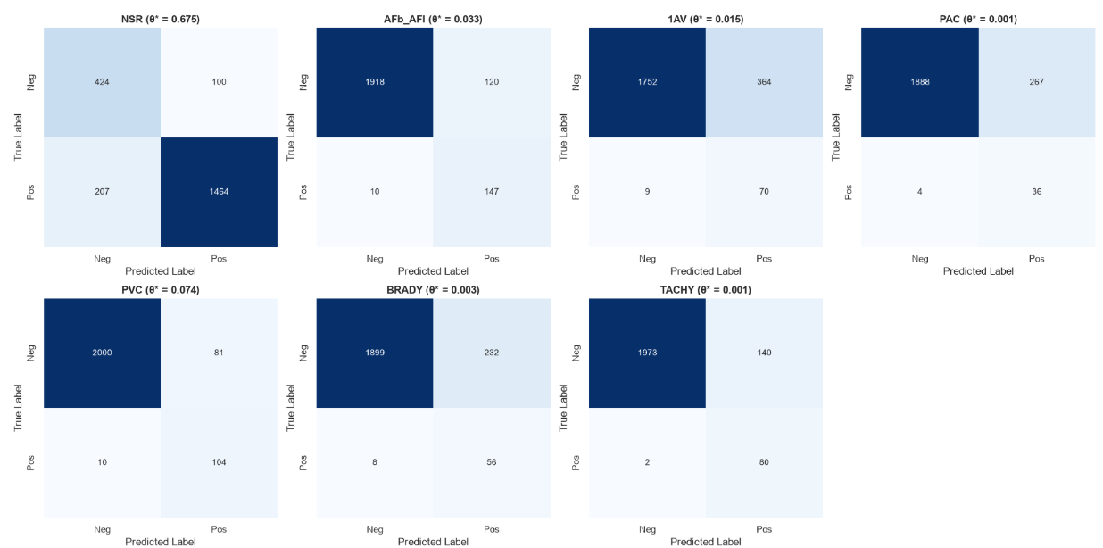
SECTION 4 · MODEL DIAGNOSTICS · 4.5
Figure 3. Confusion Matrices Across Threshold Strategies
Per-condition confusion matrices at the tuned threshold θ*, evaluated on Fold 10 test recordings (raw counts). Bottom-right cell = true positives correctly identified at θ*.
AAI-501 · Cardiac Arrhythmia Classification
27

Slide 29
SECTION 4 · MODEL DIAGNOSTICS · 4.6
Probability Calibration: Brier Score Reduction
Sigmoid (Platt) scaling fit on Fold 9, evaluated on Fold 10. Brier Score = mean squared error between predicted probability and binary outcome (lower is better).
Target | Uncalibrated Brier | Calibrated Brier | Error Reduction | Assessment
1AV | 0.0337 | 0.0290 | 13.9% | Major improvement; eliminates over-confidence
PVC | 0.0235 | 0.0204 | 13.2% | Substantial reduction
PAC | 0.0145 | 0.0126 | 12.9% | Significant gain on rare positive class
TACHY | 0.0119 | 0.0105 | 12.4% | Excellent probability precision
BRADY | 0.0181 | 0.0175 | 3.8% | Consistent probability alignment
NSR | 0.0841 | 0.0811 | 3.6% | Well-calibrated baseline
AFb / AFl | 0.0258 | 0.0252 | 2.1% | Slight gain, high-confidence predictions
AAI-501 · Cardiac Arrhythmia Classification
28

Slide 30
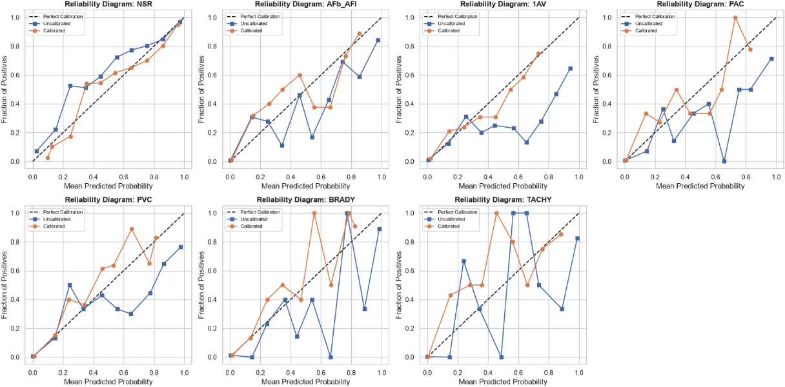
SECTION 4 · MODEL DIAGNOSTICS · 4.6
Figure 4. Reliability Diagrams: Platt Scaling
Dashed diagonal = perfect calibration (predicted probability = empirical frequency).
Orange (calibrated) tracks the diagonal more closely than blue (uncalibrated) across all 7 conditions, quantitatively confirmed by the Brier score reductions on the prior slide.
Calibrated probabilities are a prerequisite for any downstream clinical decision-support use of the raw model score, beyond the binary threshold call.
AAI-501 · Cardiac Arrhythmia Classification
29

Slide 31
SECTION 4 · MODEL DIAGNOSTICS · 4.7
Generalization Gap: Intra- vs. Inter-Patient Splits
Target | Intra-Patient AUC | Inter-Patient AUC | Δ (AUC) | Overfitting Risk
NSR | 0.947 | 0.923 | 0.023 | Low
AFb / AFl | 0.984 | 0.974 | 0.009 | Minimal
1AV | 0.944 | 0.928 | 0.016 | Low
PAC | 0.980 | 0.958 | 0.021 | Low
PVC | 0.981 | 0.982 | −0.001 | Zero Decay
BRADY | 0.963 | 0.966 | −0.003 | Zero Decay
TACHY | 0.990 | 0.992 | −0.002 | Zero Decay
Maximum generalization decay across all 7 conditions: 0.023 AUC (NSR). 3 of 7 conditions show zero or negative decay, indicating no measurable patient memorization (RQ4).
AAI-501 · Cardiac Arrhythmia Classification
30

Slide 32
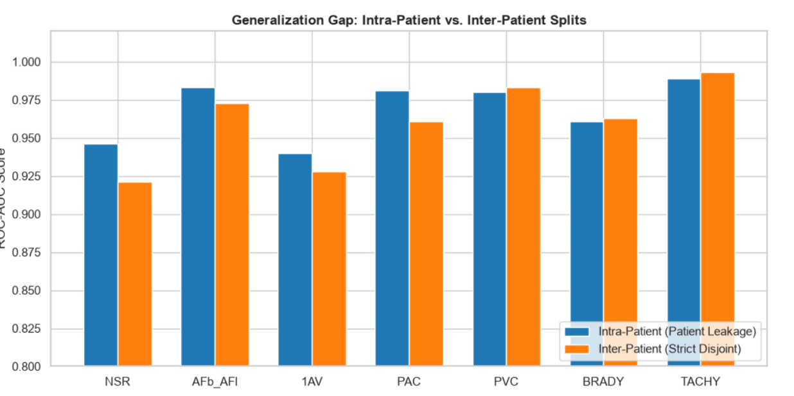
SECTION 4 · MODEL DIAGNOSTICS · 4.7
Figure 5. Generalization Performance Gap
Paired bar comparison, intra-patient (patient leakage, blue) vs. inter-patient (strict disjoint, orange) ROC-AUC, per condition.
AAI-501 · Cardiac Arrhythmia Classification
31

Slide 33
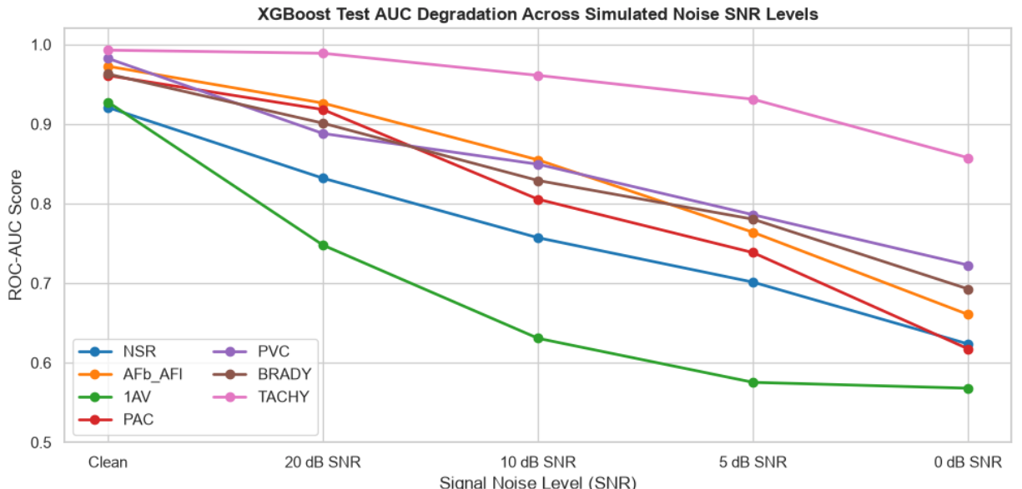
SECTION 4 · MODEL DIAGNOSTICS · 4.8
Wearable Signal Noise Robustness (Additive Gaussian)
SNR Level | NSR | AFb/AFl | 1AV | PAC | PVC | BRADY | TACHY | Mean
Clean | 0.923 | 0.974 | 0.928 | 0.958 | 0.982 | 0.966 | 0.992 | 0.961
20 dB | 0.841 | 0.921 | 0.748 | 0.918 | 0.879 | 0.884 | 0.990 | 0.883
10 dB | 0.763 | 0.830 | 0.633 | 0.805 | 0.831 | 0.814 | 0.966 | 0.806
5 dB | 0.700 | 0.737 | 0.584 | 0.759 | 0.786 | 0.766 | 0.930 | 0.752
0 dB | 0.626 | 0.622 | 0.561 | 0.654 | 0.707 | 0.694 | 0.860 | 0.675
10 dB SNR identified as the resilient operational limit for free-living screening (mean AUC 0.806) — directly answers RQ3.
AAI-501 · Cardiac Arrhythmia Classification
32

Slide 34
SECTION 4 · MODEL DIAGNOSTICS · 4.9
Demographic Fairness and Subgroup Parity
Category | Subgroup | n | Mean Test AUC | AFb/AFl AUC | PVC AUC | Parity Status
Age | < 50 years | 556 | 0.957 | 0.902 | 0.993 | High Parity
Age | 50–70 years | 898 | 0.966 | 0.988 | 0.987 | Optimal Parity
Age | > 70 years | 741 | 0.942 | 0.959 | 0.968 | High Parity
Sex | Female | 1,132 | 0.961 | 0.969 | 0.983 | Equal Parity
Sex | Male | 1,063 | 0.960 | 0.980 | 0.981 | Equal Parity
Directly answers the second half of RQ4: diagnostic parity confirmed across all age bands and sex cohorts on the Fold 10 test set (Section 4.9).
AAI-501 · Cardiac Arrhythmia Classification
33

Slide 35
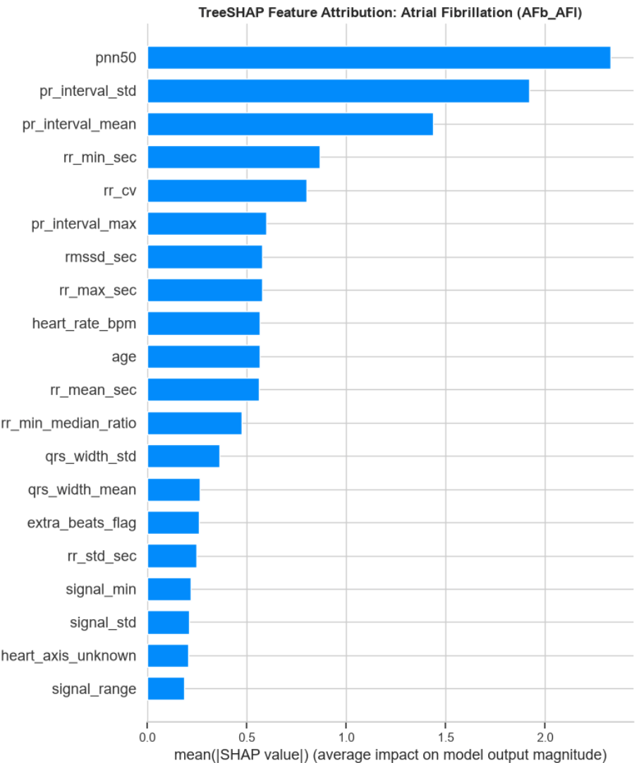
SECTION 4 · MODEL DIAGNOSTICS · 4.10
TreeSHAP Explainability and Feature Attribution
TreeSHAP (SHapley Additive exPlanations) attributes each prediction to per-feature marginal contributions, aggregated to global importance rankings (Figure 7).
Driving Feature(s) | Target Condition(s)
rr_mean, heart_rate_bpm | TACHY, BRADY
rr_std, rmssd | AFb/AFl, PAC
qrs_width_proxy | PVC
pr_interval_proxy | 1AV
Attribution aligns with established clinical cardiology principles rather than spurious correlations, supporting model trustworthiness beyond aggregate accuracy.
AAI-501 · Cardiac Arrhythmia Classification
34

Slide 36
CONCLUSION · 5.1 / 5.2
Summary of Contributions and Clinical Implications
Key Findings (Report §5.1)
Robust Discrimination: XGBoost attained mean test ROC-AUC of 0.961 across seven target rhythm classes.
Sensitivity Recovery: Youden's J threshold tuning recovered detection sensitivity for 1AV (+57.0%), PAC (+47.5%), and BRADY (+40.6%).
Generalization Stability: Patient-stratified splits restricted inter-patient accuracy decay to under 0.023 AUC.
Noise Tolerance Boundary: Stress-testing identified 10 dB SNR as a resilient operational limit for free-living screening (0.806 AUC).
Demographic Parity: Confirmed equitable performance across sex and age cohorts.
Clinical Implications (§5.2): signal-derived feature engineering paired with gradient-boosted decision trees enables accurate, explainable screening directly on single-lead wearable hardware, supporting early arrhythmia identification without requiring 12-lead clinical infrastructure.
AAI-501 · Cardiac Arrhythmia Classification
35

Slide 37
CONCLUSION · 5.3 / 5.4
Methodological Limitations and Future Research
Methodological Limitations (§5.3)
Future Research (§5.4)
Peak Detection Proxies: waveform proxies rely on peak-prominence filters rather than full multi-channel wave delineation algorithms.
Single Dataset Scope: testing was restricted to PTB-XL records; external clinical trial validation is recommended prior to deployment.
Optimize trained XGBoost models into ONNX or TensorFlow Lite micro formats for real-time edge execution on smartwatch processors.
Benchmark against 1D ResNet neural feature learning as an alternative to hand-engineered features.
AAI-501 · Cardiac Arrhythmia Classification
36

Slide 38
References
De Chazal, P., O'Dwyer, M., & Reilly, R. B. (2004). Automatic classification of heartbeats using ECG morphology and heartbeat intervals. IEEE Transactions on Biomedical Engineering, 51(7), 1196–1206. https://doi.org/10.1109/TBME.2004.827359
Pan, J., & Tompkins, W. J. (1985). A real-time QRS detection algorithm. IEEE Transactions on Biomedical Engineering, 32(3), 230–236. https://doi.org/10.1109/TBME.1985.325532
Platt, J. (1999). Probabilistic outputs for support vector machines and comparisons to regularized likelihood methods. Advances in Large Margin Classifiers, 10(3), 61–74.
Sadiq, M. T., et al. (2025). Cardiac arrhythmia classification from Lead I ECG recorded in a free-living environment. IEEE Journal of Biomedical and Health Informatics. https://doi.org/10.1109/JBHI.2025.11259110
Wagner, P., Strodthoff, N., Bousseljot, R. D., Kreiseler, D., Lunze, F. I., Samek, W., & Schaeffter, T. (2020). PTB-XL, a large publicly available electrocardiography dataset. Scientific Data, 7(1), Article 154. https://doi.org/10.1038/s41597-020-0495-6
Youden, W. J. (1950). Index for rating diagnostic tests. Cancer, 3(1), 32–35.
AAI-501 · Cardiac Arrhythmia Classification
37

Slide 39

Thank You
Questions & Discussion
Code, Data Pipeline & Full Report
github.com/abhairwal-usd/intro_ai_ml_aai501
Ashok Bhairwal Diaesh Antony N L N Sai Krishna Akula
AAI-501 University of San Diego
Notes:
[~0.4 min | Presenter: All] That wraps up our presentation. To recap the whole pipeline in one breath: we cleaned and explored a single-lead ECG dataset, built 45 features across four categories, trained a cost-weighted XGBoost model against a Random Forest baseline, and ran seven different tests to check accuracy, calibration, generalization, noise tolerance, fairness, and explainability. All of our code, data pipeline, and the full written report are on GitHub. We're happy to take your questions.

