Slide 1

AIT Onboarding Session
Jens Trotzky , SAP
Yuxin Liu, SAP
March 23, 2021

Slide 2
Agenda
Team introduction
AIT services overview
Data overview
A quick look at AIT platform
Next steps

Slide 3
Team Introduction

Slide 4
AIT Services Introduction

Slide 5
AI Services Available to Customers
Incident Solution Matching
Expert Area Predictor
Proposes solutions based on incident data in the incident creation or view form
Integrated into ONE Support Launchpad, Support Assistant, SAP Ariba Connect and Help Center
Suggests expert areas when customers book a Schedule an Expert session
Integrated into Schedule an Expert
AI Services Available to Customers
Component Predictor
Product Function Predictor
Transforming business models
Suggests components when customers try to select a component in the incident creation form
Integrated into ONE Support Launchpad
Suggests Product Functions when customers try to select a Product Function in the incident creation form
Integrated into ONE Support Launchpad
Language Detection
Detects language that is used in the incident communication for machine translation
Integrated into ONE Support Launchpad

Slide 6
AI Services Available to Internal Engineers
Incident Solution Matching
Incident-Incident Matching
Proposes solutions to engineers in incident/case processing systems
Integrated into BCP, ServiceNow, SAP Ariba The Hub and MCC Activity App
Suggests a list of similar incidents to the current one you are viewing with the last 2 solutions attached to them
Integrated into BCP, ServiceNow and Engineer Assistant
AI Services Available to Engineers
Expert Finder
Solution-Solution Matching
Transforming business models
Identifies and suggests available experts of the related components
Integrated into BCP, ServiceNow and Engineer Assistant
Suggests a list of similar KBAs or SAP Notes to the current one you are viewing
Integrated into BCP, ServiceNow and Engineer Assistant
Intelligent Correction Predictor
When a new bug is reported, it recommends five technical objects where code corrections need to be done to resolve the incident
Integrated into BCP

Slide 7
AI Services in our scope
1. Enhanced ISM with Help Documents
A machine learning Microservice that match a customer Incident with our SAP Product Documentation (a.k.a. SAP Help) and consider integration possibilities with the existing Incident Solution Matching Service to allow end users to get an integrated solution experience
2. Similar Customer
A Machine Learning Microservice that provides proactive recommendations to our customers based on their relative similarity with other customers and their respective support history. The objective would be to ensure we either omit certain recommendations because we have already given them to customers or highlight recommendations because similar customers benefited from a given solution.

Slide 8
AI Services in our scope
3. SAP Entity Recognition Service
Design and develop a machine learning Microservice on our AIT platform that indentify/recognize the SAP entities such as authorization objects, transaction codes, BADIs, tables, error messages, views, Fiori apps, Odata services and so on.This service will optential help us on:
Achieving better text preprocessing
Improving model accuracy
Detecting potential cloud outbreak after a new release

Slide 9
Data Source Overview

Slide 10
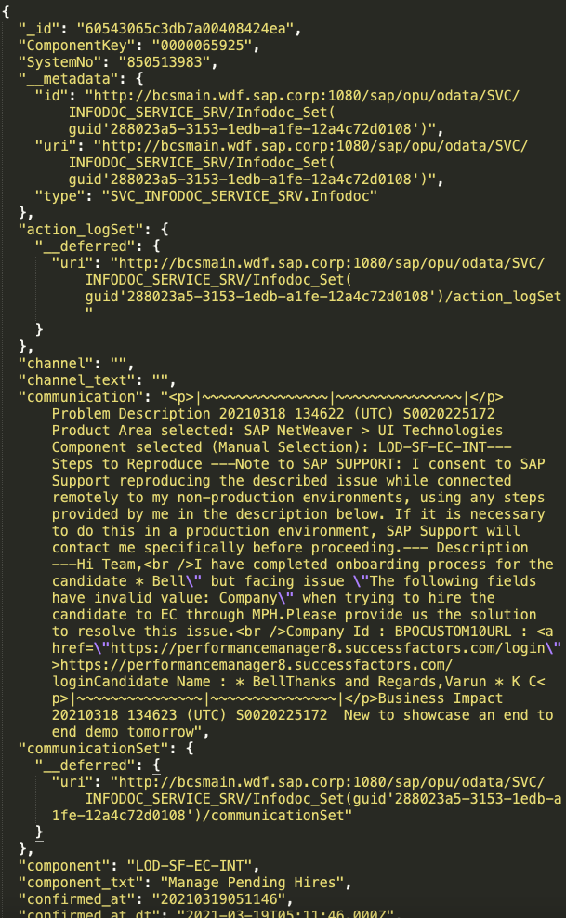
Incidents
Incident: A ticket used by a customer to describe an issue with their SAP Software
Infodoc: Anonymized Incident used for Machine Learning
Website: BCP
Where to access data: Mongodb on AIT platform
* Highly sensitive data, could not leave our platform

Slide 11
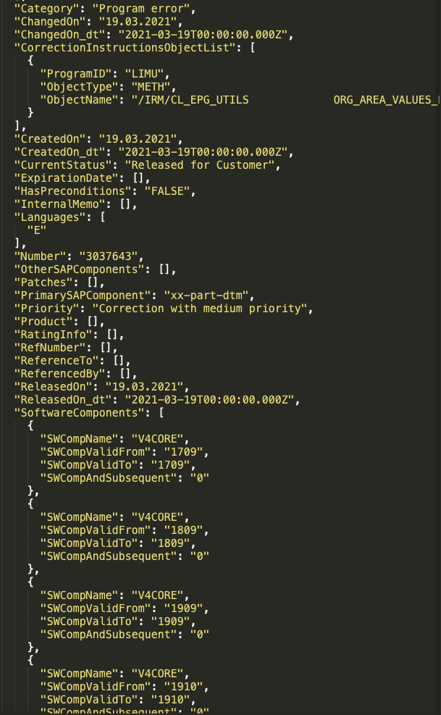
Solutions
KBA: Knowledge Base Articles = How-tos
Notes: Explain Code Corrections for SAP Products
Website: I7P
Where to access data : Mongodb on AIT platform

Slide 12
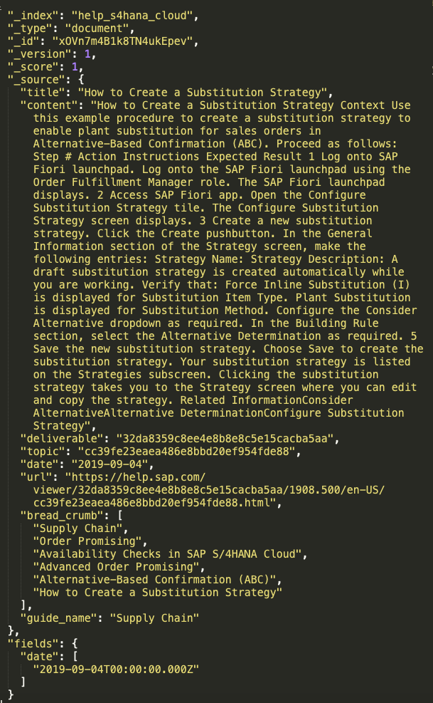
Help Documents
Help documents: complete SAP documentation by products
Website: SAP Help Portal
Where to access data: Azure Datalake
https://wiki.wdf.sap.corp/wiki/display/ServSuppDL/%5BUser+Guide%5D+How+to+access+Help+Documentation
How to request access:
https://wiki.wdf.sap.corp/wiki/display/dataandanalytics/%5BUser+Guide%5D+How+To%3A+Request+access+to+ADLS+Data+Area
https://spc.ondemand.com/sap/bc/webdynpro/a1sspc/cam_wd_central?item=request&profile=BDPI%20MDEP%20ADLS%20DBSA%20Data%20Area%20%28PROD%29

Slide 13
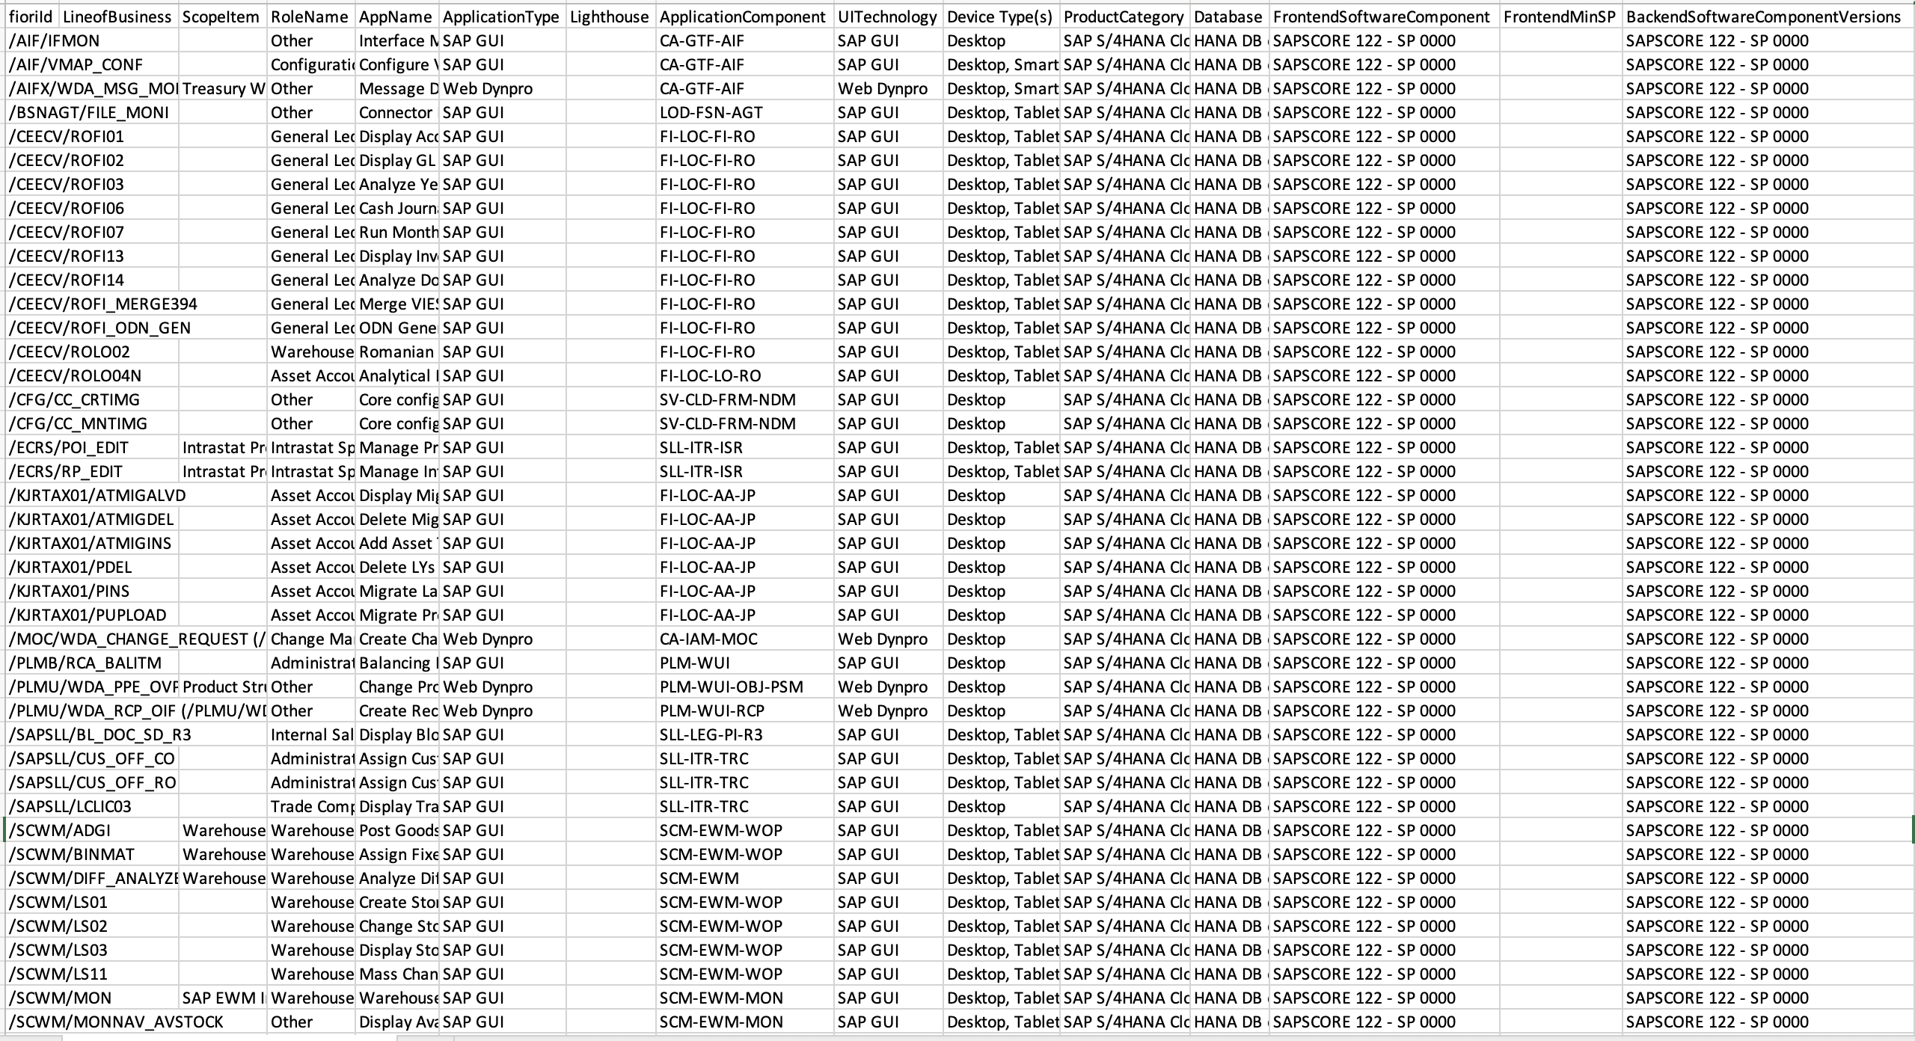
SAP Fiori Apps Reference Library
Fiori Apps: Key information for each fiori app, including all the technical data for installation and configuration
Website: Fiori Apps Reference Library
Where to access data: Azure Datalake
https://wiki.wdf.sap.corp/wiki/display/ServSuppDL/%5BUser+Guide%5D+How+to+access+Fiori+Apps

Slide 14
Several more data sources
Roadmap viewer:
SAP Activate methodology implementation roadmaps
https://roadmapviewer-supportportal.dispatcher.hana.ondemand.com/#
PPMS(Product & Production Management System):
SAP product information such as software component, software component version, software product, software product version and so on
https://wiki.wdf.sap.corp/wiki/display/ppmscont/Home#Home-ContentofPPMS

Slide 15
AIT Platform Overview

Slide 16
AIT Platform is managed by Kubernetes and running in SAP Converged Cloud infrastructure
Programming language: Python
Data scientist working space: Kubeflow

Slide 17
Next Steps

Slide 18
Next Steps
Action items:
Split the colleagues who are interested into to two groups (IBSO)
Onboard the colleagues to AIT Platform (AIT)
Define the working model together (AIT, IBSO)

Slide 19
Thank you.

