Slide 1
AIT-IBSO UC1 Testing
Validation Testing for the Ranking algorithms

Slide 2
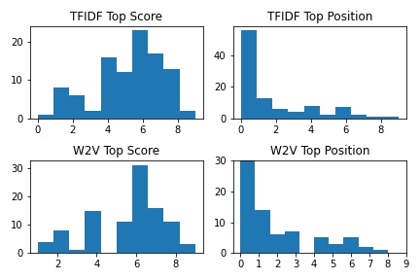
Comparing results: TFIDF vs W2V
Model Type Top Score Top Position
0 TFIDF 5.29 1.52
1 W2V 5.51 1.34
We can look at the percentage of entries that are above a threshold (a score of 6) or below a threshold (the high
score position is 3 or less)
Notes:
The standard way the help url results have been validated so far is to use the linking data set. For these incidents where there is an associated help url, we see what rank this ‘gold standard’ help url has in the results of the algorithm. Since we have >50k entries this gives us a robust method to evaluate the result by looking at the mean, median, percent in top 10, top 100, top 1000, …
Another way we have tried to establish the correctness of the results is to manually assign relevance scores to the top 10 help urls found for 200 incidents chosen from components that are most frequent
For the histogram above: for 100 incidents we get (using TFIDF and W2V) the top score and the position of the top score in the top 10. For the best result the top score would be 10 and the top position would be 0

Slide 3
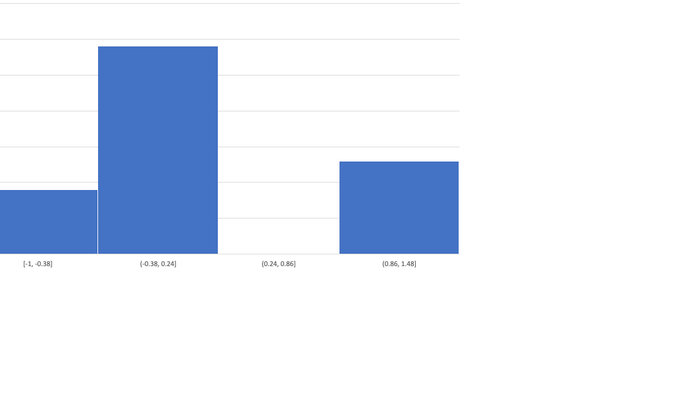
Testing Re-ranking on TFIDF

Slide 4
Combining feedback from Testers
Given the ranked lists of url’s provided by 2 different testers for a list of incident ids, for each incident id, we get the high
score in the top 10 and the position of the high score in the top 10
We can look at a scatter plot for the scores assigned – these should correlate well since testers should find (mostly
the same url’s to be most useful or high rank.
To correct for the bias that a tester may have or to adjust for the discrepancy between the scoring style of testers:
Pick a reference tester and use the median (M_0) of their high scores as a reference
Translate the scores of the other testers so they have the same median – if a tester is has median M_i, then
add the quantity (M_0 – M_i) to each high score for this tester
3. Do this separately for the high scores less than 5 and the high scores greater than 5

