Slide 1
Finding Your Best Candidate
ECE 595/495
Fall 2016
Abigail Jacoby
Alexander Roessner
Karthick Krishnamurthy
Suresh Babu Panem
Bharath Kumar Reddy Anandigari
Ravi Teja Gorti
Shawn Chavez

Slide 2
Elevator Pitch
How many times have you voted?
How many times did you not know who a candidate was?
If you knew a candidate, did you really know what they stand for?
Did you pull out your phone and look it up?
Because I did...

Slide 3
What the Web App Does
MyVote is an application that works similar to OKCupid
...except with politicians
Because who has time for that?

Slide 4
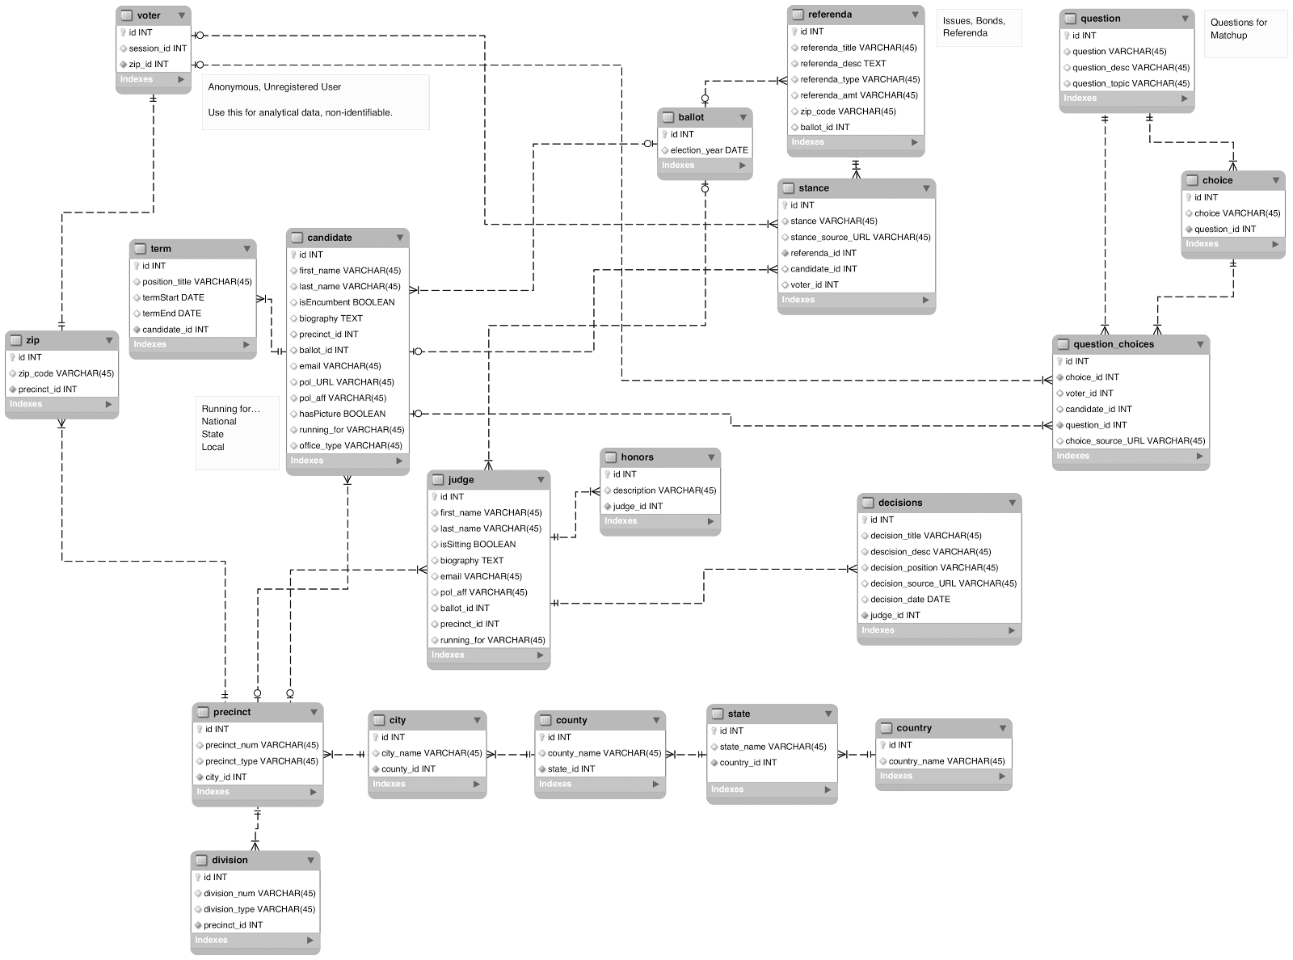
ERD

Slide 5
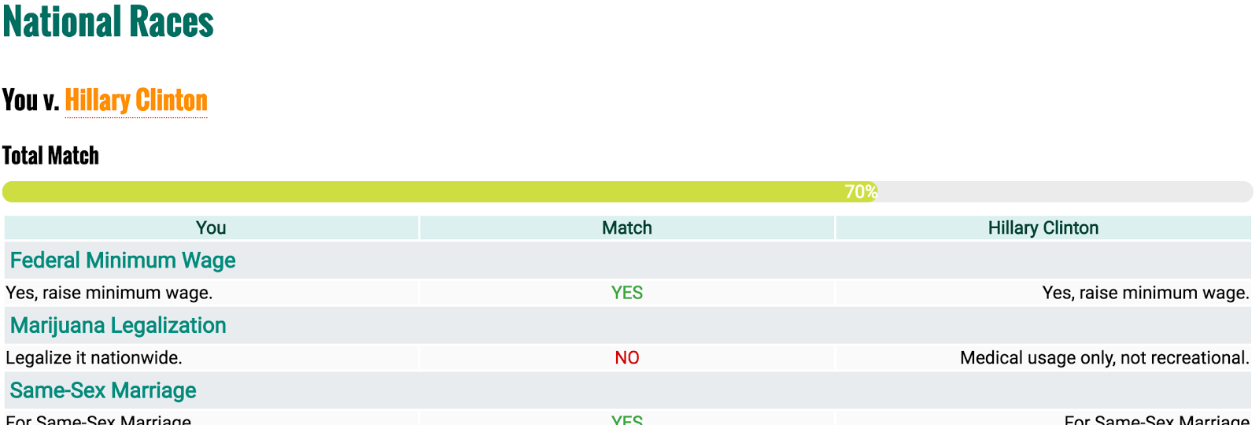
Matching Responses to Politicians
Get Array of Voter (User) responses
Get Array of Candidate’s responses to the same questions
Compare, increment, and calculate a total percentage match.
Display your answer and their answer side-by-side.
You may not agree 100% with a candidate’s position, but it may be closer than their opponent.

Slide 6
Seeded Data
So much data…
(23) ZIP Codes
(30) Districts
(63) Candidates
(11) Judges
(14) Bonds & Issues
(10) Questions
(550) Candidate Stances
…and this is just for one county

Slide 7
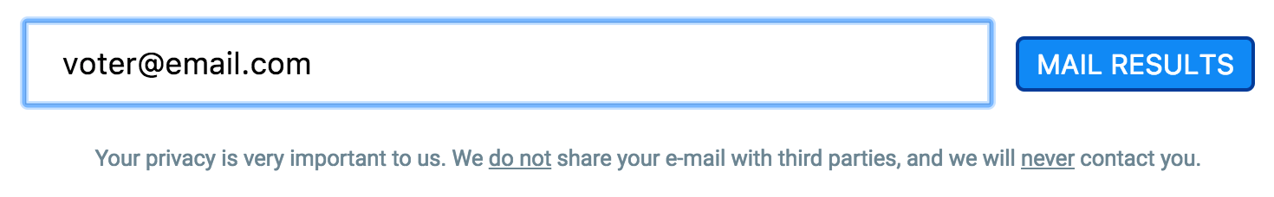
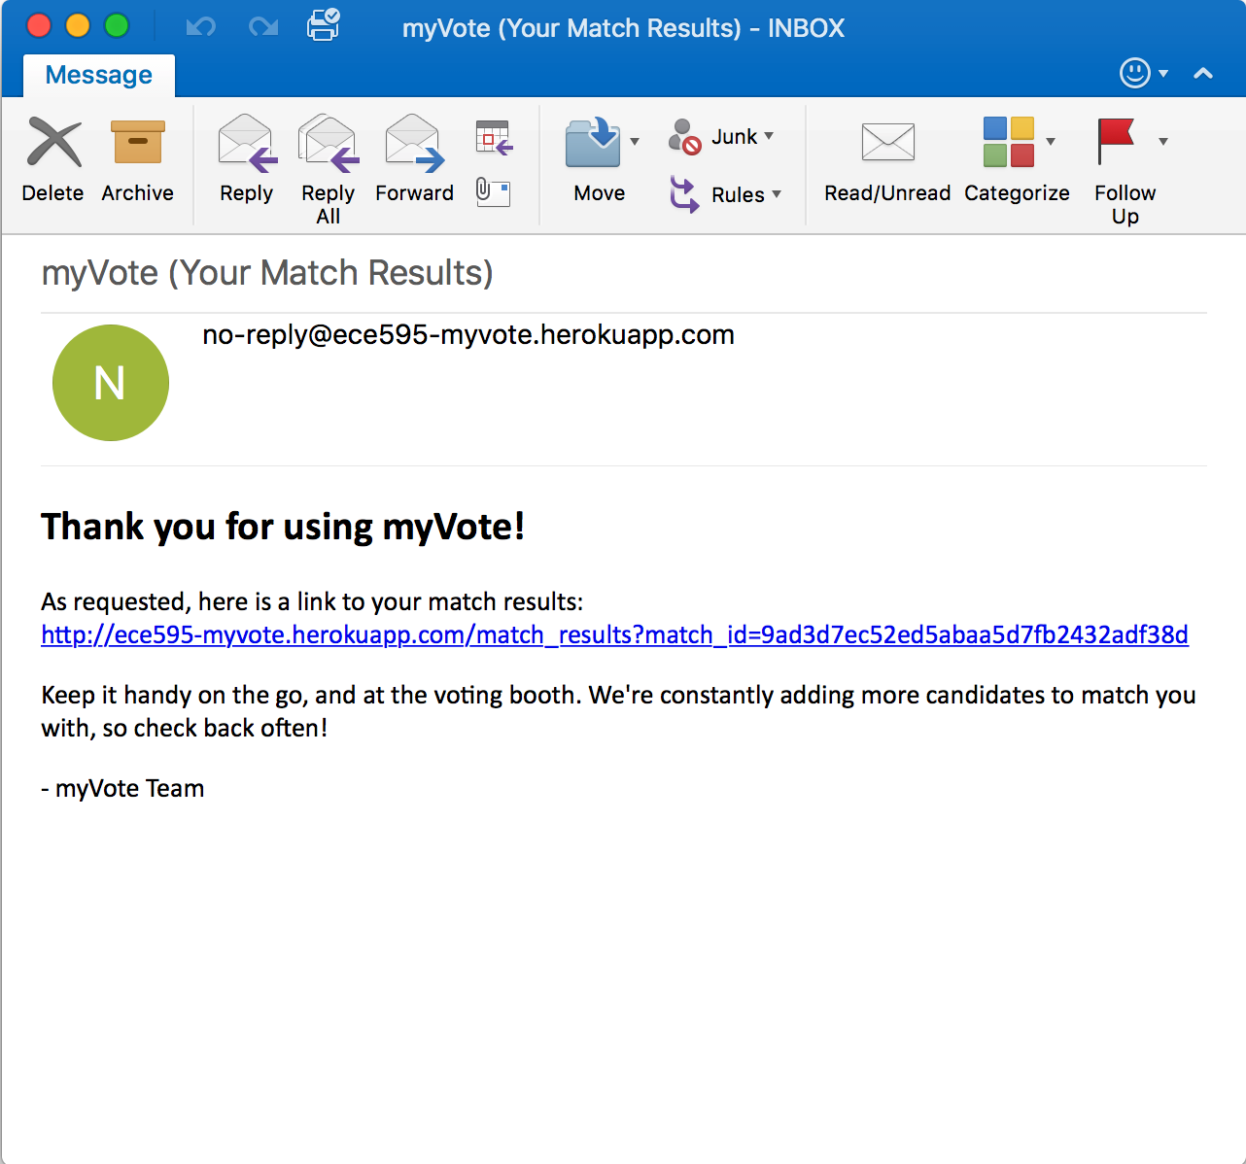
Combining Sessions and the Mailer
Session ID
Unique
Access match again without having to retake quiz.
Match results will update as database is continually populated.

Slide 8
Version 2.0?
Some ideas for the future of this application:
Ask for ZIP upfront, better for filtering on Candidates, Issues, Judges, and Bonds pages.
Expands benefits outside of the regular matching process.
Visualizations
Analyze data from those using the match tool
ZIP density maps (and ZIPs to potentially add)
Analyze user responses, see what voters in one ZIP, City, County, State, etc. care about

Slide 9
Live Demo!

