Slide 1
Graph Based Intelligent Movie Recommendation System Using RAG
Bharath Kumar A, Sriyavarma S, Venkata Siva Sai Krishna Prasad Y

Slide 2
Motivation
Traditional movie recommendations → collaborative filtering/content-based
Struggle with bias and lack of relationship understanding
Our approach involves:
Knowledge Graphs to capture rich relationships
Retrieval-Augmented Generation for better reasoning
Goal: Improve recommendation accuracy by leveraging KG structures
Notes:
Motivation behind our project:
Traditional recommendation systems mostly use:
Collaborative filtering, which looks at user behavior but struggles when there’s not enough data (like new users or new movies)
Content-based filtering, which recommends movies based on features like genre or actors, but it doesn’t understand deeper relationships
These methods often struggle with bias and a lack of reasoning. For example, they might recommend an action movie just because another one is labeled “action,” without knowing that both share the same director, theme Our idea was to overcome these limitations by:
Using a Knowledge Graph to model relationships between entities like movies, genres, actors, and users
And combining it with a language model that can reason over these facts through a RAG pipeline
Our goal is to build a system that’s not just matching based on keywords or ratings, but one that can actually reason over the relationships between people, genres, and movies leading to more accurate and explainable movie recommendations.

Slide 3
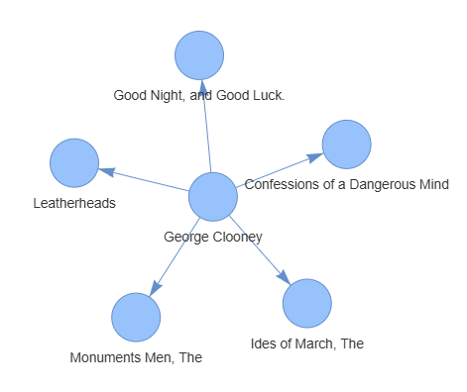
Dataset
Source: Neo4j “recommendations” dataset
Pre-built knowledge graph
Different types of relationships:
(:Movie)-[:IN_GENRE]->(:Genre)
(:User)-[:RATED]->(:Movie)
(:Actor)-[:ACTED_IN]->(:Movie)
(:Director)-[:DIRECTED]->(:Movie)
(:Person)-[:ACTED_IN|DIRECTED]->(:Movie)
(:Movie)-[:RELEASED]->(:Year)
Total number of nodes: 28865
Total number of relationships: 166262
(:Director)-[:DIRECTED]->(:Movie)
Notes:
Used cypher queries to extract triplets and relationships

Slide 4
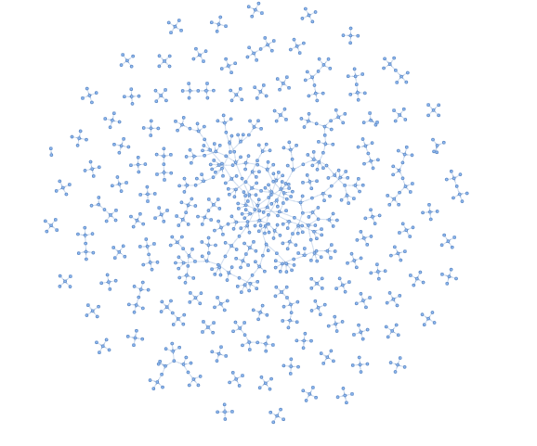
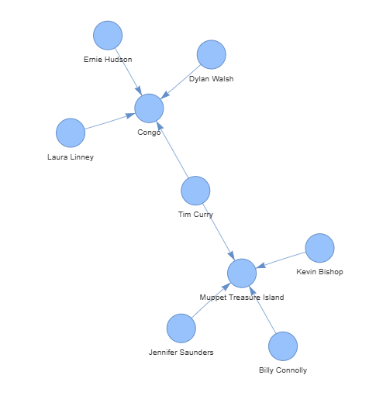
Dataset
(:Actor)-[:ACTED_IN]->(:Movie)
(:Actor)-[:ACTED_IN]->(:Movie)

Slide 5
Approach: FAISS + RAG Chain
FAISS
Facebook AI Similarity Search
Vector indexing: Finds vectors that are similar to a given vector
Supports CPU and GPU
RAG Chain
Retrieval Augmented Generation Chain
A pipeline used to combine retrieval based and generation based models to improve the performance of language tasks
Notes:
measuring distance or similarity between a given query vector and other vectors stored in a database

Slide 6
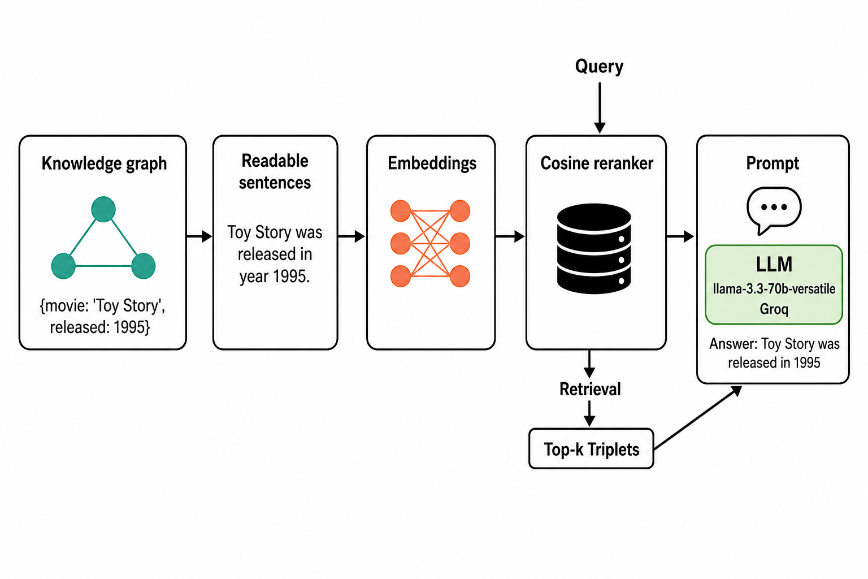
Architecture
{'movie': 'Toy Story', released: 1995}
Groq
Query
Notes:
We extract all relevant facts about movies, genres, actors, directors, and users from the knowledge graph using Cypher queries.
These facts are then used to create subject–predicate–object triplets for embedding and retrieval.
We loop through every movie and extract attribute-based facts, like:Year, budget,... After processing all the data, you generated:
→ 229,894 total triplets
After generating triplets, we converted them into plain English sentences.
This makes the knowledge easier for the language model to understand during the RAG process.
Sentences preserve the same factual meaning but are more suitable for embedding and retrieval.
These are then encoded into embeddings, stored in FAISS, and retrieved using vector similarity.
Finally, the top relevant sentences are passed to a language model to generate a grounded answer.

Slide 7
First Step: Building Knowledge Triplets
Extract (subject, predicate, object) triplets from Neo4j graph
{'movie': 'Toy Story', released: 1995}
('Toy Story', 'was released in year', '1995')
Total Triplets Created: 229,894
Convert triplets into human-readable sentences:
Toy Story was released in year 1995
Total Sentences: 229,894
Having a proper readable triplet allows for the retriever to understand reason over the information
Neo4j Graph
(subject, predicate, object)
(‘Toy Story’, ‘was released in year’, ‘1995’)
Toy Story was released in year 1995
Total Sentences: 229,894
Notes:
We did not build the graph manually, but used Cypher queries to extract meaningful facts as triplets from both relationships and node properties.
We extract all relevant facts about movies, genres, actors, directors, and users from the knowledge graph using Cypher queries.
These facts are then used to create subject–predicate–object triplets for embedding and retrieval.
We loop through every movie and extract attribute-based facts, like:Year, budget,... After processing all the data, you generated:
→ 229,894 total triplets
After generating triplets, we converted them into plain English sentences.
This makes the knowledge easier for the language model to understand during the RAG process.
Sentences preserve the same factual meaning but are more suitable for embedding and retrieval.
Example:
Triplet: ('Toy Story', 'was released in year', '1995')
Sentence: "Toy Story was released in year 1995"
Total Sentences Created: 229,894 (same as the number of triplets)

Slide 8
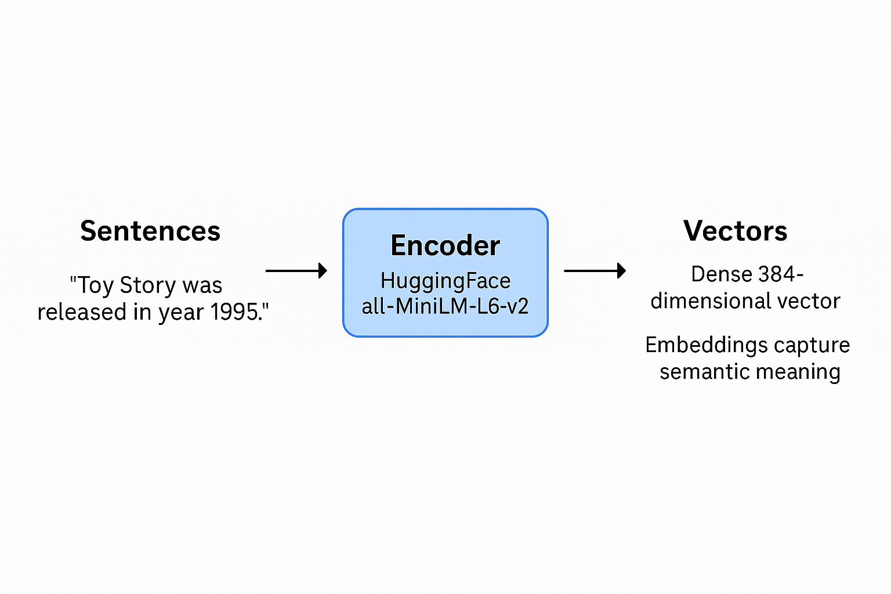
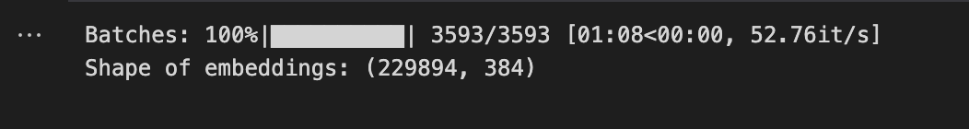
Second Step: Embedding Creation
Encode the readable triplet sentences into vector embeddings
Create an embedding model using HuggingFaceEmbeddings method
Each sentence → dense 384-dimensional vector
Embeddings captures semantic meaning
Notes:
encodes the meaning of the sentence
Used HuggingFace’s all-MiniLM-L6-v2 model to generate sentence embeddings
We use this model because it’s fast, lightweight, and accurate for sentence embeddings
We encode sentences to convert language into vectors, which allows semantic search in our RAG pipeline
Each plain English sentence (triplet) is converted into a 384-dimensional vector
This allows us to compare sentence meanings using vector similarity
Batch-encoded all 229,894 sentences
Final output shape: (229894, 384) Embeddings capture the semantic meaning of a sentence, meaning they reflect the actual idea or intent behind the text.
This helps our model find related triplets even if the user uses different words — for example, it knows that "acted in" and "features" are similar concepts.

Slide 9
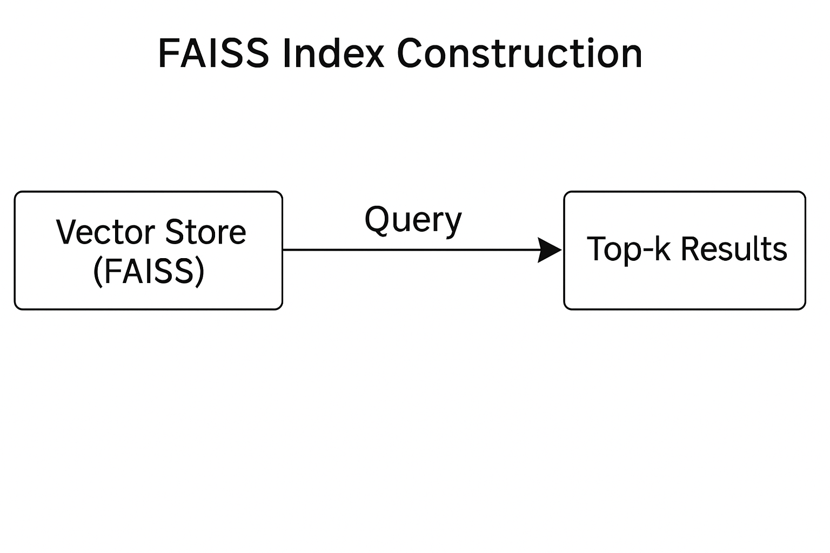

Third Step: FAISS Index Construction
FAISS (Facebook AI Similarity Search) for fast vector retrieval
Steps:
Store triplet embeddings into FAISS index
Index allows quick similarity search
Retriever function created to find top-k matching triplets for a query
Notes:
FAISS (Facebook AI Similarity Search) is a library developed by Facebook to perform fast similarity search on large sets of high-dimensional vectors.
One row = one sentence
One row contains 384 float numbers representing its semantic meaning
Creates a flat FAISS index using L2 distance (Euclidean distance) to compare embeddings Adds all 229,894 sentence embeddings into the FAISS index for efficient similarity search
Other options: FAISS Best for local, fast similarity search (what you used)
Chroma Python-native lightweight vector DB (great with LangChain)

Slide 10
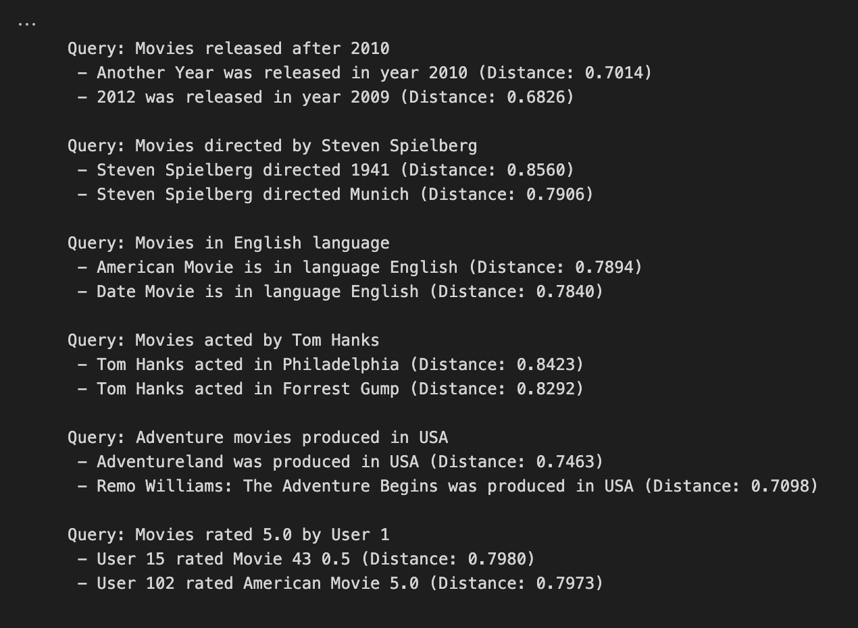
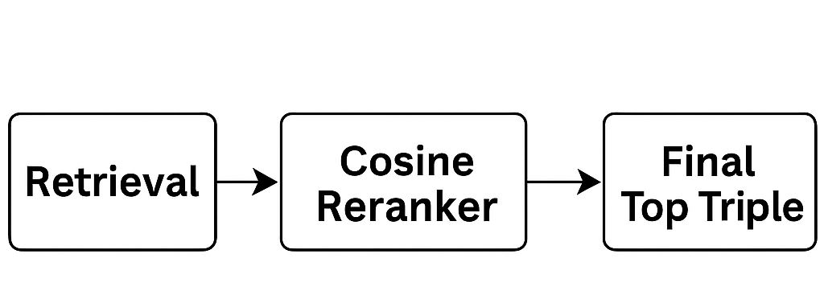
Step Four: Retrieval with Re-ranking
Initial retrieval from FAISS based on L2 distance
Re-ranking using cosine similarity (better matching)
Returns most relevant triplet sentences
Improves quality of context fed to LLM
Notes:
We created a simple retriever function that takes a user query, encodes it using our sentence embedding model, and searches the FAISS index for the top-k most similar triplet sentences.
This allows us to dynamically retrieve relevant facts from the graph in plain language, which can then be passed to the language model for answering the query.
We enhanced our retriever by adding a re-ranking step based on cosine similarity.
>Cosine similarity is better for meaning-based ranking than L2 distance
>The distance is a measure of how similar the retrieved sentence (triplet) is to your query in vector space.
A lower distance means the model retrieved a triplet that's closer in meaning to what the user asked.

Slide 11
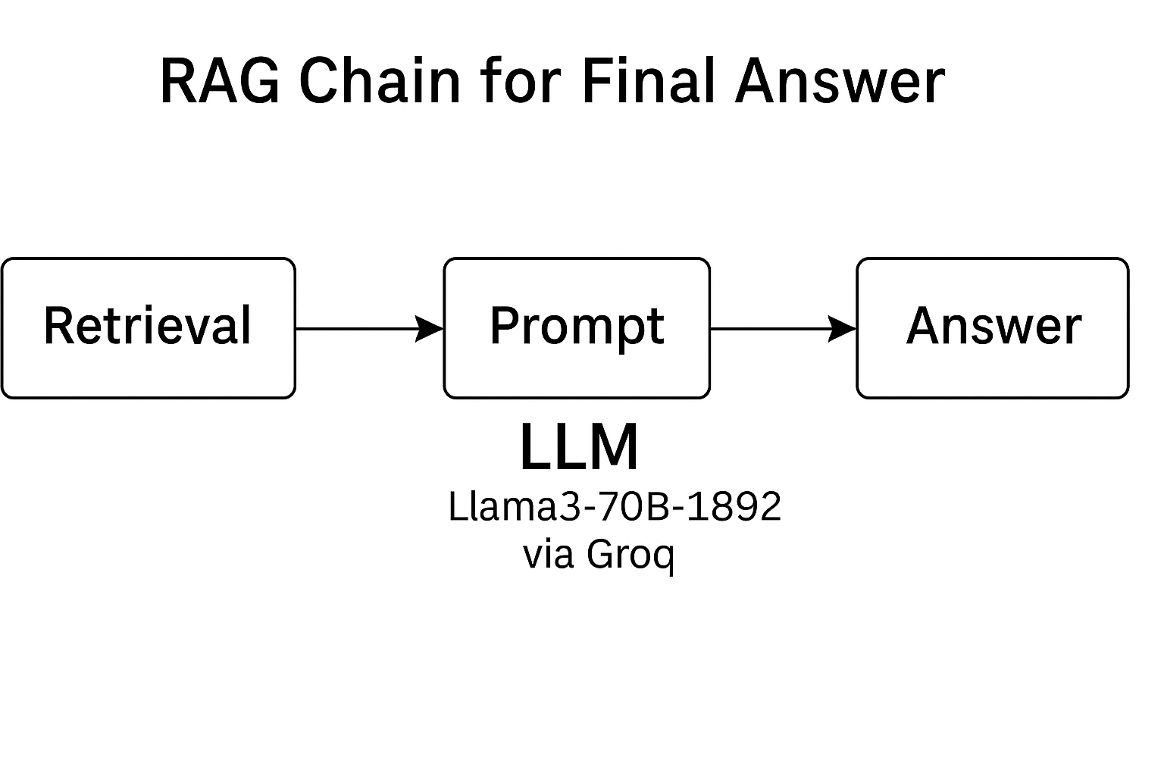
Step Five: RAG Chain for Final Answer
LLM Model: Llama-3.3-70b-versatile via Groq
RetrievalQA pipeline:
Retrieve top triplets
Pass to LLM along with user query
Generate grounded, fact-based answer
Combines retrieval + generation for better recommendations
Llama-3.3-70b-versatile via Groq
Notes:
Before building the RAG chain, we created a custom FAISS retriever with cosine re-ranking to evaluate how well our triplets matched user queries.
This helped us verify that the embeddings captured meaning correctly. Once validated, we integrated everything into LangChain's RetrievalQA chain, which handles retrieval and generation together.
>The user’s query is embedded and compared to all triplet sentence embeddings using FAISS
Top-k most relevant sentences (e.g., 500) are retrieved
>Retrieved facts are injected into a custom prompt:
Facts:
[triplets]
Question:
[user query]
Answer:
>The LLM (LLaMA3) processes both the query and the supporting facts
Outputs a natural language answer that is accurate and explainable

Slide 12
Results
Query: Find movies acted by Leonardo DiCaprio released after 2000
Model | Dataset
Answer: Based on the provided facts, here are the movies acted by Leonardo DiCaprio released after 2000: 1. Gangs of New York (2002) 2. Catch Me If You Can (2002) 3. The Aviator (2004) 4. Blood Diamond (2006) 5. The Departed (2006) 6. Revolutionary Road (2008) 7. Inception (2010) 8. Django Unchained (2012) 9. The Wolf of Wall Street (2013) 10. The Revenant (2015) | [{'title': 'Gangs of New York', 'year': 2002}, {'title': 'Catch Me If You Can', 'year': 2002}, {'title': 'Aviator, The', 'year': 2004}, {'title': 'Departed, The', 'year': 2006}, {'title': 'Blood Diamond', 'year': 2006}, {'title': 'Body of Lies', 'year': 2008}, {'title': 'Revolutionary Road', 'year': 2008}, {'title': 'Shutter Island', 'year': 2010}, {'title': 'Inception', 'year': 2010}, {'title': 'J. Edgar', 'year': 2011}, {'title': 'Django Unchained', 'year': 2012}, {'title': 'Great Gatsby, The', 'year': 2013}, {'title': 'Wolf of Wall Street, The', 'year': 2013}, {'title': 'The Revenant', 'year': 2015}]
Notes:
Model can’t get all answers because it has token limitations
Limitations come from model we use based on resources
Note key points in query

Slide 13
Results
Query: Can you recommend me a recent movie with Adventure genre and rating greater than 3 with actor leonardo dicaprio
Model | Dataset
Answer: Based on the provided data, I can recommend a recent movie with the Adventure genre and a rating greater than 3 that features Leonardo DiCaprio. The movie is "The Revenant" (2015), which has an IMDb rating of 8.0 and belongs to the Adventure genre. Leonardo DiCaprio stars in the film, which was directed by Alejandro G. Iñárritu. Please note that this recommendation is based on the provided data and might not reflect your personal preferences or opinions. | [{'title': 'The Revenant', 'year': 2015}, {'title': 'Blood Diamond', 'year': 2006}, {'title': 'Beach, The', 'year': 2000}, {'title': 'Man in the Iron Mask, The', 'year': 1998}]
Notes:
We tested our RAG chain with a complex query asking for a recent adventure movie with Leonardo DiCaprio and a rating above 3.
The model retrieved relevant triplets and correctly recommended The Revenant (2015) with an IMDb rating of 8.0.
This demonstrates that our system is capable of understanding and reasoning across multiple constraints to provide accurate movie recommendations.

Slide 14
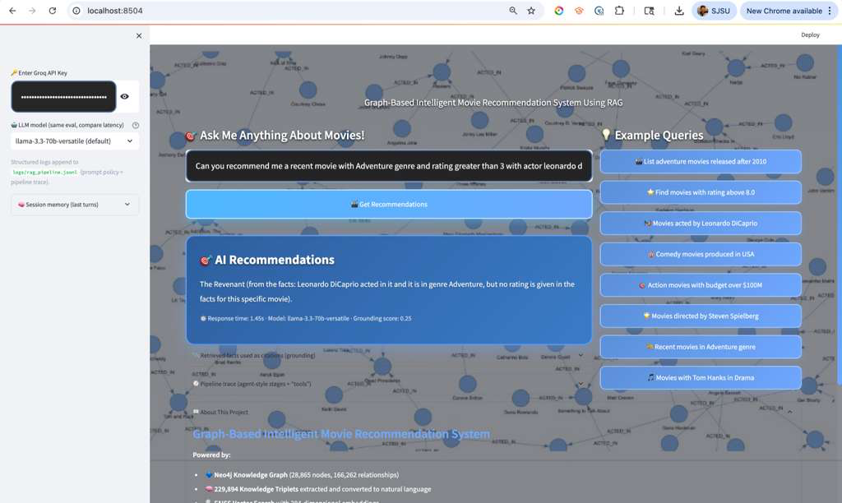
DEMO
A natural-language query is grounded with FAISS-retrieved triplets and answered by llama-3.3-70b-versatile with citations. Sidebar exposes model switching, latency, grounding score, and pipeline trace for evaluation-first transparency.
Notes:
We tested our RAG chain with a complex query asking for a recent adventure movie with Leonardo DiCaprio and a rating above 3.
The model retrieved relevant triplets and correctly recommended The Revenant (2015) with an IMDb rating of 8.0.
This demonstrates that our system is capable of understanding and reasoning across multiple constraints to provide accurate movie recommendations.

Slide 15
Evaluation of RAG System
Precision measures how many of the retrieved movies are actually correct.
Recall measures how many of the correct movies were successfully retrieved.
F1-Score balances both precision and recall.
Query: List adventure movies released after 2000 | Query: Find movies acted by Leonardo DiCaprio released after 2000 | Overall RAG System Performance
Precision@10: 0.60 Recall@10: 0.01 F1-score@10: 0.02 | Precision@10: 0.70 Recall@10: 0.50 F1-score@10: 0.58 | Average Precision@10: 0.65 Average Recall@10: 0.26 Average F1-score@10: 0.30
Notes:
To validate our RAG system, we tested it on example queries and compared its output to manually verified ground truth movie lists.
We used standard IR metrics: Precision@10, Recall@10, and F1-score.
This evaluation shows how well the system retrieves relevant results not just grammatically correct ones.
The “@10” in Precision@10 or Recall@10 means we’re evaluating only the top 10 results returned by the system.
This reflects real-world usage where users usually care about the top few recommendations. Our RAG system achieved an average Precision@10 of 0.65, meaning most of its top results were relevant.
However, the Recall@10 was 0.26, indicating that it missed many other relevant results.
This is expected in a top-10 evaluation setting. Our system is accurate but not exhaustive, and improving recall is part of our future work.
Overall, the system prioritizes accuracy over completeness.
In our evaluation, we used @10 metrics to focus only on the top 10 results the system returned — since that’s what a user would typically look at.
Precision@10 measures how many of those were correct, while Recall@10 checks how many ground truth answers were recovered within that top 10.
F1@10 balances the two.

Slide 16
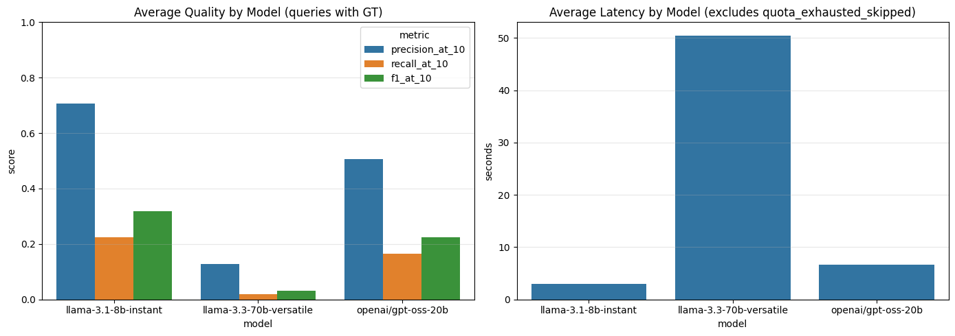
Extended Evaluation - 51 Queries × 3 Models
Evaluated three Groq LLMs on 51 queries with 15 Cypher-derived GT queries: llama-3.1-8b-instant (P@10=0.71, F1=0.32, 2.97s), openai/gpt-oss-20b (P@10=0.51, F1=0.23, 6.59s), and llama-3.3-70b-versatile (P@10=0.13, F1=0.03, rate-limited 5/51). 8B wins decisively on both quality and latency - an evaluation-driven model-selection finding.
Notes:
To validate our RAG system, we tested it on example queries and compared its output to manually verified ground truth movie lists.
We used standard IR metrics: Precision@10, Recall@10, and F1-score.
This evaluation shows how well the system retrieves relevant results not just grammatically correct ones.
The “@10” in Precision@10 or Recall@10 means we’re evaluating only the top 10 results returned by the system.
This reflects real-world usage where users usually care about the top few recommendations. Our RAG system achieved an average Precision@10 of 0.65, meaning most of its top results were relevant.
However, the Recall@10 was 0.26, indicating that it missed many other relevant results.
This is expected in a top-10 evaluation setting. Our system is accurate but not exhaustive, and improving recall is part of our future work.
Overall, the system prioritizes accuracy over completeness.
In our evaluation, we used @10 metrics to focus only on the top 10 results the system returned — since that’s what a user would typically look at.
Precision@10 measures how many of those were correct, while Recall@10 checks how many ground truth answers were recovered within that top 10.
F1@10 balances the two.

Slide 17
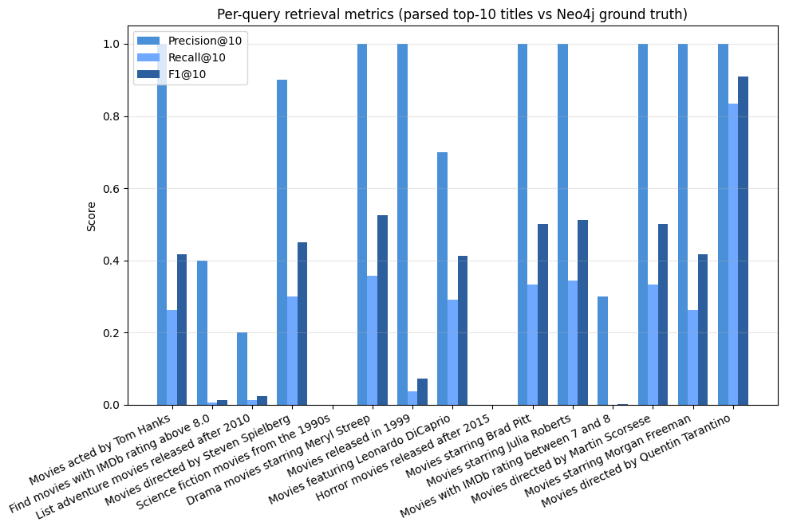
Extended Evaluation - 50 Queries × 3 Models
Notes:
To validate our RAG system, we tested it on example queries and compared its output to manually verified ground truth movie lists.
We used standard IR metrics: Precision@10, Recall@10, and F1-score.
This evaluation shows how well the system retrieves relevant results not just grammatically correct ones.
The “@10” in Precision@10 or Recall@10 means we’re evaluating only the top 10 results returned by the system.
This reflects real-world usage where users usually care about the top few recommendations. Our RAG system achieved an average Precision@10 of 0.65, meaning most of its top results were relevant.
However, the Recall@10 was 0.26, indicating that it missed many other relevant results.
This is expected in a top-10 evaluation setting. Our system is accurate but not exhaustive, and improving recall is part of our future work.
Overall, the system prioritizes accuracy over completeness.
In our evaluation, we used @10 metrics to focus only on the top 10 results the system returned — since that’s what a user would typically look at.
Precision@10 measures how many of those were correct, while Recall@10 checks how many ground truth answers were recovered within that top 10.
F1@10 balances the two.

Slide 18
Conclusion
Successfully combined Knowledge Graph triplets with RAG to enhance movie recommendations.
Overall, the system prioritizes accuracy over completeness.
Future Work:
Improve recall by retrieving more diverse triplets.
Explore hybrid RAG combining both plot embeddings and knowledge graph facts.
Fine-tune reranking models for better relevance scoring.
Expand to larger, real-world movie datasets.
Notes:
Retrieve more relevant triplets for each query. If narrow set of relevant triplets might miss useful information
Combine plot summaries and KG triplet facts during retrieval. Some queries better answered by plot
Fine-tuning how the candidate facts are ordered based on the most relevant ones first. Could use supervised learning?
Bigger datasets like IMDb or The Movie Database (TMDB)

Slide 19
References:
P. Lewis et al., “Retrieval-Augmented Generation for Knowledge-Intensive NLP Tasks,” arXiv.org, Apr. 12, 2021. https://arxiv.org/abs/2005.11401
A. Hogan et al., “Knowledge Graphs,” ACM Computing Surveys, vol. 54, no. 4, pp. 1–37, May 2022, doi: https://doi.org/10.1145/3447772.
“KG-Retriever: Efficient Knowledge Indexing for Retrieval-Augmented Large Language Models,” Arxiv.org, 2023. https://arxiv.org/html/2412.05547v1
L. S. Nair and J. Cheriyan, “Multi-Featured Movie Recommendation Using Knowledge Graph,” Jan. 2023, doi: https://doi.org/10.1109/idciot56793.2023.10053435.
Z. Xu et al., “Retrieval-Augmented Generation with Knowledge Graphs for Customer Service Question Answering,” 2024, doi: https://doi.org/10.1145/3626772.3661370.
“Example datasets - Getting Started,” Neo4j Graph Data Platform. https://neo4j.com/docs/getting-started/appendix/example-data/

Slide 20
Thank You
Any Questions?

