Slide 1
Static versus dynamic scheduling on a CPU + GPU workstation
Final benchmark: end-to-end makespan, same cost model on both sides
Real measurements on one laptop (6 P + 7 E workers, one RTX 3050 CUDA worker). Raspberry Pi out of scope.

Slide 2
Question and what was built
• Question: is a dynamic scheduler (ranking, late binding, feedback) faster than a fixed static plan from the same cost model - and when?
• Timing fixed: one end-to-end makespan = initialisation + planning + scheduling + execution (old makespan kept for comparison).
• Fair static baselines: HEFT, PEFT, HEFT with end-to-end terms, and an oracle-cost HEFT as a labelled reference.
• New dynamic policy PRED_RANK_GREEDY_E2E (adds artifact I/O and IPC terms; H2D/D2H are already inside the CUDA time, not added twice).
• GPU used only for stages/parameter regions verified in recorded speed-up measurements; one CUDA worker, no extra streams.
Notes:
The point of the final study is a fair comparison: the static and the dynamic schedulers use the same learned cost model, the same pools and the same GPU rules; only the time and way of deciding differs.

Slide 3
Setup
• Workload: image pipeline (source, denoise, edges, features, aggregate), 512 px; chains with light and heavy denoise.
• Primary workload: 16 heavy chains of 64, 25 blocks (24 analysed). Five more workloads of 13 blocks: uniform, 4 heavy, 40 heavy, light 15 and 40 iterations.
• Configurations: CPU only; strict GPU (original verified stages); extended GPU (plus denoise at verified iteration counts).
• Policies: static HEFT / PEFT / HEFT_E2E / oracle reference; dynamic B4, B4_param_first, PRED_RANK_GREEDY, PRED_RANK_GREEDY_E2E.
• Interleaved blocks, mains power and free-RAM checks, output verified for every run; paired bootstrap, Holm over 10 contrasts, +-2% equivalence margin.
Notes:
Calibration and hold-out sessions were run before, and kept separate from, the evaluation sessions. The protocol and design hashes were logged before the first evaluation run.

Slide 4
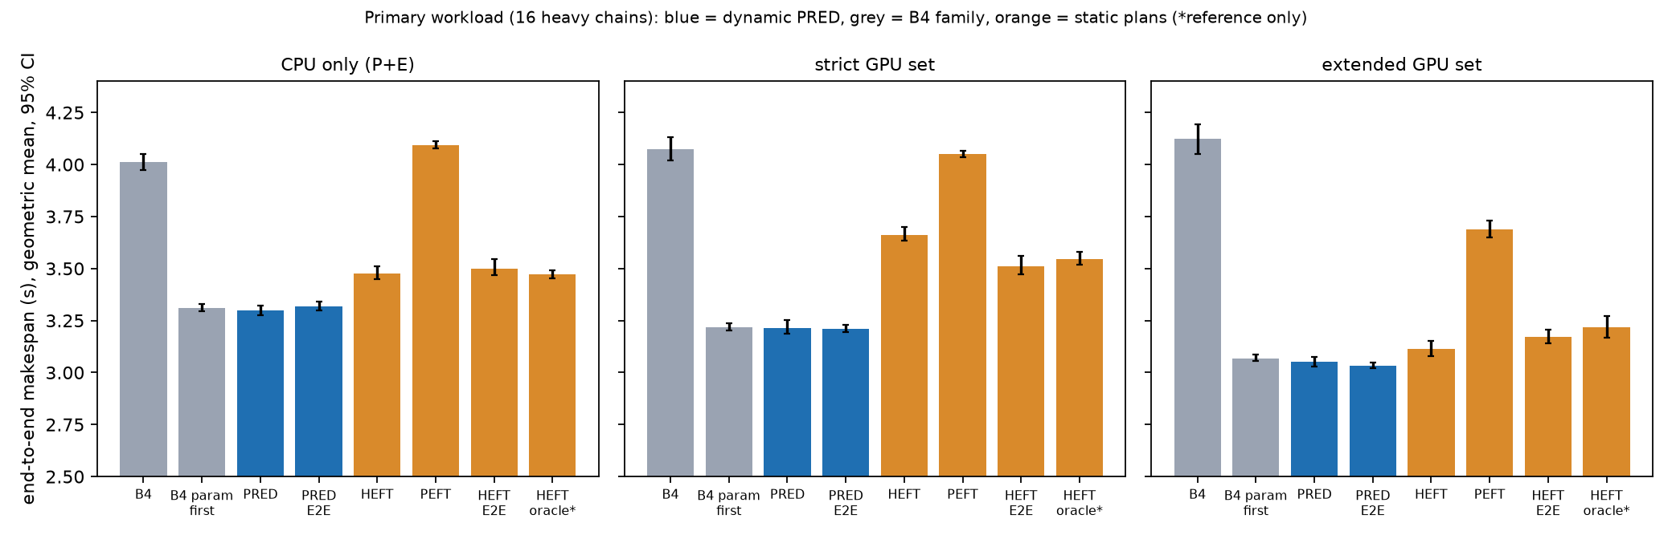
Primary result: end-to-end makespan
Extended GPU set: PRED_E2E 3.03 s, PRED 3.05 s, HEFT 3.11 s, B4 4.12 s.
Notes:
Lower is better. The orange bars are the static plans. The reference-only oracle uses class-median costs.

Slide 5
Confirmatory contrasts (Holm family of 10)
id | contrast | effect % [95% CI] | Holm p | classification
C1 | PRED vs B4, CPU | -17.8 [-18.8, -16.7] | 0.001 | faster
C2 | PRED_E2E vs PRED, CPU | +0.6 [+0.1, +1.3] | 0.141 | equivalent (CI inside +-2%)
C3 | PRED vs HEFT, CPU | -5.2 [-5.9, -4.6] | 0.001 | faster
C4 | PRED_E2E vs HEFT_E2E, CPU | -5.2 [-5.9, -4.5] | 0.001 | faster
C5 | PRED vs HEFT, strict GPU | -12.2 [-13.4, -11.1] | 0.001 | faster
C6 | PRED_E2E vs HEFT_E2E, strict GPU | -8.5 [-9.7, -7.6] | 0.001 | faster
C7 | PRED_E2E vs PRED, strict GPU | -0.0 [-0.7, +0.5] | 0.960 | equivalent (CI inside +-2%)
C8 | PRED vs B4, strict GPU | -21.2 [-22.6, -19.7] | 0.001 | faster
C9 | PRED strict GPU vs CPU | -2.6 [-3.3, -1.7] | 0.001 | faster
C10 | B4 strict GPU vs CPU | +1.6 [+0.2, +3.0] | 0.141 | inconclusive
Notes:
Predictions made before the data held for C1, C2, C7, C9, C10. C3 and C4 were predicted inconclusive or equivalent; the dynamic policy was faster by about 5%.

Slide 6
Across workloads (exploratory, unadjusted)
workload (CPU only) | PRED vs HEFT | PRED vs B4 | B4 s | PRED s | HEFT s
h16_l120 | -5.2% | -17.8% | 4.01 | 3.30 | 3.48
uniform | -0.2% | +0.0% | 2.30 | 2.30 | 2.31
h04_l120 | -2.4% | -39.4% | 3.84 | 2.33 | 2.39
h40_l120 | -4.8% | -2.8% | 6.15 | 5.98 | 6.28
h16_l40 | -3.2% | -4.8% | 2.48 | 2.36 | 2.43
h16_l15 | -1.4% | -0.7% | 2.04 | 2.03 | 2.06
Notes:
Negative = dynamic faster. The gap depends on the spread of task cost: it vanishes for the uniform workload.

Slide 7
GPU findings
• Verified speed-up records: edges 7.7x, features 2.9x, denoise 8 it 1.16x; denoise 2 it 0.99x dropped; 6/15/40/120 it 1.06-1.77x (512 px, incl. H2D/D2H).
• PRED extended set vs CPU only -7.5% [-7.8, -7.2]; strict set vs CPU only -2.6% [-3.3, -1.7] (C9).
• Blind B4 with the GPU: +1.6% [+0.2, +3.0] (C10, inconclusive) - the GPU does not help without a cost model.
• GPU cost model is the weakest part: 23-31% median error on hold-out (CPU 4-11%).
• One CUDA worker; the benefit comes from putting the right tasks on it.
Notes:
The GPU only helps when the right tasks are placed on it; blind B4 sends work to the GPU without a cost model and gains nothing.

Slide 8
Honest findings
• A hand-written parameter-aware rule (B4_param_first) is within 1% of PRED: most of the gain is parameter-aware choice, not ranking as such.
• The end-to-end cost terms changed nothing: C2 +0.6% [+0.1, +1.3], C7 -0.0% [-0.7, +0.5] (equivalent).
• On the uniform workload the policies tie; PRED_E2E on the strict GPU set was slower than B4 (exploratory).
• Hybrid B4/PRED selector: not justified (best possible gain 1.1% over always using PRED).
• PEFT is clearly the slowest static plan; adding end-to-end terms to HEFT did not help consistently.
Notes:
These are the points a reviewer will ask about. A hand-written rule that knows the hidden parameter gets almost the same gain as the learned scheduler.

Slide 9
Remote worker and limits
• Remote worker: emulated only (loopback node behind a delay shim); on a fast link no benefit, on a slow link blind placement was harmful; not rerun with the final policies.
• One machine, one workflow family, 512 px; confirmatory only for the primary workload; other five are exploratory.
• GPU estimates are rough, so part of the static-vs-dynamic gap on GPU configurations may be model error.
• Static oracle reference uses class medians, not realised per-run times.
• No Raspberry Pi or real-network result.
Notes:
Remote results are emulation from the earlier study and were not rerun with the final policies.

Slide 10
Contribution
• A reproducible end-to-end timing convention and benchmark that compares static and dynamic scheduling with the same cost model on a CPU+GPU workstation.
• Per-task GPU eligibility derived from recorded speed-up measurements, with the GPU transfer cost counted exactly once.
• Result: the dynamic policy is faster than the static plan by -5.2% (CPU) to -12.2% (strict GPU) on the primary workload, ties blind B4 where task cost does not vary, and a simple parameter-aware rule gets nearly the same gain.
• Everything is logged, hashed and reproducible; failures and superseded files are kept.

