Slide 1
Claim-Level Hallucination Detection System
LLM answer → atomic claims → evidence retrieval → selective NLI verification
Python · PyTorch · Transformers · BM25 + FAISS RAG · FastAPI · React
v5 · one held-out FEVER test pass · all eight preregistered gates passed
github.com/abhassen44/hallucination_detector_LLM
Served path uses the fixed calibrated rule; the learned detector stays offline.

Slide 2
PROBLEM
Why claim-level verification?
• Whole-response scoring hides compound answers: one LLM reply can be partly supported and partly fabricated.
• We assess each atomic factual claim individually, not the response as a whole.
• Three-way verdict with evidence: SUPPORTED, CONTRADICTED, or INSUFFICIENT.
• Not-enough-info (NEI) is the hardest class — a wrong answer is worse than a calibrated abstention.
• Serving must therefore be selective: answer only when evidence supports a verdict.
Datasets & corpus
• FEVER claims (train / val / test)
• 247,848-sentence Wikipedia corpus
• HaluEval QA for transfer analysis
• RAGTruth span-level annotations
• Silver labels — research only
LLM answer
Gemma/Ollama extraction
Atomic claims
subject-predicate-object
Per-claim verdicts
3-way + evidence
Claim-Level Hallucination Detection System — v5
2

Slide 3
SYSTEM
Pipeline architecture
1 · Claim extraction
Ollama LLM JSON pipeline
2 · Hybrid retrieval
BM25 + BGE dense (RRF)
3 · Evidence fusion
top-k sentence evidence
4 · Verification
DeBERTa NLI + similarity
5 · Selective policy
frozen 0.7 / 0.95 rule
6 · Verdict & UI
FastAPI + React
• Claims are deduplicated and mapped to concise factual propositions before retrieval.
• Retrieval fuses lexical BM25 with dense BGE embeddings over a 247,848-sentence Wikipedia corpus; strict Recall@5 reaches 90.2% (dense).
• Verification combines DeBERTa-v3 NLI with BGE semantic similarity; oracle-evidence accuracy is 94.3%.
• The selective policy abstains on low-confidence claims; the app serves the fixed calibrated rule, never the learned model.
• The FastAPI app serves the built React UI on one origin (/verify, /retrieve, /detect, /health).
Claim-Level Hallucination Detection System — v5
3

Slide 4
VERSIONS
Research evolution v1 → v5
Version | Focus | Outcome
v1 | Learned verifier (logistic regression on NLI, similarity, retrieval features) | Test: macro-F1 0.702 vs 0.633 fixed rule
v2 | Temperature scaling + selective policy + abstention flag | Test: Brier / abstention gates failed → stays offline
v3 | Vector scaling + answerability booster, richer diagnostics | Val only — no test pass spent
v4 | Cross-encoder rerank + 9k train + NEI tuning | Val only — no test pass spent (negative result)
v5 | MiniCheck grounding features + answerability head + robust policy | Test: all eight preregistered gates passed
Discipline: exactly one FEVER test pass in total; every earlier version stopped on validation.
Claim-Level Hallucination Detection System — v5
4

Slide 5
RESEARCH
v5 method: grounding-aware NEI
Grounding features
MiniCheck MC-LLM / HHEM
NLI + similarity
DeBERTa-v3 + BGE
Answerability head
HGB, distilled from policy
Robust policy
frozen thresholds (τ = 0.62)
Verdict / abstain
abstain → INSUFFICIENT
• MiniCheck grounding scores judge each claim against its retrieved evidence and become calibrated features.
• A distilled answerability head models when NEI claims can reliably be answered.
• The robust policy maps abstentions to INSUFFICIENT and keeps answered precision high.
• Frames: 9,000 train / 999 val / 1,998 test; frozen before the single test pass.
Serving boundary
Served app → fixed 0.7 / 0.95 rule
Learned v5 → offline research only
No serving promotion of v5.
Claim-Level Hallucination Detection System — v5
5

Slide 6
RIGOUR
Evaluation protocol
• FEVER splits: 3,000 train / 999 val / 1,998 test claims; 666 per class at test time.
• One test pass total: pipeline, features, thresholds, and seeds frozen in experiments/v5/freeze.json before the run.
• Eight preregistered gates evaluated on test: macro-F1, INSUFFICIENT F1, answerability AUROC, Brier, overall precision / coverage, verifiable precision / coverage, NEI coverage.
• Metric hygiene: FEVER claim-level metrics are kept separate from HaluEval answer-level and RAGTruth span-level metrics.
• Labels are silver (LLM-proposed), so no human-adjudication claim is made.
Freeze checklist
✓ Feature set locked
✓ Thresholds frozen
✓ Seeds fixed
✓ Gates predeclared
✓ Single test execution
✓ Predictions archived
Claim-Level Hallucination Detection System — v5
6

Slide 7
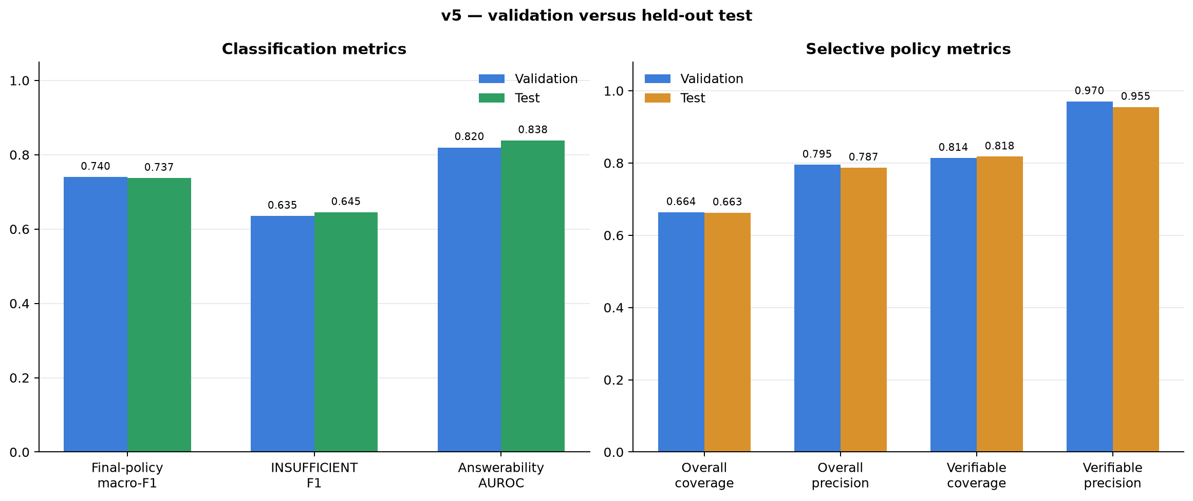
RESULTS
Held-out test results (1,998 claims)
Metric | Value
Macro-F1 | 0.7369
Accuracy | 0.7372
SUPPORTED F1 | 0.8601
CONTRADICTED F1 | 0.7059
INSUFFICIENT F1 | 0.6448
Answerability AUROC | 0.8381
Brier / ECE | 0.3752 / 0.0218
Verifiable precision @ coverage | 0.9550 @ 0.8176
Validation vs test — v5 generalises without val-tuned inflation.
Claim-Level Hallucination Detection System — v5
7

Slide 8
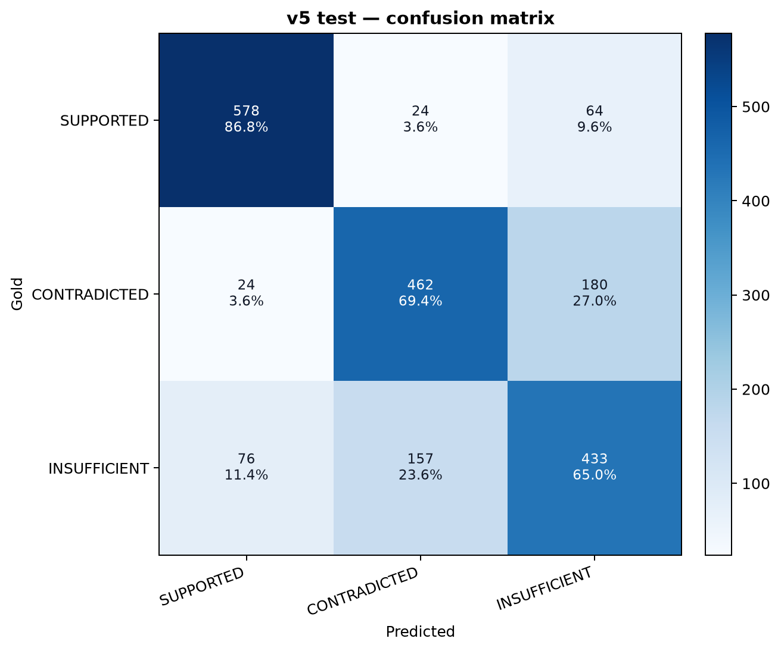
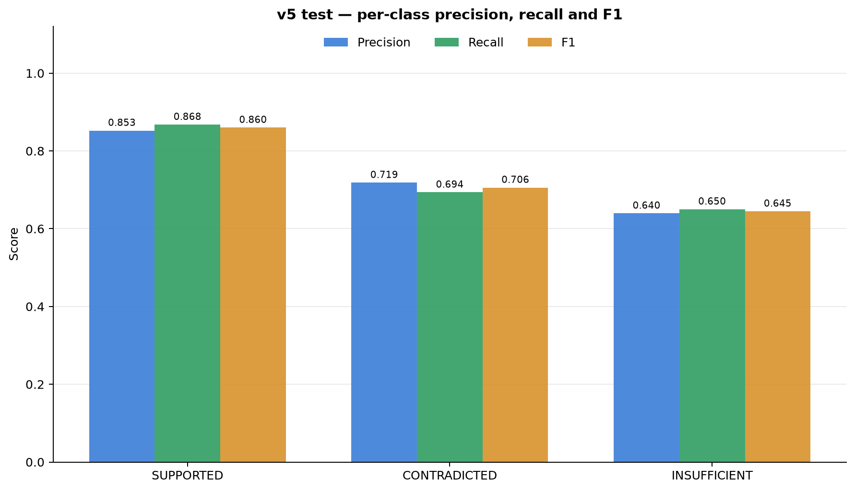
RESULTS · DEEP DIVE
Per-class behaviour and confusion
SUPPORTED is strong; CONTRADICTED/INSUFFICIENT trade off.
Main confusions: INSUFFICIENT ↔ CONTRADICTED.
Claim-Level Hallucination Detection System — v5
8

Slide 9
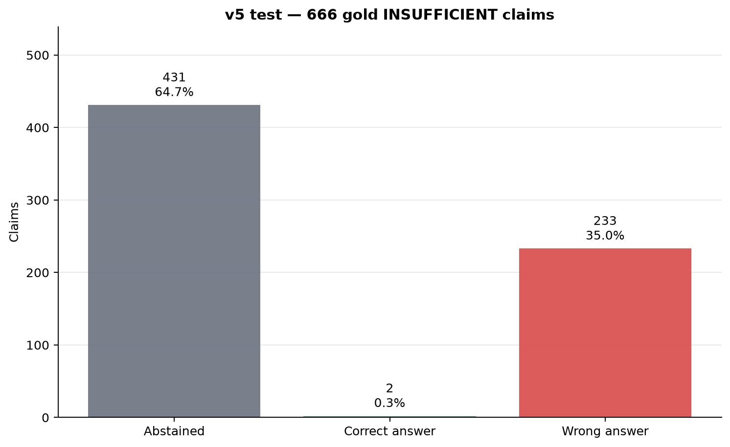
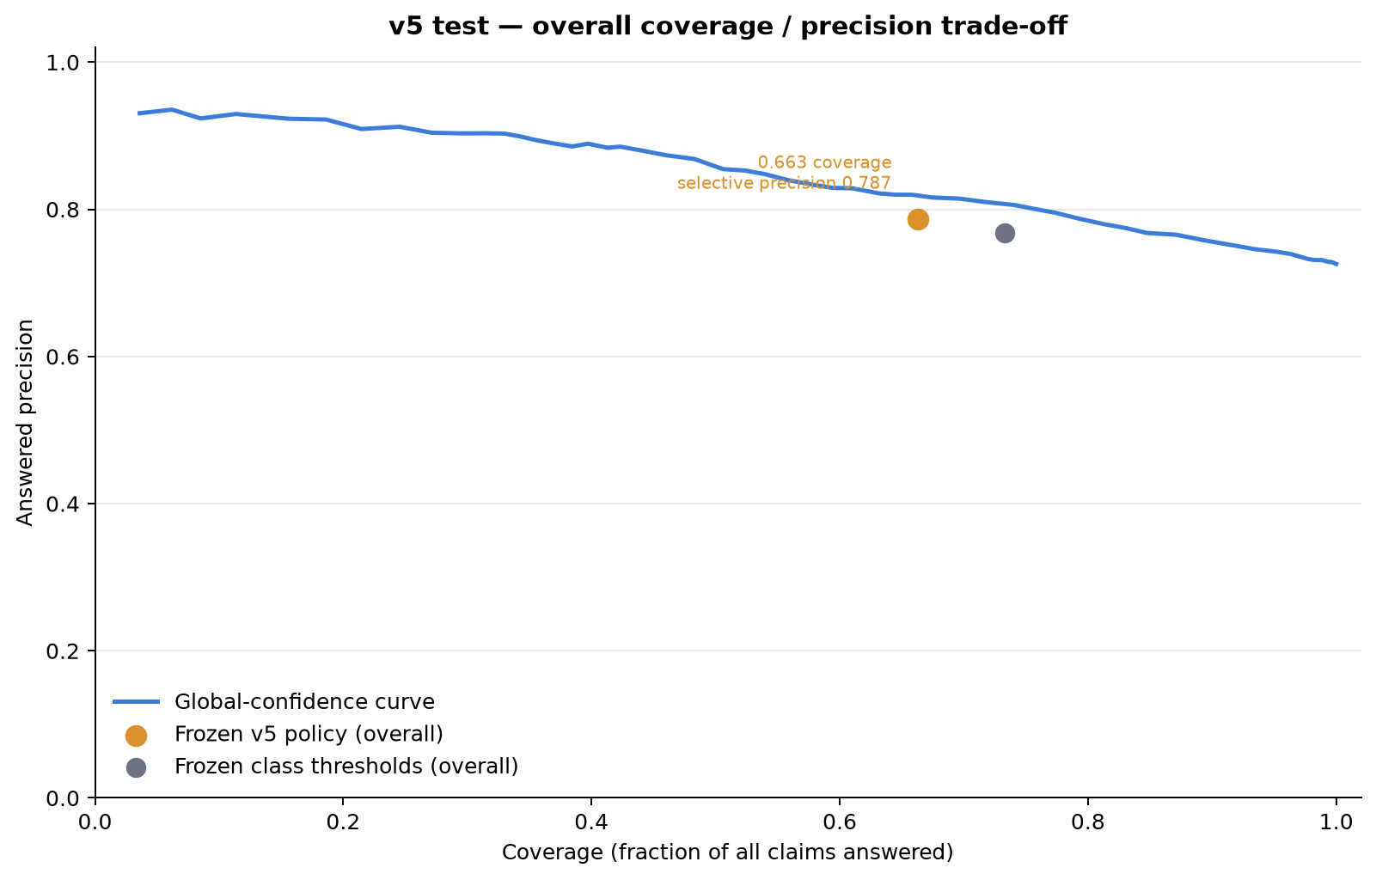
ERROR ANALYSIS
NEI outcomes and the risk–coverage trade-off
• Of 666 NEI claims: 431 abstained (64.7%), 2 answered correctly, 233 answered wrong — answered NEI precision is only 0.85%.
• Effective verifiable accuracy ≈ 0.8176 × 0.9550 ≈ 0.781 — the policy buys precision with coverage.
Claim-Level Hallucination Detection System — v5
9

Slide 10
SERVING
Application: FastAPI + React demo
React client
bounded 240 s calls
FastAPI app
v0.3.1 hardened
Endpoints
/verify · /retrieve · /detect
Pipelines
extraction → RAG → policy
Response
verdict + evidence citations
• Two modes: Wikipedia retrieval evidence and user-supplied source verification.
• Hardened: request IDs, CORS local allowlist, nosniff / cache headers, safe metrics parsing, 503 handling with build command.
• Serialized inference keeps GPU work stable; the built React bundle is served on one origin.
Correctness of the demo
• 163 Python + 7 frontend tests
• Live smoke tests: /health, /, /charts,
/verify, /retrieve, /detect
• Serves the fixed 0.7 / 0.95 rule —
learned detector stays offline
Claim-Level Hallucination Detection System — v5
10

Slide 11
CLOSE
Limitations and conclusion
• v5 is the best research version but is NOT promoted to serving; the fixed calibrated rule remains the served path.
• NEI answer precision is still poor (0.85%); abstention covers most NEI claims instead of answering them.
• Labels are silver; there is no human-adjudication claim, and NER/NN latency for the learned path is unmeasured.
• Overall answered precision is 0.787 at 0.663 coverage — useful, but not production vetting.
Conclusion & next steps
Evidence-grounded, selective claim verification works and is honest about its boundary. Next: improve NEI answer quality, human validation of a sample, latency gates, and an optional opt-in grounded verifier port (defaults off).
Claim-Level Hallucination Detection System — v5
11

