Slide 1
A Matrix-Based Algorithm for MWE Extraction
Orhan Bilgin

Slide 2
Overview
An algorithm to extract/discover MWEs in a corpus:
node-based
uses a fixed window
knowledge-poor
computationally efficient
Compares observed frequencies to expected frequencies
Main idea: Detect the frequency anomalies that occur at the starting and ending points of a MWE
Developed as part of a PhD project on MWEs in Turkish
Lancaster University, Linguistics and English Language, supervised by Dr. Andrew Hardie

Slide 3
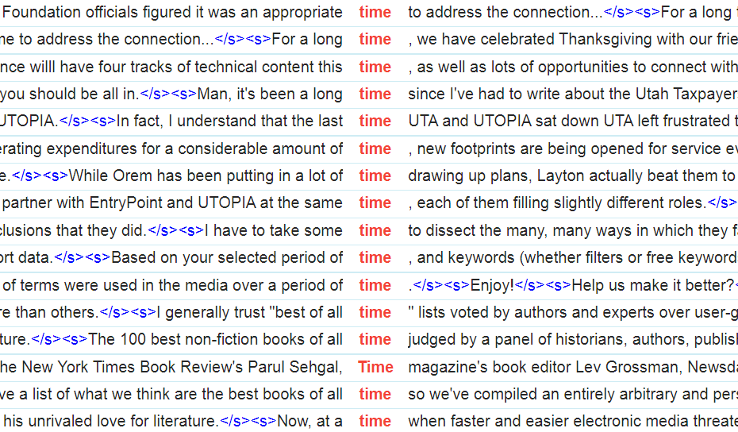
Concordances

Slide 4
Concordances
time occurs 58,071,539 times in the EnTenTen20 corpus available at Sketch Engine
The following demo uses 50,000 of them, i.e. less than 0.1%

Slide 5
Concordances
reverse the state of the "Reopen Windows when logging back in" checkbox, but I have found that it does not react reliably at the time of this writing with version 10.7's initial release. Lastly, there are a few other ways of dealing with the Resume feature for

Slide 6
Window size
reverse the state of the "Reopen Windows when logging back in" checkbox, but I have found that it does not react reliably at the time of this writing with version 10.7's initial release. Lastly, there are a few other ways of dealing with the Resume feature for

Slide 7
Window size
not react reliably at the time of this writing with version

Slide 8
Observed frequencies
RIGHT CONTEXT
 | time
time | 49,875
LEFT CONTEXT
not react reliably at the time of this writing with version

Slide 9
Observed frequencies
 | time | of
time | 49,875 | 2,280
not react reliably at the time of this writing with version

Slide 10
Observed frequencies
 | time | of
time | 49,875 | 2,280
the | 7,102
not react reliably at the time of this writing with version

Slide 11
Observed frequencies
 | time | of
time | 49,875 | 2,280
the | 7,102 | 1,161
not react reliably at the time of this writing with version

Slide 12
Observed frequencies
 | time | of
time | 49,875 | 2,280
the | 7,102 | 1,161
at | 2037
not react reliably at the time of this writing with version

Slide 13
Observed frequencies
 | time | of | this | writing | with | version
time | 49,875 | 2,280 | 41 | 19 | 1 | 1
the | 7,102 | 1,161 | 33 | 17 | 1 | 1
at | 2037 | 691 | 29 | 16 | 1 | 1
reliably | 1 | 1 | 1 | 1 | 1 | 1
react | 1 | 1 | 1 | 1 | 1 | 1
not | 1 | 1 | 1 | 1 | 1 | 1
not react reliably at the time of this writing with version

Slide 14
Observed frequencies
 | time | of | this | writing | with | version
time | 49,875 | 2,280 | 41 | 19 | 1 | 1
the | 7,102 | 1,161 | 33 | 17 | 1 | 1
at | 2037 | 691 | 29 | 16 | 1 | 1
reliably | 1 | 1 | 1 | 1 | 1 | 1
react | 1 | 1 | 1 | 1 | 1 | 1
not | 1 | 1 | 1 | 1 | 1 | 1
not react reliably at the time of this writing with version

Slide 15
Nesting problem
United Nations
Nations Children’s
Children’s Fund
United Nations Children’s Fund
United Nations Children’s
Nations Children’s Fund

Slide 16
Nesting adjustment
 | time | of | this | writing | with | version
time | 49,875 | 2,280 | 41 | 19 | 1 | 1
the | 7,102 | 1,161 | 33 | 17 | 1 | 1
at | 2037 | 691 | 29 | 16 | 1 | 1
reliably | 1 | 1 | 1 | 1 | 1 | 1
react | 1 | 1 | 1 | 1 | 1 | 1
not | 1 | 1 | 1 | 1 | 1 | 1
not react reliably at the time of this writing with version

Slide 17
Nesting adjustment
 | time | of | this | writing | with | version
time | 49,875 | 2,280 | 41 | 19 | 1 | 1
the | 7,102 | 1,161 | 33 | 17 | 1 | 1
at | 2037 | 691 | 29 | 16 | 1 | 1
reliably | 1 | 1 | 1 | 1 | 1 | 1
react | 1 | 1 | 1 | 1 | 1 | 1
not | 1 | 1 | 1 | 1 | 0 | 1
not react reliably at the time of this writing with version

Slide 18
Nesting adjustment
 | time | of | this | writing | with | version
time | 49,875 | 2,280 | 41 | 19 | 1 | 1
the | 7,102 | 1,161 | 33 | 17 | 1 | 1
at | 2037 | 691 | 29 | 16 | 1 | 1
reliably | 1 | 1 | 1 | 1 | 1 | 1
react | 1 | 1 | 1 | 1 | 1 | 1
not | 1 | 1 | 1 | 0 | 0 | 1
not react reliably at the time of this writing with version

Slide 19
Nesting adjustment
 | time | of | this | writing | with | version
time | 49,875 | 2,280 | 41 | 19 | 1 | 1
the | 7,102 | 1,161 | 33 | 17 | 1 | 1
at | 2037 | 691 | 29 | 16 | 1 | 1
reliably | 1 | 1 | 1 | 1 | 1 | 1
react | 1 | 1 | 1 | 1 | 1 | 0
not | 1 | 1 | 1 | 0 | 0 | 1
not react reliably at the time of this writing with version

Slide 20
Nesting adjustment
 | time | of | this | writing | with | version
time | 41,654 | 1,111 | 6 | 2 | 0 | 0
the | 4,595 | 466 | 3 | 1 | 0 | 0
at | 1,346 | 662 | 13 | 15 | 0 | 0
reliably | 0 | 0 | 0 | 0 | 0 | 0
react | 0 | 0 | 0 | 0 | 0 | 0
not | 0 | 0 | 0 | 0 | 0 | 0
not react reliably at the time of this writing with version

Slide 21
Nesting adjustment
 | time | of | this | writing | with | version
time | 41,654 | 1,111 | 6 | 2 | 0 | 0
the | 4,595 | 466 | 3 | 1 | 0 | 0
at | 1,346 | 662 | 13 | 15 | 0 | 0
reliably | 0 | 0 | 0 | 0 | 0 | 0
react | 0 | 0 | 0 | 0 | 0 | 0
not | 0 | 0 | 0 | 0 | 0 | 0
not react reliably at the time of this writing with version

Slide 22
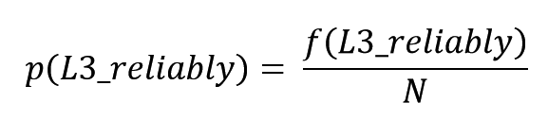
Expected frequencies
Definition 1: The probability of observing a given token at a given positions approximated by dividing the number of times that token occurs at that position by the number of ngrams included in the analysis:
not react reliably at the time of this writing with version

Slide 23
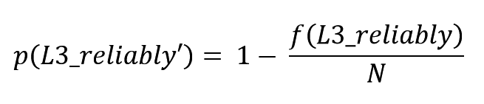
Expected frequencies
Definition 2: The probability of not observing a given token at a given position is approximated by taking the complement of the probability of observing that token in that position:
not react reliably at the time of this writing with version

Slide 24
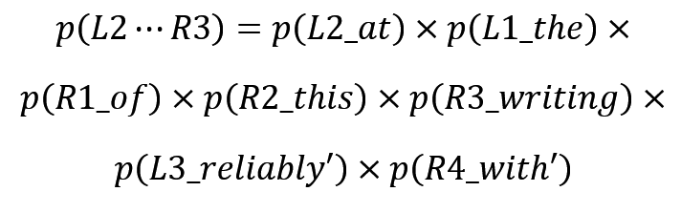
Expected frequencies
Definition 3: The expected probability of observing a sequence L_{m}…R_{n} is approximated by multiplying the probabilities of observing each token in the sequence, the probability of not observing L_{m+1}, and the probability of not observing R_{n+1}:
not react reliably at the time of this writing with version

Slide 25
Expected frequencies
 | time | of | this | writing | with | version
time | 40,818 | 1,946 | 8 | 0 | 0 | 0
the | 6,046 | 288 | 1 | 0 | 0 | 0
at | 729 | 34 | 0 | 0 | 0 | 0
reliably | 0 | 0 | 0 | 0 | 0 | 0
react | 0 | 0 | 0 | 0 | 0 | 0
not | 0 | 0 | 0 | 0 | 0 | 0
not react reliably at the time of this writing with version

Slide 26
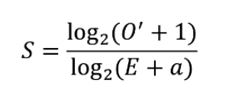
Scores

Slide 27
Scores
 | time | of | this | writing | with | version
time | 1.01 | 0.93 | 0.85 | 1.58 | 0.00 | 0.00
the | 0.97 | 1.08 | 1.26 | 1.00 | 0.00 | 0.00
at | 1.09 | 1.81 | 3.81 | 4.00 | 0.00 | 0.00
reliably | 0.00 | 0.00 | 0.00 | 0.00 | 0.00 | 0.00
react | 0.00 | 0.00 | 0.00 | 0.00 | 0.00 | 0.00
not | 0.00 | 0.00 | 0.00 | 0.00 | 0.00 | 0.00
not react reliably at the time of this writing with version

Slide 28
Candidate selection
Each concordance line produces zero or more MWE candidates
Candidates are then forwarded to the score aggregation and ranking stage.
Two parameters:
number of candidates to be selected from each score matrix
minimum score required for being selected

Slide 29
Score aggregation
Aggregate the scores of the MWE candidates selected by the individual concordance lines
Three methods:
add-one: increment aggregate score by one every time a given candidate is selected
add-score: increment aggregate score by the candidate’s score in S every time it is selected
max: aggregate score is equal to the highest score a candidate obtained in any of the score matrices that selected it

Slide 30
Experiment parameters
nesting adjustment: yes, no
score matrix: expected, aggregate
length adjustment on score matrix: yes, no
different values for correction factor a: 2, 4, 8
different values for c: 1, 2, 3
different values for t: 0, 0.5, 1, 2
score aggregation method: add-one, add-score, max
2 × 2 × 2 × 3 × 3 × 4 × 3 = 864 possible parameter combinations
Run algorithm once for each parameter combination and calculate precision against human-annotated gold standard

Slide 31
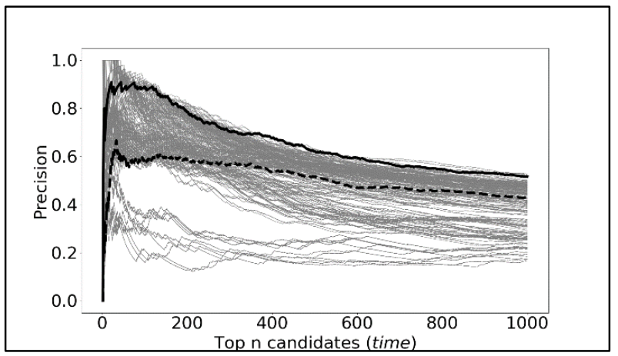
Evaluation

Slide 32
Evaluation
Best-performing version:
nesting adjustment: yes
comparison method: expected freq.
length adjustment: none
correction factor: 2
number of candidates: 1
score threshold: 0
score aggregation method: add-one
generates top-50 precision values between 0.71 and 0.88 on Turkish and English data
performs better than the baseline method even at n=1000

Slide 33
Top 30 candidates for time
1. at the same time | 16. at any time
2. from time to time | 17. for some time
3. for the first time | 18. in time
4. at the time | 19. in real time
5. this time | 20. at the time of
6. for a long time | 21. it is time to
7. over time | 22. of time
8. at that time | 23. during this time
9. at this time | 24. at a time when
10. for the first time | 25. every time
11. all the time | 26. of all time
12. most of the time | 27. the time
13. a lot of time | 28. and at the same time
14. at the time of the | 29. for the time being
15. at a time | 30. at the right time

Slide 34
Conclusion
The algorithm generates a separate set of matrices for each concordance line
This allows it to locally select only those sub-sequences that have the highest probability of being a MWE
This prevents the remaining subsequences from ‘contaminating’ the statistics
This ensures a dramatic reduction in the amount of data to be considered during score aggregation and ranking

Slide 35
Conclusion
Strengths
Requires little to none linguistic knowledge
Can deal with MWEs of any length
Can deal with MWEs of any type
Is computationally efficient
Weaknesses
Cannot deal with discontinuous MWEs
Cannot deal with positional variation

Slide 36
Thank you!
orhan@zargan.com

