Slide 1


Git - Fast Version Control System
Presentation By: Aseem Jain

Slide 2

Agenda (apart from fun)
Visualize “GIT Vs SVN”
What is Delta Storage ?
GIT Work Flow
GIT Architecture
Branching
Merge and Rebase
Dictator Model
Getting GIT Remote Repository
Git Help
Demos

Slide 3

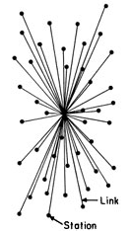
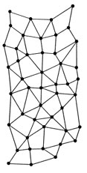
Visualize SVN Vs GIT
KEY POINTS :
SVN is vulnerable to corruption
SVN repository should have better backup plans
SVN cannot work with low network speed.
SVN consumes more space
SVN is not scalable if your bases is of 1000s user
SVN, if build is failed every one is stuck
SVN, if central code is diluted all code fades out
SVN, for collaboration code has to be checked in
http://www.youtube.com/watch?v=ntTpM8hfl_E&feature=related

Slide 4
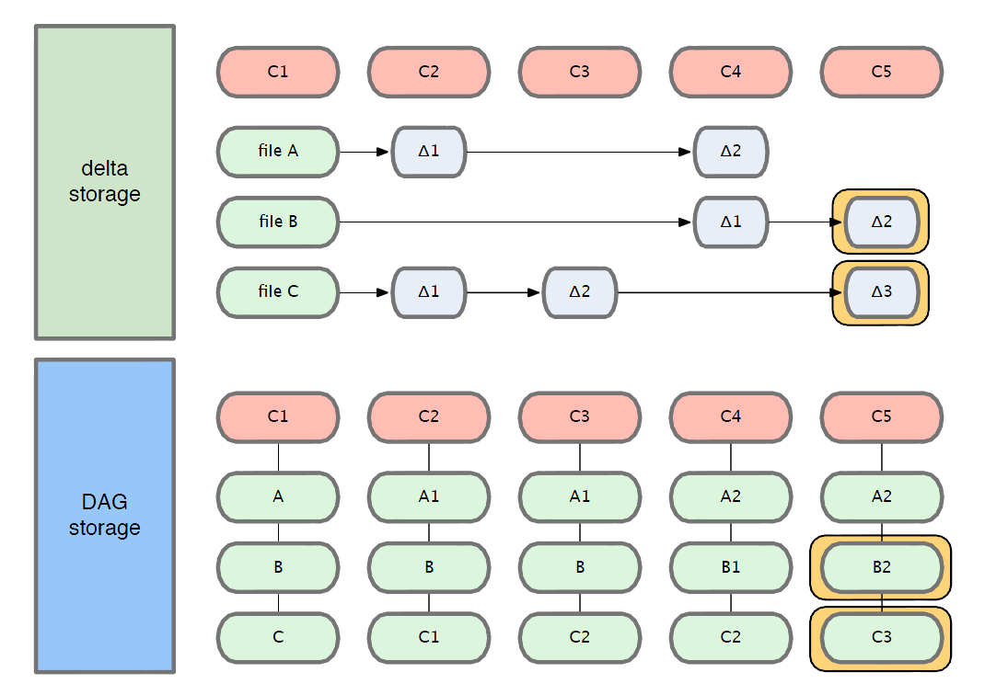
What is Delta Storage ?
Instead of saving or replacing entire file, only differences are saved and tracked.

Slide 5
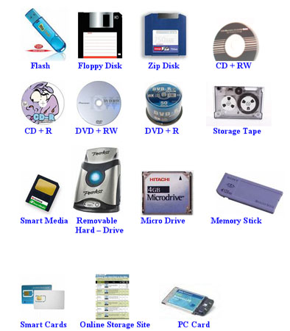
Git portability – (Svn corruption problem)
Svn is vulnerable to corruption even when the OS or media is not changed. However the git can be ported on daily basis to different media without corruption, it is robust it will be up after 10 years.
Animation – P 483
https://github.com/premaseem/precisionlms

Slide 6
Git Architecture
Index
Stores information about current working directory and changes made to it
Object Database
Blobs (files)
Stored in .git/objects
Indexed by unique hash
All files are stored as blobs
Trees (directories)
Commits
One object for every commit
Contains hash of parent, name of author, time of commit, and hash of the current tree
Tags

Slide 7
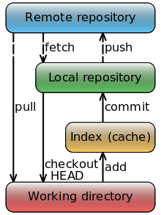
Git Workflow
Fetch or clone (create a copy of the remote repository) (compare to cvs check out)
Modify the files in the local branch
Stage the files (no cvs comparison)
Commit the files locally (no cvs comparison)
Push changes to remote repository (compare to cvs commit)

Slide 8
Git Local repository
add
commit
Working tree
(sand box)
Index
(cache)
Object
store
pull, push
Other Repositories

Slide 9
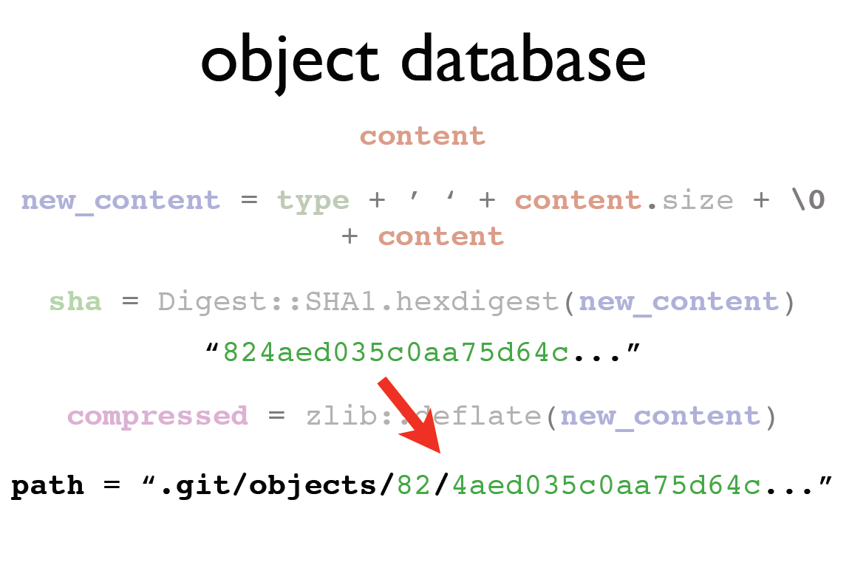
How Git object Database works
Entire version history, branch data and content are hashed, compressed and stored locally to make it faster better and easy to share.

Slide 10
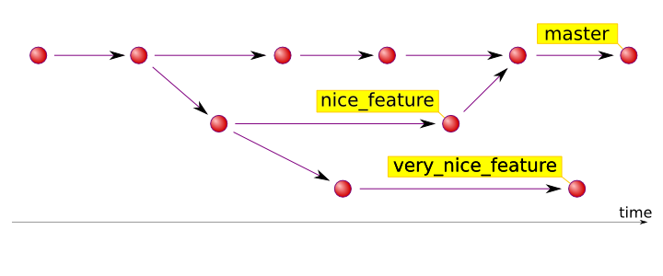
Branching(context switching)
Light weight(delta) No massive copying can be switched can be local/remote can be shared commit specific branch

Slide 11
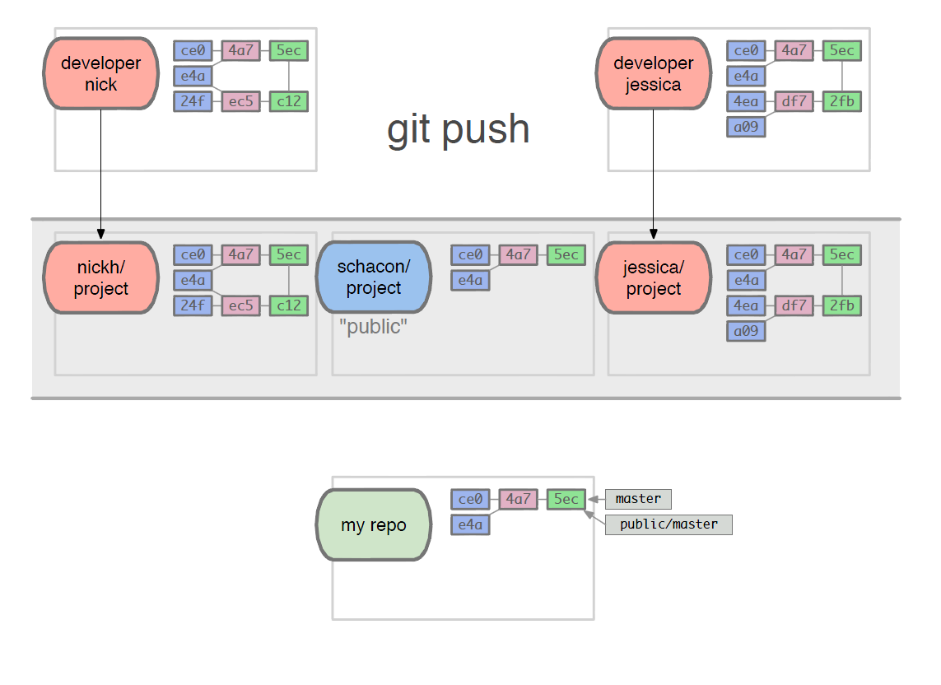
Multiple remote repository
Instead of sticking to one central repository, git helps to deal with multiple remote repository
Refer – p 188

Slide 12
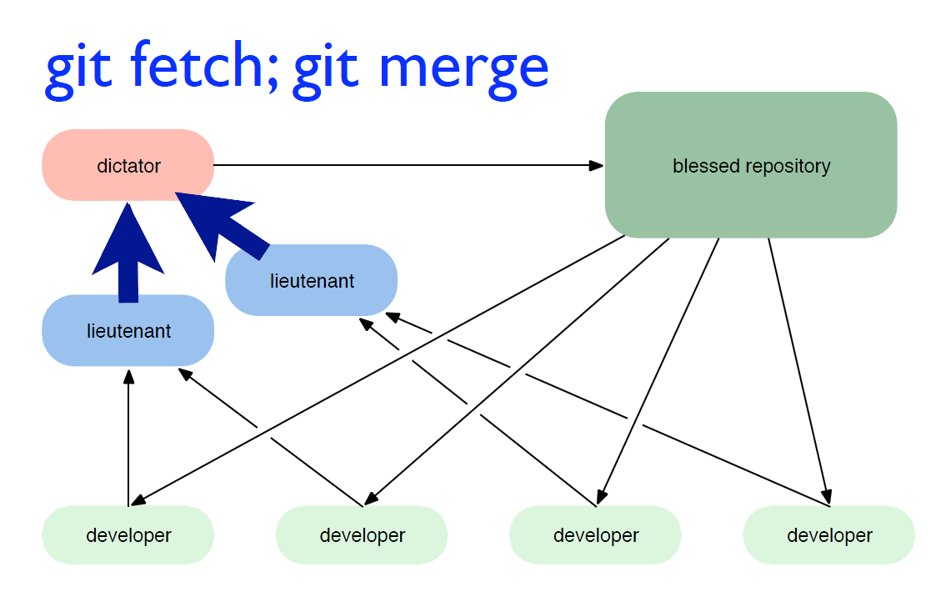
Dictator model
The workflow demonstrated here solves the problem of multiple projects working on same codebase.
Animation – P 483
https://github.com/premaseem/precisionlms

Slide 13
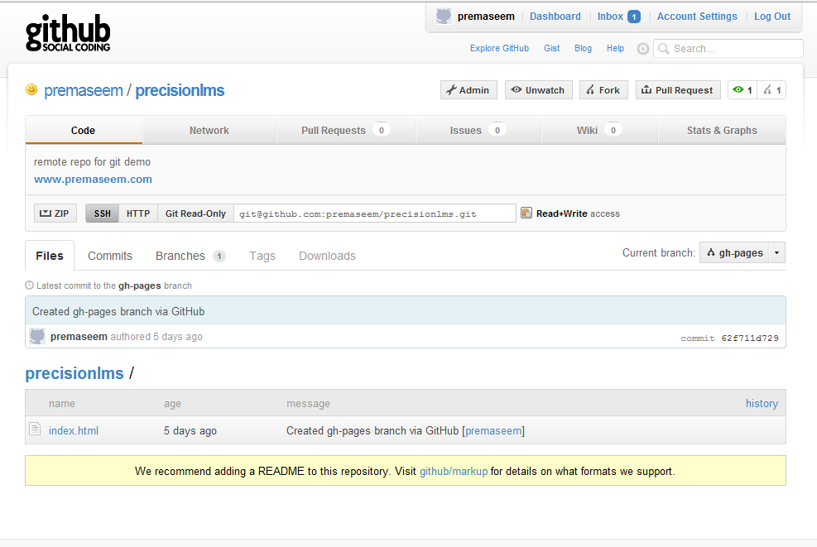
Getting Git Remote Repository
Getting git remote repository which is free. It has simple login, configuration than you get the remote location to open you code base to rest of the world for contribution.
(Pizz application)
Demo
https://github.com/premaseem/precisionlms

Slide 14
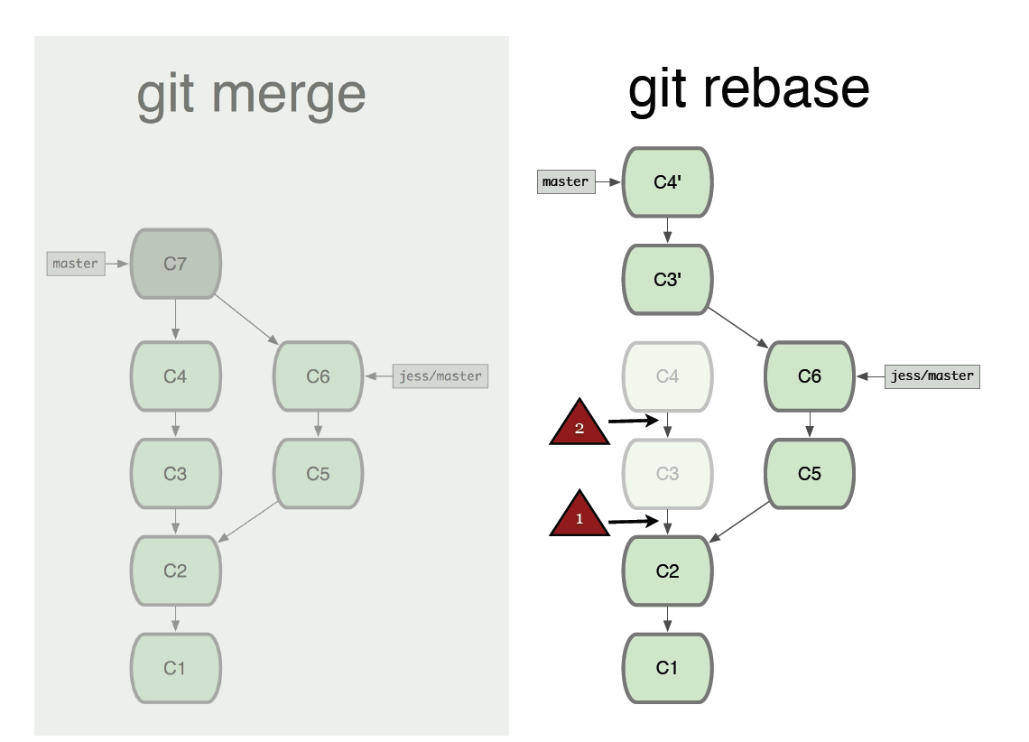
Git Merge and Rebase
With SVN you are compelled to merge and some time gets frustrated to loose or rewrite what you were doing. Git will help you to rebase and continue without distraction
Refer – p 213

Slide 15
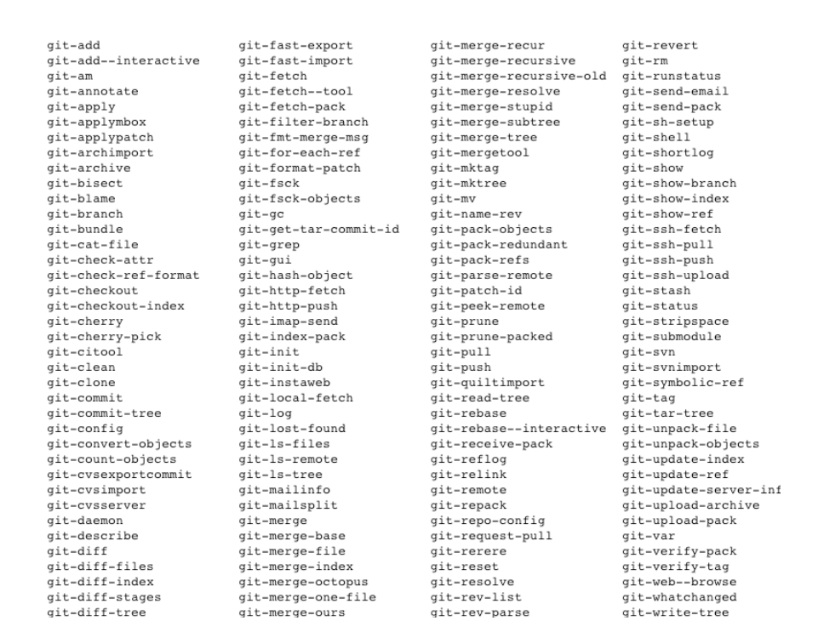
Blog link for details of git commands : http://premaseem.wordpress.com/2011/11/16/git-commans/
152 Git Commands

Slide 16
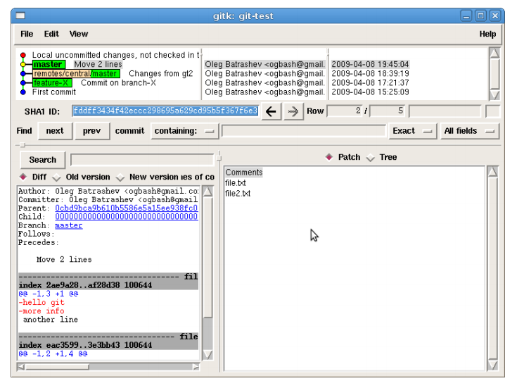
Blog link for details of git commands : http://premaseem.wordpress.com/2011/11/16/git-commans/
GIT – “GUI”
Graphic User Interface

Slide 17
Some GIT Disadvantages
Definite learning curve, especially for those used to centralized systems
- Can sometimes seem overwhelming to learn ☺
Documentation mostly through man pages

Slide 18

How to get help with git
Read That Fabulous Manual http://www.kernel.org/pub/software/scm/git/docs/user-manual.html
Books http://progit.org/book/ (free)
Online training: https://github.com/training/online
Git user groups online http://old.nabble.com/git-f12403.html
Git mailing lists git-users@googlegroups.com
link: www.premaseem.com/git

Slide 19
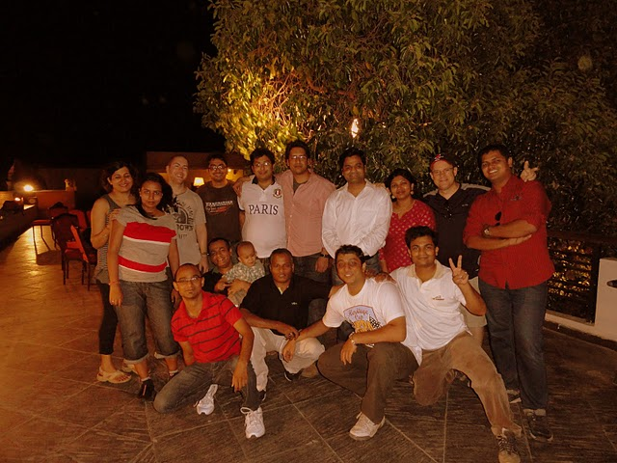
Team Question ?
?

Slide 20
To download this presentation visit : www.premaseem.com/git

