Slide 1
Roles Mapping
By default:
Simple Content Management System
-> Only a content writer and a manager.
-> Content writer can add data, edit it & is private by default but it can be published by him.
-> Manager has choice to edit any content, make it private or publish it.
Many other type of role mapping is allowed, one of them is

Slide 2
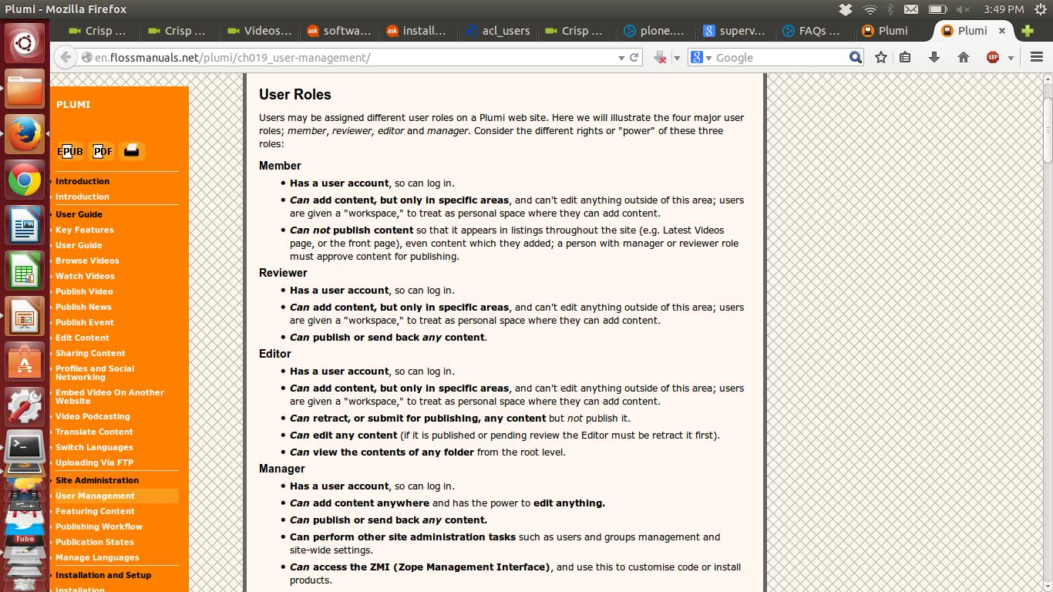
User roles and management

Slide 3
The default publishing workflow on Plumi
A Member creates content - it is automatically submitted for publishing when it is saved.
At this point any of these things could happen:
The Member could retract the content, choosing to re-edit it and re-submit it for publishing, or choose to make it private (where it is not viewable to anyone else but the owners of that content, or a Manager) or in the public draft state (where it is viewable, but not included in site listings such as Latest Videos or the front page).
An Editor could choose to retract (make public draft), re-edit that content, and then re-submit it for publishing.
A Reviewer could choose to publish the content, or send it back (making the content a public draft).
A Manager could choose to re-edit, publish, send back, make the content private, or even delete it.
Once the content is published, any of these options are still available.
We can add a user to a particular group with particular task or we can also assign role to a user.

Slide 4
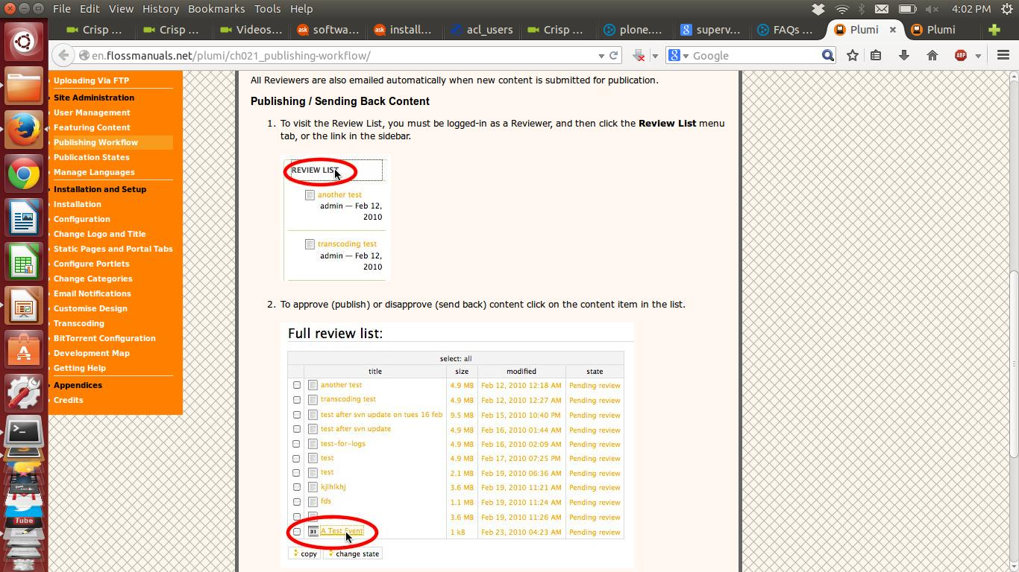
Review List

Slide 5
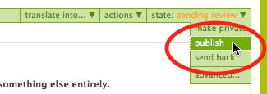
Publishing / Sending Back Content

Slide 6
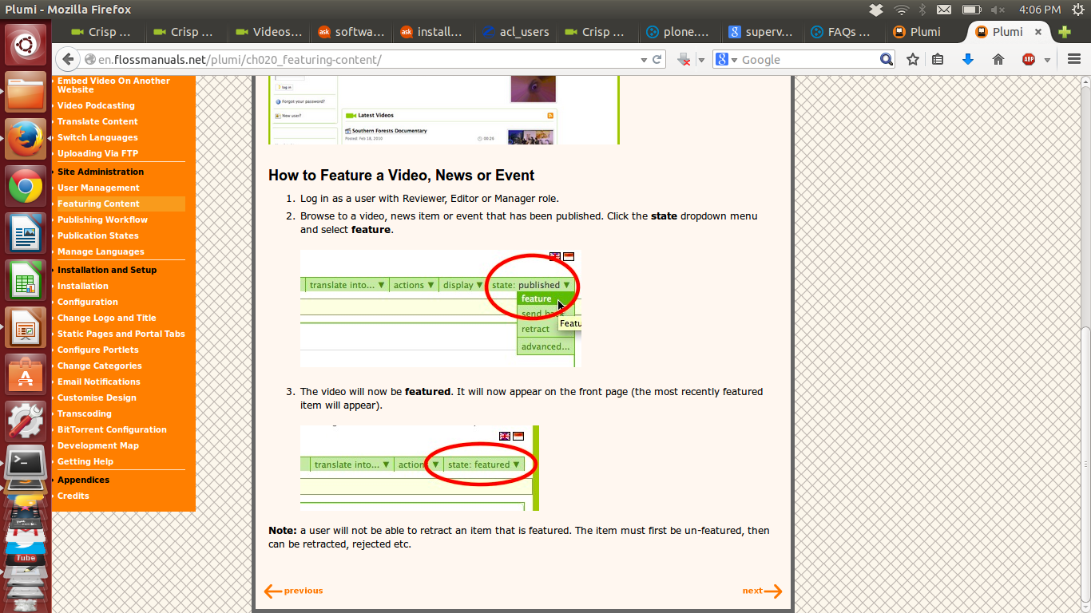
How to feature a video.

Slide 7
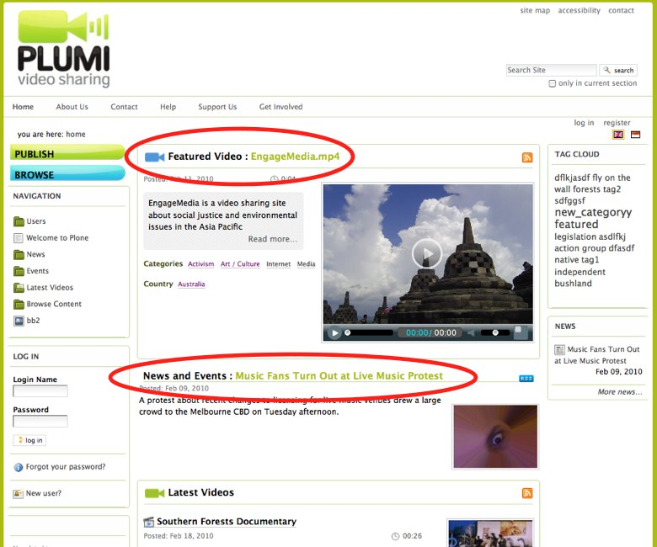
What feature content looks like

Slide 8
Theme
It has by default plone theme installed or we can use some inbuilt themes.
We can also import .zip files of themes
We can use Diazo theming in plone with help of it we can copy theme of any other website just by providing link to that site.

