Slide 1
RISK PREDICTION ON PRUDENTIAL LIFE INSURANCE DSEM Mid-term Project Northeastern University
Team 9
Aakash Bhatt - 002791277
Aishwarya Katkar - 002961534
Makarand Zende - 002772931

Slide 2
Index
Problem Statement
Dataset Details
Data preparation
Machine Learning Models
Conclusion

Slide 3
Prudential Insurance Dataset Details
Overview: In this dataset we are provided with 128 attributes describing the life of applicants who apply for insurance.
Problem Statement: For each Id in test set, predict a Response which is an ordinal attribute having 8 risk levels
Features: 128 features
Records in train.csv: 59381
Records in test.csv: 19765

Slide 4
Prudential Insurance Dataset Details
CONTINUOUS:
Product_Info_4, Ins_Age, Ht, Wt, BMI, Employment_Info_1, Employment_Info_4, Employment_Info_6, Insurance_History_5, Family_Hist_2-5
DISCRETE:
Medical_History_1, Medical_History_10, Medical_History_15, Medical_History_24, Medical_History_32, Medical_Keyword_1-48
CATEGORICAL:
Product_Info_1-7, Employment_Info_2, Employment_Info_3, Employment_Info_5, InsuredInfo_1-7, Insurance_History_1-9, Family_Hist_1, Medical_History_2-41

Slide 5
Data preparation
Visualizing the value counts of different risk levels in the Response column
Checking data for categorical variables and null values
Identifying columns having null values and plotting the percentage of missing values in each of these columns where null values were observed
Analyzing the value counts in each field through visualizations
Discarding irrelevant columns and columns having null values greater than 30%
Imputing null values with median
Identifying the correlation between the attributes and preparing the data in X and y for model training.

Slide 6
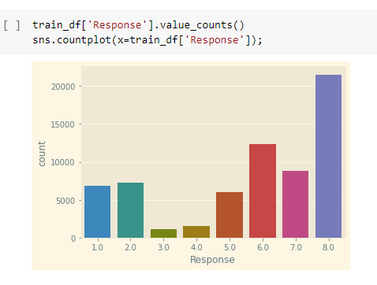
Data Preparation - Visualizing the value counts in Response

Slide 7

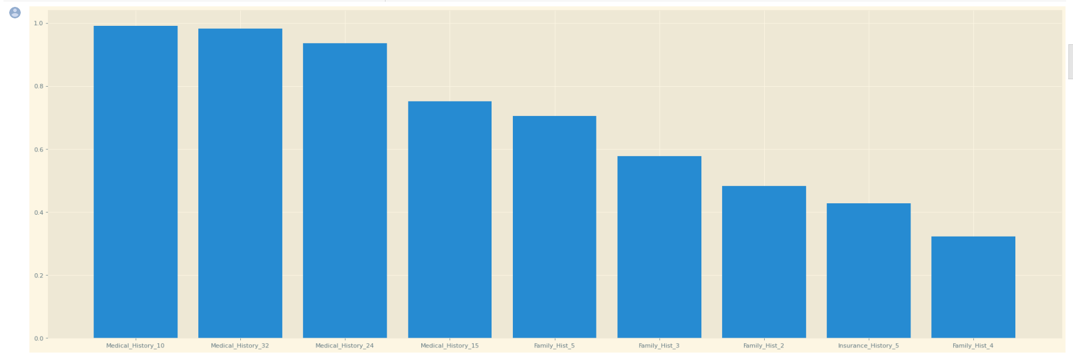
Data Preparation - Identifying null values

Slide 8
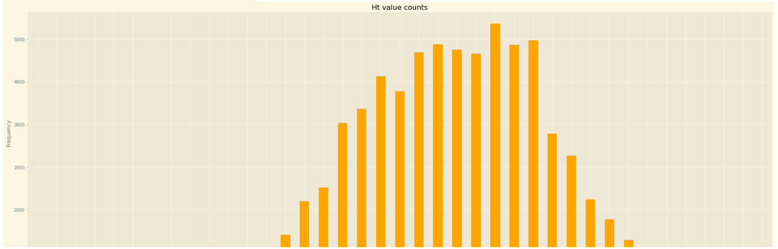
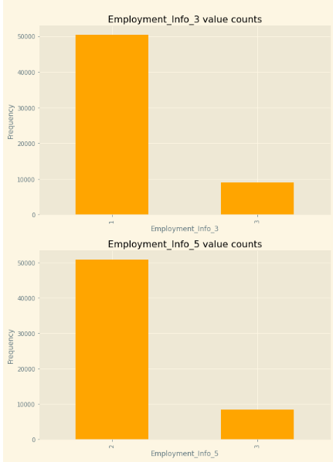
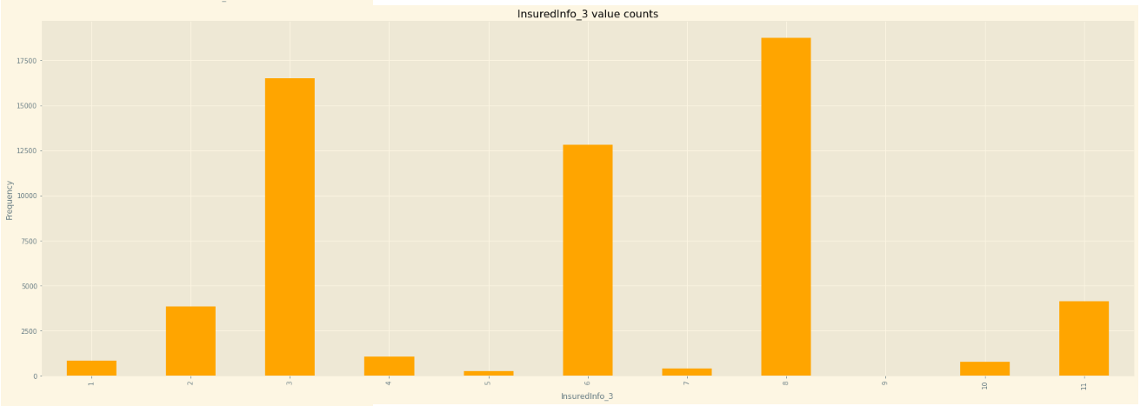
Data Preparation - Analyzing the value counts in each field

Slide 9
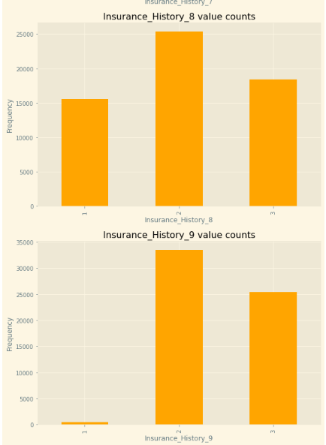
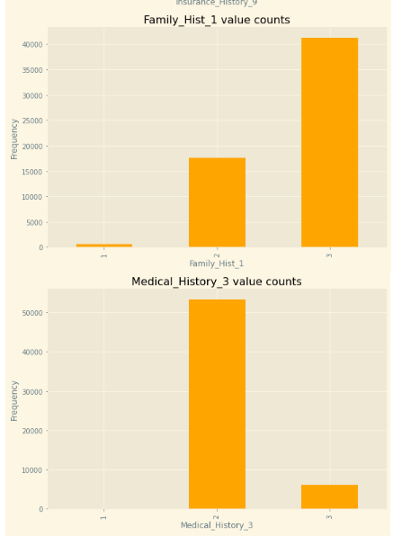
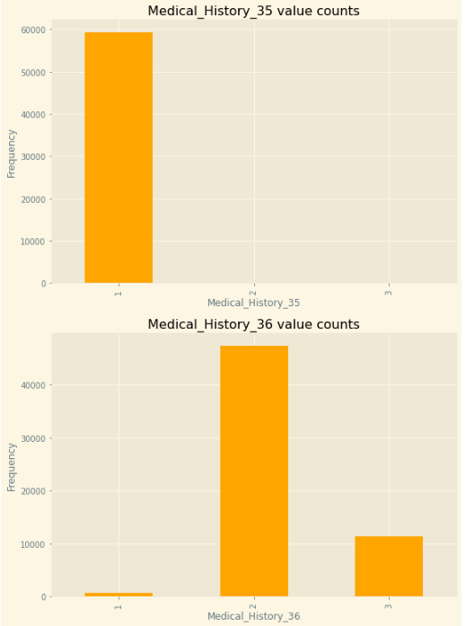
Data Preparation - Analyzing the value counts in each field

Slide 10
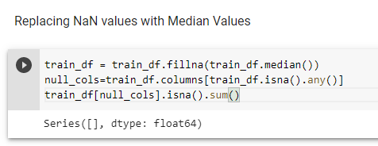
Data Preparation - Dimensionality Reduction & Handling Null Values

Slide 11
Machine Learning Models Implemented
Logistic Regression
XGBoost Classifier
Linear Regression

Slide 12
Logistic Regression
A supervised statistical method for determining the likelihood of a dependent variable is logistic regression
Logistic regression uses functions called the logit functions, that helps derive a relationship between the dependent variable and independent variables by predicting the probabilities or chances of occurrence.
The logistic functions, also referred to as sigmoid functions, turn probabilities into binary values that can then be utilized to make predictions.
Types of regression:
Binary - The dependent variable has only two 2 possible outcomes/classes.
Multinomial - The dependent variable has only two 3 or more possible outcomes/classes without ordering.
Ordinal - The dependent variable has only two 3 or more possible outcomes/classes with ordering.

Slide 13
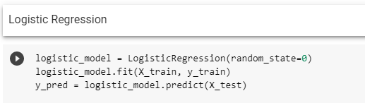
Implementation

Slide 14
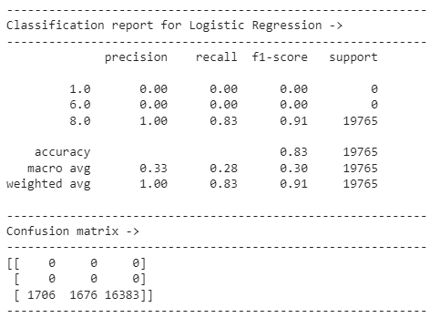
Accuracy of Logistic Regression

Slide 15
Boosting
Boosting is a sequential strategy that operates under the ensemble theory
A group of weak learners are combined, and the prediction accuracy increases
The model results are weighted based on the results of the previous instant p-1 at any instant p
Correctly anticipated outcomes receive a lesser weight than incorrectly classified ones

Slide 16
XGBoost Classifier
For classification or regression predictive modeling issues, gradient boosting refers to a class of ensemble machine learning techniques
XGBoost is an effective open-source implementation of the gradient boosting technique
Decision tree models are used to build ensembles.
In order to repair the prediction mistakes caused by earlier models, trees are added one at a time to the ensemble and fitted.
We use the XGBoost python library which has its own custom API via the scikit-learn wrapper classes: XGBRegressor and XGBClassifier.

Slide 17
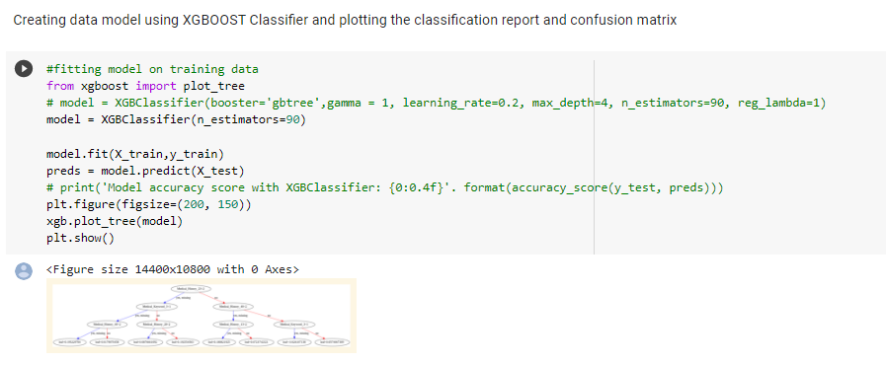
Implementation

Slide 18
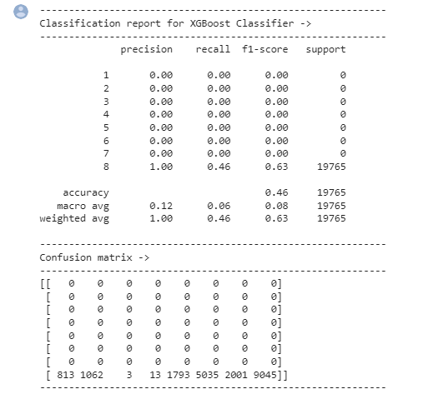
Accuracy of XGBoost Classifier

Slide 19
Linear Regression
Linear Regression is a supervised machine learning algorithm which predicts output that is continuous and has a constant slope
Instead, of trying to categorize values, it is used to predict values within a continuous range
There are two main types:
Simple regression : Simple linear regression uses the conventional slope-intercept form, with m and b serving as the variables which are used to "learn" in order to generate the most precise predictions. x represents input data and y represents prediction
y = mx + c
Multiple Linear regression : A more complex, multi-variable linear equation might look like this, where represents the coefficients, or weights, our model will try to learn
f(x,y,z)=w1x+w2y+w3z

Slide 20
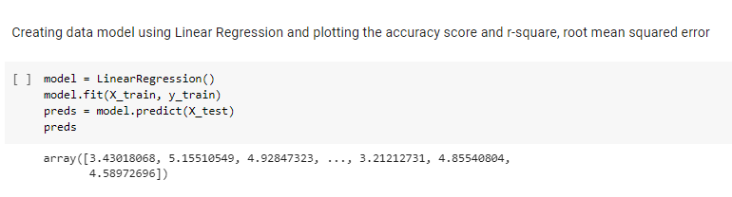
Implementation & Accuracy

Slide 21
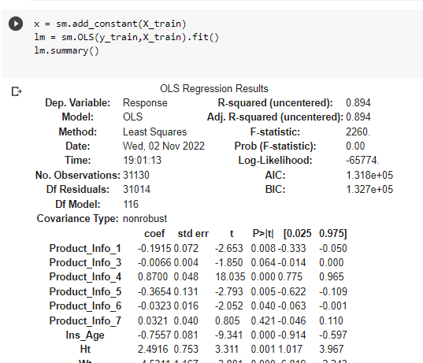
Linear Regression performance metrics

Slide 22
Conclusion
After evaluating the dataset and building 3 machine learning models, we got to know that Logistic Regression model is giving the highest accuracy in predicting the risk.
Algorithms | Ranking as per Execution time | Accuracy
Logistic Regression | 1 | 83%
XGBoost | 3 | 43%
Linear Regression | 2 | R-square value : 0.895

