Slide 1
Generating $20.5M in Incremental Revenue
Strategic Initiatives for Midwest State Athletics
KODING with KAGR Case Competition
November 2025

Slide 2
The Challenge & Context
The Challenge:
  NCAA vs. House settlement: $20.5M annual impact (10 years)
  Revenue sharing starting 2025-26: up to 22% of revenue to athletes
  Bottom Line: Need 27% revenue growth to remain competitive
Current Position:
  Total Athletic Revenue: $94.4M (at NCAA Div I average)
  Strong programs: Football, Men's Basketball
  Question: Where do we find $20.5M+ without alienating fans?

Slide 3
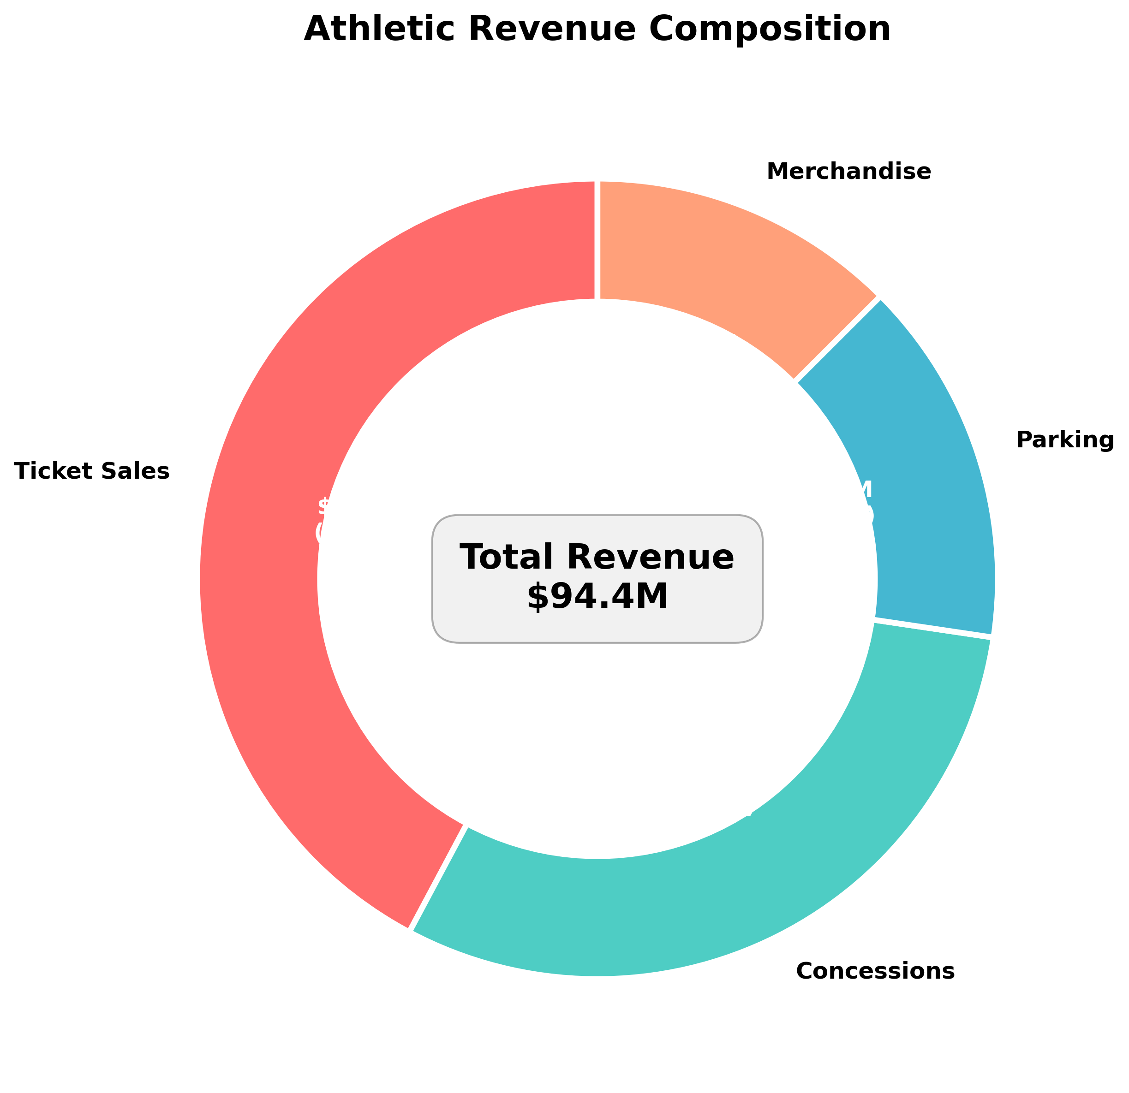
Current State: Revenue Composition

Slide 4
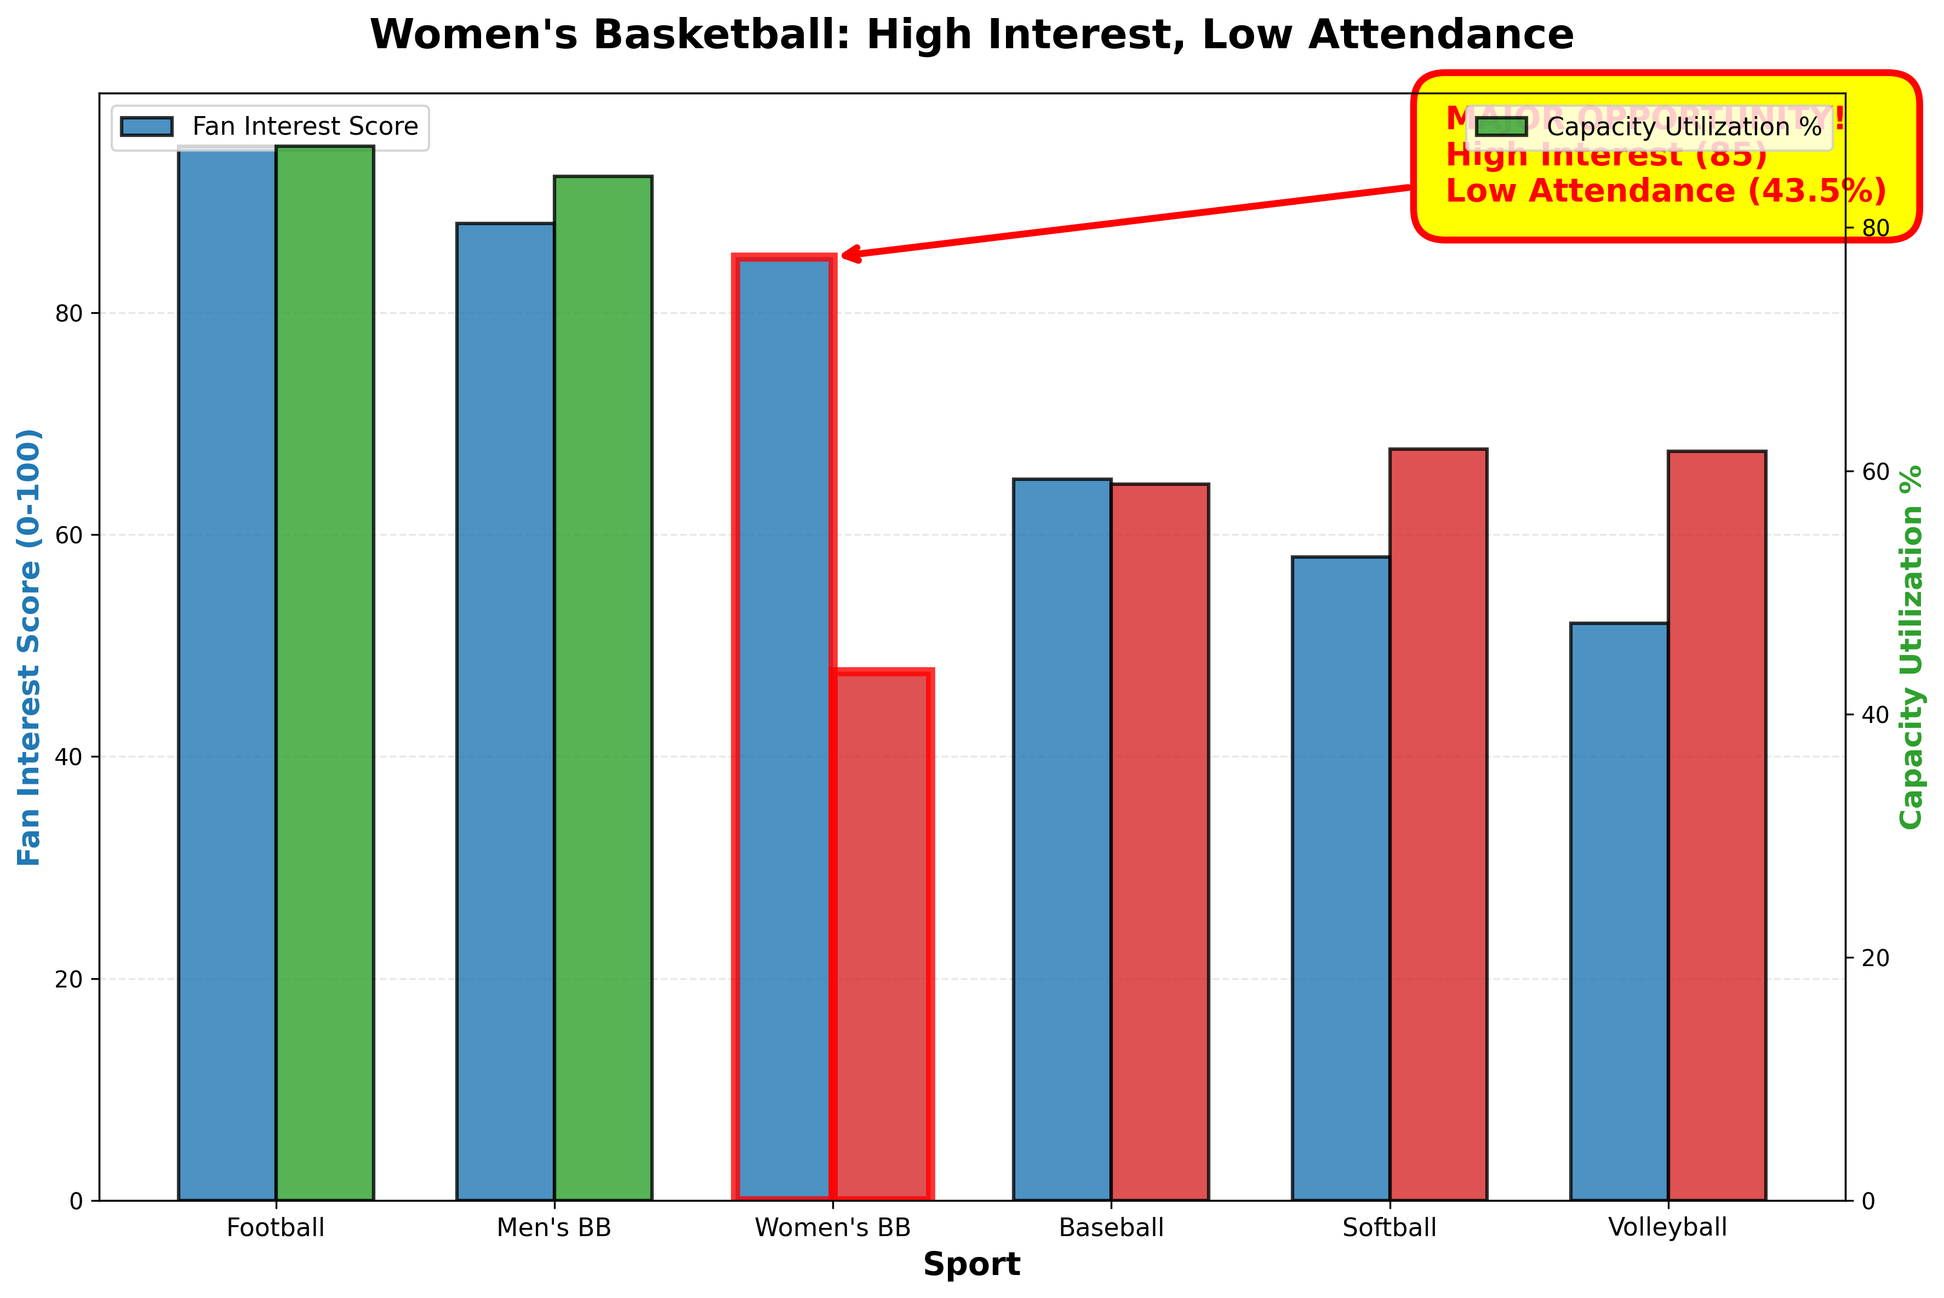
Critical Finding #1: Women's Basketball
Survey shows 85 interest score (vs. Men's 88)
Only 43.5% capacity utilization
Same 12,000-seat arena as Men's
Gap = 3,988 empty seats/game
Opportunity: $4.4M annually

Slide 5
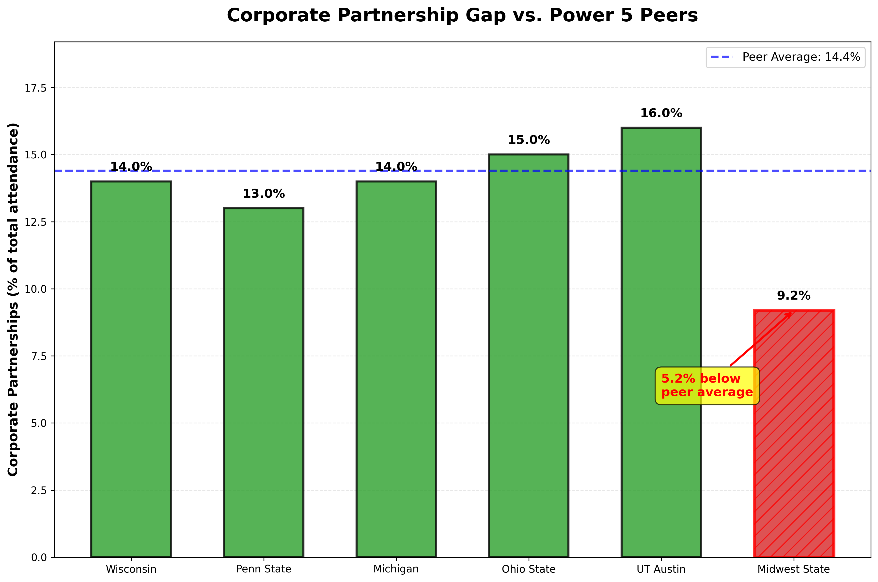
Critical Finding #2: Corporate Partnership Gap
Midwest State: 9.2% corporate
Peer average: 15%
38% below benchmark
Opportunity: +100K corporate attendees
Projected impact: $7.5M annually

Slide 6
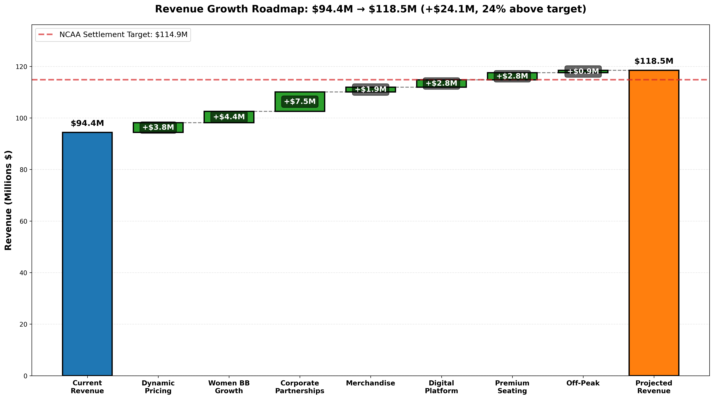
Full Initiative Portfolio

Slide 7
Seven Strategic Initiatives
# | Initiative | Annual Impact | Implementation Cost | Net Impact
1 | Dynamic Pricing | $4.8M | $1.0M | $3.8M
2 | Women's BB Growth | $4.6M | $200K | $4.4M
3 | Corporate Partnerships | $8.2M | $700K | $7.5M
4 | Premium Seating Expansion | $4.0M | $1.2M* | $2.8M
5 | Digital Platform | $3.2M | $400K | $2.8M
6 | Merchandise Optimization | $2.1M | $200K | $1.9M
7 | Alumni Engagement | $1.0M | $100K | $0.9M
 | TOTAL | $27.9M | $3.8M | $24.1M

Slide 8
Implementation Flexibility - Phased Approach
Tier 1 - Start Here (Months 0-3): $15.7M
  Dynamic Pricing ($3.8M net)
  Women's Basketball Growth ($4.4M net)
  Corporate Partnership Expansion ($7.5M net)
Tier 2 - Quick Wins (Months 3-9): $20.4M Total
  Digital Platform ($2.8M net)
  Merchandise Optimization ($1.9M net)
Tier 3 - Long-term (Months 9-18): $24.1M Total
  Premium Seating ($2.8M net, capital intensive)
  Alumni Engagement ($0.9M net)

Slide 9
The Bottom Line
Summary:
  Challenge: Generate $20.5M to offset House settlement
  Solution: 7 data-driven initiatives
  Result: $24.1M net revenue (24% above target)
  Timeline: 12-18 months to full implementation
Immediate Next Steps:
  Week 1-2: Approve Tier 1 initiatives, RFP for dynamic pricing vendor
  Months 1-3: Launch women's basketball campaign, pilot dynamic pricing
  Months 6-18: Full deployment, measure and optimize

