Slide 1

Optimization in High-Performance Computing
Avinna Bhattarai
050028547
Notes:
Hello, everyone. My name is Avinna Bhattarai, and today I’ll be presenting my research and implementation project on optimization techniques in high-performance computing, focusing on data structure optimization. Throughout this presentation, I will discuss how optimizations in data structures can significantly improve performance in HPC applications and demonstrate an implementation based on an empirical study.

Slide 2
Introduction
High-Performance Computing (HPC) overview
Importance of data structure optimization
Examples of common optimization techniques:
Loop unrolling
Data locality
Cache optimizations
Notes:
To start with, let’s quickly review what High-Performance Computing is. HPC involves using supercomputers and parallel processing to solve complex problems. In this environment, performance is key, and one way to improve performance is by optimizing data structures and their access patterns. Optimization techniques such as loop unrolling, data locality improvements, and cache optimizations are often used to ensure that systems can process data faster, improving execution time and resource efficiency.

Slide 3
Case Study
Key Findings: Performance bugs often stem from inefficient data access patterns.
Focus on Cache: Cache-friendly patterns improve data structure performance.
Memory Access Impact: Optimized access patterns reduce cache misses.
Notes:
In my research, I analyzed an empirical study on performance bugs in HPC applications. The study focused on cache behavior and memory access patterns in data structures. One of the key optimization techniques I found particularly impactful was the idea of cache-friendly access patterns, where optimizing how data is stored and accessed in memory can significantly reduce cache misses and improve performance. We’ll see this in action shortly in the example I implemented.

Slide 4
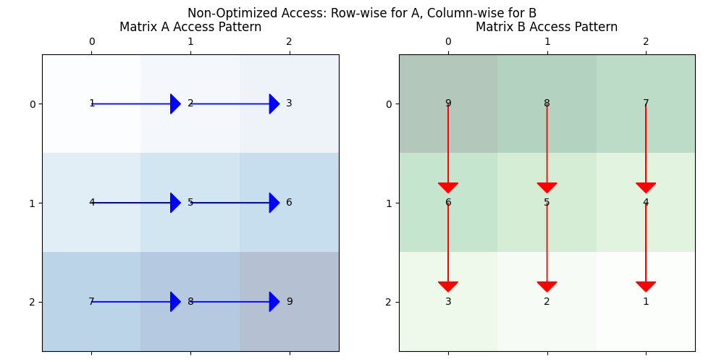
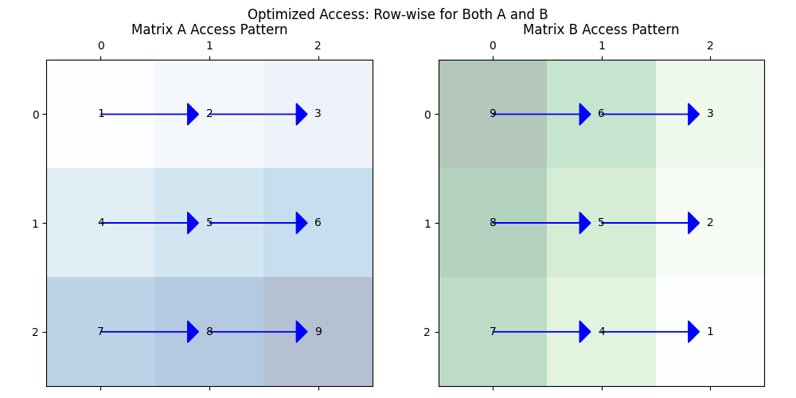
Access Patterns
Non-Optimized Access:Column-wise access leads to poor cache performance.
Optimized Access:Row-wise access improves cache hit rates and efficiency.
Notes:
Here, we have two visual examples of memory access patterns. On the top, we see the non-optimized version, where matrix data is accessed column-wise. This results in non-sequential memory access, which leads to poor cache performance. On the one below, we have the optimized version, where the data is accessed row-wise, meaning consecutive memory locations are accessed, improving cache hit rates and overall performance. I’ve implemented this optimization in Python, which you can find in the github link provided in the report.

Slide 5

Implementation and Performance
Implementation: Python code demonstrates both access patterns.
Performance Results:
Optimized version shows significant execution time improvements.
Screenshot:
Notes:
For the implementation, I created a Python script that simulates both non-optimized and optimized memory access patterns. The non-optimized version accesses the matrix column-wise, whereas the optimized version transposes the matrix to enable row-wise access. After running the code, I measured the performance, and as expected, the optimized version showed a significant improvement in execution time due to better cache performance. This reflects the theoretical expectations from the research paper, and the results clearly show how even a simple optimization can have a large impact on performance.

Slide 6
Conclusion
Key Takeaway: Optimization techniques drastically improve HPC performance.
Implications: Understanding data access patterns is crucial for future applications.
Notes:
In conclusion, we’ve seen how small changes in data structure design and memory access can have a big impact on the performance of HPC applications. Through both theoretical research and practical implementation, we’ve demonstrated the power of optimization techniques in improving cache efficiency and reducing overall runtime.

Slide 7
References
Frigo, M., and Johnson, S. G. 'The Design and Implementation of FFTW3,' Proceedings of the IEEE, 2005.
Ghorpade, J., Parande , J., Kulkarni , M., & Bawaskar , A. (2012). GPGPU processing in Cuda Architecture. Advanced Computing: An International Journal, 3(1), 105–120. https://doi.org/10.5121/acij.2012.3109
Md Abul Kalam Azad, Nafees Iqbal, Foyzul Hassan, Probir Roy. 'An Empirical Study of High Performance Computing (HPC) Performance Bugs.' University of Michigan - Dearborn.
R. R. Curtin, et al. 'mlpack 3: A Fast, Flexible Machine Learning Library,' Journal of Open Source Software, 2018.
Tan, J., Jiao, S., Chabbi, M., & Liu, X. (2020). What every scientific programmer should know about compiler optimizations? Proceedings of the 34th ACM International Conference on Supercomputing, 1–12. https://doi.org/10.1145/3392717.3392765
Wang, Q., Zhang, X., Zhang, Y., and Yi, Q. 'AUGEM: Automatically Generate High Performance Dense Linear Algebra Kernels on x86 CPUs,' Proceedings of SC'13, 2013.
Weller, H. G., Tabor, G., Jasak, H., & Fureby, C. (1998). A tensorial approach to computational continuum mechanics using object-oriented techniques. Computational Physics, 12(6), 620–631. https://doi.org/10.1063/1.168744
Notes:
I’ve included my references here, and I encourage you to explore more about this fascinating field of HPC optimization.

Slide 8
Thank You !!!
Notes:
Thank you for your attention!

