Slide 1
Front End Engineering Project
HAPPYHEADSPACE
Team Members:
Aanchal Jha 2310991670
Abha Vashisht 2310991673
Ananya Tuli 2310991690
Arshpal Singh 2310991710

Slide 2
Table of Contents
Introduction
Problem Statement
Technical Details
Key Features
Project Highlights
Conclusion
References/Links used

Slide 3
Introduction
Project: HappyHeadspace Mental Health Website
TEAM DETAILS:
ROLL.NO: NAME:
2310991670 AANCHAL JHA
2310991673 ABHA VASHISHT
2310991690 ANANYA TULI
2310991710 ARSHPAL SINGH
PURPOSE: A mental health website can provide valuable resources, information, and support for individuals struggling with mental health issues. It can serve as a platform for raising awareness, reducing stigma, and connecting people with professional help and peer support.
GOAL: A mental health website aims to raise awareness, provide information, connect people, promote self-care, facilitate access to help, and advocate for mental health. It seeks to improve the lives of individuals affected by mental health conditions and create a more supportive society.

Slide 4
Problem Statement
Mental health problems are conditions that affect our thoughts, feelings, and behaviors. They can range from mild to severe and impact our daily lives.
HappyHeadspace can help by offering resources, information, and support to individuals struggling with mental health. Our website provides tools for self-care, connects people with others who understand, and facilitates access to professional help.

Slide 5
Technical Details
.
HTML(version:5): used to create the basic structure of the website.
CSS(version:3) : used to style the basic html code using various css properties.
3. Java script(version:ECMAscript2023):
used to create dynamic pages.
4. Bootstrap(version:5): External library for making the webpage responsive.
5. React: (version: 19) external js library used for form.

Slide 6
Key Features
Self-Help Resources
Interactive Community
Professional Support
Crisis Resources
Streamlined Recruitment
Educational content
Dashboards
Booking appointments

Slide 7
Project Advantages
1.Comprehensive Resource Integration:
Centralized Access: Users benefit from a single point of access to various mental health resources, reducing the need to navigate multiple platforms or services.
2.User-Friendly Interface:
Intuitive Design: The platform is designed with a focus on ease of use, ensuring that users of all technological backgrounds can navigate the site effortlessly.
Responsive Layout: Optimized for both desktop and mobile devices, providing a seamless experience across different screen sizes.

Slide 8
3.Enhanced Accessibility:
24/7 Availability: Users can access mental health resources and support at any time, removing barriers related to traditional office hours.
Geographic Flexibility: The platform can serve users from various locations, making it especially beneficial for those in underserved areas or with limited access to local mental health services.
4.Streamlined Healthcare Provider Interaction:
Efficient Management: The doctor’s dashboard streamlines patient management and appointment scheduling, improving the efficiency of healthcare providers.
Data Insights: Advanced analytics and reporting tools enable providers to better understand patient needs and optimize treatment plans.

Slide 9
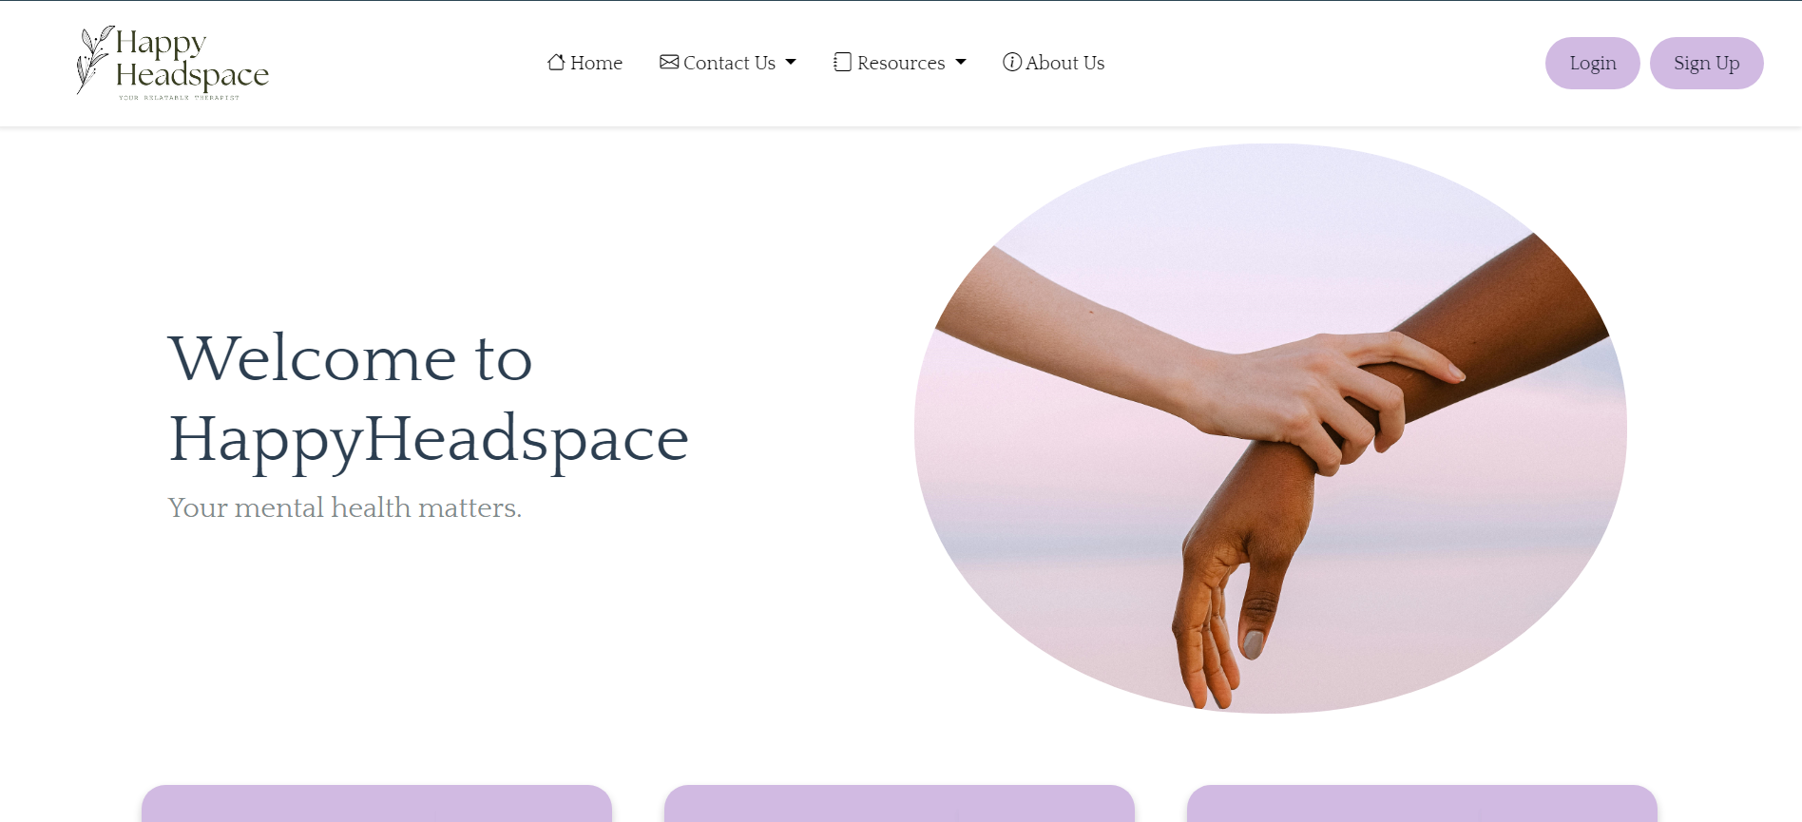
Project Highlights
Main Page:-

Slide 10
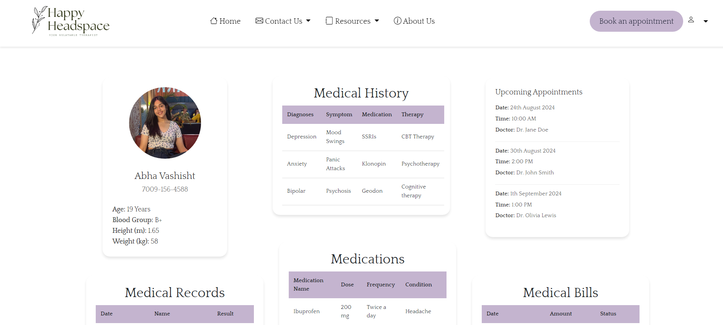
Patient Dashboard:-

Slide 11
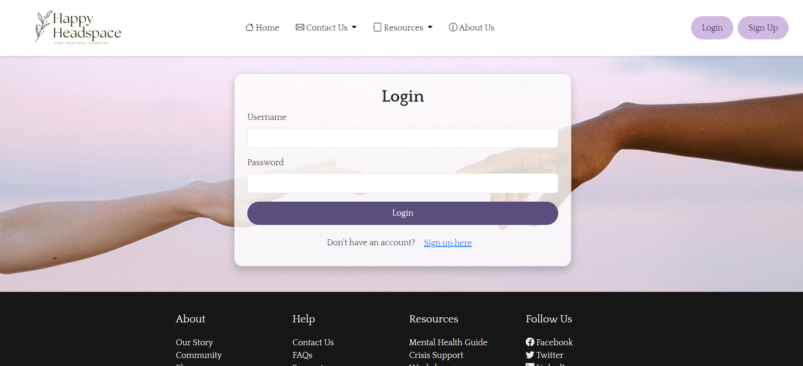
Login Page:

Slide 12
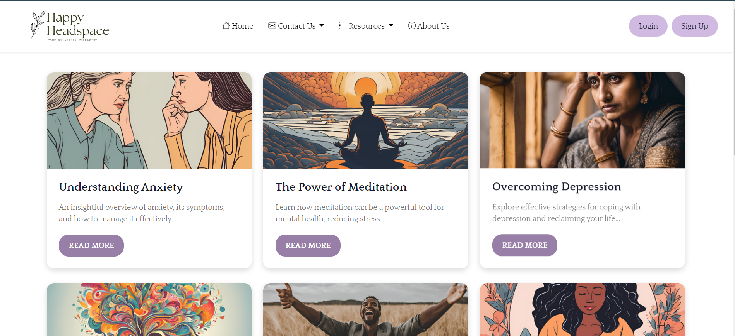
Blogs:

Slide 13
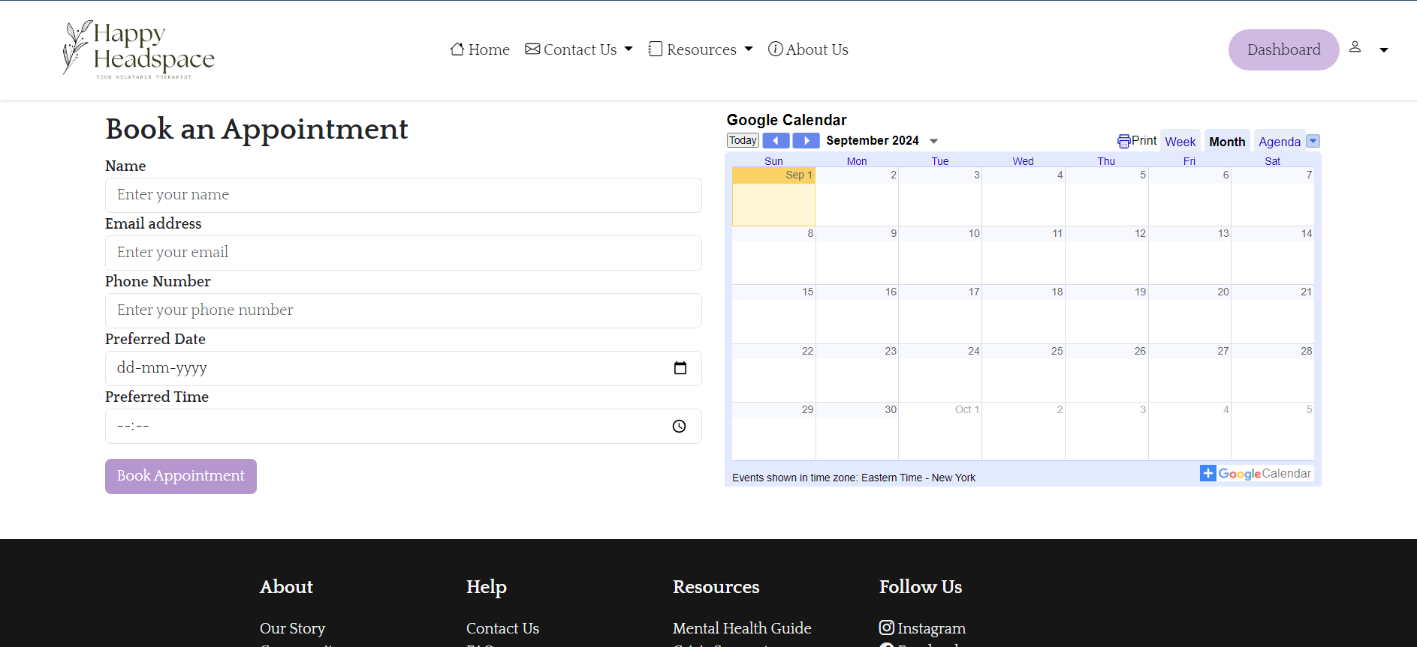
Booking a session:

Slide 14
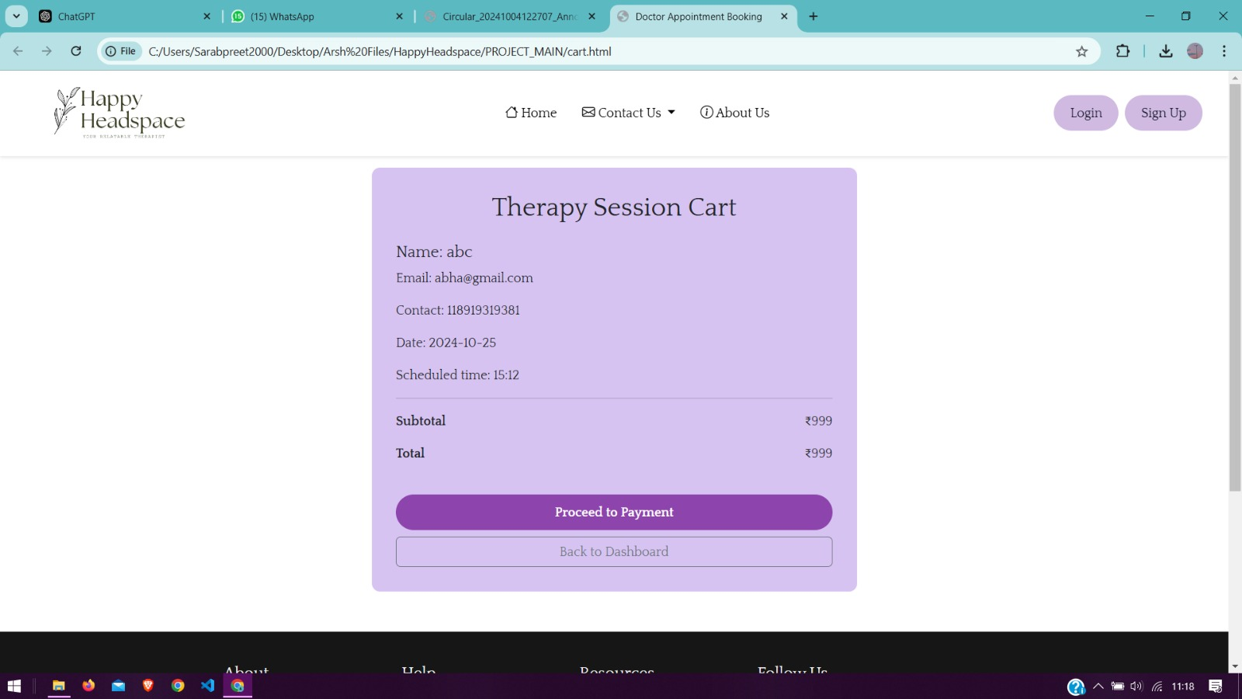
Payment cart:

Slide 15
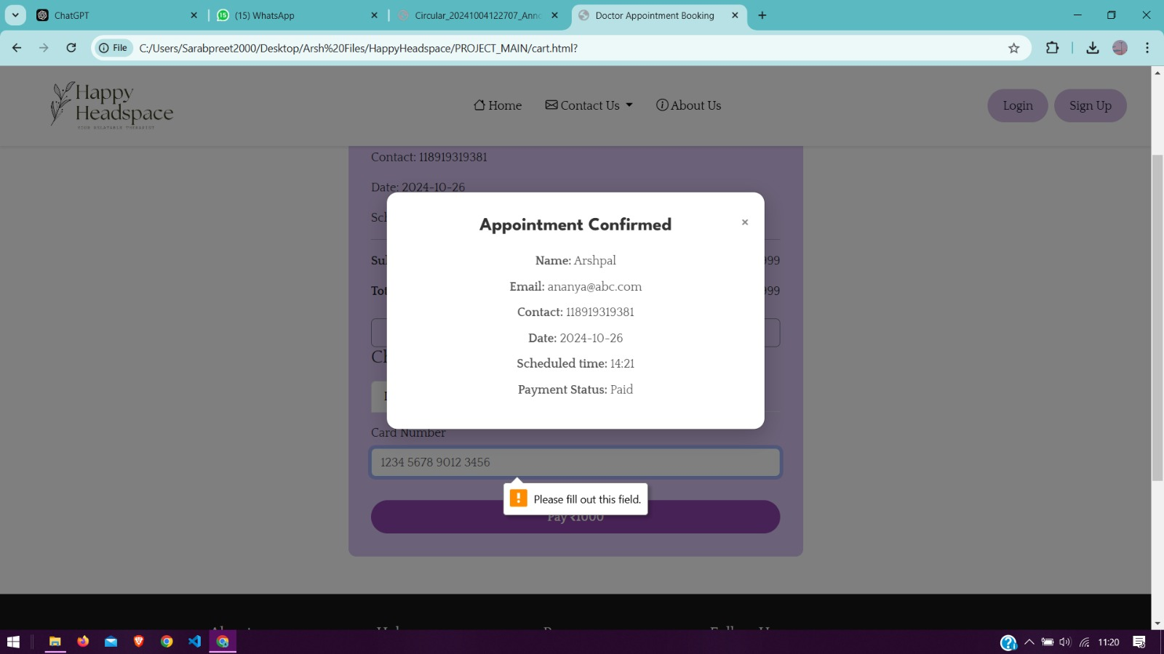
Confirmation:

Slide 16
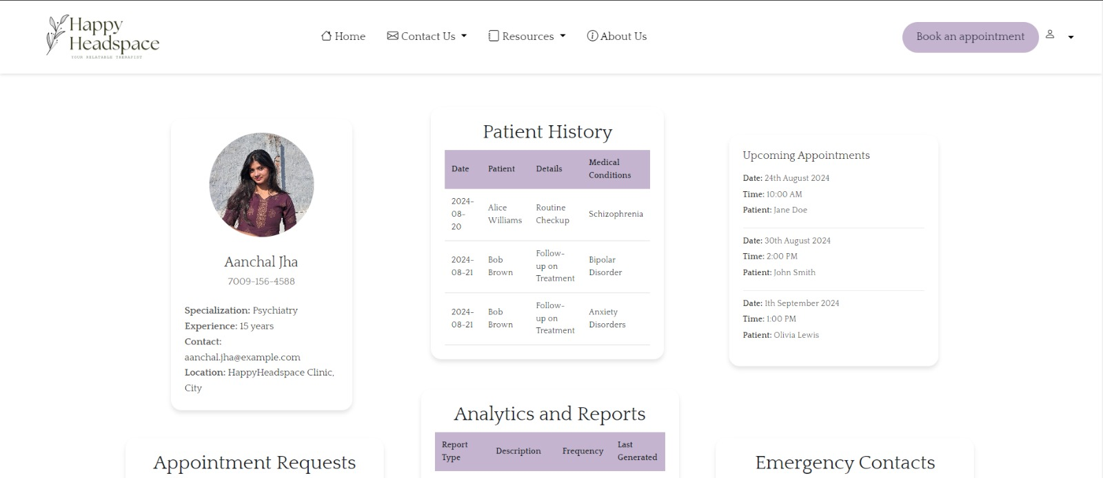
Doctor Dashboard:

Slide 17
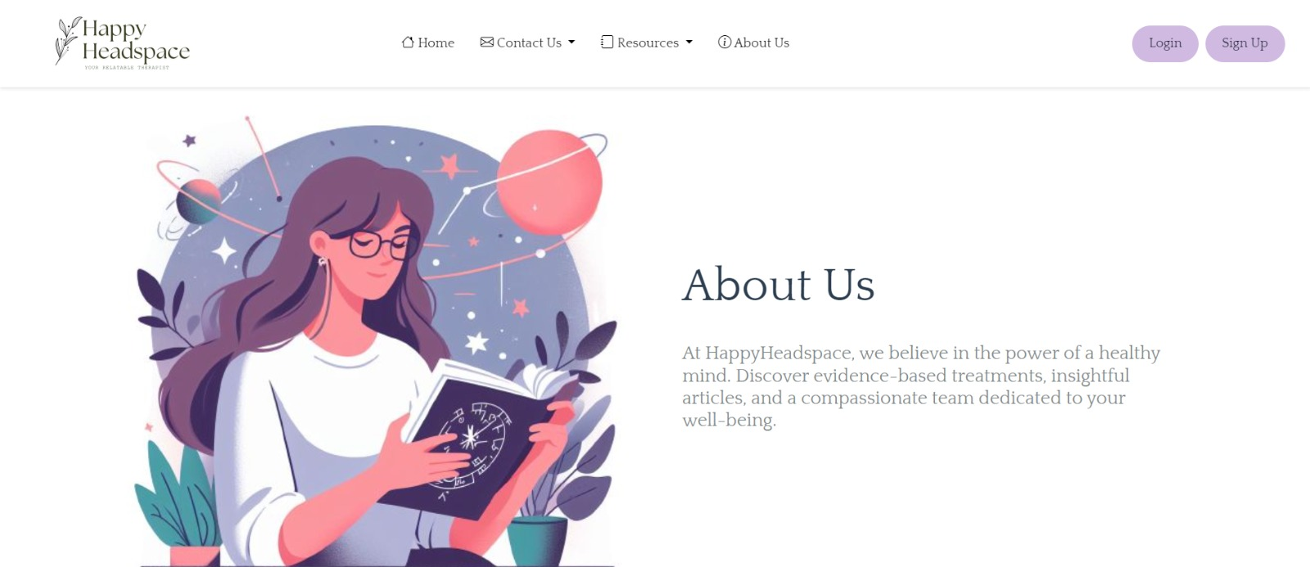
About Us:

Slide 18
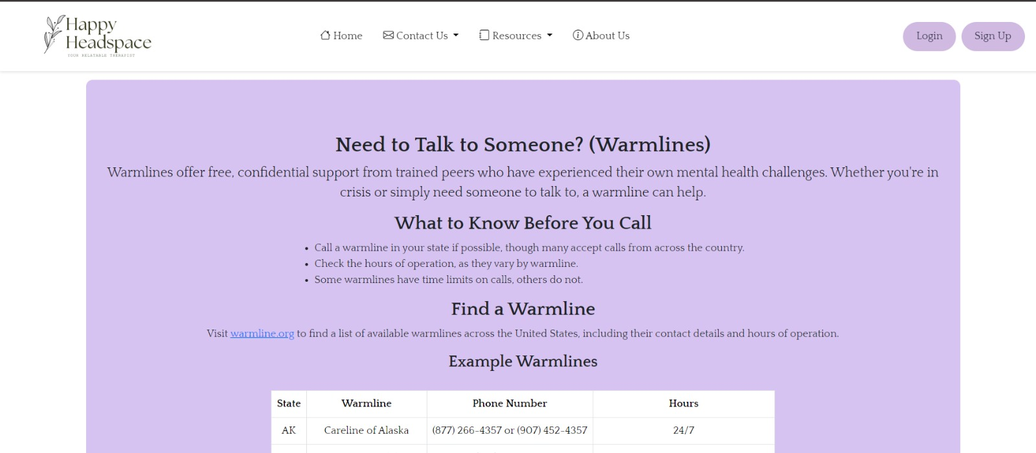
Crisis Support:

Slide 19
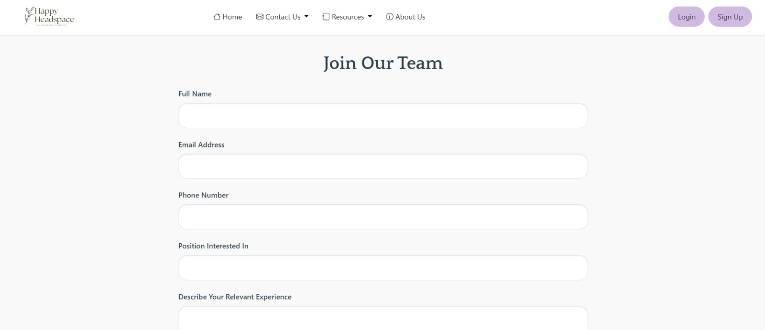
Join Us:

Slide 20
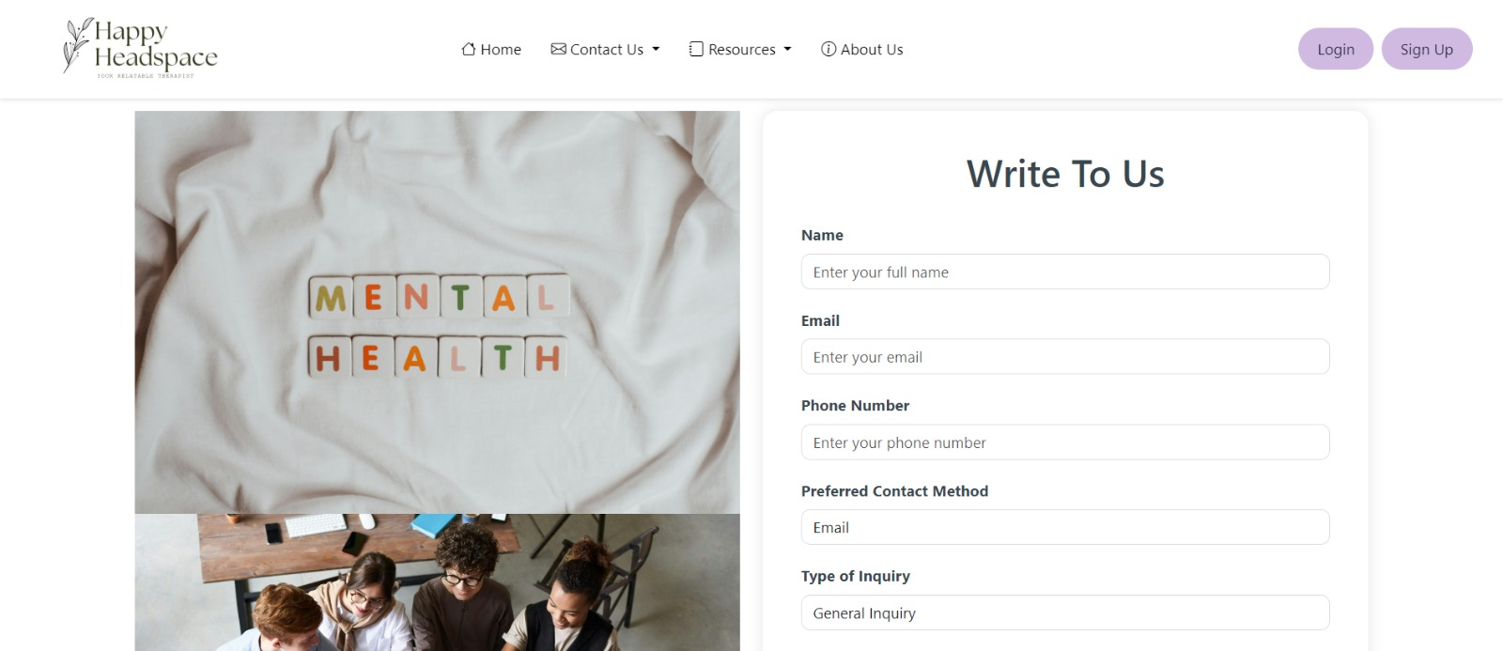
Write to Us:

Slide 21
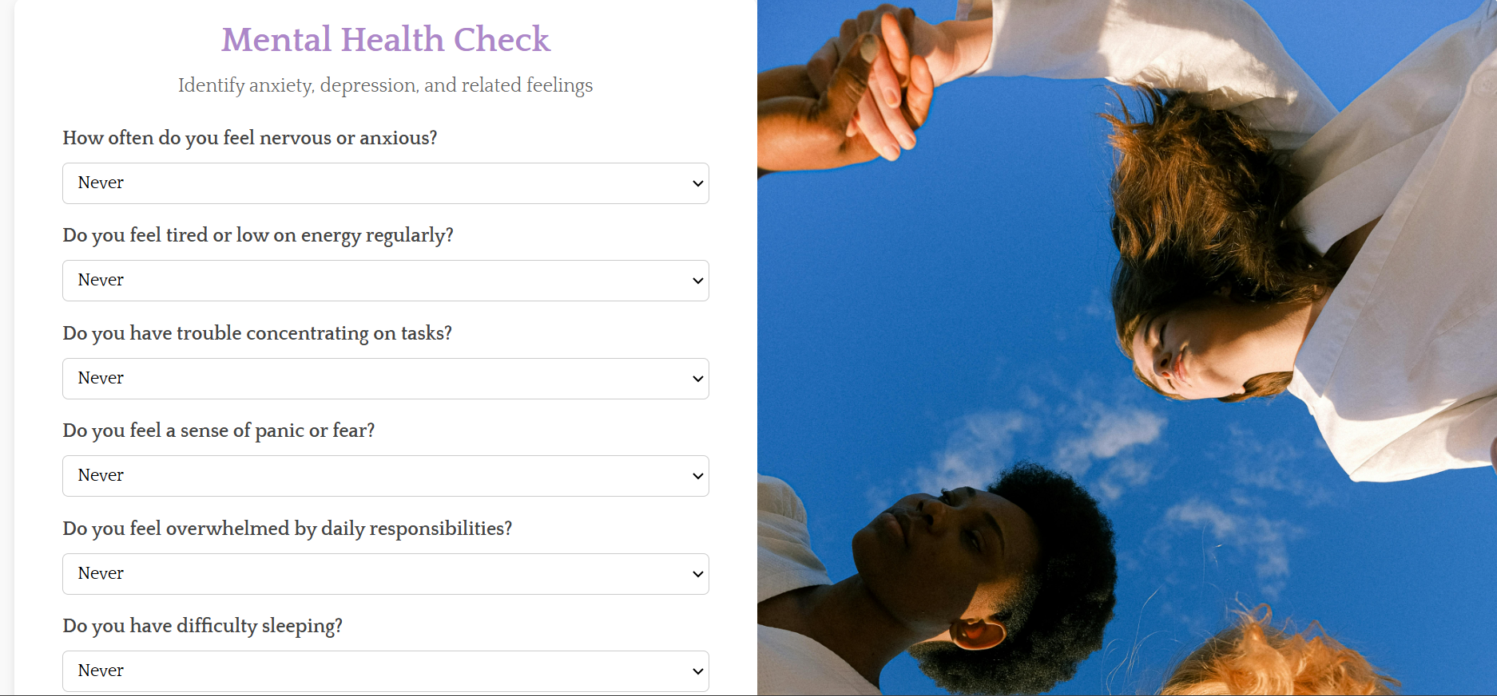
Quiz:

Slide 22
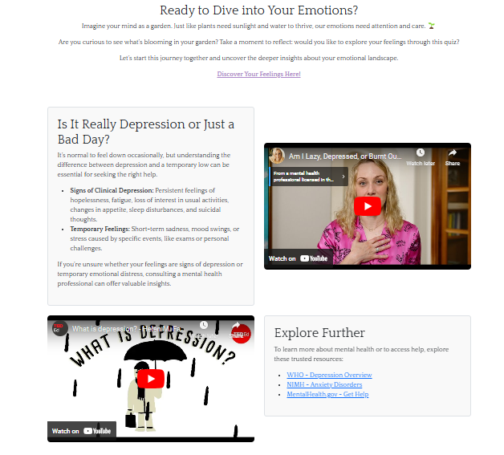
More on mental health:

Slide 23
Conclusion
Our mental health website provides a valuable resource for individuals seeking support and information.
By offering, end-to-end support, blogs, appointments and many more facilities, we aim to reduce stigma, promote understanding, and empower individuals to prioritize their mental well-being.
We believe that by fostering a supportive community and providing accessible resources, we can contribute to a healthier and more compassionate society.

Slide 24
References/Links used
https://www.csstricks.com/
Geeksforgeeks.com
https://code.visualstudio.com/
www.youtube.com
https://screening.mhanational.org/screening-tools/

Slide 25


