Slide 1

Sinhgad College of Engineering
Department of Information Technology
BE Project Presentation
On
Word Sense Disambiguation (WSD)
By
Ankit Bhawsar (71706761M)
Anup Bandawar (71706724G)
Omkar Aurangabadkar (71706699B)
Pratik Zode (71608729E)
Guide
Mr. C. D. Kokane

Slide 2
Contents
Project Details
Project Aim, Objectives, and Motivation
Introduction
Fundamentals of Word Sense Disambiguation
Literature Survey
Proposed Schema
Conclusions
References

Slide 3
Project Details
Project Title :Word Sense Disambiguation(WSD)
Project Domain: Supervised Machine Learning
Project Group Members:
- Ankit Bhawsar 71706761M
- Anup Bandawar 71706724G
- Omkar Aurangabadkar 71706699B
- Pratik Zode 71608729E

Slide 4
Problem Statement
The identification of the correct meaning of a word used in a sentence is easy for humans. The human brain is capable of spontaneously determining the correct sense using context of the word.
This task is much more complex to replicate within machines.
The identification of meaning for words by computers using only context is called Word Sense Disambiguation (WSD).

Slide 5

Purpose
For better user experience and improved interfacing between man and machine, there needs to be clear communication between them.
One obstruction in the way is the problem of ambiguity in word senses.
In an effort to solve this problem and enhance intelligence of computers, we propose our system for Word Sense Disambiguation.

Slide 6

Aim of the Project
The aim of this project is to create a model which maximizes accuracy of Word Sense Disambiguation (WSD) using Neural Networks.

Slide 7
Objectives
To understand the problem concerning word sense ambiguity.
To study the previous research work done in the field of Word Sense Disambiguation.
To find and acquire necessary labelled datasets for the purpose of training and testing.
To design and train a WSD model based on machine learning and neural network algorithms, with the goal of maximizing accuracy.
To compute accuracy of the model using appropriate testing data, and to compare it with other WSD models already documented.

Slide 8
Introduction to Project
Word-Sense Disambiguation (WSD) is a branch of Natural Language Processing which is concerned with the open problems concerned with identifying the correct sense of a word is used in a respective sentence.
Many words used in the English language have various different senses or meanings.
WSD is concerned with the problem of selecting the correct meaning of the word.

Slide 9

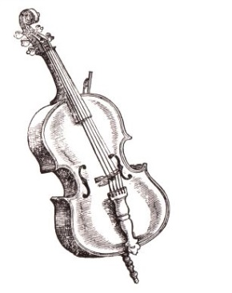
Example
For example, the word “bass” in English can have the following meanings:
Any of various North American lean-fleshed freshwater fishes.
Denoting the member of a family of instruments that is the lowest in pitch.
Word sense disambiguation deals with the ambiguous word by the selecting correct meaning depending on the surrounding context.

Slide 10
Approaches of WSD
The four main approaches to Word Sense Disambiguation are:
Knowledge-based Approach
Supervised Approach
Semi-supervised Approach
Unsupervised Approach

Slide 11

Knowledge-based Approach
Knowledge based algorithms use various lexical resources such as Machine Readable Dictionaries (MRDs) or WordNet to identify the correct sense of words.
A knowledge based system only needs access to commercial dictionary resources to start process of disambiguation.
WSD System
Read

Slide 12
Advantage of this approach is that the algorithms used require little to no coding and are mostly dependant on the knowledge base they use.
Drawback of these algorithms is that their performance is limited on the speed of searching and retrieval of these resources.
As the size of the resources increase, so does the latency and hence performance decreases.
An example of this approach is the Lesk Algorithm.

Slide 13
Supervised Approach
Supervised methods of WSD require large sets of labelled data in order to train the models.
Labelled data in this case is a set of inputs where the correct senses of words are known.
This labelled data is used to train a classifier using machine learning algorithms.
This classifier is then used on unlabelled testing data to identify the correct senses of words.
Labelled Learning Set
WSD System
Unlabelled Input
Set
TRAINING
PREDICTING

Slide 14
Advantage:
Supervised approach always gives superior performance than any other methods.
Disadvantage:
These supervised methods are subject to a knowledge holdup since they rely on considerable amounts of manual resources for training, which are difficult and expensive to create.
Examples:
Naïve Bayes Algorithm, Decision Tree Model

Slide 15
Semi-supervised Approach
Semi-supervised approach is mainly used when the quantity of training data available is small.
These methods start from a small amount of seed data for each word: such as a small number of sure fire decision rules
Example:
'play' in the context of 'bass' almost always states the musical instrument

Slide 16
Using any of the supervised method, seeds are used to train an initial classifier.
This classifier is then used on new portions of unlabelled data to extract larger training sets, in which only the most assured classifications are included.
Small Seed Data
Initial Classifier
External Untagged Corpus
TRAINING
CORRECT PREDICTIONS
Better Classifier

Slide 17
Advantages:
  Small amount of trained/tagged data is required initially.
  Larger Classifiers are built recursively.
Disadvantage:
  Accuracy obtained practically is not as high as supervised approaches.
  Predictions have to be checked manually if they are correct.
Examples:
  Yarowsky Bootstrapping, Label Propagation Algorithms

Slide 18
Unsupervised Approach
Unsupervised learning methods are the greatest challenge for WSD researchers.
The underlying assumption is that similar meaning words occur in similar contexts, and thus senses can be induced from text.
This is done by clustering word occurrences using some measure of similarity, a task referred to as word sense discrimination or induction.
Do not require any labelled or sense-tagged data.

Slide 19
Advantage:
They are not dependent on manual effort or any large knowledge set.
Disadvantage:
Performance has been observed to be lower than for the other methods described above.
Examples:
Co-occurrence Graphs, Hyperlex Algorithm, WSD using Parallel Corpora

Slide 20
Base Paper
2016 Semi-Supervised Word Sense Disambiguation with Neural Models[14]
In this paper, the research team have used Supervised and Semi-supervised approaches to Word Sense Disambiguation (WSD) using Neural Nets and label propagation method respectively.
They compare and contrast the 2 different ways of obtaining word embeddings including using Word2Vec model and a recurrent neural network model using Long Short-Term Memory (LSTM) architecture.
This LSTM Recurrent Neural Network shows extremely high accuracy results when tested in SemEval International Workshop Tasks with training done on both SemCor[11] and OMSTI[12]

Slide 21
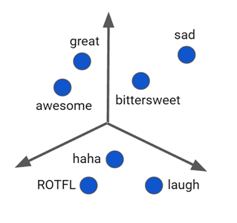
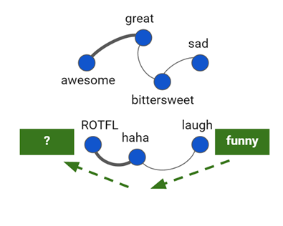
Base Paper (cntd)
They also implement Semi-supervised WSD using label propagation method.
This method works by representing labelled and unlabelled examples as vertices in a connected graph.
The label information is then circulated from any vertex to nearby vertices through weighted edges iteratively, finally inferring the labels of unlabelled examples after the propagation process converges.
Seed Data
Propagation of Labels
Simplified Label Propagation

Slide 22
Base Paper (cntd)
We have chosen this paper as our base paper since its accuracy results are consistently higher than any previous research models.
We plan to use the Word2Vec algorithms as well as Long Short-Term Memory (LSTM) Architecture as the team have used to build Word Embeddings.
But instead of testing data based on these word embeddings, we plan to use them to create feature vectors for our neural network.
We hypothesize that using these input vectors along with suitable cost reduction functions for our neural network will produce an increase in accuracy.

Slide 23
Literature Survey
Year | Author | Title of the paper | Method | Advantages | Limitations
2018 | Myung Yun Kang, Tae Hong Min, Jae Sung Lee | Sense Space for Word Sense Disambiguation | Word Space Model | Sense Space Model more effective than Word space model | Not practical
2017 | Pratibha Rani, Vikram Pudi, Dipti M. Sharma | Semi- supervised Data-Driven Word Sense Disambiguation for Resource-poor Languages | Contextual similarity property based on hypothesis of Yarowsky (1993) | Generic Method is suitable for resource- poor languages | low accuracy for English language

Slide 24
Year | Author | Title of the paper | Method | Advantages | Limitations
2016 | Ignacio Iacobacci, Mohammad Taher Pilehvar, Roberto Navigli | Embedding for Word Sense Disambiguation: An Evaluation Study | Knowledge-based word embedding | Word Embedding can be used to Improve state-of-the-art Supervised WSD. | Best performance is obtained when WSD features are augmented With extra knowledge from Word2vec
2015 | Udaya Raj Dhungana, Subarna Shakya | Word Sense Disambiguation using WSD Specific WordNet of Polysemy Words | Adapted Lesk algorithm | Accuracy Is increased | Requires Large amount of training data.
2013 | Alok Pal, Anupam Munshi and Diganta Saha | An Approach To Speed-up the Word Sense Disambiguation procedure Through Sense Filtering | Filtering Method using un- supervised method | Correct sense of an ambiguous word is found using the Part-of-Speech Tagging | Execution time might be increased

Slide 25
Year | Author | Title of the paper | Method | Advantages | Limitations
1986 | Michael Lesk | Automatic Sense Disambiguation using Machine Readable Dictionaries: How to Tell a Pine Cone from an Ice Cream Cone | Supervised Method, Lesk Algorithm | Laid the foundation of Supervised Learning, providing 50-70% accuracy | Accuracy is limited to technology of lexical resources.

Slide 26
Project Introduction
Various solutions to word sense ambiguity have been put forward.
As we have seen, Supervised approach requires large quantity of sense-tagged data sets to train models.
But looking past the knowledge acquisition bottleneck problem, it has been proven that these supervised models provide the highest accuracy to WSD among all other approaches.
Therefore in a bid to focus on maximizing accuracy of the system, we will be using Supervised approach as well.

Slide 27

Introduction to Machine Learning
Machine Learning (ML) is defined as programming computers to optimize a performance criterion using example data or past experience.
In our system, the performance criterion is the accuracy of the model on testing data.
Supervised ML consists of 2 main parts: Training and Testing.
Training comprises of feeding labelled data into the model to gain experience.
Testing comprises of predicting outputs by trained model based on experience.

Slide 28
Machine Learning in WSD
As stated before, the human brain is masterful at distinguishing between various senses of a word based on their context.
The best way to reproduce this capability within machines is to make the computer think like humans do, allow it to learn from experience and make predictions based on this experience.
The way this is implemented is Machine Learning, specifically using a Neural Network.

Slide 29
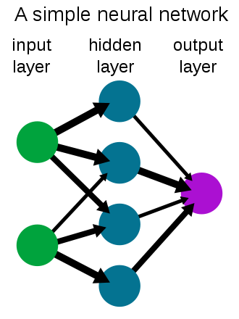
Neural Networks
A neural network is a network or circuit of neurons composed of artificial neurons or nodes.
Artificial neural networks (ANN) are computing systems that are inspired by the biological neural networks that constitute human brains.
Such systems "learn" to perform tasks by considering examples, generally without being programmed with any task-specific rules.

Slide 30
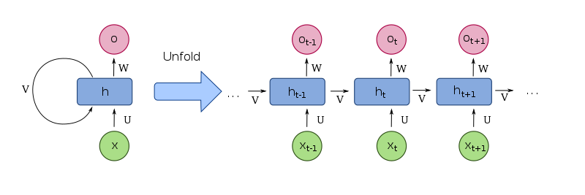
Recurrent Neural Net
The Recurrent Neural Network (RNN) works on the principle of saving the output of a layer and feeding this back to the input to help in predicting the outcome of the layer.
It main allow it to process temporal data or data in a sequential order

Slide 31
Simple Example of Neural Network
The diagram shows a neural network implementation of NAND or Not-AND Gate.
1
1
-15
10
~(A.B)
0 or 1
0 or 1
A
10
A.B
-20
10
0 or 1
B
Input
Layer
Hidden
Layer
Output
Layer

Slide 32
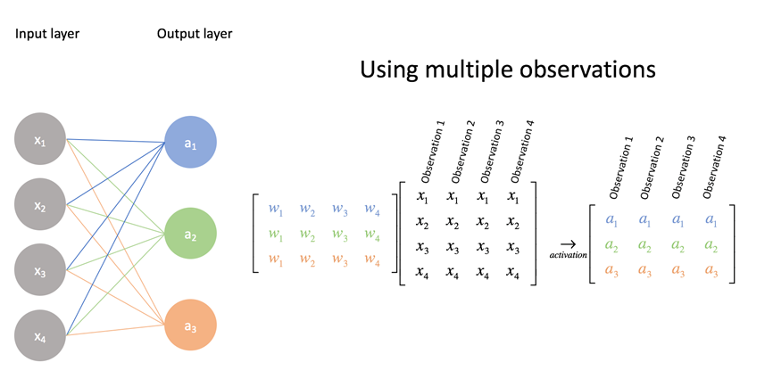
Weight Matrix of Neural Network
Weight Matrix
Input Matrix
Activation Values
θ

Slide 33
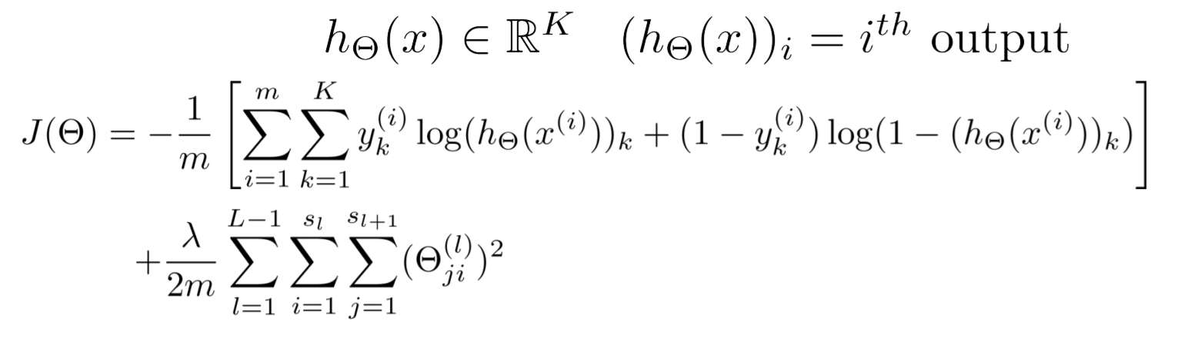
Cost Function of Neural Network
Cost Function of a Neural Network is given by:
Where:
m = number of features
K = number of output layer nodes
L = number of layers in network
θ represents weight matrix

Slide 34
Reducing Cost of Neural Network
Cost function J(θ) represents ‘how wrong the model is’
Higher the cost function, greater the number of errors the model will make.
Therefore we must minimize value of cost function J(θ).
To minimize cost J(θ), there are various methods available.
Examples include Backpropagation algorithm with gradient descent, fmincg(), fminunc().

Slide 35
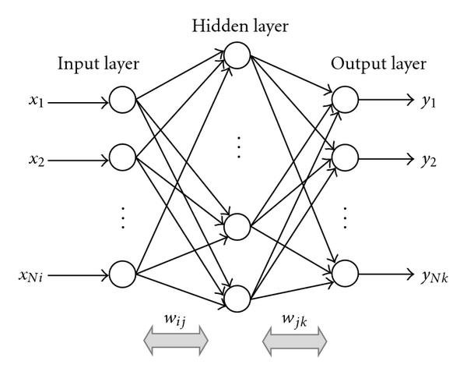
WSD model using Neural Network
Input Feature Vectors
Number of senses of the word
Neural Network for one Ambiguous Word

Slide 36
Word Embeddings
The input feature vector of an ambiguous word for the neural network will be created using its word embeddings.
The vectors we use to represent words are called neural word embeddings
Word Embeddings are created using the words similar and most commonly used context words.
They can be created using various methods such as Word2Vec, Recurrent RNN models such as LSTM, etc.

Slide 37
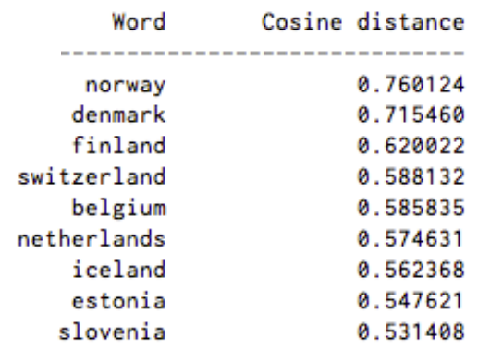
Word Embeddings (cntd)
Word Embeddings can also have a cosine similarity measure: no similarity is expressed as a 0, while total similarity of 1.
While Norway has a cosine distance of 0.760124 from Sweden, the highest of any other country.
Here’s a list of words associated with “Sweden” using Word2vec, in order of proximity:

Slide 38
Word Embeddings (cntd)
For example:
The Word Embedding of the word ‘crown’ will be something like
[ … gold jewels king teeth drill dentist … ]
Using these embeddings, feature vectors will be found using the current input.
“The dentist did a really good job putting the crown on my teeth”
Therefore Feature vector will be:
[ … 0 0 0 1 0 1 … ]

Slide 39
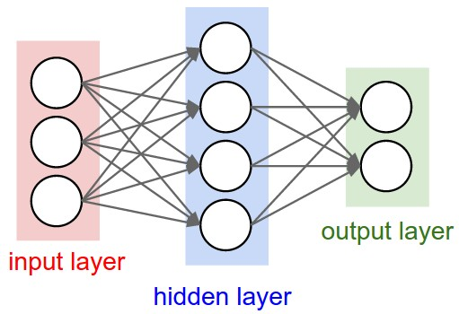
Output of Neural Network
The input feature vector will then be passed to neural net and output will be observed.
The node which calculates the highest value, will correspond to the predicted sense.
Therefore if the 3rd node of output layer will contain highest value, the 3rd sense of the word is correct.
The sense number annotations are given according to WordNet 3.0[10]
0.16
0.78

Slide 40
Datasets
Supervised Machine Learning requires several thousand datasets for effectively training and testing models.
Neural Networks are no different.
List of approximately 1000 highly ambiguous words will be created from various dictionary sources such as dillfrog[13].
Each ambiguous word will have its own neural net and word embeddings.

Slide 41
Datasets (cntd)
Each ambiguous word will have its own neural net and word embeddings.
Training data for all these words will be acquired from open source semantic resources such as SemCor[11] or OMSTI[12].
Both these resources contain hundreds of thousands of sense-tagged datasets for training of WSD models.
OMSTI
One Million Sense Tagged Instances

Slide 42
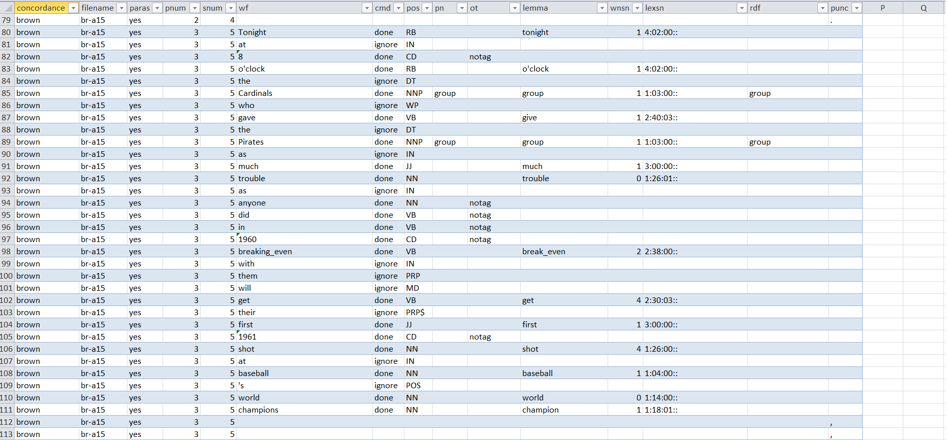
Datasets (cntd)
Sample Sentence from SemCor

Slide 43
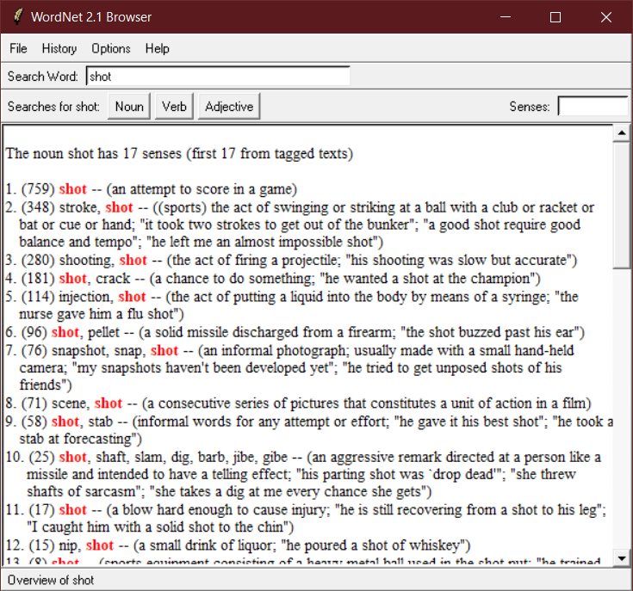
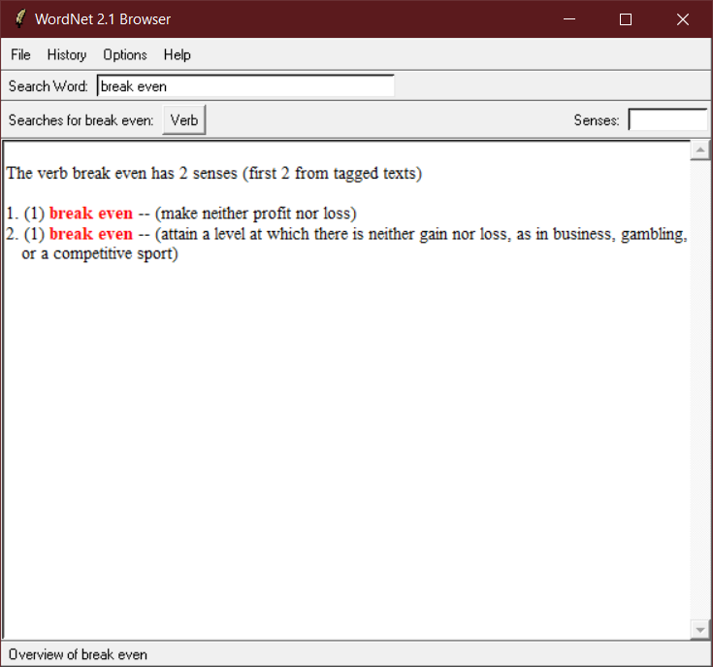
Datasets (cntd)
All words senses are annotated using WordNet 3.0

Slide 44
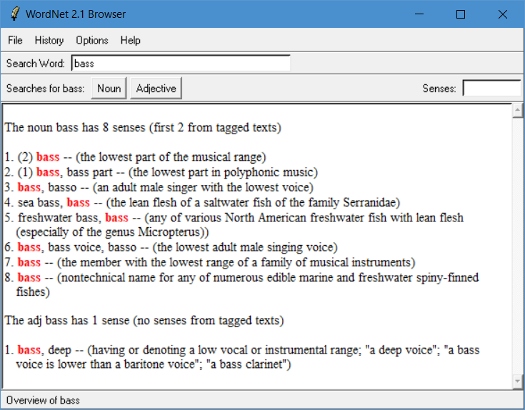
WordNet
All the resources mentioned are annotated using WordNet[10] 3.0
WordNet [10] is a large lexical database of English.
WordNet is open source and is easily imported and executed in plenty of languages.
It’s primary use is in automatic text analysis and artificial intelligence applications.
http://wordnetweb.princeton.edu/perl/webwn
WordNet Application Interface

Slide 45
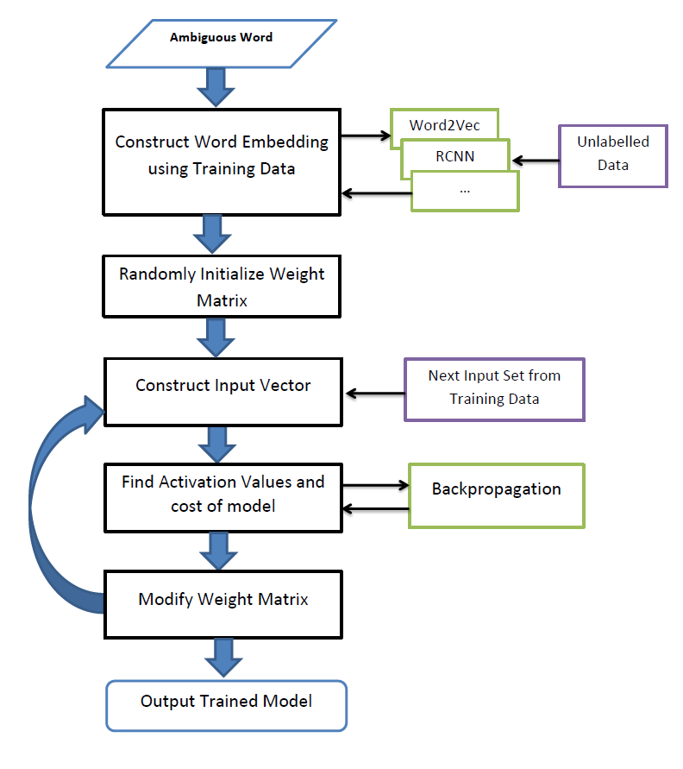
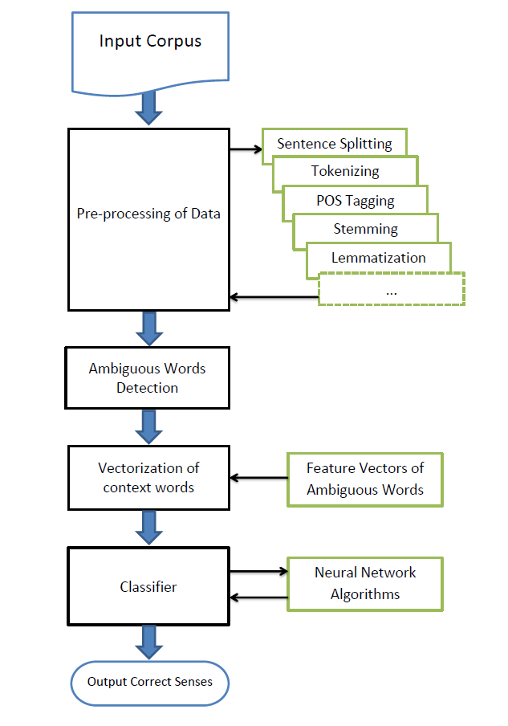
System Architecture
Training
Testing

Slide 46
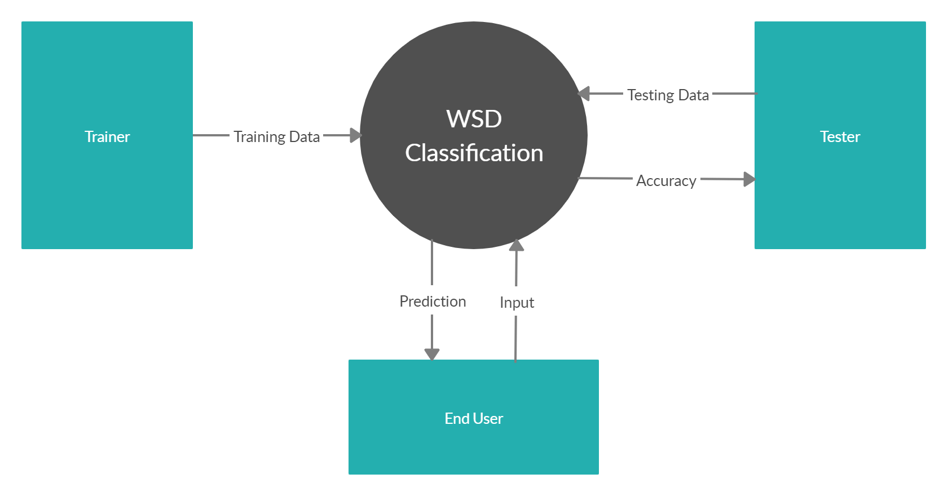
Data Flow Diagram Level 0

Slide 47
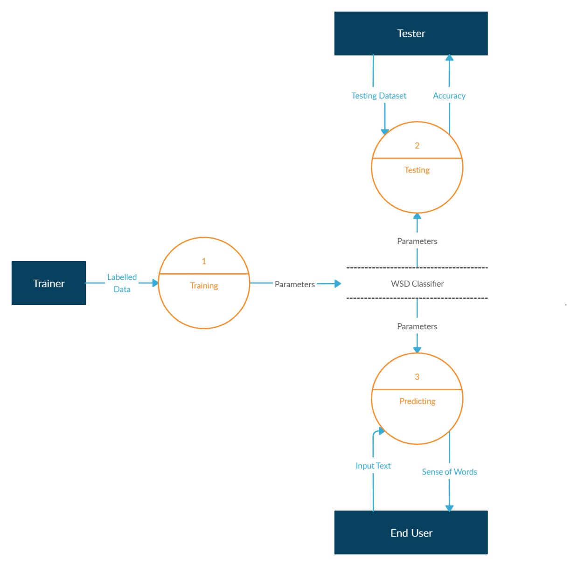
Data Flow Diagram Level 1

Slide 48
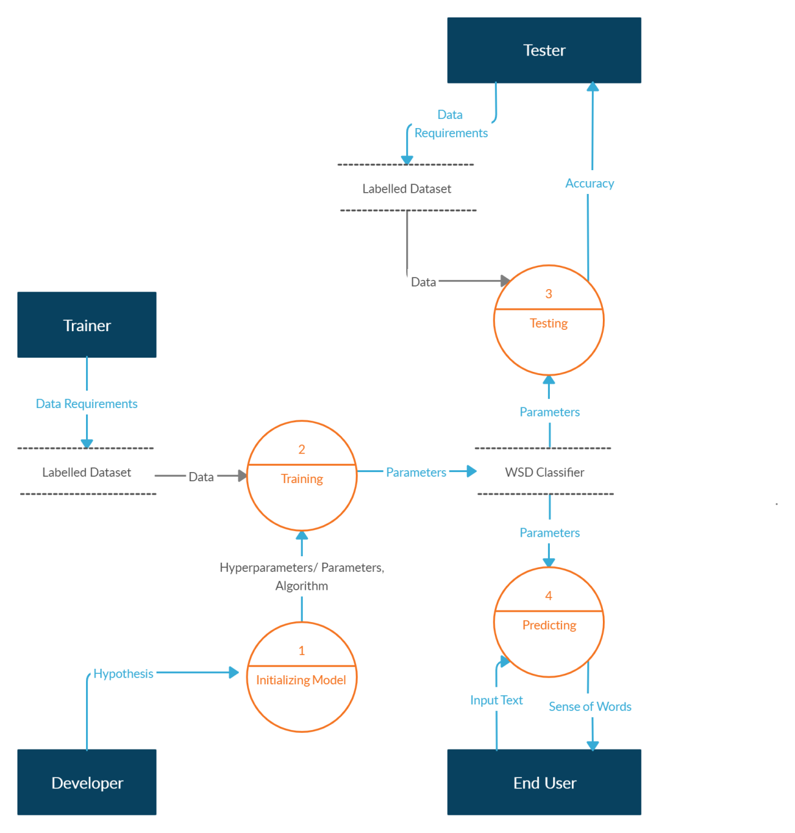
Data Flow Diagram Level 2

Slide 49
Applications
Word sense ambiguity is a very important problem involving various different computer science fields.
Applications of Word Sense Disambiguation include:
  Artificial Intelligence
  Information Retrieval (IR)
  Information Extraction (IE)
  Search Engine Optimization
  Software Assistants
  Voice Command Interpretation

Slide 50
References
[1] Myung Yun Kang, Tae Hong Min, Jae Sung Lee.
"Sense Space for Word Sense Disambiguation".
2018 IEEE International Conference on Big Data and Smart Computing
[2] Pratibha Rani, Vikram Pudi, Dipti M. Sharma
"Semi-supervised Data-Driven Word Sense Disambiguation for Resource- poor Languages"
2017 14th International Conference on Natural Language Processing(ICON)
[3] Ignacio Iacobacci, Mohammad Taher Pilehvar, Roberto Navigli
"Embedding for Word Sense Disambiguation: An Evaluation Study"
2016 Proceedings of the 54th Annual Meeting of the Association for Computational Linguistics, pages 897-907
[4] Udaya Raj Dhungana, Subarna Shakya, Kabita Baral and Bharat Sharma
"Word Sense Disambiguation using WSD Specic WordNet of Polysemy Words"
2015 Proceedings of the 2015 IEEE 9th International Conference on Semantic Computing
[5] Alok Pal, Anupam Munshi and Diganta Saha
An Approach To Speed-up the Word Sense Disambiguation Procedure Through Sense Filtering
2013 International Journal of Instrumentation and Control Systems (IJICS) Vol.3, No.4, October 2013

Slide 51
References (cntd)
[6] Lokesh Nandanwar and Kalyani Mamulkar
"Supervised, Semi-Supervised and Unsupervised WSD Approaches: An Overview
2013 International Journal of Science and Research (IJSR)
[7] Niladri Chatterjee and Rohit Misra
Word-Sense Disambiguation using Maximum Entropy Model
International Conference on Methods and Models in Computer Science, 2009
[8] Bartosz Broda and Maciej Piasecki.
"Semi-Supervised Word Sense Disambiguation Based on Weakly Controlled Sense Induction".
2009 Proceedings of the International Multiconference on Computer Science and Information Technology
[9] Michael Lesk
Automatic Sense Disambiguation using Machine Readable Dictionaries: How to Tell a Pine Cone from an Ice Cream Cone
Bell communications Research Morristown, NJ 07960

Slide 52
References (cntd)
[10] George A. Miller
WordNet: A Lexical Database for English.
Communications of the ACM Vol. 38, No. 11: 39-41
Bell communications Research Morristown, NJ 07960 https://wordnet.princeton.edu/
[11]George A. Miller
SemCor: Semantically Annotated English Corpus
Princeton University
[12]Kaveh Taghipour and Hwee Tou Ng
One Million Sense-Tagged Instances for Word Sense Disambiguation and Induction
2015 Conference on Computational Language Learning
[13]https://muse.dillfrog.com/
Online Dictionary
[14] Dayu Yuan, Julian Richardson, Ryan Doherty, Colin Evans, Eric Altendorf
2016 Semi-Supervised Word Sense Disambiguation with Neural Models
Google, Mountain View CA, USA

