Slide 1

SMART INDIA HACKATHON 2026
Problem Statement ID –26176
Problem Statement Title- ORCA Marine EcOsystem Reasoning with Collaborative Agents
Theme-Disaster Management
PS Category- Software
Team ID-
Team Name-ALT F4

Slide 2
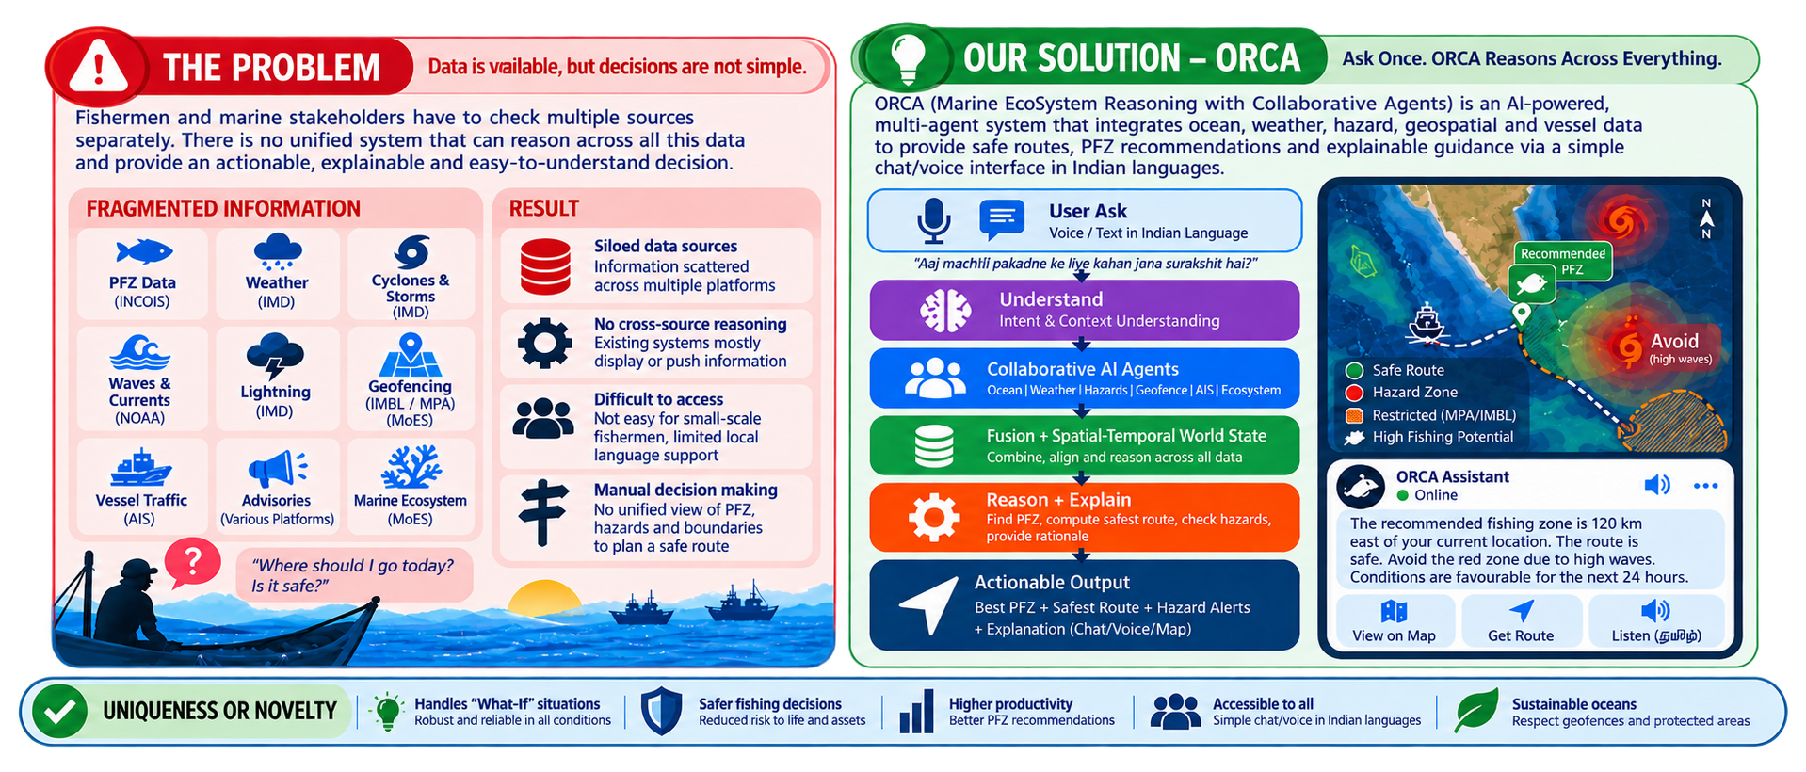
ORCA MARINE ECOSYSTEM REASONING WITH COLLABORATIVE AGENTS
ALT F4

Slide 3
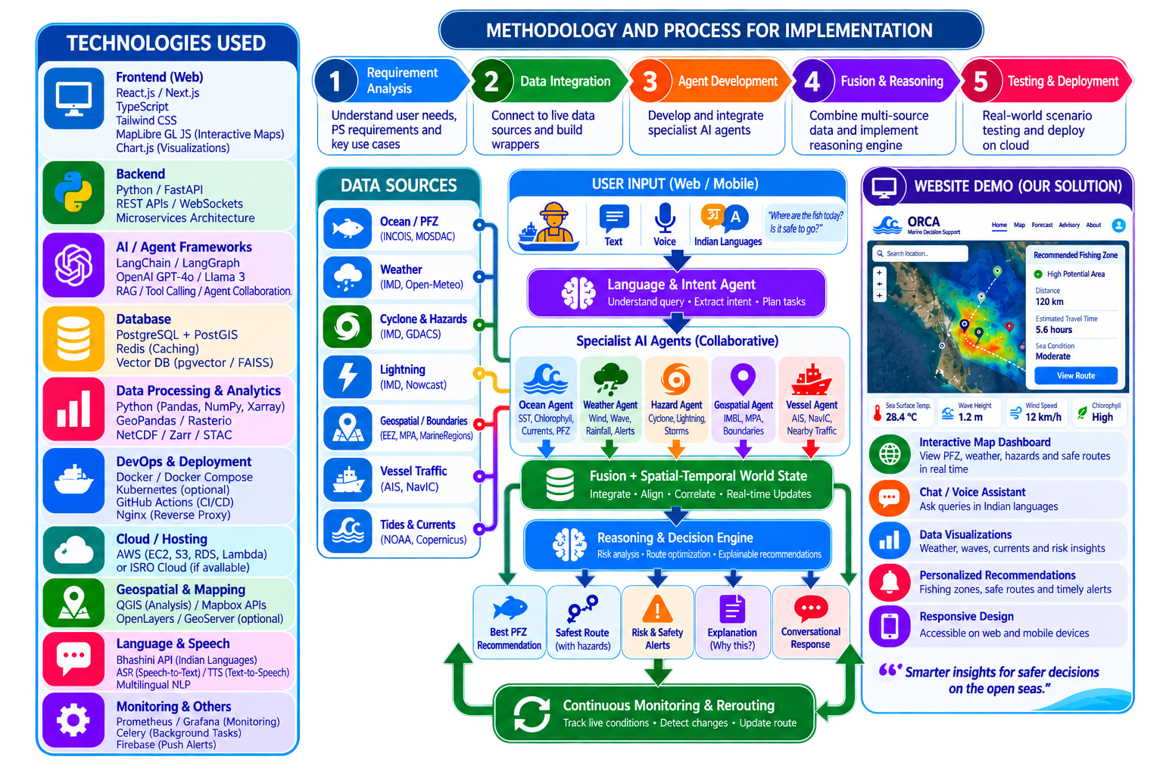
TECHNICAL APPROACH
ALT F4

Slide 4
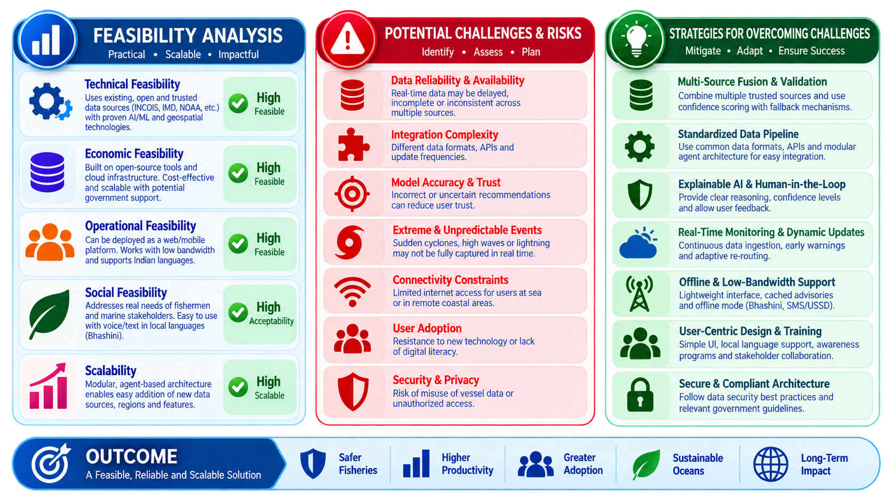
FEASIBILITY AND VIABILITY
ALT F4

Slide 5
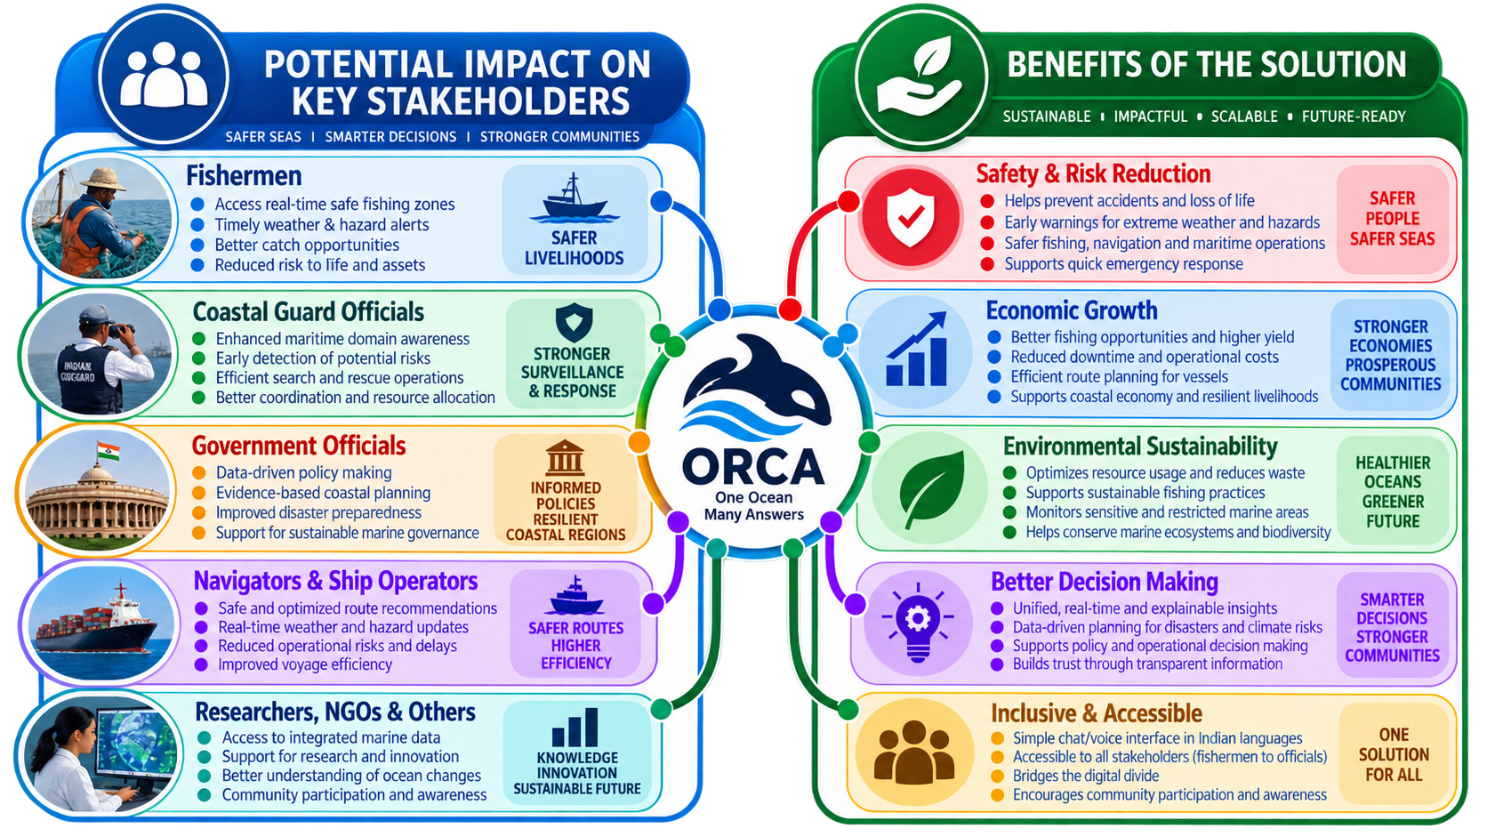
IMPACT AND BENEFITS
ALT F4

Slide 6
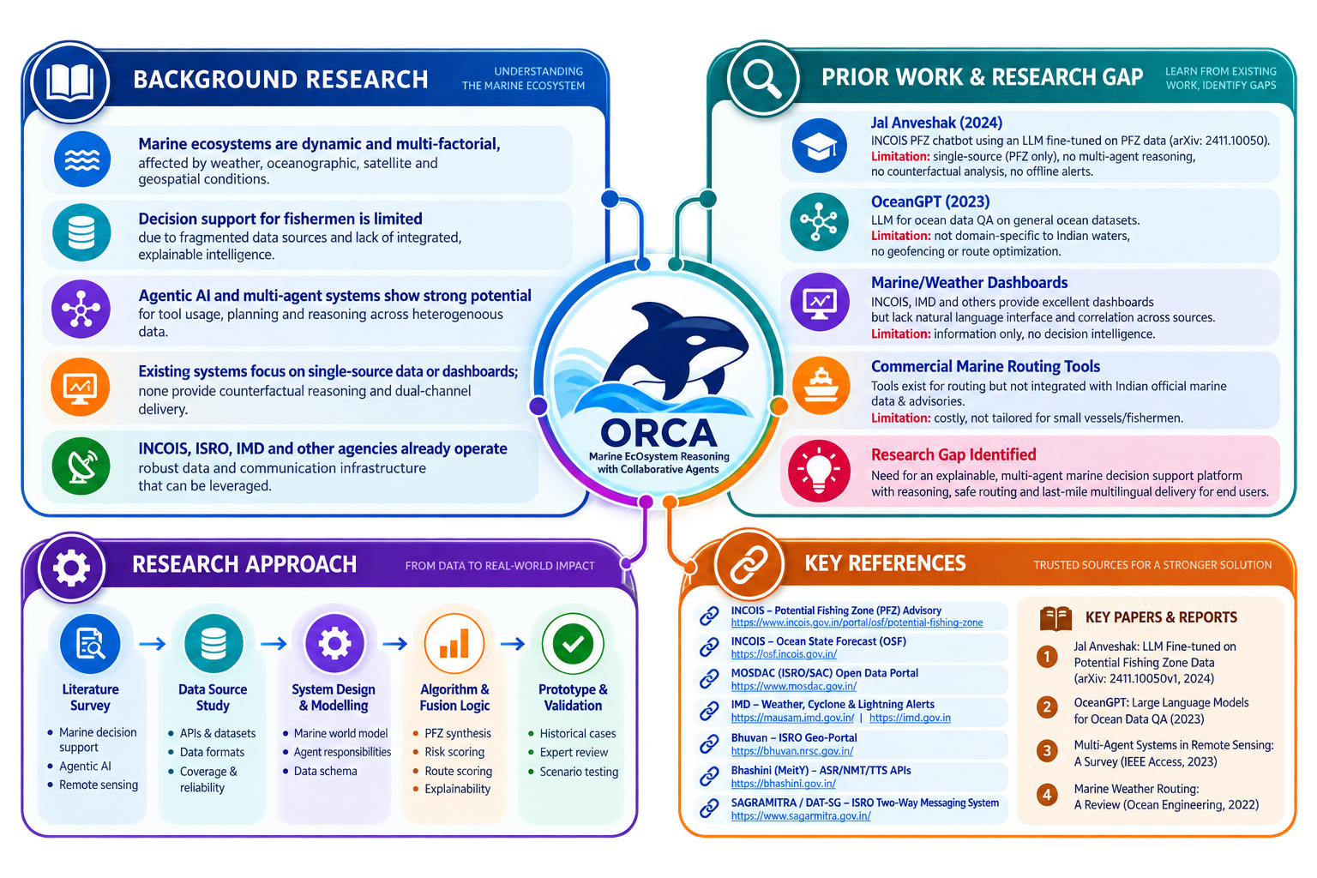
RESEARCH AND REFERENCES
ALT F4

