Slide 1


Slide 2
Content Filtering
d.ML, Winter 2018-2019
Notes:
This presentation is about content filtering, but it’s actually about ethical responsibility

Slide 3
What are some content filters used in the world around us?
Notes:
nintendo online chat, reddit, radio songs, all newspapers, academia, history!

Slide 4

What are some content filters used in the world around us?

Slide 5
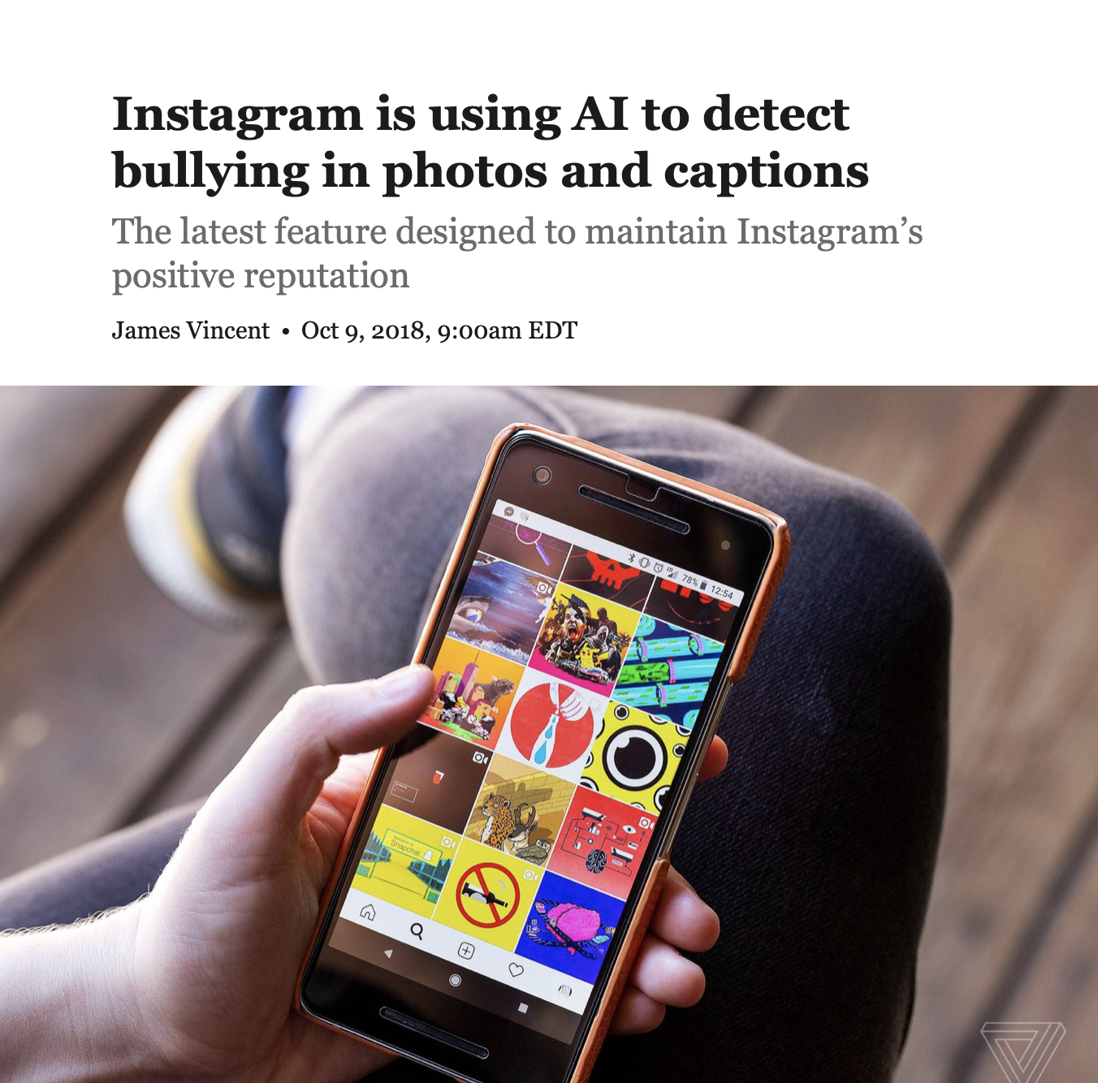
What are some content filters used in the world around us?

Slide 6
In a global world, machines are absolutely necessary to make sense of information. However, is ML necessary?
Notes:
Examples of content filtering online that isn’t automated? Examples of content filtering that is?

Slide 7
So what is the role of design in this landscape?
Notes:
Designers take responsibility for making great products. Designers ensure that products provide the most possible value to users.

Slide 8


Slide 9
242 | Redirecting a substantial existing page - new user throttle | Throttle, Disallow
247 | Adding emails in articles | Warn, Tag
249 | New user conducting large scale reverts | Throttle, Tag
260 | Common vandal phrases | Disallow
261 | Page creation throttle for new users | Throttle, Disallow
264 | Specific-page vandalism | Disallow
271 | Possible spambot | Warn
279 | Repeated attempts to vandalize | Throttle, Tag
285 | Common Vandalism | Disallow
287 | Sanders conspiracies | Disallow
294 | Personal attacks | Disallow
316 | Subtle changes to articles | Throttle
320 | "Your mom" Vandalism | Warn, Disallow
323 | Undoing anti-vandalism bot | Tag
339 | Claims of homosexuality, bisexuality, or transexuality in a BLP | Tag
345 | Extraneous formatting from browser extension | Warn, Tag
346 | Large non-English contributions | Warn, Tag
351 | Text added after categories and interwiki | Warn, Tag
354 | Promotional text added by user to own user(-talk) page | Tag
358 | Od Mishehu's test filter
364 | Changing the name in a BLP infobox | Tag
365 | Unusual changes to featured or good content | Warn, Disallow
380 | Multiple obscenities | Disallow
384 | Addition of bad words or other vandalism | Disallow
391 | Changing height/weight in an infobox | Tag
397 | Userpage vandalism | Disallow
398 | Test filter 398 | Throttle
420 | Large removal of talk page content by IP | Throttle, Disallow
422 | Possible template vandalism | Disallow
425 | Magic/astrology spambots
432 | Starting new line with lowercase letters | Warn, Tag
459 | Long-term block evasion | Disallow
464 | Possible open proxy | Warn
465 | FIFA IP hopper from Lima, Peru | Disallow
466 | Userspace & talk page spamming | Warn, Tag
478 | Talk page abuse | Disallow
491 | Edits ending with emoticons or ! | Warn, Tag
499 | Possible spambot or promotional username
519 | Possible sockpuppets
527 | T34234: log/throttle possible sleeper account creations | Throttle
534 | Preuss filter | Disallow
545 | British Railways/Bus vandal
547 | Cat Creek | Disallow
550 | nowiki tags inserted into an article | Tag
554 | top100 blog charts | Warn, Disallow
559 | archive.is additions
560 | The "truly" vandal | Warn
579 | Possible sockpuppet account creations
590 | Unicode replacement characters
591 | Christian2941

Slide 10
'''xHamster''' is welcome to Wikipedia, where literally anyone can edit any article that isn’t locked. Since this one is about a porn site, some random guy like me can throw anything in. Like this! Waffles waffles waffles waffles waffles waffles waffles waffles waffles waffles. Don’t use this site for anything serious, because it could be just made up nonsense. Anyway, back the the article. I won’t edit anymore. [[pornography|pornographic]] media and [[social networking]] site headquartered in [[Limassol]], [[Cyprus]].<ref name="TNW-BW"/> xHamster serves user-submitted pornographic videos, [[webcam model]]s, pornographic photographs, and [[erotic literature]], and incorporates social networking features. xHamster was founded in 2007. With more than 10 million members, it is the third most popular pornography website on the Internet after [[XVideos]] and [[Pornhub]].

Slide 11
Let’s assess the role of machine learning in changing the spam filtering process

Slide 12
[quick demo]

Slide 13
Let’s outline the trade-offs between the current process and an ML-driven process

Slide 14
Your first guided investigation is:
Using insights from stakeholder interviews, data, and team research, redesign the process for filtering spam and editing pages on Wikipedia.

Slide 15
Deliverable
A 4-minute team presentation that answers the prompt and addresses the question of: should or should not the editing process incorporate machine learning?

Slide 16
Deliverable
Each team member must speak in your presentation.
Slides, demos, and concepts encouraged.
The presentation should outline your design process as well as your proposal.
Hand in your brainstorming sheets along with a print-out of your presentation materials.

Slide 17
What We Expect
Meet several times outside of class. Plan your group meetings as soon as possible (after class if possible!)

Slide 18
What We Expect
Meet several times outside of class. Plan your group meetings as soon as possible (after class if possible!)
Do first-hand interviews. You can search the web for a list of wikipedia’s biggest contributing editors. Schedule time with them. Read news. Ask your network about their use of Wikipedia.

Slide 19
What We Expect
Meet several times outside of class. Plan your group meetings as soon as possible (after class if possible!)
Do first-hand interviews. You can search the web for a list of wikipedia’s biggest contributing editors. Schedule time with them. Read news. Ask your network about their use of Wikipedia.
Define a stance: what should the process and outcomes look like? Start fresh!

Slide 20
What We Expect
Meet several times outside of class. Plan your group meetings as soon as possible (after class if possible!)
Do first-hand interviews. You can search the web for a list of wikipedia’s biggest contributing editors. Schedule time with them. Read news. Ask your network about their use of Wikipedia.
Define a stance: what should the process and outcomes look like? Start fresh!
Brainstorm ideas with your group, and select a few promising ones to model and prototype.

Slide 21
Suggestions & Starting Points
Find potential data sets and explore them for insights. What is the data capable of doing, and what is it not?

Slide 22
Suggestions & Starting Points
Find potential data sets and explore them for insights. What is the data capable of doing, and what is it not?
Map out the stakeholders of wikipedia (this includes more than editors and users)

Slide 23
Suggestions & Starting Points
Find potential data sets and explore them for insights. What is the data capable of doing, and what is it not?
Map out the stakeholders of wikipedia (this includes more than editors and users)
Ask yourself: what is the mission behind Wikipedia, and what about that mission is explicitly vs. implicitly encoded in the organizational structure?

Slide 24
Suggestions & Starting Points
Find potential data sets and explore them for insights. What is the data capable of doing, and what is it not?
Map out the stakeholders of wikipedia (this includes more than editors and users)
Ask yourself: what is the mission behind Wikipedia, and what about that mission is explicitly vs. implicitly encoded in the organizational structure?
There are many kinds of adverse actors, e.g. trolls, paid marketers, etc. How can your solution be resilient?

Slide 25
Project Groups
Team 1: Daniel Levine, Angelica Willis, James Liu
Team 2: Barr Yaron, Andrew Huang, Gal Ron
Team 3: Jooyeon Song, Zhihao Lin, Vikram Jindal
Team 4: Zoe, King Alandy Dy, Tianxing Ma
Team 5: Ting-Wei Su, Ian Taylor, Erica Pincus
Team 6: Katia, Marcy, Farid Soroush
Team 7: Sam Yang, Tyler Su, Alexander Maschmedt
Auditors: creates 3-person teams with each other

Slide 26
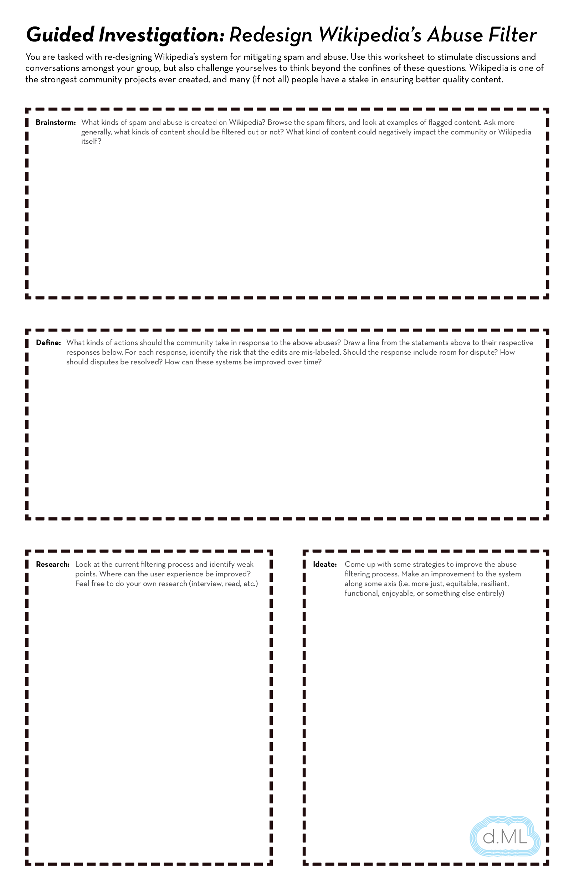

Slide 27
What is an ML Prototype?
Notes:
Assess - understand broad categories of user behaviors, and understand differences in user experiences. Identify edge cases and false positives. Interview stakeholders. Map key tensions, journeys, experiences, and moments in the product.
Envision - Imagine and create new experiences or possibilities for your product. Drive organizational transformation based on creative possibilities. Give creative input and become the voice for the user.
Facilitate - Bring together diverse skill-sets who can inform aspects of your product or concept. Create shared spaces and frameworks. Encourage open-ended thinking.

Slide 28

Assess
Envision
Facilitate
Notes:
Assess - understand broad categories of user behaviors, and understand differences in user experiences. Identify edge cases and false positives. Interview stakeholders. Map key tensions, journeys, experiences, and moments in the product.
Envision - Imagine and create new experiences or possibilities for your product. Drive organizational transformation based on creative possibilities. Give creative input and become the voice for the user.
Facilitate - Bring together diverse skill-sets who can inform aspects of your product or concept. Create shared spaces and frameworks. Encourage open-ended thinking.

Slide 29
Machine Learning doesn’t change the product. It is the product.
Notes:
Designers take responsibility for making great products. Designers ensure that products provide the most possible value to users.

Slide 30
Machine Learning doesn’t change the user experience. It is the user experience.
Notes:
Designers take responsibility for making great products. Designers ensure that products provide the most possible value to users.

Slide 31
Machine Learning doesn’t change the business. It is the business.
Notes:
Designers take responsibility for making great products. Designers ensure that products provide the most possible value to users.

