Slide 1
Data Flow in an ML system
d.ML, Winter 2018-19
Notes:
Data flow in an ML system
Example: https://teachablemachine.withgoogle.com/
Labs based on: https://github.com/dlab-berkeley/R-Fundamentals
"Simple outline of learning"
A learning system can be described at a high level as such
Step one observe one or more examples, step two find relevant features to interpret, step three create a rule that evaluates your features, apply that rule and output the result, and optionally to observe a "true" result and use that to revise your features and rules. This is how humans learn from experience. Machine learning operates on the same structural principles.
Some people have outlined ML as taking up three 'categories' -- detection, prediction, and generation. [explain the three]. However, as designers, this classification limits our creative thinking skills, by ignoring the different kinds of human machine interaction that take place in between these distinctions. There's predictive detection, predictive generation, generative detection and so on.

Slide 2
Data design
Model design
Output design
Data
Model Interaction
Data Cleaning
Model
Evaluating
Model Output
Model Building
Notes:
https://coolors.co/83c4e4-ff99c8-fcf6bd-d0f4de-e4c1f9
What would this look like on a sheet of paper
Key ideas and learning objectives into a visually digestable format
5 pieces - but what is the designers role in each of these pieces, how do each of these benefit from design
This is a process model for a ML thing, but misses the “why use ml” -- this is to go from stated problem to stated solution
“Why do this?”
Model output + model interaction?
Goal: have some form of presentation for this model - have a print out
Missing:
Human element
Data roadmap

Slide 3
Data design
Model design
Output design
Data
Model Output
Data Cleaning
Model
Evaluating
Model Building
Notes:
https://coolors.co/83c4e4-ff99c8-fcf6bd-d0f4de-e4c1f9
What would this look like on a sheet of paper
Key ideas and learning objectives into a visually digestable format
5 pieces - but what is the designers role in each of these pieces, how do each of these benefit from design
This is a process model for a ML thing, but misses the “why use ml” -- this is to go from stated problem to stated solution
“Why do this?”
Model output + model interaction?
Goal: have some form of presentation for this model - have a print out
Missing:
Human element
Data roadmap

Slide 4
Data design
Model design
Output design
Data
Model Output
Data Cleaning
Model
Evaluating
Model Building
Notes:
https://coolors.co/83c4e4-ff99c8-fcf6bd-d0f4de-e4c1f9
What would this look like on a sheet of paper
Key ideas and learning objectives into a visually digestable format
5 pieces - but what is the designers role in each of these pieces, how do each of these benefit from design
This is a process model for a ML thing, but misses the “why use ml” -- this is to go from stated problem to stated solution
“Why do this?”
Model output + model interaction?
Goal: have some form of presentation for this model - have a print out

Slide 5
Data
All machine learning models need data
Where does your data come from?
What is the type() of each of the variables (columns)
Key vocab:
Training data - the data you use to train your ML model
Data type - the type/format of your data (string/integer)
Animal | Legs | Furry | Sound
Cat | 4 | Yes | Meow
Dog | 4 | Yes | Woof
Pig | 4 | No | Oink
Lizard | 4 | No | N/A
... | ... | ... | ...

Slide 6
Data Cleaning
Format the data in a way that the computer can read it
Might choose to exclude missing values
Explore your data - look for trends that might inform you
Remember - how was your data collected? How is it going to be used?
Key vocab:
Normalizing
Remove NA
Animal | Legs | Furry | Sound
Cat | 4 | Yes | Meow
Dog | 4 | Yes | Woof
Pig | 4 | No | Oink
Lizard | 4 | No | N/A
... | ... | ... | ...
Animal | Legs | Furry
Cat | 4 | 1
Dog | 4 | 1
Pig | 4 | 0
Lizard | 4 | 0
... | ... | ...
Notes:
https://elitedatascience.com/data-cleaning

Slide 7
Data design
Model design
Output design
Data
Model Output
Data Cleaning
Model
Evaluating
Model Building
Notes:
https://coolors.co/83c4e4-ff99c8-fcf6bd-d0f4de-e4c1f9
What would this look like on a sheet of paper
Key ideas and learning objectives into a visually digestable format
5 pieces - but what is the designers role in each of these pieces, how do each of these benefit from design
This is a process model for a ML thing, but misses the “why use ml” -- this is to go from stated problem to stated solution
“Why do this?”
Model output + model interaction?
Goal: have some form of presentation for this model - have a print out

Slide 8
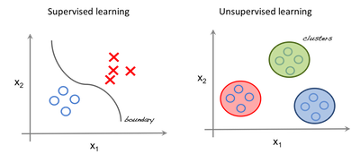
Model Building
Ask yourself: What type of problem are you trying to solve?
Data + Algorithm = model
Algorithm:
Clustering, Regression, Decision Tree, etc.
Key vocab:
Supervised vs Unsupervised learning
Supervised - knowing what the data should be, categorizing
Unsupervised - letting the ML find patterns for you
Algorithm

Slide 9
What can Machine Learning do?
Classification of new data
Dog or cat?
Find trends and patterns (regression, clustering)
What can’t ML do?
Clean your data!
Identify patterns that ARE NOT in the data
Animal | Legs | Furry | Sound
Cat | 4 | Yes | Meow
Dog | 4 | Yes | Woof
Pig | 4 | No | Oink
Lizard | 4 | No | N/A
... | ... | ... | ...
Animal | Legs | Furry
Cat | 4 | 1
Dog | 4 | 1
Pig | 4 | 0
Lizard | 4 | 0
... | ... | ...
Notes:
https://thenewstack.io/what-machine-learning-can-and-cant-do/

Slide 10
Model Evaluating
How well can your model [predict] unseen data?
Key vocab:
Test Data
Precision
Recall
Confidence Interval
Animal | Legs | Furry
Cat | 4 | 1
Dog | 4 | 1
Pig | 4 | 0
Lizard | 4 | 0
... | ... | ...
Animal | Legs | Furry
Cat | 4 | 1
Pig | 4 | 0
Parrot | 2 | 0
... | ... | ...

Slide 11
Data design
Model design
Output design
Data
Model Output
Data Cleaning
Model
Evaluating
Model Building
Notes:
https://coolors.co/83c4e4-ff99c8-fcf6bd-d0f4de-e4c1f9
What would this look like on a sheet of paper
Key ideas and learning objectives into a visually digestable format
5 pieces - but what is the designers role in each of these pieces, how do each of these benefit from design
This is a process model for a ML thing, but misses the “why use ml” -- this is to go from stated problem to stated solution
“Why do this?”
Model output + model interaction?
Goal: have some form of presentation for this model - have a print out

Slide 12
Model Output
What will the output of your model look like?
Key vocab:
Confidence Interval
Bayesian

Slide 13
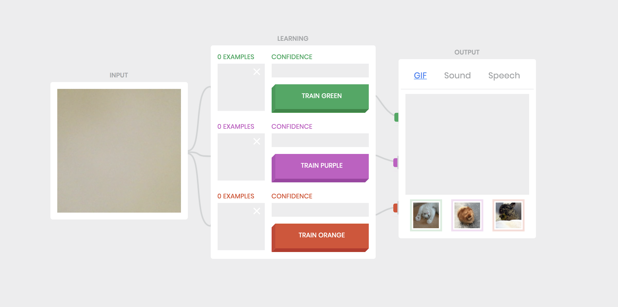
https://teachablemachine.withgoogle.com/

Slide 14
Old slides

Slide 15
Animal | Legs | Furry
Cat | 4 | 1
Pig | 4 | 0
Parrot | 2 | 0
... | ... | ...
Data
Data Cleaning
Model Building
Model
Evaluating
Select an algorithm based on the problem you’re trying to solve
Does this predict well?
…
Supervised vs unsupervised
Animal | Legs | Furry | Sound
Cat | 4 | Yes | Meow
Dog | 4 | Yes | Woof
Pig | 4 | No | Oink
Lizard | 4 | No | N/A
... | ... | ... | ...
Animal | Legs | Furry
Cat | 4 | 1
Dog | 4 | 1
Pig | 4 | 0
Lizard | 4 | 0
... | ... | ...

Slide 16
Animal | Legs | Furry
Cat | 4 | 1
Pig | 4 | 0
Parrot | 2 | 0
... | ... | ...
Data
Data Cleaning
Model Building
Model
Evaluating
Select an algorithm based on the problem you’re trying to solve
Does this predict well?
…
Supervised vs unsupervised
Animal | Legs | Furry | Sound
Cat | 4 | Yes | Meow
Dog | 4 | Yes | Woof
Pig | 4 | No | Oink
Lizard | 4 | No | N/A
... | ... | ... | ...
Animal | Legs | Furry
Cat | 4 | 1
Dog | 4 | 1
Pig | 4 | 0
Lizard | 4 | 0
... | ... | ...

Slide 17
Data
All machine learning models need data
Where does your data come from?
What is the type() of each of the variables (columns)
Key vocab:
Training data - the data you use to train your ML model
Data type - the type/format of your data (string/integer)
Animal | Legs | Furry | Sound
Cat | 4 | Yes | Meow
Dog | 4 | Yes | Woof
Pig | 4 | No | Oink
Lizard | 4 | No | N/A
... | ... | ... | ...

Slide 18
Data - try for yourself!
Animal | Legs | Furry | Sound
Cat | 4 | Yes | Meow
Dog | 4 | Yes | Woof
Pig | 4 | No | Oink
Lizard | 4 | No | N/A
... | ... | ... | ...
Open Python (premade workbook - just run code)

Slide 19
Animal | Legs | Furry
Cat | 4 | 1
Pig | 4 | 0
Parrot | 2 | 0
... | ... | ...
Data
Data Cleaning
Model Building
Model
Evaluating
Select an algorithm based on the problem you’re trying to solve
Does this predict well?
…
Supervised vs unsupervised
Animal | Legs | Furry | Sound
Cat | 4 | Yes | Meow
Dog | 4 | Yes | Woof
Pig | 4 | No | Oink
Lizard | 4 | No | N/A
... | ... | ... | ...
Animal | Legs | Furry
Cat | 4 | 1
Dog | 4 | 1
Pig | 4 | 0
Lizard | 4 | 0
... | ... | ...

Slide 20
Data Cleaning
Animal | Legs | Furry | Sound
Cat | 4 | Yes | Meow
Dog | 4 | Yes | Woof
Pig | 4 | No | Oink
Lizard | 4 | No | N/A
... | ... | ... | ...
Format the data in a way that the computer can read it
Might choose to exclude missing values
Explore your data - look for trends that might inform you
Remember - how was your data collected? How is it going to be used?
Key vocab:
Normalizing
Remove NA
Animal | Legs | Furry
Cat | 4 | 1
Dog | 4 | 1
Pig | 4 | 0
Lizard | 4 | 0
... | ... | ...
Notes:
https://elitedatascience.com/data-cleaning

Slide 21
Data Cleaning - try for yourself!
Animal | Legs | Furry | Sound
Cat | 4 | Yes | Meow
Dog | 4 | Yes | Woof
Pig | 4 | No | Oink
Lizard | 4 | No | N/A
... | ... | ... | ...
Premade python notebook
Animal | Legs | Furry
Cat | 4 | 1
Dog | 4 | 1
Pig | 4 | 0
Lizard | 4 | 0
... | ... | ...
Notes:
https://elitedatascience.com/data-cleaning

Slide 22
Animal | Legs | Furry
Cat | 4 | 1
Pig | 4 | 0
Parrot | 2 | 0
... | ... | ...
Data
Data Cleaning
Model Building
Model
Evaluating
Select an algorithm based on the problem you’re trying to solve
Does this predict well?
…
Supervised vs unsupervised
Animal | Legs | Furry | Sound
Cat | 4 | Yes | Meow
Dog | 4 | Yes | Woof
Pig | 4 | No | Oink
Lizard | 4 | No | N/A
... | ... | ... | ...
Animal | Legs | Furry
Cat | 4 | 1
Dog | 4 | 1
Pig | 4 | 0
Lizard | 4 | 0
... | ... | ...

Slide 23
Model Building
Ask yourself: What type of problem are you trying to solve?
Data + Algorithm = model
Algorithm:
Clustering, Regression, Decision Tree, etc.
Key vocab:
Supervised vs unsupervised learning
Supervised - knowing what the data should be, categorizing
Unsupervised - letting the ML find patterns for you
Algorithm

Slide 24
What can Machine Learning do?
Animal | Legs | Furry | Sound
Cat | 4 | Yes | Meow
Dog | 4 | Yes | Woof
Pig | 4 | No | Oink
Lizard | 4 | No | N/A
... | ... | ... | ...
Classification of new data
Dog or cat?
Find trends and patterns (regression, clustering)
What can’t ML do?
Clean your data!
Identify patterns that ARE NOT in the data
Animal | Legs | Furry
Cat | 4 | 1
Dog | 4 | 1
Pig | 4 | 0
Lizard | 4 | 0
... | ... | ...
Notes:
https://thenewstack.io/what-machine-learning-can-and-cant-do/

Slide 25
Animal | Legs | Furry
Cat | 4 | 1
Pig | 4 | 0
Parrot | 2 | 0
... | ... | ...
Data
Data Cleaning
Model Building
Model
Evaluating
Select an algorithm based on the problem you’re trying to solve
Does this predict well?
…
Animal | Legs | Furry | Sound
Cat | 4 | Yes | Meow
Dog | 4 | Yes | Woof
Pig | 4 | No | Oink
Lizard | 4 | No | N/A
... | ... | ... | ...
Animal | Legs | Furry
Cat | 4 | 1
Dog | 4 | 1
Pig | 4 | 0
Lizard | 4 | 0
... | ... | ...

Slide 26
Model Evaluating
Animal | Legs | Furry
Cat | 4 | 1
Dog | 4 | 1
Pig | 4 | 0
Lizard | 4 | 0
... | ... | ...
How well can your model [predict] unseen data?
Key vocab:
Test Data
Precision
Recall
Confidence Interval
Animal | Legs | Furry
Cat | 4 | 1
Pig | 4 | 0
Parrot | 2 | 0
... | ... | ...

Slide 27
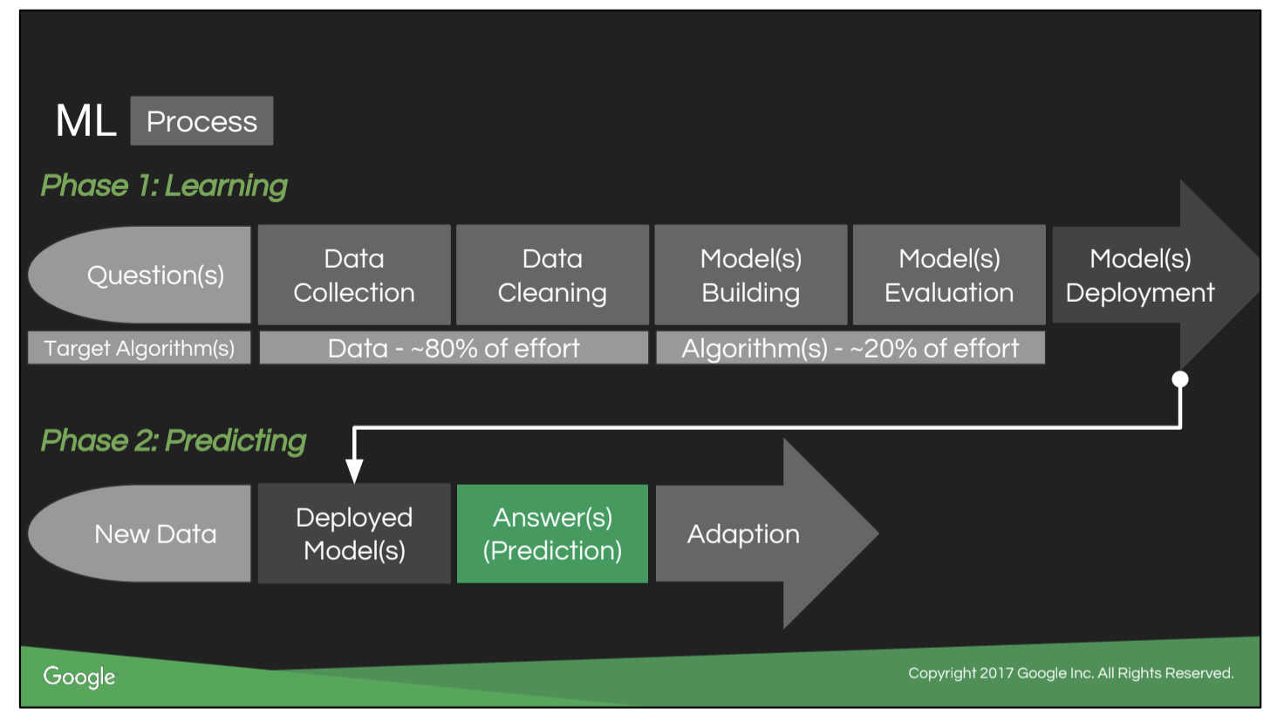
FROM MELODY IVORY - do not use

