Slide 1
PM4Py
Python library for process mining, built on Petri nets
About
Pros
Cons
By: Process Intelligence Solutions (Fraunhofer FIT spin-off)
Licence: AGPL-3.0 (paid licence for closed-source use)
Install: pip install pm4py (v2.7.23, Python ≥ 3.11)
Key features
Process discovery, conformance, performance
P/T Petri nets: build, fire, reachability, soundness
Logs: CSV, XES, OCEL 2.0; models: PNML, BPMN
Learns Petri nets from real event logs
Checks reality against a model (fitness, alignments)
Soundness check, reachability, PNML export built in
Large, active project, frequent releases
Works directly on pandas DataFrames
Tokens are counts only: no data, guards or time
AGPL: company products need a paid licence
Heavy install (numpy, pandas, scipy, cvxopt)
Pictures need Graphviz
Basic state-space tools, no temporal logic

Slide 2
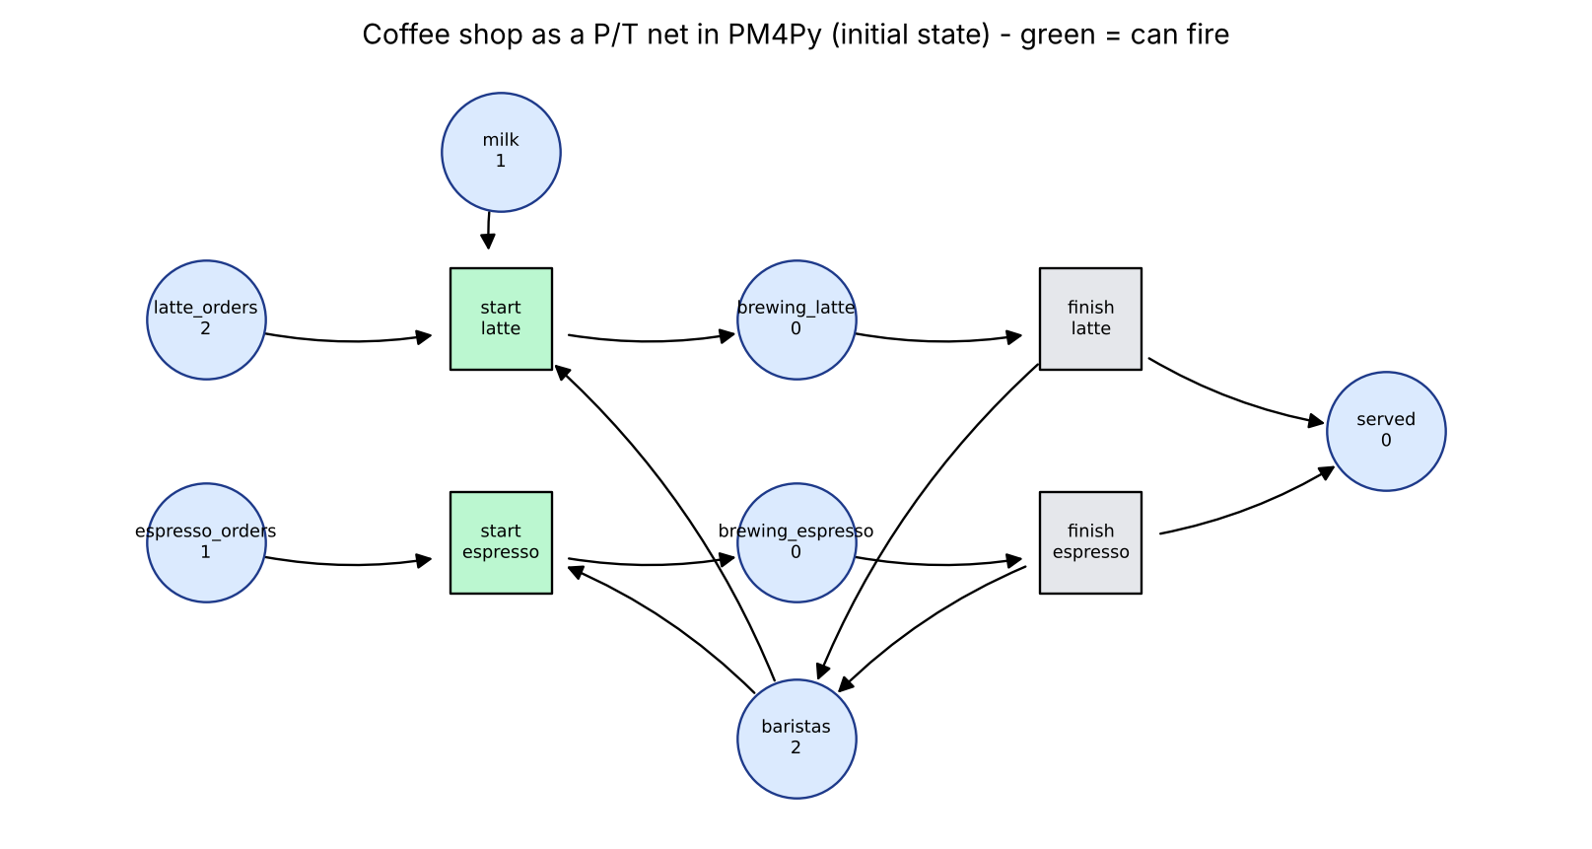
Modelling a Petri net in PM4Py
Same coffee shop: 3 orders, 2 baristas, milk for only 1 latte
from pm4py.objects.petri_net.obj import PetriNet, Marking, InhibitorNet
from pm4py.objects.petri_net.utils.petri_utils import add_arc_from_to as arc
net = InhibitorNet("CoffeeShop") # PetriNet that also allows inhibitor arcs
P = {n: PetriNet.Place(n) for n in ["latte_orders", "espresso_orders", "baristas",
"milk", "brewing_latte", "brewing_espresso", "served"]}
T = {n: PetriNet.Transition(n, n) for n in ["start_latte", "start_espresso",
"finish_latte", "finish_espresso"]}
net.places.update(P.values()); net.transitions.update(T.values())
arc(P["latte_orders"], T["start_latte"], net)
arc(P["baristas"], T["start_latte"], net)
arc(P["milk"], T["start_latte"], net) # latte uses the milk token
arc(T["start_latte"], P["brewing_latte"], net)
arc(P["espresso_orders"], T["start_espresso"], net)
arc(P["baristas"], T["start_espresso"], net)
arc(T["start_espresso"], P["brewing_espresso"], net)
for d in ("latte", "espresso"):
arc(P[f"brewing_{d}"], T[f"finish_{d}"], net)
arc(T[f"finish_{d}"], P["served"], net)
arc(T[f"finish_{d}"], P["baristas"], net) # barista free again
im = Marking({P["latte_orders"]: 2, P["espresso_orders"]: 1,
P["baristas"]: 2, P["milk"]: 1}) # tokens are just counts
fm = Marking({P["served"]: 3, P["baristas"]: 2}) # final marking: all served
Drink type moves into the net: separate latte and espresso places
No guards: "latte needs milk" is just an arc
Final marking marks the "all served" state

Slide 3
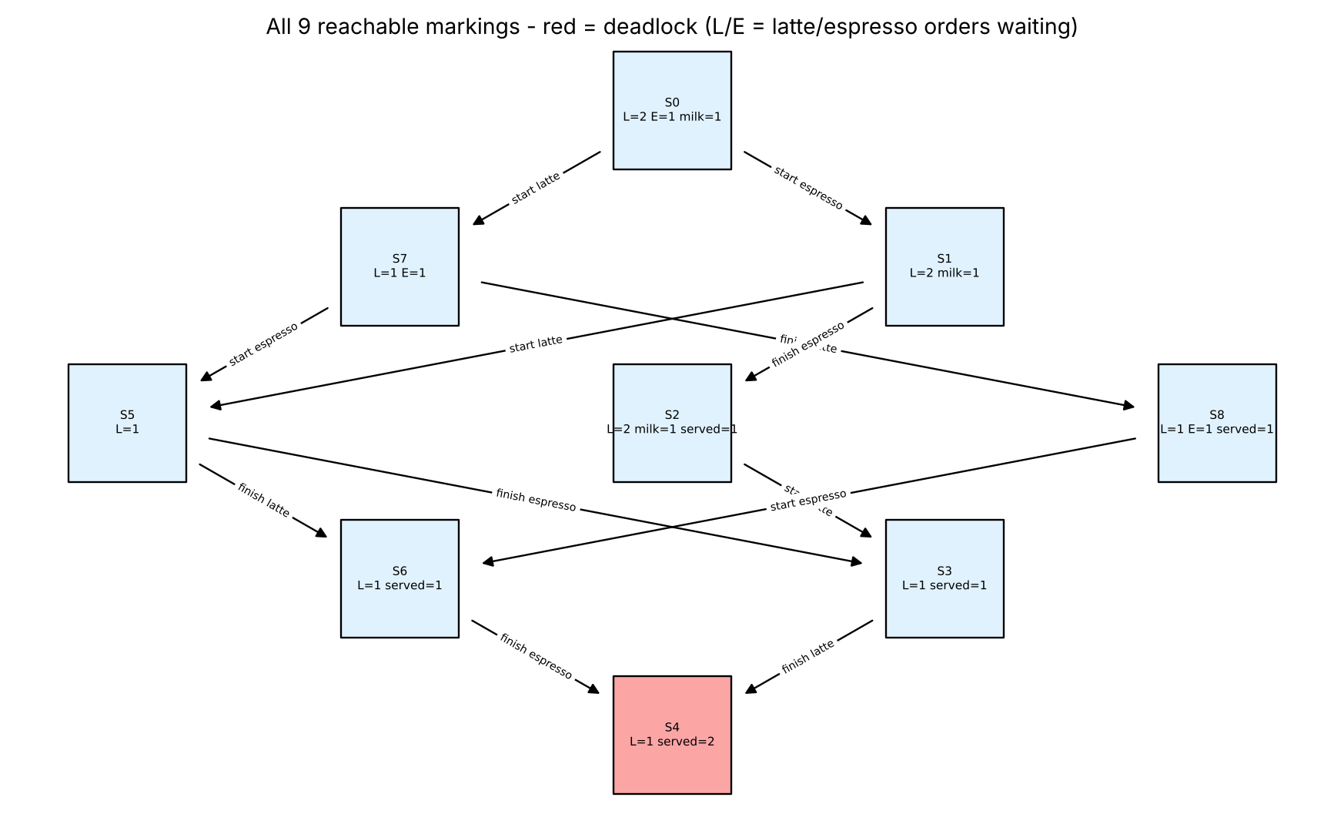
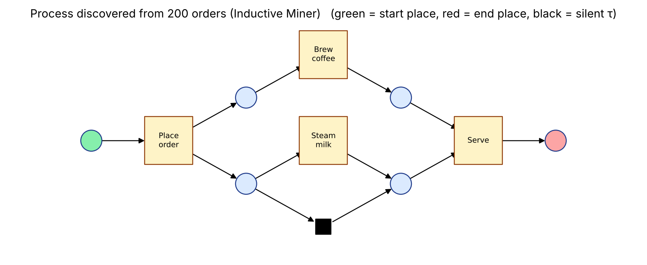
Run it, check it, mine it
Fix needs an inhibitor arc; PM4Py can also learn the process from data
sem = InhibitorResetSemantics()
sem.enabled_transitions(net, im) # start_latte, start_espresso
m1 = sem.execute(T["start_latte"], net, im) # returns a new marking
_, out, _ = rg.marking_flow_petri(net, im,
parameters={rg.Parameters.PETRI_SEMANTICS: sem}) # all markings
dead = [m for m, nxt in out.items() if not nxt and m != fm]
restock = PetriNet.Transition("restock", "restock")
net.transitions.add(restock)
arc(P["milk"], restock, net, type="inhibitor") # fires only when milk = 0
arc(restock, P["milk"], net)
1 deadlock
9 states (orders have no identity)
0 deadlocks
31 states, with the inhibitor arc
# what PM4Py adds: process mining on a log of 200 orders
log = pm4py.format_dataframe(df, case_id="case", activity_key="activity",
timestamp_key="time")
net2, im2, fm2 = pm4py.discover_petri_net_inductive(log) # model from data
pm4py.fitness_alignments(log, wf, wf_im, wf_fm) # 0.973: 6 orders never brewed

