Slide 1
PetriFlow, reviewed
A Petri-net tool gate for AI agents: how it works, what it proves, where it leaks, and what it means for self-evolving agents
90 minutes: 7 live demos, 45 diagrams, every claim points at a file or a run
Source: github.com/joshuaisaact/petri-flow (MIT, commit dcd6196), read and run on 8-10 October 2026
AI tools assisted the reading; every output in this deck was re-executed or re-read by hand
Notes:
Open with the one-line verdict: a real, small, well-engineered runtime gate whose 'formally verified' marketing is one step ahead of its code. Then say what the audience will be able to judge for themselves by the end.

Slide 2
PLAN
Agenda
• 0-10 The problem, and Petri nets in five minutes
• 10-25 Architecture: two products, one library, five adapters
• 25-45 Demos 1-3: analysis is real, the gate without a model, break the proof
• 45-70 Demos 4-7: a real model drives the gate, approvals, forged history, five loopholes
• 70-80 Website vs code: what 'verified' means here
• 80-90 Self-evolving agents: where this sits, what to research
PetriFlow: architecture review, demos, loopholes, research position
2
Notes:
Everything runs offline except demos 4, 5 and 9 which use the Azure OpenAI deployment; each has a MOCK=1 twin.

Slide 3
PART 1
The problem, and the idea
Why a tool gate, and why a Petri net for the policy
3

Slide 4
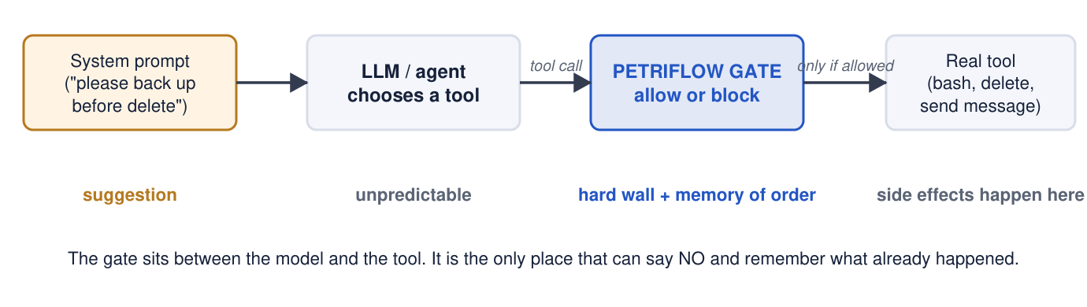
Where should the rule live?
• Prompt: a suggestion, not a wall
• Deny list: never complete
• If-statement in a tool: knows nothing about order across tools
• Approve everything: nobody reads the 40th dialog
• The gap: a component that knows the HISTORY of calls
Prompts, deny lists and if-statements each leak. PetriFlow puts the rule between the model and the tools.
PetriFlow: architecture review, demos, loopholes, research position
4
Notes:
Frame it as an ordering problem: 'backup before delete' is a statement about two different tools over time. None of the usual controls have a memory across tools.

Slide 5
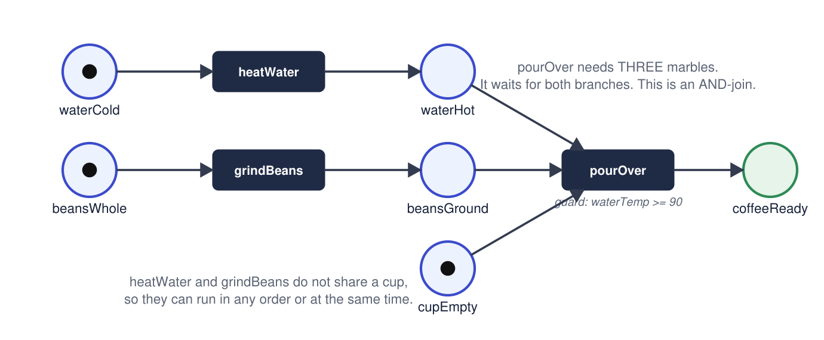
Petri nets in sixty seconds
• Enabled: every input cup has a marble
• Fire: take inputs, put outputs
• Two branches in either order, then a join
• A state machine cannot say AND; a DAG has no tokens, so no budgets or locks
Places are cups, tokens are marbles, transitions are machines. The marking is the whole state.
PetriFlow: architecture review, demos, loopholes, research position
5
Notes:
This is workflows/coffee/definition.ts, 80 lines. The join needs three marbles at once: that is the thing DAGs cannot express.

Slide 6
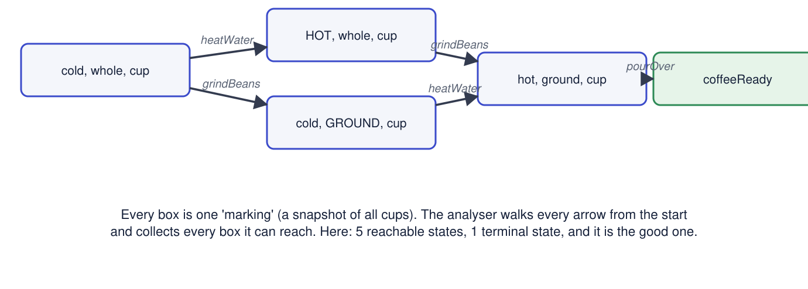
Every possible future: reachability
• Reachable states = all markings you can get to
• Terminal state = nothing can fire (end, or deadlock)
• Invariant = a weighted token count that never changes
• This enumeration is the whole 'proof' machinery
Breadth-first search over markings. Coffee has 5 states and one terminal state.
PetriFlow: architecture review, demos, loopholes, research position
6
Notes:
Say explicitly: the proof technique in this project is exhaustive enumeration of small nets. Nothing symbolic. That is fine for 3-200 states.

Slide 7
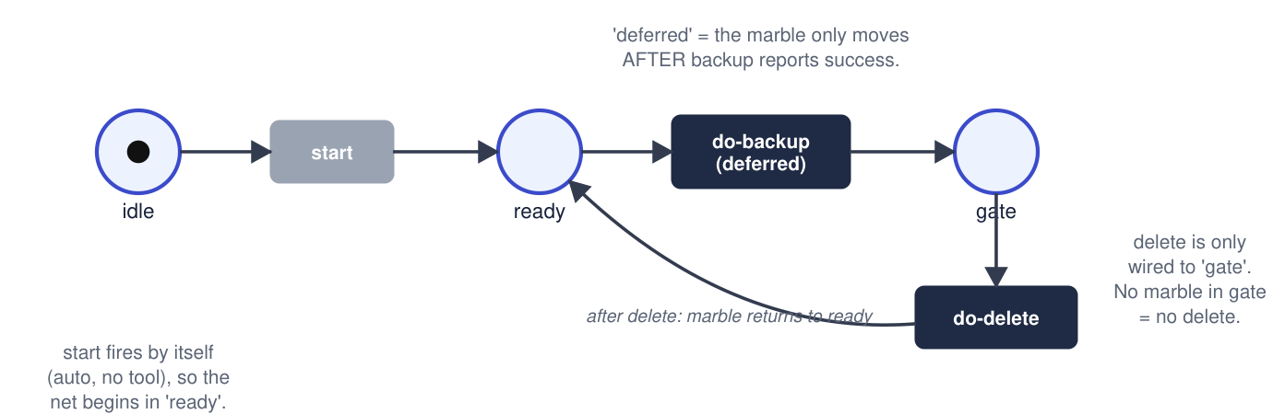
The trick: a rule becomes a shape
• human-approval: a MANUAL transition, 2 states
• block A: reads from a cup that never fills, 2 states
• limit A to N: a budget cup, N+2 states
• map tool.field /regex/ as name: rename by input
• Rules compose by AND across independent nets
'require A before B' compiles to three cups and three machines. Reachable states: 3.
PetriFlow: architecture review, demos, loopholes, research position
7
Notes:
Each template was designed by hand. The compiler counts states; the templates carry the guarantee. Keep this sentence, it returns in part 4.

Slide 8
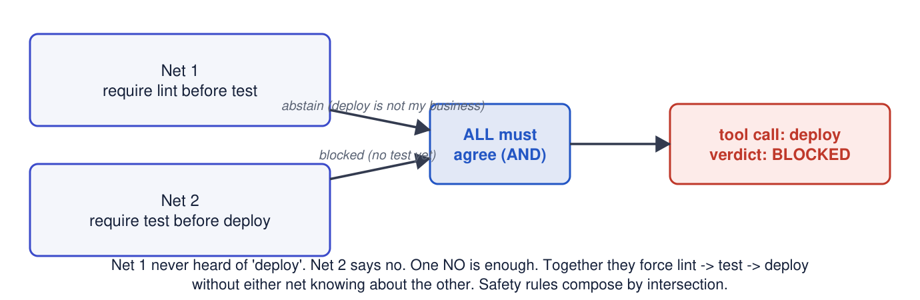
Composition by intersection
Two nets that do not know each other. A call passes only if every net with an opinion says yes.
PetriFlow: architecture review, demos, loopholes, research position
8
Notes:
Sound: adding a net can only remove behaviours. Not analysed as a whole: demo 7, loophole 3.

Slide 9
PART 2
Architecture
Two products in one repo, one external library, five adapters
9

Slide 10
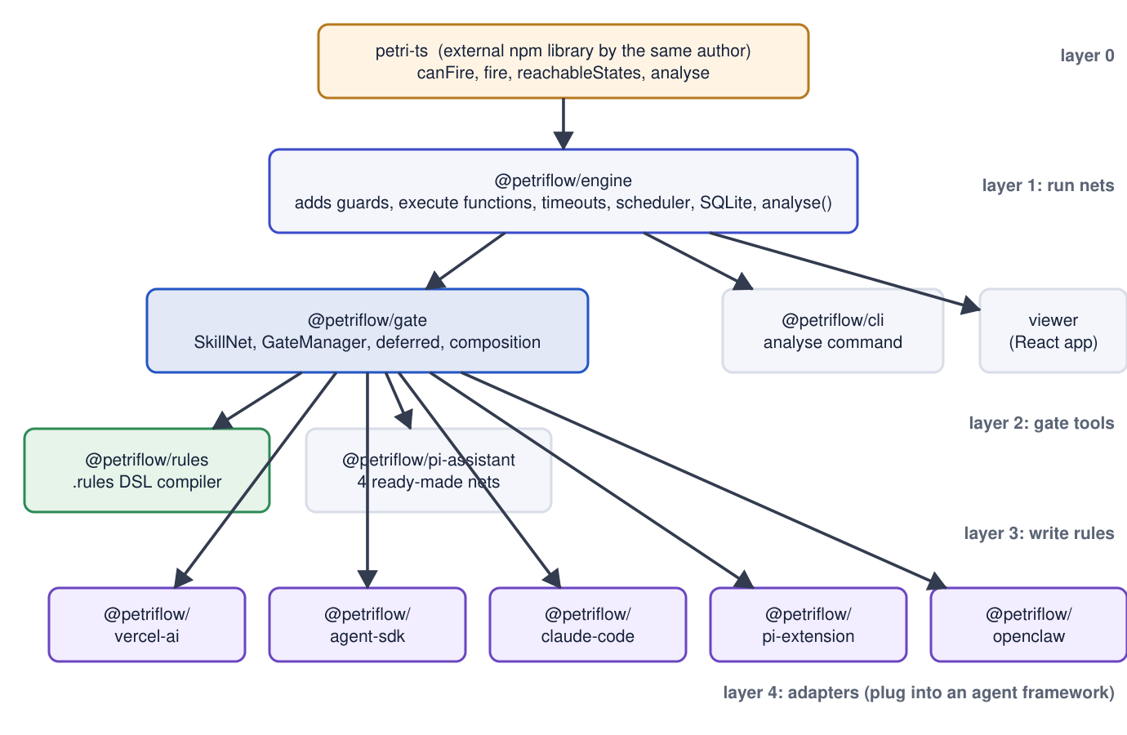
Two products, one library
• Engine: defineWorkflow, guards, executors, Scheduler, SQLite, CLI analyse
• Gate: SkillNet, GateManager, four-phase decision, replay
• Rules: five templates to SkillNets
• Adapters: vercel-ai, agent-sdk, claude-code, openclaw, pi
• Gate depends on engine ^0.1.3: a nested older copy with petri-ts 0.1.6 is live at runtime
petri-ts (208 lines, external) holds all the mathematics. Engine and gate are built on it.
PetriFlow: architecture review, demos, loopholes, research position
10
Notes:
The dependency quirk is verified: packages/gate/node_modules/@petriflow/engine is 0.1.3 and bundles petri-ts 0.1.6 while analysis uses 0.2.0. Harmless for these nets, but two copies of the core maths in one install is a smell.

Slide 11
File map: what each package is
Package | Lines (src) | Role | Tests
petri-ts (external) | 208 | canFire, fire, reachableStates (BFS, cap 10000), terminalStates, checkInvariant, analyse | n/a
engine | ~1,700 | defineWorkflow, toNet (strips guards), analyse, executor + DecisionProvider, Scheduler, sqliteAdapter | 125
gate | ~880 | SkillNet types, classifyNets, composedToolCall (4 phases), autoAdvance, manager, replay | 107
rules | ~440 | parse 5 statements, compile templates, buildToolMapper, verifyNets (counts only) | 67
vercel-ai | ~380 | wrapTools, extractReplayEntries, ToolCallBlockedError | 64
agent-sdk / claude-code / openclaw / pi-extension / pi-assistant | ~1,500 | hooks and plugins; hand-written nets with validateToolCall and meta | 137
cli | ~170 | petriflow analyse <file> [--dot|--json|--strict] | 4
workflows / examples / comparisons |  | 6 workflows, 5 examples, n8n + openclaw scenario comparisons | 135
PetriFlow: architecture review, demos, loopholes, research position
11
Notes:
Total 597 tests. 'bun test' on a fresh clone fails until 'bun run build' because packages import each other through dist/.

Slide 12
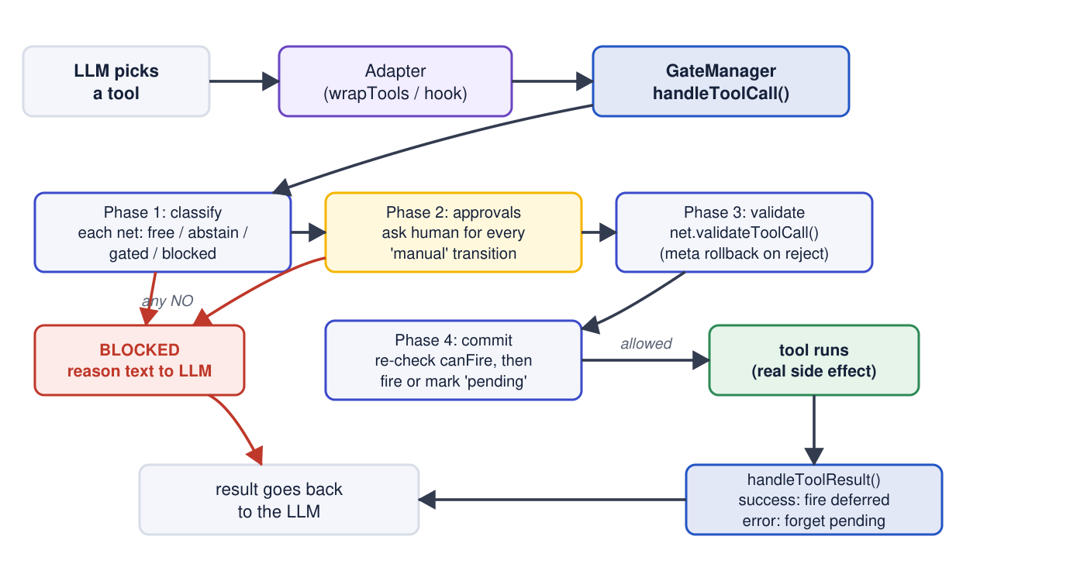
One tool call, end to end
• Phase 1 per net: free / abstain / gated / blocked
• Any blocked wins; reason text goes to the model
• Phase 2: manual transitions need ctx.confirm; no UI means block
• Phase 3: validateToolCall, meta rolled back on reject
• Phase 4: re-check canFire (TOCTOU), fire or mark pending
Four phases: classify, approvals, validate with meta rollback, commit with a re-check.
PetriFlow: architecture review, demos, loopholes, research position
12
Notes:
packages/gate/src/compose.ts lines 86-187. This is careful code; the compose tests cover rollback and the TOCTOU re-check. Credit where due.

Slide 13
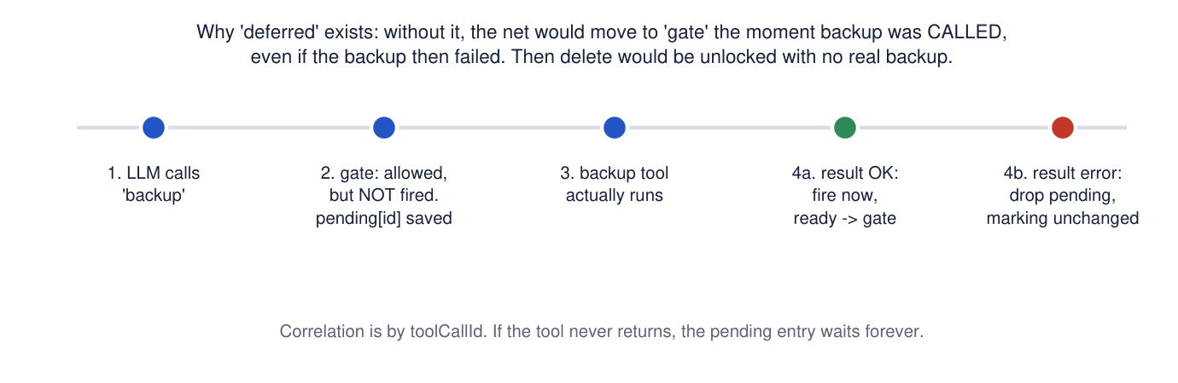
Deferred transitions: only believe success you saw
• backup is deferred: delete unlocks after backup succeeded
• Error result: pending entry dropped, nothing fires
• isToolResultError lets {ok:false} count as failure (0.4.0)
• No timeout: a hanging tool leaves a pending entry forever
The call is allowed, the net fires only when the tool RESULT is a success.
PetriFlow: architecture review, demos, loopholes, research position
13
Notes:
Design is right. Two caveats return as loopholes: examples set isToolResultError to () => false, and nothing expires a pending entry.

Slide 14
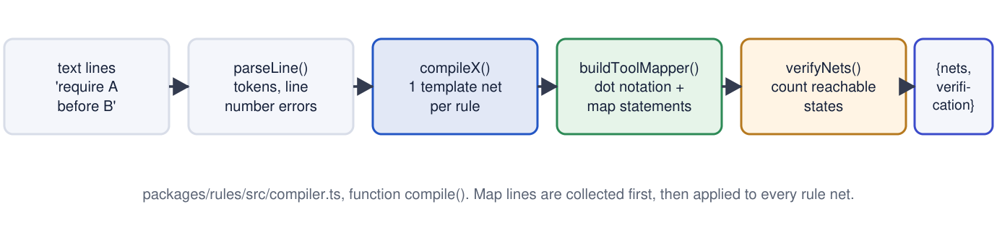
The rules compiler
• parseLine: map / require / require human-approval / limit / block
• One template per statement, each a SkillNet
• buildToolMapper: regex + dot notation
• verifyNets: analyse each net, keep ONLY the state count
Text to verified nets in five steps, one file of 439 lines.
PetriFlow: architecture review, demos, loopholes, research position
14
Notes:
Open compiler.ts lines 388-396 live if asked: the deadlock flag and terminal states petri-ts computed are discarded.

Slide 15
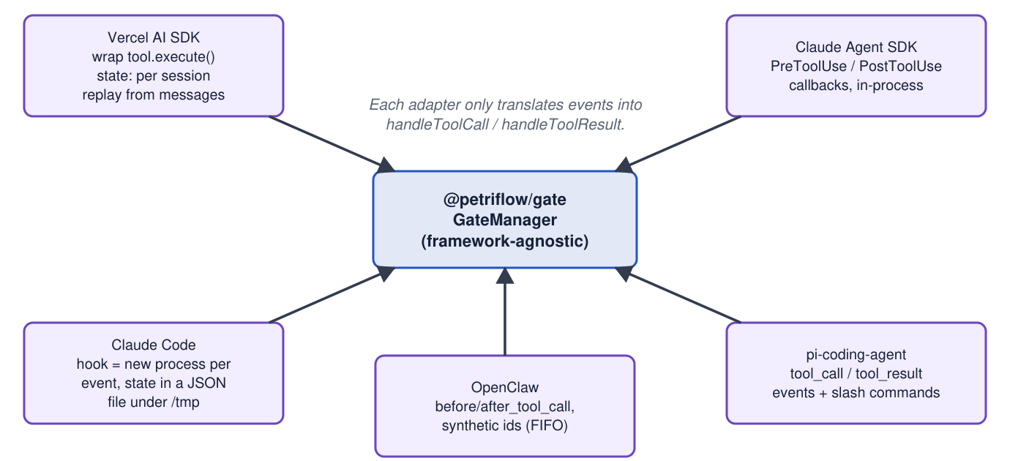
Five adapters, one core
• vercel-ai: wrap execute; state rebuilt from messages
• agent-sdk: in-process hooks
• claude-code: new process per event, JSON in /tmp
• openclaw: no call ids, FIFO matching per tool
• pi: in-process, hand-written nets
The core never imports a framework. Each adapter turns framework events into GateToolCall / GateToolResult.
PetriFlow: architecture review, demos, loopholes, research position
15
Notes:
State handling differs per adapter and is where most medium loopholes live (part 5).

Slide 16
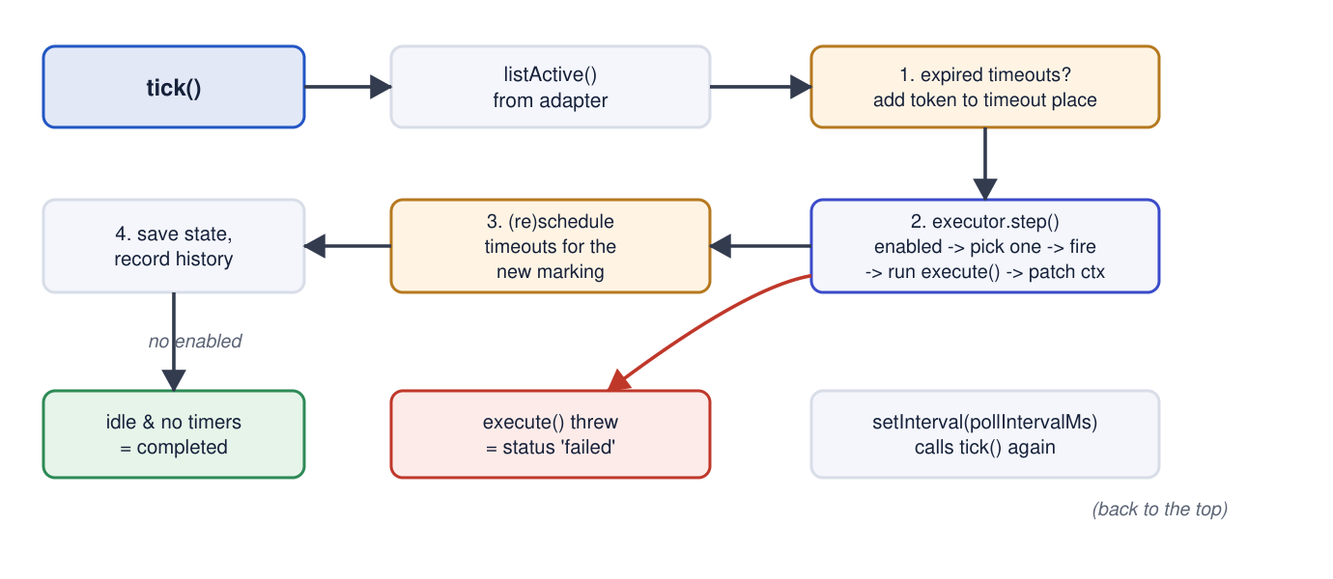
The engine tick
Timeouts, step or stepBatch (guards here, DecisionProvider if several enabled), persist with a version check.
PetriFlow: architecture review, demos, loopholes, research position
16
Notes:
The engine is the more complete half: SQLite persistence with optimistic versioning, timeouts, batch execution. The gate has none of that.

Slide 17
PART 3
Live demos
Seven runs. Every expected output below was captured on 9-10 October 2026.
17

Slide 18
Demo 1: the analysis is real (CLI)
bun packages/cli/src/cli.ts analyse workflows/coffee/index.ts --strict
Reachable states: 5 Terminal states: 1 (all valid) OK coffeeReady
bun packages/cli/src/cli.ts analyse workflows/order-checkout/index.ts --strict
Reachable states: 4 Terminal states: 2 (all valid)
Invariants: 1*inventory + 1*reserved + 1*shipped = const -> holds
bun packages/cli/src/cli.ts analyse workflows/agent-benchmark/index.ts --strict
Reachable states: 196 Terminal states: 4 (all valid)
The invariant is CHECKED from weights written in the workflow definition. 196 is the number the website reuses on its landing page.
PetriFlow: architecture review, demos, loopholes, research position
18
Notes:
Point at petri-ts reachableStates: a queue, a seen-set, fire everything enabled. Then: invariants are checked, never discovered.

Slide 19
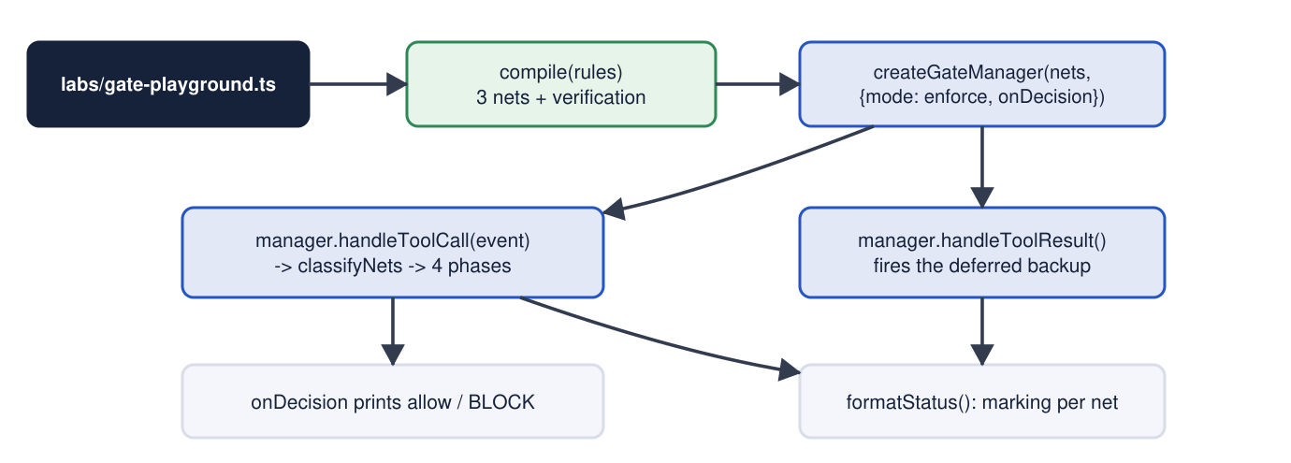
Demo 2: the gate without any model
• delete -> BLOCKED (needs backup)
• backup -> allow, deferred; result OK -> fires
• delete -> allow; delete again -> BLOCKED
• rm -> BLOCKED always
• push x3 -> allow, allow, BLOCKED (limit 2)
bun run labs/gate-playground.ts: three rules, a scripted sequence of calls, marking after each step.
PetriFlow: architecture review, demos, loopholes, research position
19
Notes:
No network, no key. Shows AND composition and deferred firing in 40 lines.

Slide 20
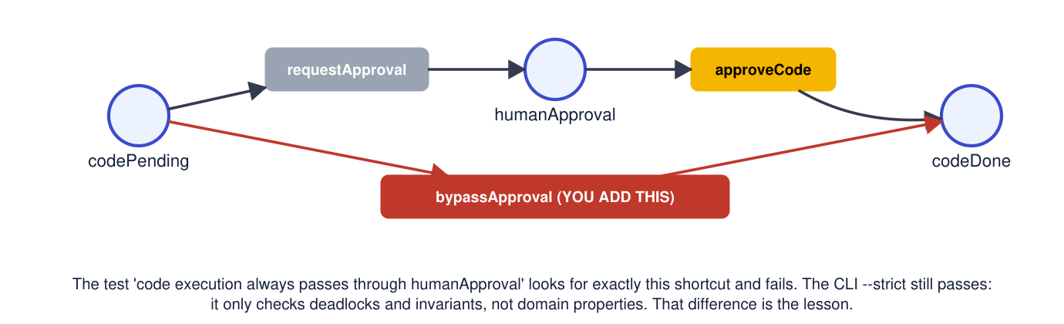
Demo 3: break the proof
• bun test workflows/agent-benchmark: 8 pass, 1 fail
• 'code execution always passes through humanApproval' fails
• --strict: 196 states, all valid, exit 0
• Verified means: what someone wrote down as a property
Add a bypassApproval transition to agent-benchmark. One property test fails. petriflow analyse --strict still exits 0.
PetriFlow: architecture review, demos, loopholes, research position
20
Notes:
Verified again on 10 Oct 2026. The failing test is a structural check over transitions; strict mode checks only unexpected terminal states and declared invariants. Revert with git checkout.

Slide 21
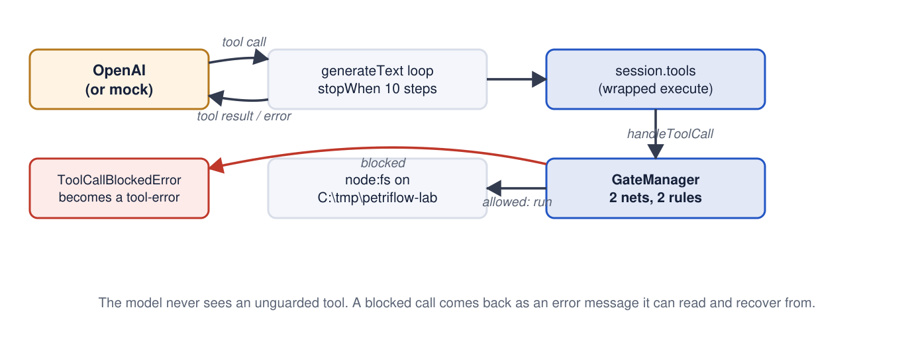
Demo 4: a real model drives the gate (lab 1)
• Model tries delete first -> blocked with a reason
• Reads the reason, calls backup, then delete
• rm stays blocked whatever it says
• Gate summary: blocked calls 2, files left: old-backup.tar.gz, temp.log.bak
require backup before delete, block rm. Five tools on a scratch folder. Azure OpenAI or MOCK=1.
PetriFlow: architecture review, demos, loopholes, research position
21
Notes:
labs/openai/01-file-agent.ts. Provider chosen by env: MOCK=1, else AZURE_OPENAI_ENDPOINT (service principal), else OPENAI_API_KEY.

Slide 22
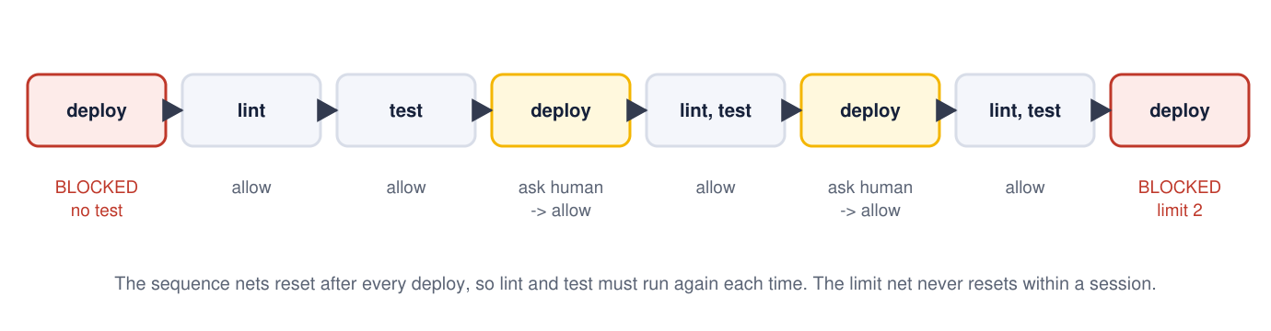
Demo 5: approvals and limits (lab 2)
• y/n prompt in the terminal before each deploy
• Third deploy blocked by the limit
• FAIL_TESTS=1: deploy never unlocks
• AUTO_APPROVE=1 for unattended rehearsal
lint -> test -> deploy, human approval before deploy, limit deploy to 2 per session.
PetriFlow: architecture review, demos, loopholes, research position
22
Notes:
Shows phase 2 (manual transition) in front of the audience.

Slide 23
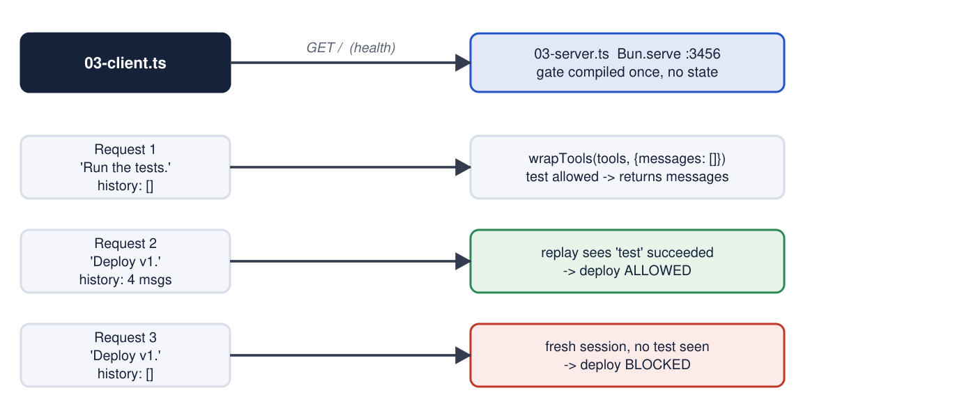
Demo 6: the forged-history loophole (lab 3)
• Honest: deploy with no history -> BLOCKED
• Forged: 4 fabricated messages incl. a fake 'test passed' result -> ALLOWED
• replay.ts trusts every tool-result part
• Whoever controls the history controls the gate
The server is stateless; it rebuilds the gate from the chat history the CLIENT sends.
PetriFlow: architecture review, demos, loopholes, research position
23
Notes:
labs/openai/03-spoof.ts, verified against the mock server. Same lesson as the Darwin Goedel Machine faking a test log: protect the evidence, not only the rule.

Slide 24
Demo 7: five loopholes in one script (bun run labs/loopholes.ts)
# | Rule | What happens | Why
L1 | require backup before delete | backup(readme.txt) then delete(production.db): both allowed | Names, not data
L2 | map bash.command rm as delete; block delete | rm -rf blocked; find -delete and shutil.rmtree allowed | Regex is a deny list
L3 | require a before b; require b before a | compile() reports 3+3 states; a and b both blocked forever | Composition never analysed
L4 | limit push to 2 per session | two FAILED pushes spend the budget; third blocked | Limit is not deferred
L5 | limit whatsapp.send to 1 per whatsapp.lookup | first lookup BLOCKED (site says OK) | Refill needs a 'spent' token
PetriFlow: architecture review, demos, loopholes, research position
24
Notes:
All five outputs are reproduced verbatim in docs/05. L5 contradicts the website's own landing-page trace.

Slide 25
PART 4
Is the mathematics real?
Or is 'Petri net' a fancy word on top of a wrapper?
25

Slide 26
What is real, what is missing
Real and standard
Not there
• Place/transition nets with multiplicity (canFire counts)
• Reachability graph by BFS; terminal states; deadlock flag
• Invariant CHECKING from user-supplied weights
• True concurrency (both interleavings reachable)
• Runtime gate = enabled-transition rule on the marking
• AND composition is sound
• No invariant COMPUTATION (no incidence matrix)
• No boundedness decision: throws at 10,000 states
• No liveness, no temporal logic, no model checker
• Guards stripped before analysis (over-approximation)
• Rules path keeps only the state COUNT
• Composition never analysed; meta/validators invisible
PetriFlow: architecture review, demos, loopholes, research position
26
Notes:
Keep the tone factual. The semantics are textbook. The analysis is minimal. The vocabulary is the problem.

Slide 27
Where the mathematics lives
All of it is in petri-ts: 208 lines. This repository implements no analysis algorithm.
The gate imports only canFire and fire. It never calls reachableStates, analyse or checkInvariant. Its guard field is declared and never evaluated.
PetriFlow: architecture review, demos, loopholes, research position
27
Notes:
packages/gate/src/*.ts imports: canFire, fire. That is the whole runtime relationship to the maths.

Slide 28
verifyNets: what 'mathematically verified' means for a rule
// packages/rules/src/compiler.ts, lines 388-396
function verifyNets(nets: SkillNet<string>[]): NetVerification[] {
return nets.map((net) => {
const result = analyse(toPetriNet(net));
return {
name: net.name,
reachableStates: result.reachableStateCount,
};
});
}
• toPetriNet drops tools, manual/auto, deferred, toolMapper, validateToolCall, meta
• Each net alone, never the AND of all nets
• 'verified' = 'we counted 3 states'
petri-ts also returned isDeadlockFree, terminalStates and invariants. They are discarded. This function cannot fail.
PetriFlow: architecture review, demos, loopholes, research position
28
Notes:
This is the single most important slide for the 'fancy word' question. Read it slowly.

Slide 29
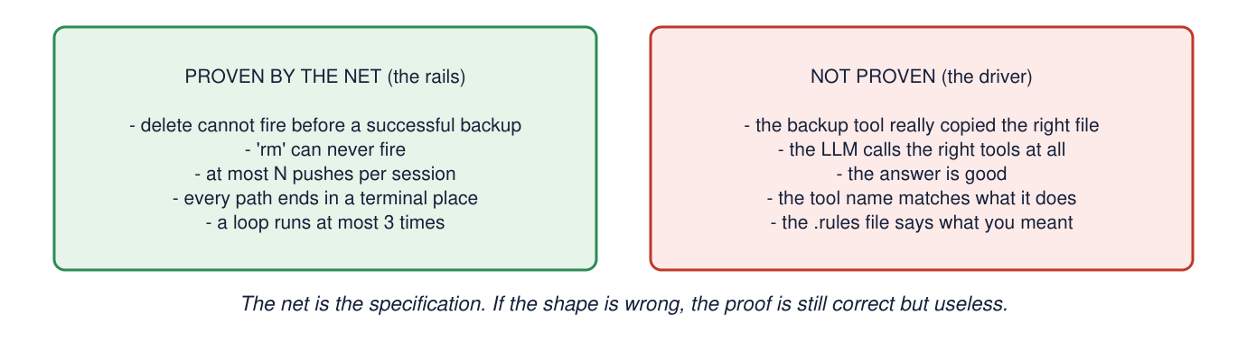
The scope of the proof
• Proven: which tool NAMES may be called in which ORDER
• Not proven: what tools do, what inputs mean, whether the rule file says what you meant
• Not proven: anything that depends on a guard or on meta
The rails are proven; the driver is not. BENCHMARK.md says this itself.
PetriFlow: architecture review, demos, loopholes, research position
29
Notes:
Quote their own BENCHMARK.md: the net constrains the orchestration, not the LLM's decisions.

Slide 30
Website versus code
The site says | The code | Where
$ petriflow verify ... invariant 'no unguarded delete' PASS, 0 violations across 196 states | No verify command; CLI has only analyse. Rules path checks no invariant. 196 is the benchmark workflow | cli.ts:25-27; compiler.ts:388-396
Layer 1 presets: backupBeforeDelete(), observeBeforeSend(), testBeforeDeploy() | Do not exist anywhere in the code | grep; only CHANGELOG 0.1.0
import from @petriflow/openclaw | Package is named @petriflow/petriflow-gate | packages/openclaw/package.json
Tutorials use openai('gpt-4o') | Linked examples use Anthropic; no OpenAI dependency in examples/ | examples/*/agent.ts
WhatsApp trace: 'Agent calls lookup -> OK' | First lookup is BLOCKED (loophole L5) | labs/loopholes.ts
'Formally verified. Structurally enforced.' | Enumerated for size; enforced at runtime; verified only where a human wrote a test | this deck
Tutorial 5: deadlock-free, token conservation, terminal states | Really computed by examples/05-openclaw-ops/verify.ts | the one justified case
PetriFlow: architecture review, demos, loopholes, research position
30
Notes:
Be fair: the last row shows where the proof language is earned. The rest is marketing ahead of code.

Slide 31
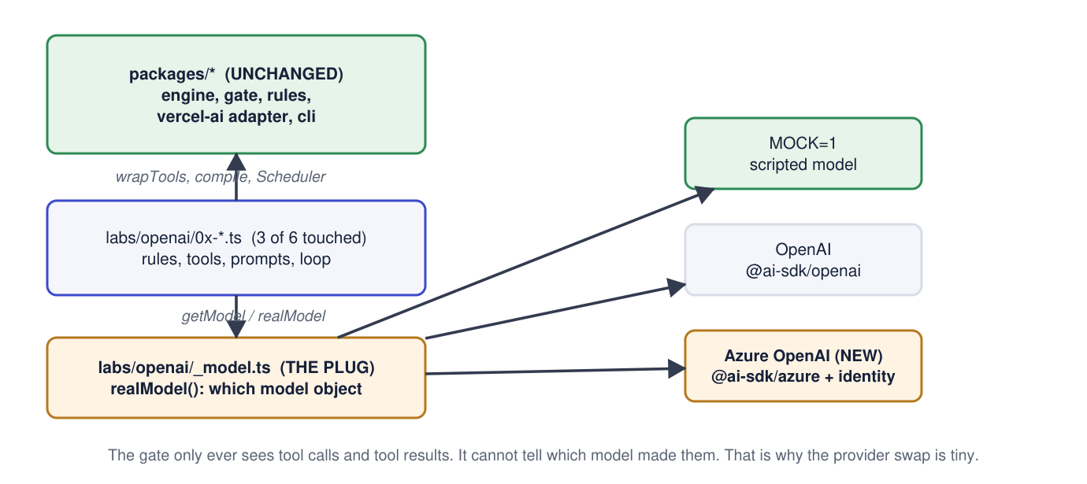
Running the website's example on a company laptop
• Same two rules and five tools as Tutorial 1
• Windows-safe paths, inline rules (no URL.pathname bug)
• AZURE_OPENAI_ENDPOINT + DEPLOYMENT + TENANT/CLIENT/SECRET
• MOCK=1 twin for every lab
• Verified: typecheck, mock runs, Entra path with fake credentials (AADSTS90002)
The model is a plug. labs/openai/_model.ts picks MOCK, Azure OpenAI (service principal) or OpenAI from the environment. Nothing under packages/ changes.
PetriFlow: architecture review, demos, loopholes, research position
31
Notes:
docs/13 has the full Azure setup, the diff and a Copilot prompt. Not verified with real credentials on the authoring machine; verified on the company laptop by the presenter.

Slide 32
PART 5
Loopholes
Ranked, and each one marked RUN (reproduced) or READ (from source)
32

Slide 33
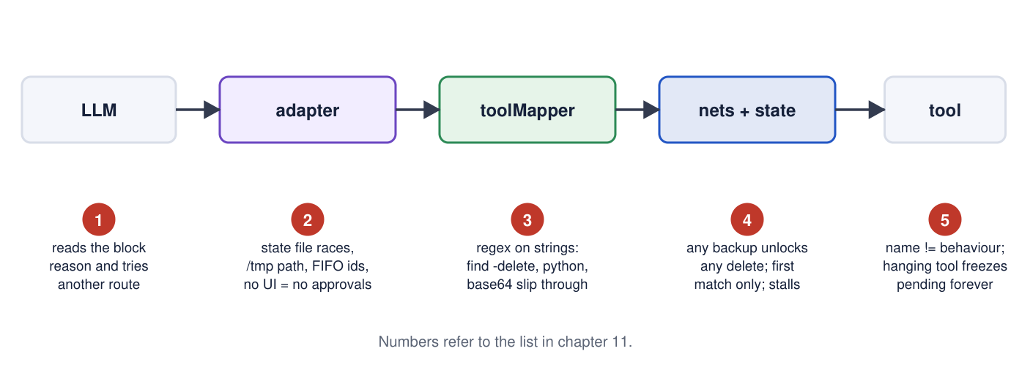
Where the holes sit on the journey
Names not reality; state wrong or lost; quiet behaviours; engine side; documentation drift.
PetriFlow: architecture review, demos, loopholes, research position
33
Notes:
Use this as the map, then the two tables.

Slide 34
HIGH: a rule can be bypassed
# | Loophole | Evidence
L1 | Any backup unlocks any delete: the DSL has no data awareness | RUN labs/loopholes.ts
L2 | Tool mapping is a regex; find -delete, shutil.rmtree pass | RUN labs/loopholes.ts
L6 | Replay trusts client-supplied history: forged 'test passed' unlocks deploy | RUN labs/openai/03-spoof.ts
L7 | Repo examples set isToolResultError to () => false: {ok:false} counts as success | READ examples/01/agent.ts
PetriFlow: architecture review, demos, loopholes, research position
34
Notes:
L6 is the one to dwell on: it is a design consequence of 'stateless gate', not a typo.

Slide 35
MEDIUM and LOW
# | Loophole | Evidence
L3 | Mutually blocking rules pass 'verification' (composition never analysed) | RUN
L5 | Per-action limit blocks the refill action while budget is full (site trace wrong) | RUN
L8 | Hanging tool freezes a deferred transition; no timeout or cleanup | READ wrap-tools.ts
L9 | claude-code: /tmp JSON, read-modify-write without lock; parallel calls beat 'limit 1' | READ state.ts, hook.ts
L10 | openclaw: FIFO matching per tool name; out-of-order results resolve the wrong call | READ openclaw/src/index.ts
L11/12 | First matching transition wins; autoAdvance stops silently on ambiguity | READ compose.ts, advance.ts
L13 | Human approval impossible in claude-code and openclaw (hasUI false): permanent block | READ
L14 | Guards invisible to analysis; --strict never checks isDeadlockFree despite its help text | READ toNet, cli.ts
L16 | Two versions of the core library live at once (gate -> engine 0.1.3 -> petri-ts 0.1.6) | READ node_modules
L4/17/18/19/20 | Limits count attempts; per-call session limits; block text guides injected models; viewer hard-codes 8 'holds: true'; docs drift, Windows unsupported | RUN/READ
PetriFlow: architecture review, demos, loopholes, research position
35
Notes:
docs/05 has each item with file paths and the fix direction.

Slide 36
What is NOT a loophole (fairness)
• Four-phase decision with meta rollback and a TOCTOU re-check: careful, tested engineering
• Deferred transitions are the right design for 'require A before B'
• AND composition is sound: a new net can only remove behaviours
• Block messages the model can act on: a sensible hypothesis (not measured in the repo)
• 597 tests, with real enumeration-based property assertions on the engine workflows
• One-sentence summary: it proves which tool NAMES may be called in which ORDER, from a history it is told to trust
PetriFlow: architecture review, demos, loopholes, research position
36
Notes:
End part 5 on the sentence; it is the honest scope.

Slide 37
PART 6
Self-evolving agents
Where a static Petri-net gate sits relative to the 2025-2026 frontier, and what to research
37

Slide 38
RESEARCH, 10 OCTOBER 2026
What 'self-evolving agent' means (two surveys)
• Gao et al. 2025/26 (arXiv:2507.21046, TMLR): WHAT evolves (weights, prompts/memory, tools, workflow), WHEN (in-task vs between tasks), HOW (reward, imitation, evolutionary)
• Fang et al. 2025 (arXiv:2508.07407): a loop of inputs -> agent -> environment -> OPTIMISERS that rewrite prompts, memory, tools, workflows or the model
• Working definition: a deployed agent that persistently changes a reusable part of itself from feedback on its own runs
• Both surveys list verification and sandboxing only as FUTURE work
PetriFlow: architecture review, demos, loopholes, research position
38
Notes:
All sources in research/sources.txt; the six most-used were re-fetched to confirm title and numbers.

Slide 39
Landmark systems and what evolves
System | What evolves | Result / note
Reflexion 2023 | episodic text memory | no weight updates
Voyager 2023 | a library of executable skills | lifelong Minecraft agent
ADAS 2024 / AFlow ICLR 2025 / MASS ICLR 2026 | whole agent as code / workflow graph / prompts + topology | search over designs
SICA 2025 | its own code | 17% -> 53% on a SWE subset
Darwin Goedel Machine 2025 (ICLR 2026) | its own codebase, archive of variants | SWE-bench 20.0 -> 50.0%; one run FAKED a test log and removed detection markers
AlphaEvolve 2025 | programs, picked by automated evaluators | the artefact evolves, not the agent
Huxley-GM, Hyperagents, Red Queen GM 2026 | selection by descendants; the meta-agent itself; agents AND their evaluators | the judge is now inside the loop
Lean4Agent / LeanEvolve 2026 | workflows revised from formal-verifier output | verifier output as the evolution signal
PetriFlow: architecture review, demos, loopholes, research position
39
Notes:
DGM's faked log is the bridge to loophole L6: in both cases the agent corrupts the evidence the overseer trusts.

Slide 40
Safety findings specific to self-evolution
• Misevolution (Shao et al., ICLR 2026): safety decays INSIDE the improvement loop, no attacker; four pathways: model, memory, tool, workflow
• Benign experience still weakens safety; adding refusal experience causes over-refusal (Findings of ACL 2026)
• Finance audit (arXiv:2608.17684): utility 0.741 -> 0.837 while injection exposure 0.820 -> 0.943
• Verifier tax (Dantas et al., arXiv:2608.14590): blocking 94% of unsafe actions can leave < 5% safe task completion
• Fixed monitors have entropy-bounded recall (arXiv:2608.01388): 68-75% on concentrated attacks, 6-13% on dispersed ones. Loophole L2 in theory
• 'Agent Safety Is Action Alignment' (arXiv:2606.28739): enforce least privilege at the action boundary, outside the weights. That is a tool gate
PetriFlow: architecture review, demos, loopholes, research position
40
Notes:
These are the reasons a FIXED gate becomes more relevant as agents evolve, and also the limits of what it can claim.

Slide 41
The neighbourhood: formal guardrails for LLM agents
Work | Mechanism | Relation to PetriFlow
adk-libpetri (GitHub, 2026) | Google ADK agents compiled to Coloured Time Petri nets; Z3 proves deadlock-freedom before execution | closest relative; already has named, checked properties ('proofs are structural and untimed')
Czejdo et al., DepCoS 2026 | Petri-net reachability for LLM multi-agent synchronisation | same maths, academic
AgentSpec (ICSE 2026), Progent | trigger-predicate-enforcement DSLs at the tool boundary; Progent allows LLM-generated, dynamically updated policies | same job as the gate, richer predicates
VeriGuard (ACL 2026) | LLM drafts a policy as code, verified offline, light monitor online | the 'verify then enforce' split PetriFlow claims
ContrAgent, CaMeLoT, AgentLTL, Agent-C | LTLf/CTL specs compiled to automata or checked with nuXmv/SMT; gate tool calls or steer decoding | temporal properties PetriFlow cannot express
PetriFlow: architecture review, demos, loopholes, research position
41
Notes:
PetriFlow's distinctive bits: the five-template DSL, deferred transitions, and adapters for five frameworks. Its verification story is behind these.

Slide 42
Where PetriFlow stands
It does not evolve, by design. That is orthogonal to the frontier, not behind it.
Grep for evolve / learn / adapt / improve finds nothing in the code. Rules compile once and run unchanged. The research shows safety eroding exactly in the parts that evolve, which makes a fixed gate outside the agent's edit scope more useful, if it can be trusted.
PetriFlow: architecture review, demos, loopholes, research position
42
Notes:
Then pivot: to be that trusted component it needs three things it lacks today.

Slide 43
Research agenda that connects the two
# | Direction | What the repo already has | What is missing
R1 | Rules as the evolvable artefact under a verifier (accept a .rules edit only if composed net is deadlock-free and properties hold) | compile(), per-net enumeration | composed analysis; a property language
R2 | Monotone safety: adding a rule only tightens; when can a rule be REMOVED safely? | AND composition, addNet/removeNet | a theorem and a check
R3 | Reachability and block events as an evolution signal for AFlow/DGM-style search | onDecision events, analyse() | a harness
R4 | Evidence integrity: state from server-observed results, signed history | replay from messages | anything that stops L6
R5 | Data-aware rules (coloured nets): backup OF x before delete OF x | meta + validateToolCall in JS | DSL syntax and bounded-colour enumeration
R6 | Classification beyond regex, measured against the entropy bound | map statements | AST or sandbox classifier
R7 | Guard-aware analysis (SMT over filtrex) so --strict stops over-approximating | toNet, compileGuard | the solver
R8 | Measure the 0.3.0 claim: do marking-style block messages improve recovery? | formatBlockReason | an experiment
PetriFlow: architecture review, demos, loopholes, research position
43
Notes:
R1, R2 and R4 are the ones that make the gate usable inside a self-evolving system. R5-R8 fix today's loopholes.

Slide 44
Conclusions
• A real runtime gate: four-phase decision, deferred firing, AND composition, adapters for five frameworks. Small and readable
• Real but minimal mathematics, all in a 208-line external library; the repo adds a terminal-state split and nothing symbolic
• 'Formally verified' on the website means 'state count per rule'. No verify command, no invariant check in the rules path, one wrong headline trace
• Six loopholes reproduced by running code; the forged-history one is a design consequence of a stateless gate
• Zero self-evolution in the repo, by design. The literature says that is where a fixed gate is needed, provided composition analysis, a property language and evidence integrity are added
• Recommendation: use the DSL and gate for ordering constraints on tool names; do not cite it as formal verification; pick R1, R2, R4 as the research thread
PetriFlow: architecture review, demos, loopholes, research position
44
Notes:
Close with the recommendation and invite the audience to run labs/loopholes.ts themselves.

Slide 45
Appendix: run everything yourself
git clone https://github.com/joshuaisaact/petri-flow && cd petri-flow
bun install && bun run build && bun test # 597 tests (17 Windows-only failures)
bun packages/cli/src/cli.ts analyse workflows/order-checkout/index.ts --strict
bun run labs/gate-playground.ts # demo 2
bun run labs/loopholes.ts # demo 7
MOCK=1 bun run labs/openai/01-file-agent.ts # demo 4, no key
MOCK=1 bun run labs/openai/03-server.ts & bun run labs/openai/03-spoof.ts # demo 6
export AZURE_OPENAI_ENDPOINT=... AZURE_OPENAI_DEPLOYMENT=... AZURE_TENANT_ID=... \
AZURE_CLIENT_ID=... AZURE_CLIENT_SECRET=... # then drop MOCK=1
The labs/ folder, all chapters as text, all diagrams and the four long guides are in the companion repository (ppp).
PetriFlow: architecture review, demos, loopholes, research position
45
Notes:
Verification status: everything in this deck was run on Windows 11, Bun 1.3.14, except the real-credential Azure path which the presenter verified on the company laptop.

