Slide 1
RFID stands for radio frequency identification, It is a short range wireless communication technology which uses radio waves to uniquely identify an object, animal or person.
RFID systems consist of three components: an RFID tag, RFID reader, and an antenna. RFID tags contain an integrated circuit and an antenna, which are used to transmit data to the RFID reader (also called an interrogator). The reader then converts the radio waves to a more usable form of data. Information collected from the tags is then transferred through a communications interface to a host computer system, where the data can be stored in a database and analyzed at a later time.

Slide 2
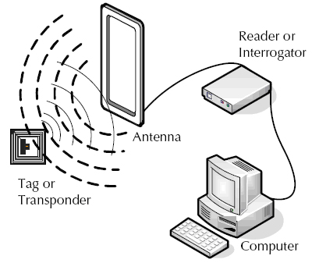
It consist of the following components
RFID Tag
RFID Reader
Host Computer

Slide 3
RFID tags/ labels/transponder :
RFID tags or transponders are small devices that utilize low-power radio waves to receive, store, and transmit data to nearby readers.
The main components of RFID tags are : a microchip or integrated circuit (IC), an antenna, and a substrate or protective material layer that holds all the components together.
The tag comprises of a simple silicon microchip attached to a small flat aerial and mounted on a substrate. The whole device can then be encapsulated in different materials (such as plastic) dependent upon its intended usage. The finished tag can be attached to an object, typically an item, box or pallet and read remotely the identity of tag.
Tags, which uses radio waves to communicate their identity and other information to nearby readers, can be passive or active. Passive RFID tags are powered by the reader and do not have a battery. Active RFID tags are powered by batteries. RFID tags can store a range of information from one serial number to several pages of data.

Slide 4
RFID Reader or Interrogator
In this RFID system, this RFID reader continuously sends radio waves of a particular frequency.
If the object, on which this RFID tag is attached is within the range of this radio waves then it sends the feedback back to this RFID reader.
And based on this feedback, RFID reader identifies the object.
Host Computer
The data acquired by the readers is then passed to a host computer, which may run specialist RFID software or middleware to filter the data and route it to the correct application, to be processed into useful information.

Slide 5
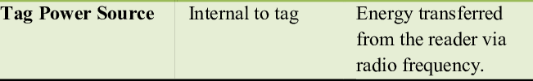
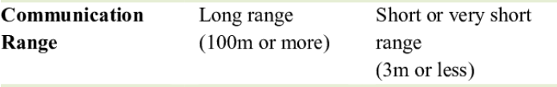
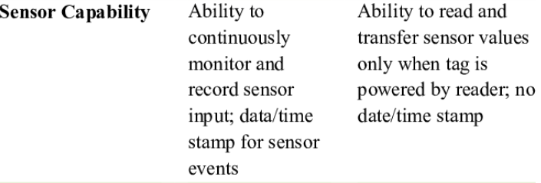
Parameters Active Tag Passive Tag

Slide 6
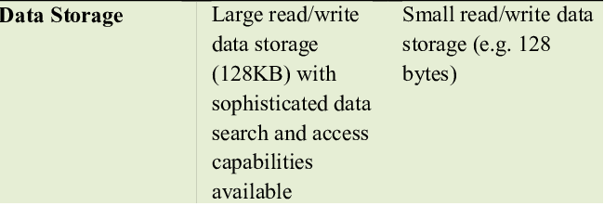
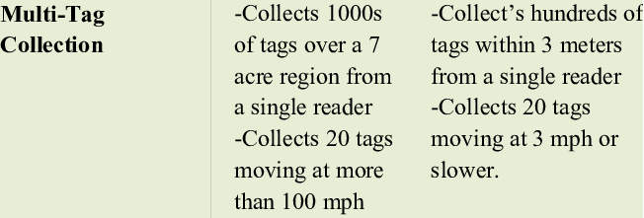

Slide 7
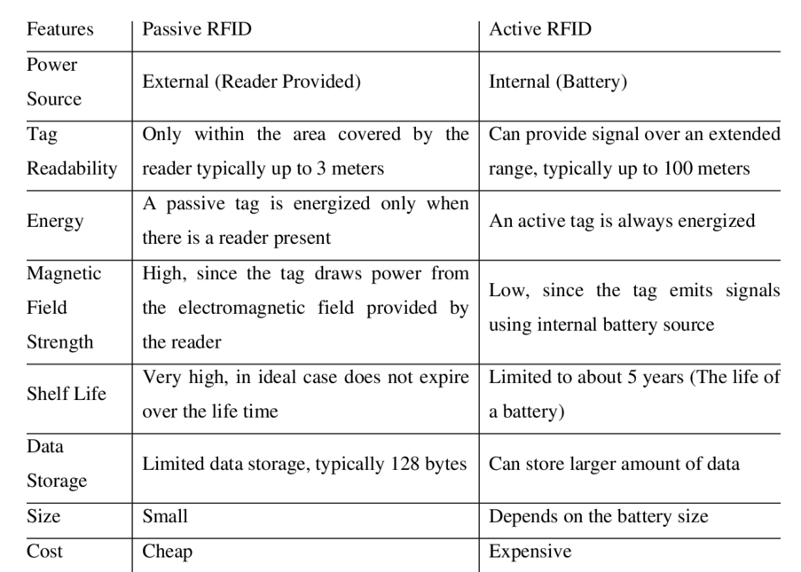

Slide 8
Frequency used in RFID
There are three main types of RFID systems: low frequency (LF), high frequency (HF) and ultra-high frequency (UHF). Microwave RFID is also available. Frequencies vary greatly by country and region.
Low-frequency RFID systems. These range from 30 KHzto 500 KHz, though the typical frequency is 125 KHz. LF RFID has short transmission ranges, generally anywhere from a few inches to less than six feet.
High-frequency RFID system These range from 3 MHzto 30 MHz, with the typical HF frequency being 13.56 MHz. The standard range is anywhere from a few inches to several feet.
UHF RFID systems. These range from 300 MHz to 960 MHz, with the typical frequency of 433 MHz and can generally be read from 25-plus feet away.
Microwave RFID systems. These run at 2.45 Ghzand can be read from 30-plus feet away.

Slide 9
RFID tags | Barcodes
Can identify individual objects without direct line of sight. | Direct line of sight required for scanning.
Can scan items from inches to feet away, depending on type of tag and reader. | Require closer proximity for scanning.
Data can be updated in real time. | Data is read-only and can't be changed.
Require a power source. | No power source needed.
Read time is less than 100 milliseconds per tag. | Read time is half a second or more per tag.
Contain a sensor attached to an antenna, often contained in a plastic cover and more costly than barcodes. | Printed on the outside of an object and more subject to wear.

