Slide 1




Smart City IoT Data Platform
Turning city sensor data into decisions in seconds
Case Study 6 | Topics 6.1, 6.3: Real-time pipelines and ML systems
<Name> | <Roll No>
Notes:
Our project builds a small smart-city control room: sensor data comes in, Spark processes it live, a model predicts the next hour, and a dashboard warns the city.

Slide 2


The Problem in Simple Words
A city is full of sensors, but raw readings alone don't help anyone
We asked two questions a city really cares about:
Will this junction be jammed in the next hour?
So traffic police can act before the jam, not after.
Is the air dangerous right now?
The accurate CO machine is offline 18% of the time, so we estimate CO from cheap sensors.
IN ONE LINE: We built a platform that predicts traffic and estimates pollution live, then raises alerts.
Notes:
Keep it simple: two questions. One about traffic in the next hour, one about air quality right now.

Slide 3

Step 1: Our Data Sources
Real, public data in three formats: CSV, CSV and a live API (JSON)
CSV
CSV
API → JSON
Traffic counters
Air-quality station
Weather station
Kaggle: Smart City Traffic
UCI: Air Quality dataset
Open-Meteo (free API)
48,120
9,357
Live
readings
readings
hourly car counts, 4 junctions, 2015–2017
hourly gas readings (CO, NOx), 2004–2005
temperature, rain, wind for the city
IN ONE LINE: We have no real sensors, so a small program replays this real data as if it were arriving live.
Notes:
Traffic from Kaggle, air quality from UCI, weather from a free API. A replayer program sends one hour of data every second to imitate real sensors.

Slide 4



Step 2: How the Platform Works
Like a conveyor belt: every step has one job
Sensors
Landing folder
Spark Streaming
Storage
Dashboard
replayer sends readings
new files arrive
cleans, predicts, alerts every 5 s
Parquet files (raw → clean → results)
live charts and alerts
Two sides: Batch = learn from all past data (train the models). Streaming = use the models on new data as it arrives.
IN ONE LINE: Data flows left to right continuously; results are on screen about 3 seconds after a reading arrives.
Notes:
Sensors write small files into a folder, Spark picks them up every 5 seconds, cleans them, runs the model, saves results, and the dashboard reads them.

Slide 5
Cleaning the Data
Real data is messy; bad data means wrong alerts
Problem we found | What we did
Decimals written with commas ("2,6") | Converted to normal numbers (2.6)
Missing values written as -200 | Marked them as empty, not as a real reading
114 blank lines and 2 empty columns | Removed
One gas column 90% empty | Dropped it
Duplicates or missing hours in traffic? | Checked: none found (all 48,120 rows valid)
IN ONE LINE: Every file is read with a fixed format (schema), so bad values get caught early.
Notes:
The air file had commas as decimals and -200 for missing values. If we did not fix those, the model would learn from fake numbers.

Slide 6


Step 3: How Fast Is "Real Time"?
We set targets first, then measured what we achieved
2.8 s
0.6 s
0
median time from reading to result
Spark needs per 5-second batch
duplicate or lost results
target: under 10 s
plenty of headroom
safe restart (checkpoints)
Late data: a reading up to 2 hours late is still counted (watermark). Not everything is urgent: a jam alert needs seconds, a monthly report can wait.
IN ONE LINE: Every result reached the dashboard in under 6 seconds, well inside our 10-second target.
Notes:
We measured: median 2.8 seconds, 95% of results within about 5 seconds. Each micro-batch took 0.6 seconds of work.

Slide 7
Step 4: Predicting the Next Hour
Machine learning moves the city from reacting to preparing
Traffic forecast
Air "soft sensor"
Looks at: last hour, same hour yesterday and last week, time of day, day of week
Predicts: cars at each junction next hour
Looks at: 5 cheap gas sensors, temperature, humidity
Estimates: true CO level, even when the expensive machine is offline
25%
smaller error than simply guessing "same as last hour"
18%
of hours had no reference reading; we still give a value
Best model: GBT, off by about 3 cars/hour on average
Off by about 0.5 mg/m³ on average, on unseen months
IN ONE LINE: Models are tested on months they never saw (time-based split), so the scores are honest.
Notes:
Two models made with Spark MLlib. We always test on later months than we train on, otherwise the model would be peeking at the future.

Slide 8
Did the Model Beat Simple Guessing?
Typical error (RMSE, cars per hour) on the test months March–June 2017; lower is better
IN ONE LINE: All three ML models beat simple guessing; GBT was best and is the one we use live.
Notes:
Grey bars are simple guesses. Blue and teal are our models. GBT has the smallest error, about 25% better than the best guess.

Slide 9
Smart Alerts: When Is Traffic "Unusual"?
A fixed limit stopped working because traffic keeps growing
Fixed limit
Our adaptive limit
busiest 10% of past hours
busiest 10% of the same hour, last 28 days
34%
14%
of hours raised an alert
of hours raised an alert
Too many alerts: people ignore them
Fair across junctions, adapts as the city grows
IN ONE LINE: An alert means "busier than normal for this hour", so it stays meaningful over time.
Notes:
With a fixed number, by 2017 a third of all hours were alerts. Comparing to the same hour over the last four weeks brought it to about 14% and made it fair for every junction.

Slide 10
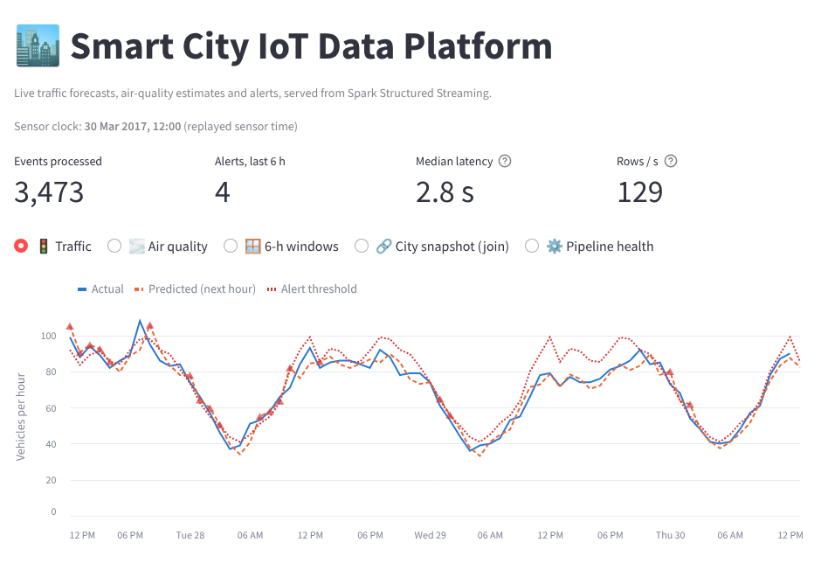



Step 5: The Live Dashboard
Where the data finally becomes a decision
Actual vs predicted traffic per junction
Alerts (▲) when a jam is forecast
Air quality: estimate vs real machine
Pipeline health: speed and delay
IN ONE LINE: Built with Streamlit; refreshes every 5 seconds with the newest Spark results.
Notes:
Real screenshot from our run. Blue is actual traffic, orange dashed is the forecast, the red dotted line is the alert limit. Triangles are alerts.

Slide 11
Making Spark Faster
Tested on a ×100 copy of the data (4.8 million rows); how many times faster each trick made it
IN ONE LINE: The biggest wins come from reading less data: Parquet files and skipping folders we don't need.
Notes:
Each bar is how many times faster the optimized version was. Best: partition pruning, 6.4 times faster, because Spark skips whole folders.

Slide 12




Problems We Hit and How We Solved Them
Being honest about the data made the project better
Different cities and years
Traffic keeps growing
Traffic and air data don't match in time, so we put both on one shared clock and say so openly.
Tree models can't predict above past values, so they predict the change from the last hour instead.
Cheap sensors drift
Spark on Windows
The air estimate slowly reads too high, so recent real readings are used to recalibrate it.
Needs Java + winutils; one setup script installs everything and tests it.
Notes:
Four real problems from the build and how we fixed them. Good to mention during questions.

Slide 13
Summary
1
Data sources: traffic, air and weather; CSV, CSV and API
2
Pipeline: sensors → Spark streaming → storage → dashboard
3
Real time: results in 2.8 s (target 10 s)
4
ML: traffic forecast 25% better than guessing
5
Dashboard: live charts and smart alerts
"A smart city is not a city full of sensors. It is a city that turns data into timely decisions."
Notes:
Recap the five steps from the assignment, then take questions.

