Slide 1


Slide 2
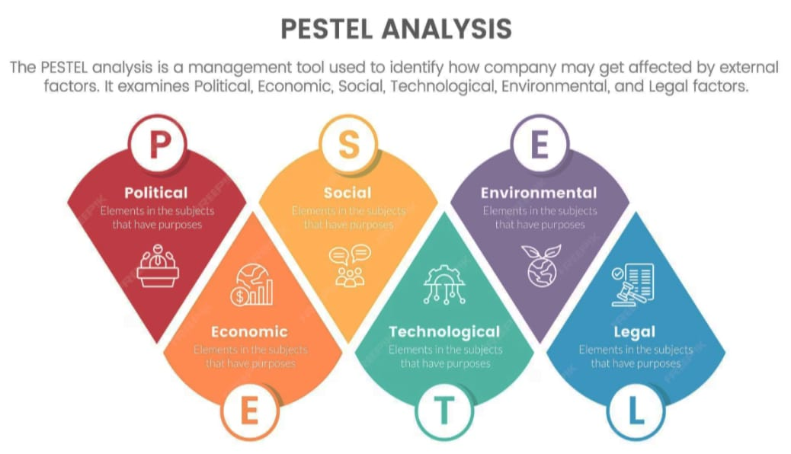

Slide 3

Social Analysis in Business Environment
Understanding the Social Factors Affecting Business
Presented by: Himanshu Jayara, Dhruv Bhatt, Hritik Roshan, Jatin Singh Bisht, Mayank, Jeevan, Harsh,Kabeer

Slide 4

Definition / Meaning
Social analysis examines cultural, demographic, and lifestyle trends.
Helps businesses understand people’s attitudes, behaviors, and expectations.
These factors influence consumer choices and brand reputation.

Slide 5

Key Social Factors
Population growth and demographics
Education level and literacy rate
Cultural values and beliefs
Lifestyle changes and social trends
Health and safety consciousness

Slide 6

Importance of Social Factors
Influences product design and marketing strategies.
Affects workforce availability and training needs.
Shapes demand patterns and brand loyalty.
Helps align business with social expectations.

Slide 7

Companies that Failed to Adapt
Kodak – Ignored changing consumer trends toward digital photography.
Nokia – Failed to adapt to changing lifestyle preferences in mobile technology.
Blockbuster – Ignored social shift toward online streaming and convenience.

Slide 8

Companies that Succeeded by Adapting
Nike – Promoted inclusivity and social campaigns like 'Equality' and 'Just Do It'.
Apple – Focused on lifestyle and design appealing to modern users.
Unilever – Emphasized sustainability and social responsibility through brands like Dove and Lifebuoy.

Slide 9
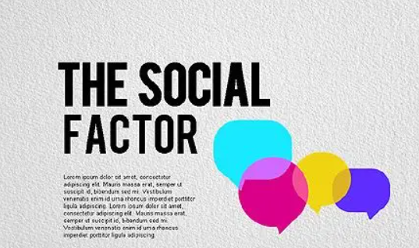
Summary / Key Takeaways
Social factors shape how businesses interact with society.
Understanding trends helps firms remain relevant and trusted.
Ignoring social changes can lead to decline or failure.

Slide 10
Thank You
Presented by: Kajal Kumari

