Slide 1
WOMEN SAFETY ANALYTICS Mini project (Group No. 05) Semester – 03 Guided by :- Dr. Mamta Kalas
TEAM members :
Sayali khatkar – a 41
Yash mhasekar – a 43
Abhay patil - a 46
Harshvardhan sathe – a 56

Slide 2

INTRODUCTION
The safety of women is a critical issue in today’s society, with rising incidents of violence and harassment.
Traditional safety measures often fail to provide timely responses or adequate protection.
This project focuses on developing an innovative Women Safety Analytics system that uses real-time threat detection to ensure prompt alerts and intervention.
By leveraging modern technology, the system aims to enhance women’s safety in various environments.

Slide 3
LITERATURE REVIEW
Women Safety Analytics (Dr. S. Aarthi et al.): Dr. S. Aarthi and her team outline an innovative AI-based surveillance system designed to bolster women's safety in public areas. This system incorporates real-time video analysis, facial recognition, and gesture detection to identify threats and notify law enforcement promptly. Additionally, it features automated high-risk situation recognition and integrates crime hotspot mapping for safer route suggestions. This comprehensive approach aims to bridge existing public safety gaps by leveraging proactive, AI-driven monitoring and swift interventions
The Safety of Women in Journalism (Adedoyin F. O. and Felicia Awolope): Authored by Adedoyin F. O. and Felicia Awolope, this study highlights the pervasive safety challenges confronting female journalists, including physical and digital harassment. Such abuse often results in self-censorship and psychological strain, impacting their work. The authors call for stronger legislative measures, gender-sensitive workplace policies, and specialized training to create safer, supportive environments for women in journalism. These changes aim to empower female journalists and address critical gaps in protection and support .
The paper, titled "Convolutional Neural Network Driven Computer Vision Based Facial Emotion Detection and Recognition," authored by Tsega Asresa, Getahun Tigistu, and Melaku Bayih, focuses on the application of Convolutional Neural Networks (CNN) for facial emotion recognition. It explores the significance of facial emotion recognition in fields such as security, social communication, and law enforcement. The authors discuss the role of AI and CNN in detecting emotions like anger, happiness, sadness, fear, disgust, neutral, and surprise from facial images. Using the FER-2013 dataset, the authors trained the CNN model, achieving 93.8% accuracy in training and 75% accuracy in testing. The research highlights the potential of CNN in advancing human-computer interaction and improving various applications that rely on emotion detection, such as security and commercial enterprises.

Slide 4
The research paper titled "Computer Vision-Based Gender Detection from Facial Image" by Emon Kumar Dey, Mohsin Khan, and Md Haider Ali focuses on developing an intelligent system for gender detection using facial images. Published in 2013, the paper proposes a method that combines several computer vision techniques for gender classification, aiming to improve accuracy in applications such as surveillance, human-computer interaction, and biometric authentication. The system detects faces in images using the Viola-Jones algorithm and processes the detected region of interest (ROI) with Local Binary Patterns (LBP) and Discrete Cosine Transformation (DCT) for feature extraction. The results are then classified using a supervised learning model based on a gender knowledge base, which improves the system's accuracy. The research tested the system on a database of over 4000 facial images, predominantly from the subcontinent, achieving an average accuracy rate of 78%. The paper discusses previous work in the field, including methods based on facial features and image pixel properties, and presents the effectiveness of low-level information approaches for gender classification.

Slide 5
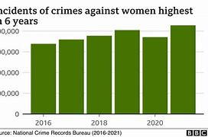
PROBLEM DEFINITION
Women face increasing safety threats in public and private spaces, including harassment, violence, and abduction. Despite various safety measures, timely intervention remains a challenge due to delayed response and lack of effective monitoring. This project aims to develop a real-time threat detection and response system that enhances women’s safety by providing instant alerts and enabling quicker intervention, ensuring a safer environment for women.

Slide 6
OBJECTIVES
•Real-time Threat Detection: Develop a system to monitor and identify potential safety threats to women in real-time using sensors, data analytics, and machine learning techniques.
•Instant Alert System: Create an automated alert system to notify emergency contacts and authorities immediately when a safety threat is detected, ensuring timely intervention.
•User-friendly Interface: Design a simple, intuitive interface for easy access to safety features, such as emergency alerts, tracking, and monitoring, for women in distress.

Slide 7
PROPOSED SOLUTION
The "Women Safety Analytics – Protecting Women from safety threats" project is designed to address the growing concern for women's safety in various urban environments by leveraging advanced real-time monitoring and analytics. The system aims to create safer public spaces for women by detecting potential threats and alerting law enforcement before incidents escalate. Key functionalities include person detection with gender classification, analysis of gender distribution, identification of lone women during nighttime, detection of suspicious scenarios like a woman surrounded by men, recognition of SOS situations through gesture analytics, and hotspot identification based on past alerts. This proactive system not only enhances public safety but also provides valuable data for strategic planning and law enforcement.

Slide 8
HARDWARE AND SOFTWARE REQUIREMENTS:
1. System:
- Processor: Intel Core i3/i5/i7/i9 (compatible and recent gen)
- RAM: 8 GB
- Storage: 512 GB SSD
- Graphics Card: NVIDIA GTX 1650
- OS: Windows 7/8/10/11, macOS or Linux
2. Cameras:
- Indoor: HD IP cameras (1080p), night vision, motion detection
- Outdoor: Weatherproof HD IP cameras (1080p), night vision
- Specialized: 360-degree or panoramic cameras (if needed)
3. Website Requirements
- Operating System: Windows 7/8/10/11/Linux or macOS
- Browser: Any browser with latest version.
- Coding Language: HTML, CSS, JavaScript, Python.
- Code Editor: VS Code.
- Database: Firebase, MongoDB.

Slide 9
WEB PAGE INTERFACE
HOME PAGE:
• A home page consists of concise, clear title that communicates what your website or service is about.
• The prominent buttons like "Login", “Get started”, "Resources", "Contact", etc.
• The safety resources provides links to key pages like “Emergency Contacts”, “Self-Defense Tips”, “Support group”.

Slide 10
PROPOSED WEB PAGE INTERFACE:
MAIN PAGE (AFTER SIGNUP AND LOGIN):
The main page displays the Real-Time Detection Module, which is activated by clicking a Start Real-Time Detection Button.
Once the detection module starts, a live Camera Feed is displayed, capturing the surroundings in real time.
The Detection Status section updates with the current safety status (e.g., "Safe" or "Threat Detected"), based on the model’s analysis.
Basic Controls include the option to stop the detection and return to the homepage, ensuring easy navigation for the user

Slide 11
MERITS
Real-time Threat Detection: An efficient Women Safety Analytics system quickly detects potential safety threats in real time, enabling immediate alerts and prompt intervention, which enhances overall safety and reduces response time.
User Interface Efficiency: The system features an intuitive, minimalistic interface that simplifies navigation, allowing users to easily start and stop detection, access emergency functions, and view live camera feeds without confusion or unnecessary steps.
Instant Alert and Emergency Response: The system automates the alert process by notifying emergency contacts and authorities as soon as a threat is detected, ensuring swift and efficient emergency response, reducing delays in critical situations.
Resource Optimization: The system is optimized for performance, running efficiently on standard hardware with minimal resource consumption, ensuring smooth operation without draining device resources or slowing down performance during real-time detection.

Slide 12
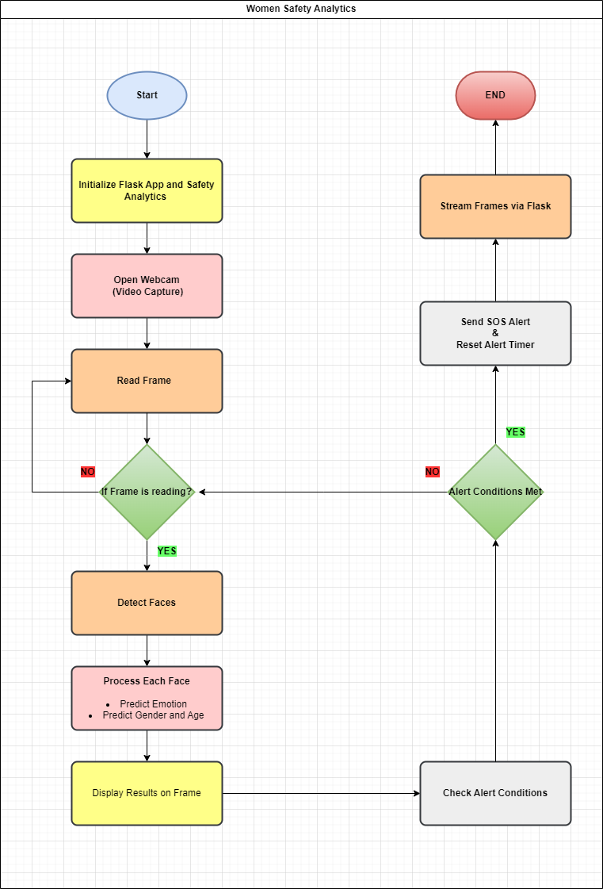
FLOWCHART:
WOMEN SAFETY ANALYSIS – PROTECTING WOMEN AGAINST SAFETY THREATS.

Slide 13
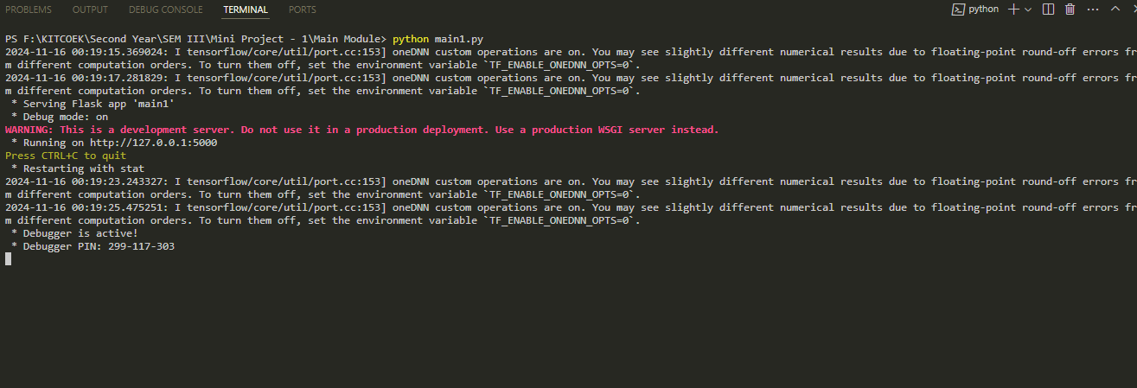
Screen shots of the terminal :

Slide 14
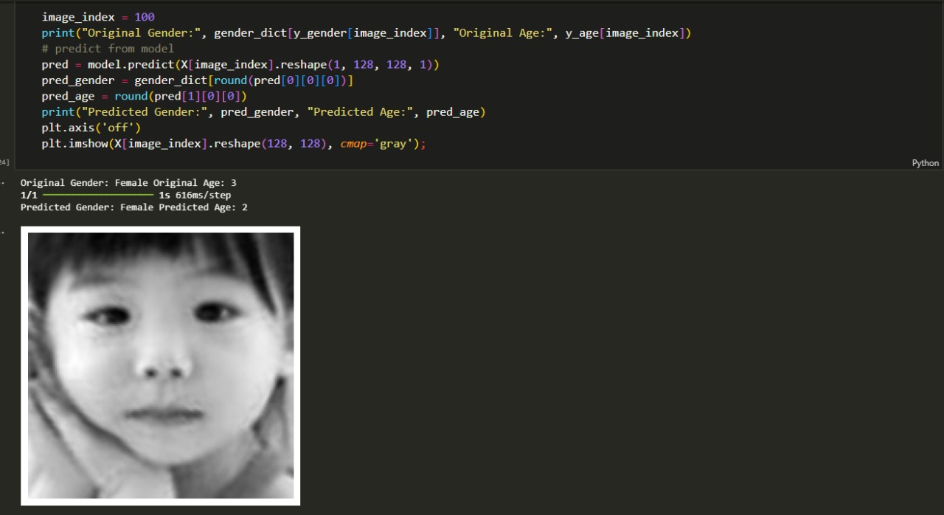
SCREEN SHOT OF THE GEDER AND AGE DETTECTION AI MODEL :
# AI MODEL RETURNED THE RESULT , AFTER ANALYSING THE IMAGE(.png) = GENDER: “WOMEN ” AGE : “2”

Slide 15
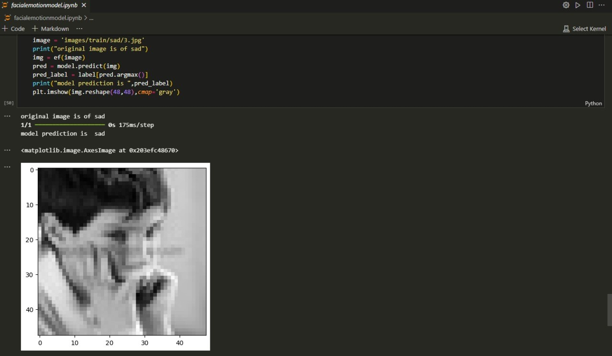
SCREEN SHOT OF THE EMOTION DETECTION AI MODEL:
# AI MODEL RETURNED THE RESULT , AFTER ANALYSING THE IMAGE(.png) = EMOTION : “SAD”

Slide 16
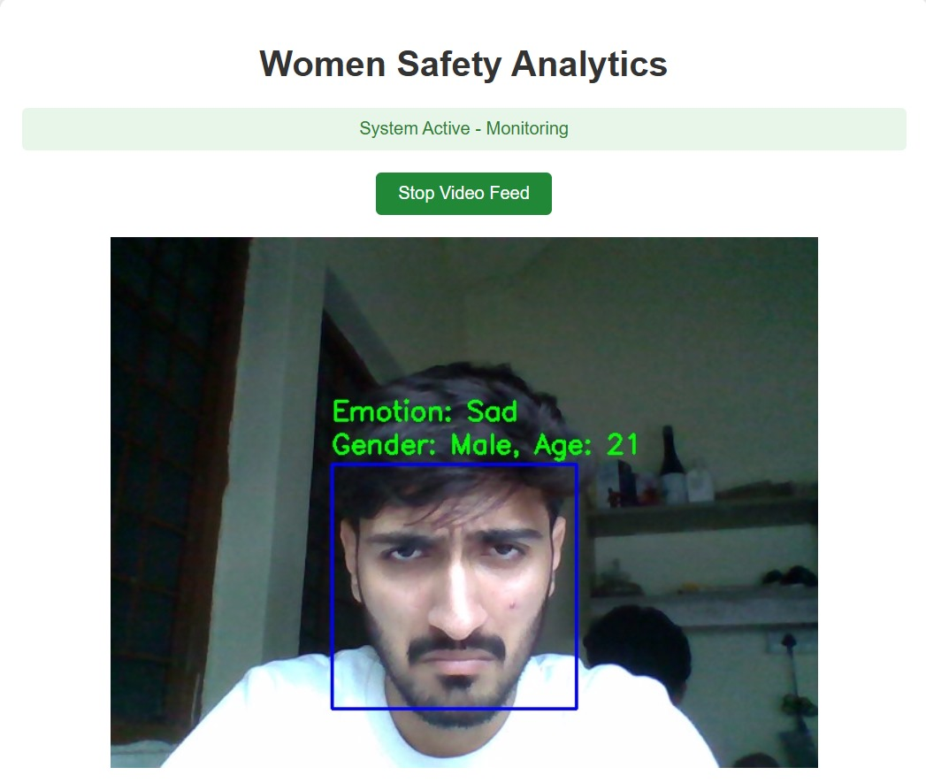
WOMEN SAFETY ANALYTICS (LIVE FEED):
#THE AI MODEL RETURNED : GENDER , AGE AND EMOTION OF THE SUBJECT IN LIVE FEED =
GENDER=“MALE”,AGE=“21”,EMOTION=“SAD”.

Slide 17
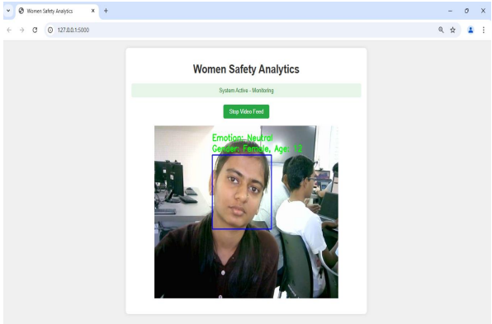
WOMEN SAFETY ANALYTICS (LIVE FEED):
#THE AI MODEL RETURNED : GENDER , AGE AND EMOTION OF THE SUBJECT IN LIVE FEED =
GENDER=“FEMALE”,AGE=“12”,EMOTION=“NEUTRAL”.

Slide 18
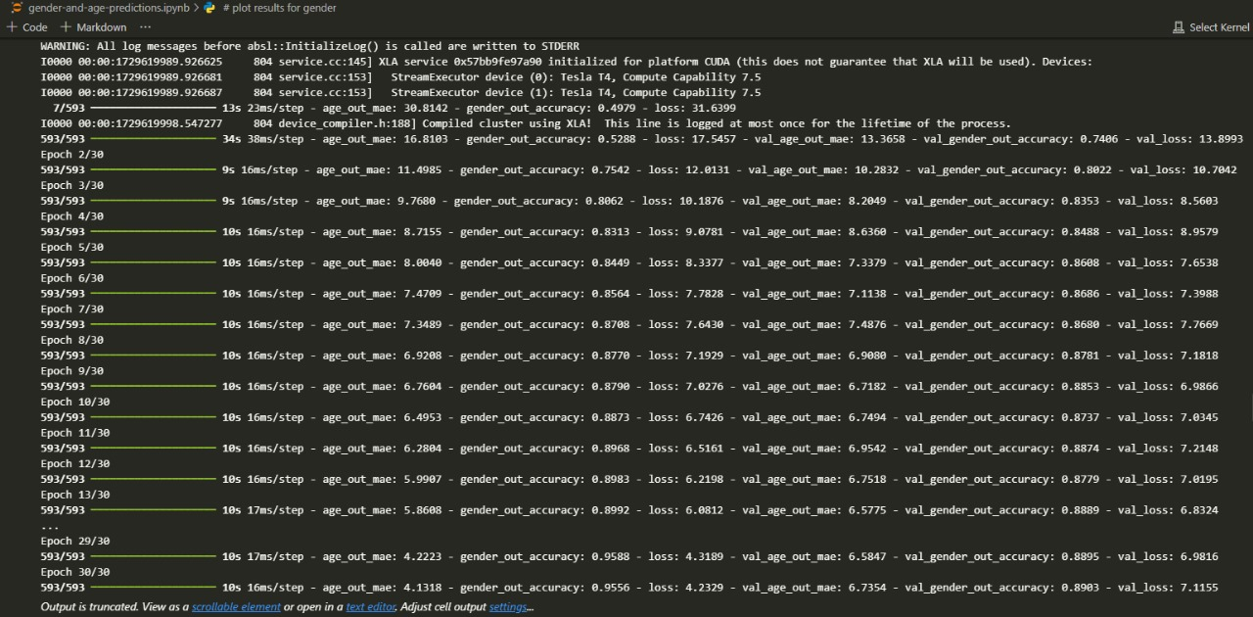
BACKEND ON THE TERMINAL , DURING THE AI MODEL IS ENABLED ON TE WEBSITE:
# THE AI MODEL IS ANALYSING THE LIVE FEED , AND RETURNING THE RESULT AS “GENDER”,”AGE”AND “EMOTION”.

Slide 19

WEB DESIGN (FRONT END)

Slide 20
CONCLUSION
The Women Safety Analytics system leverages two key machine learning models: Person Detection with Gender Classification and Recognizing SOS Situations through Gesture Analytics. These models effectively detect individuals in various environments, classify their gender, and identify distress gestures, providing real-time alerts for potential safety threats. This proactive approach enhances women's safety by enabling early intervention in critical situations.
For future improvements, the system can focus on enhancing the accuracy of these models, reducing false positives, and expanding threat detection capabilities. Integrating additional models for other types of danger, improving real-time alert systems, and developing mobile applications for broader accessibility will further strengthen the system’s functionality and impact.

Slide 21
REFERENCE
Dr. S. Aarthi https://www.researchgate.net/publication/384076254_Women_Safety_Analytics_Pr otecting_Women_From_Safety_Threats
Adedoyin F. O. and Felicia Awolope https://www.researchgate.net/publication/380294958_Adedoyin_F_O_The_Safety_o f_Women_in_Journalism_The_Safety_of_Women_in_Journalism_A_Dissertation_o n_the_Safety_of_Women_in_Journalism
Tsega Asresa, Getahun Tigistu, and Melaku Bayih https://www.researchgate.net/publication/376559066_Convolutional_Neural_Netwo rk_Driven_Computer_Vision_Based_Facial_Emotion_Detection_and_Recognition
Emon Kumar Dey, Mohsin Khan, and Md Haider Ali https://www.researchgate.net/publication/271447627_Computer_VisionBased_Gender_Detection_from_Facial_Imag

