Slide 1




Data Analysis of a superstore
~Abhay Shukla

Slide 2
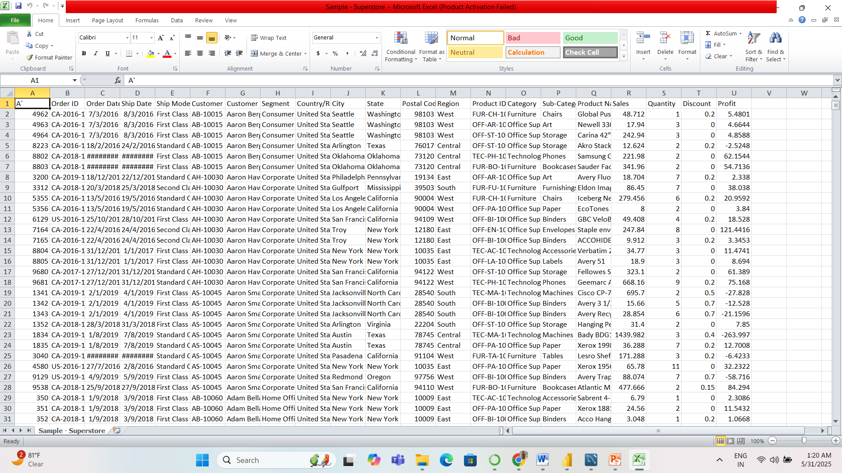
At very first step I got this raw data of superstore. And then I performed
Cleaning and transformation of data through excel to make it appropriate
For further analysis through different tools.

Slide 3
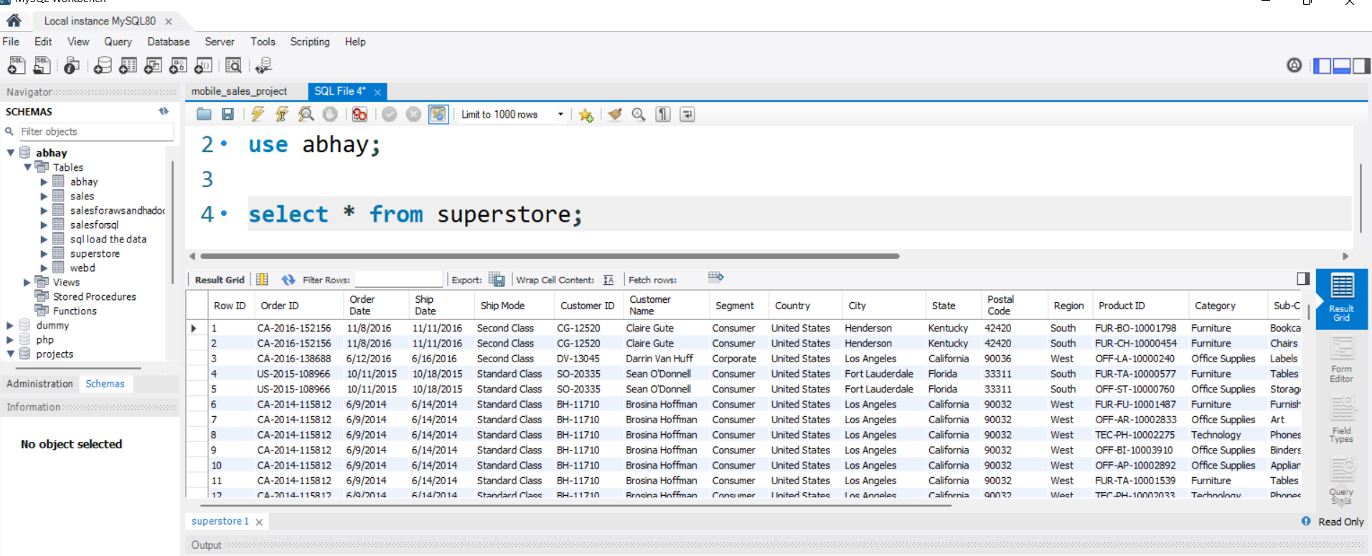
After cleaning process I imported this data in mysql,where I performed
Queries to get meaningful insights from data for business growth.
I solved queries to get data for KPIs,charts,bars,tables etc. whose reference is given
Below:-
This is table overview in mysql:-
table name-superstore

Slide 4
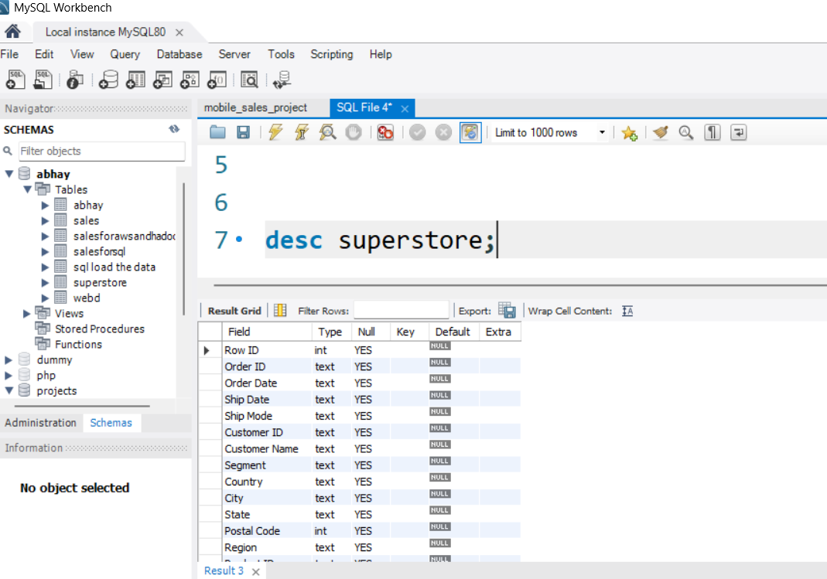
This is the overall structure of table superstore on which I am
Currently working on this project…

Slide 5
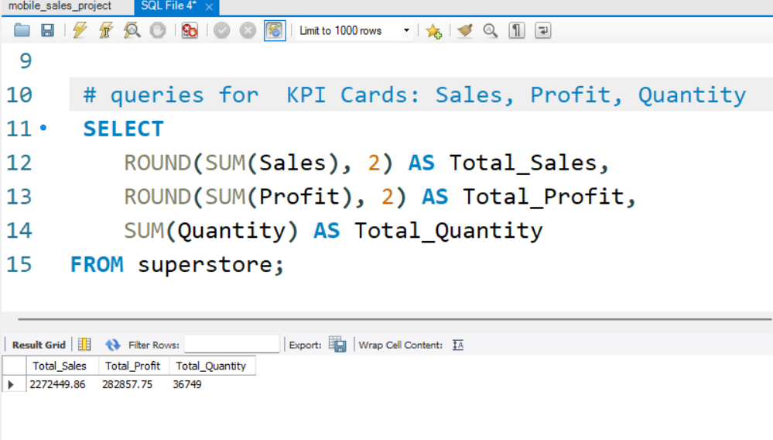
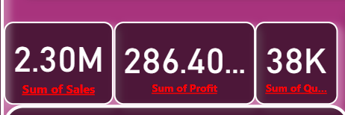
KPI Metrics Summary from Superstore Dataset-(using SQL and PowerBI)
This query extracts Key Performance Indicators (KPIs) from the superstore dataset, providing essential business metrics for dashboard insights:

Slide 6
"KPI Summary: Sales, Profit & Quantity from Superstore Data"
SQL Query Purpose:-
To summarize total sales, total profit, and total quantity sold across all records.Uses aggregate functions and ROUND for cleaner display values.
SQL Query Breakdown:
SUM(Sales): Total revenue generated from all transactions.
SUM(Profit): Overall profit after discounts and cost.
SUM(Quantity): Total number of units sold.ROUND(..., 2): Formats sales and profit values to 2 decimal places for readability.
Dashboard Display:
The KPI cards (shown at the bottom of the image) visually represent:
Sales as ~2.30M
Profit as ~286.4K
Quantity as ~38K

Slide 7
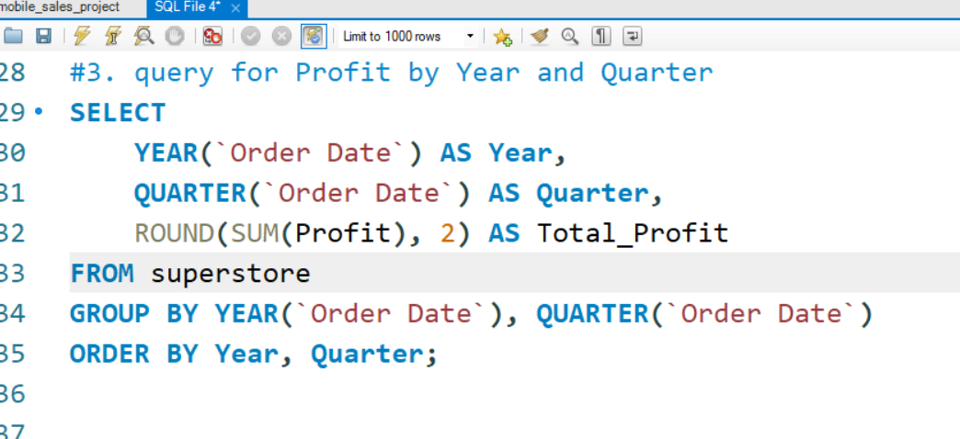
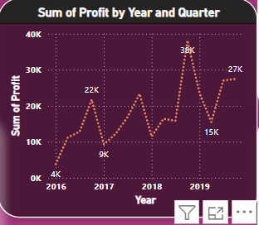
Profit trend by year and quarter

Slide 8
Profit Trend by Year and Quarter-
This query visualizes quarterly profit performance over the years using the superstore dataset. It helps in identifying seasonal trends, growth patterns, and year-over-year performance.
"Quarterly Profit Analysis (2016–2019)"
SQL Query Purpose:-To calculate and display total profit grouped by both year and quarter of the order date.Useful for time series analysis and business trend tracking.
SQL Query Breakdown:-
YEAR(Order Date): Extracts the year from the order date.
QUARTER(Order Date): Extracts the quarter (Q1 to Q4).
SUM(Profit): Total profit for each year-quarter.
ROUND(..., 2): Limits profit to 2 decimal places.
GROUP BY and ORDER BY :- organize data chronologically.
Graph Output (on Slide):-
Title: “Sum of Profit by Year and Quarter”
Visual: A line graph showing profit peaks and troughs per quarter from 2016 to 2019.
Key Insights:Profit rose sharply in some Q4 periods (e.g., 38K in 2018 Q4).Consistent upward trend over time with minor dips (e.g., 9K in 2017 Q2).

Slide 9
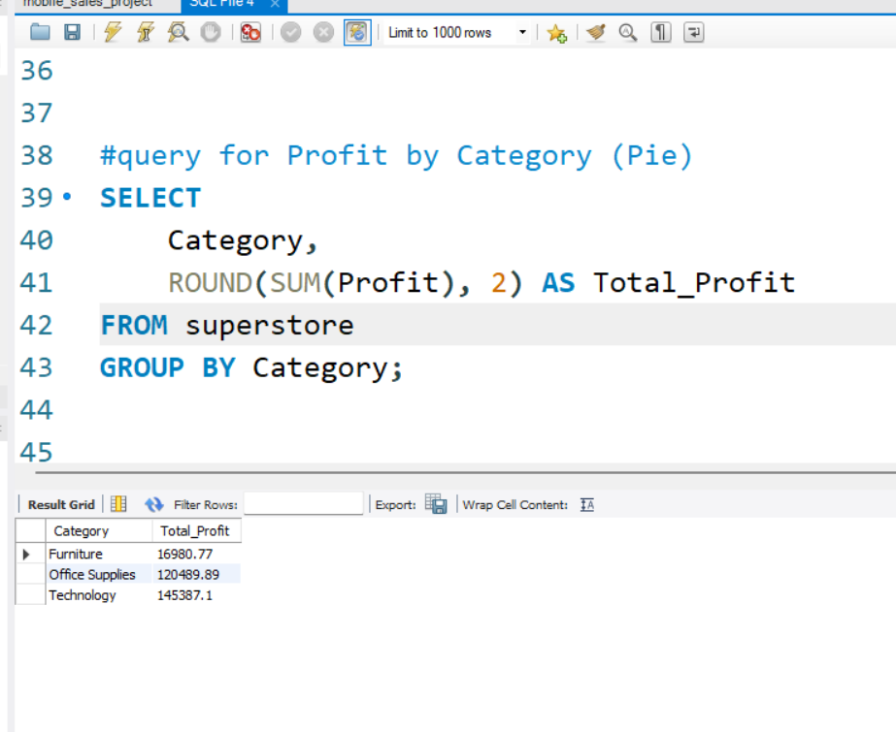
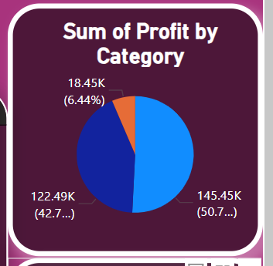
Profit distribution by Category (Pie chart)

Slide 10
"Profit Contribution by Product Category"
Profit Distribution by Category (Pie Chart):-
This slide shows the distribution of total profit across different product categories using a pie chart. It helps identify which category contributes most to the business's overall profit.
SQL Query Purpose:-
To calculate total profit for each product category from the superstore dataset and visualize the results as proportions.
SQL Query Breakdown:-
Category: Groups data by product category (e.g., Furniture, Office Supplies, Technology).
SUM(Profit): Calculates total profit per category.
ROUND(..., 2): Limits values to 2 decimal points for clarity.
Chart Output (on Slide):
Title: “Sum of Profit by Category”
Chart Type: Pie chart
Segments show:Technology: ₹145.43K (≈50.7%)Office Supplies: ₹122.49K (≈42.7%)Furniture: ₹18.45K (≈6.44%)
Key Insights:-Technology is the most profitable category, contributing over half of total profits.Furniture contributes the least to overall profit, signaling possible underperformance or fewer sales.

Slide 11
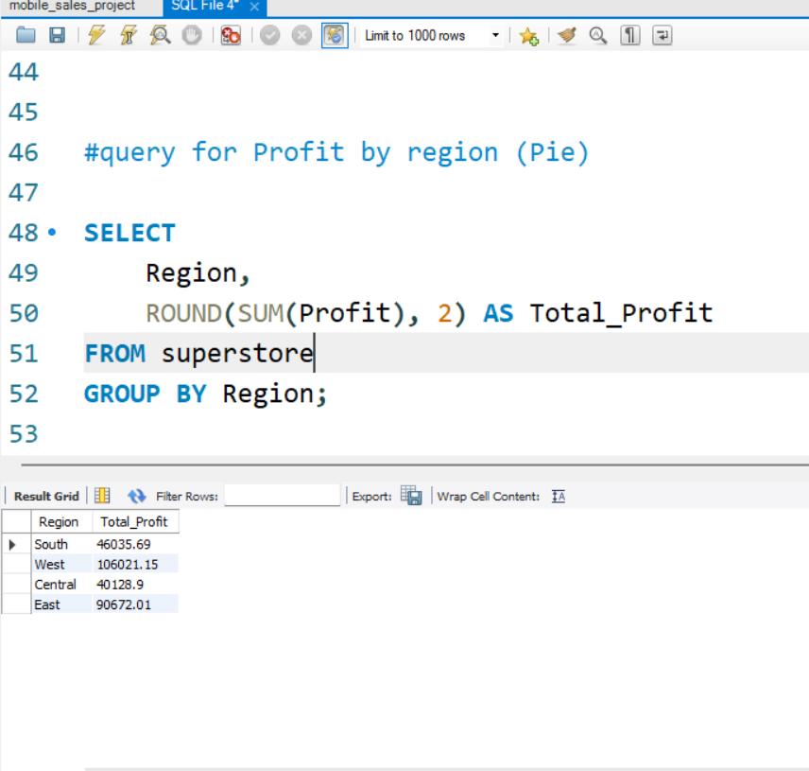
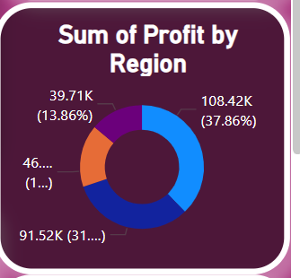
“Profit Distribution by Region”

Slide 12
"Regional Profit Contribution Breakdown"
Profit Distribution by Region (Pie Chart)-
This slide visualizes the sum of profits from different regions using a pie chart. It helps identify regional performance in terms of total profit contribution.
SQL Query Purpose:To calculate and display total profit from each region using the superstore dataset.
Chart Output (on Slide):
Title: “Sum of Profit by Region”
Chart Type: Pie chart
Segment details:
West: ₹108.42K (~37.86%)
East: ₹91.52K (~31.95%)
Central: ₹46.23K (~16.14%)
South: ₹39.71K (~13.86%)
Key Insights:-
West region is the top performer, generating the highest profit.South region contributes the least, indicating potential for strategic improvement.

Slide 13
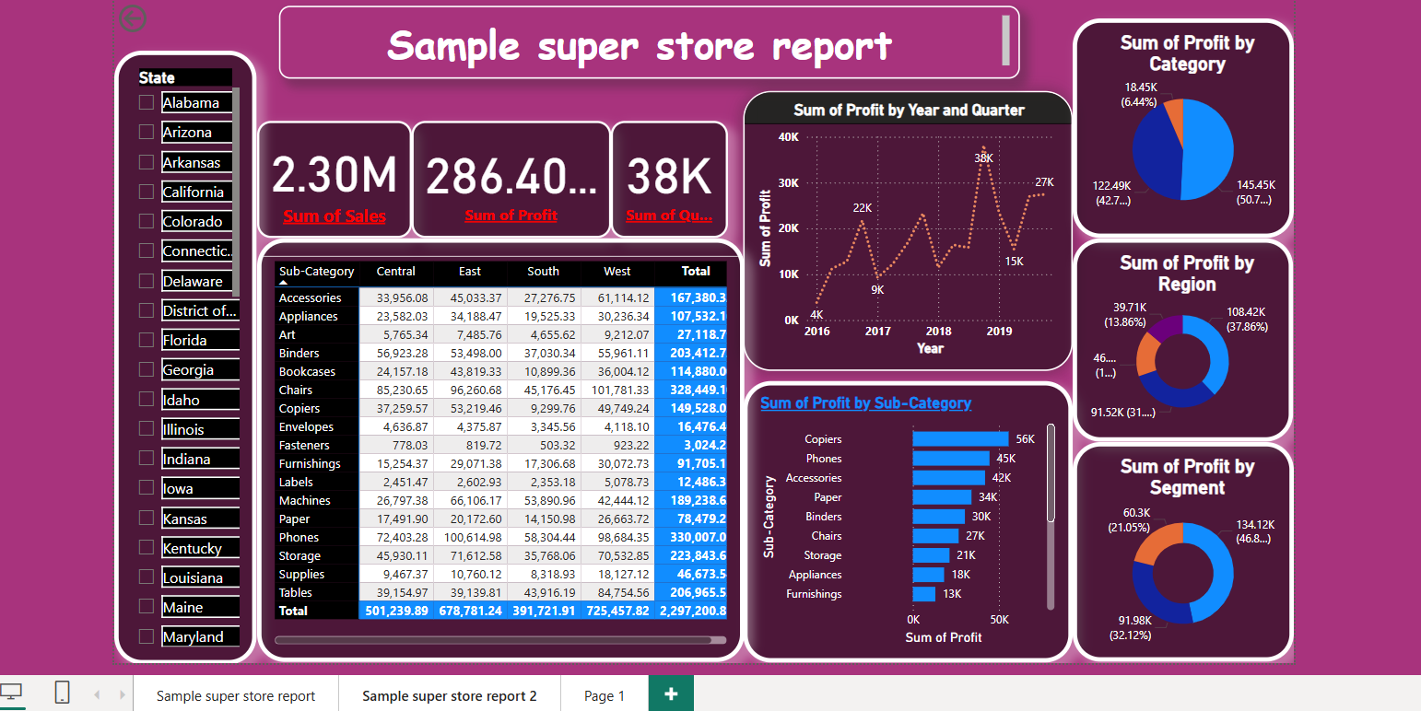
Comprehensive Sample Superstore Report Dashboard

Slide 14
Attached powerBI dashboard includes-(Summary)
Key KPIs Displayed .
Trend Analysis: Profit by Year and Quarter
Profit Distribution Charts:
Technology leads in profit contribution.
Sum of Profit by Region (Middle Right - Pie Chart):
The West region contributes the most profit.
Sum of Profit by Segment (Bottom Right - Donut Chart):
Consumers are the largest profit-generating segment.
Profit Table: Profit by Sub-Category and Region
Horizontal Bar Chart: Sum of Profit by Sub-Category
Shows which product types are most profitable.
State filters

Slide 15
Business -insights
Profit Trends by Year and Quarter:-
There is a steady upward trend in profit from 2016 to 2019, peaking in 2018 (₹38K).Quarterly spikes imply seasonal buying patterns, possibly during end-of-year or promotional periods.
Recommendation:Capitalize on high-profit quarters by increasing marketing spends and inventory ahead of these periods.
2.Profit by Category:-Technology contributes the highest profit (₹145.45K), over 50% of total profits.Furniture is significantly underperforming (₹18.45K).
Recommendation:Increase focus on Technology through promotions and bundling.Reevaluate Furniture pricing, vendor terms, or reduce SKUs to improve profitability.

Slide 16
Business -insights
3. Profit by Region:-
West and East regions are top performers, contributing ~70% of total profit combined.South region underperforms significantly (₹39.71K).
Recommendation:Allocate more resources and inventory to West and East regions.Investigate customer needs and delivery logistics in South to boost performance.
4.Profit by Segment:-Consumer segment yields the highest profit (₹134.12K).Home Office lags behind (₹60.3K).
Recommendation:Double down on consumer-targeted campaigns.Explore product-market fit improvements for the Home Office segment.

Slide 17
Business -insights
5. Sub-Category Performance:-Copiers, Phones, and Accessories are the most profitable sub-categories.Items like Furnishings and Appliances generate the lowest returns.
Recommendation:Focus promotions and stock investments on top sub-categories.Consider phasing out low-performing items or repositioning them in the market.
6.Regional Sub-Category :-TrendsPerformance varies by region—e.g., Phones sell well in the West, while Chairs do better in the East.
Recommendation:implement region-specific product strategies to align inventory and marketing with local preferences.

Slide 18
-:Strategic Actions:-
Prioritize investment in Technology and Consumer segment.
Perform deep-dive analysis on underperforming regions (South) and categories (Furniture).
Use seasonal trends to plan sales campaigns and inventory buildup.
Tailor marketing strategies regionally using sub-category insights.

Slide 19
Thank-you..

