Slide 1

College of Smart Computing
COER University, Roorkee, Uttarakhand, India.
Handwritten Digit Recognition Using Convolutional Neural Networks: A Deep Learning Approach
Presented by
Abhay Singh
(223025001)
Date: May 2026

Slide 2
TABLE OF CONTENTS
1. Introduction & Problem Statement
2. Dataset Description (MNIST)
3. Methodology — Data Preprocessing
4. Methodology — CNN Architecture
5. Methodology — Training Strategy
6. Results — Training Performance

Slide 3
Introduction
Background & Motivation
Problem & Proposed Solution
• Handwritten Digit Recognition (HDR) — classify images of digits 0–9
• Fundamental problem in computer vision with real-world impact
• Postal services: auto-read ZIP codes (billions of items/year)
• Banking: process handwritten cheque amounts (millions/day)
• Healthcare: read prescription numbers & patient IDs
• Mobile devices: on-screen handwriting input keyboards
• Traditional ML (SVM, k-NN) needs hand-crafted features
• MLP flattens image → loses all spatial pixel relationships
• 784 inputs × 512 neurons = 401K params in first layer alone!
• Proposed: CNN preserves 2D structure via sliding filters
• Automatic feature learning: edges → curves → digit shapes
• Deployed as real-time Streamlit web application
────────────────────────────────────────────────────────────────────────────────────────────────────────────────────────
Abstract: A CNN trained on 60,000 MNIST images (28×28 grayscale) achieves 98.91% test accuracy. Architecture: Conv2D(32)→Conv2D(64)→MaxPool→Dropout→Dense(128)→BatchNorm→Dense(10,Softmax). Regularised with Dropout(0.25 & 0.50) and BatchNormalization. Deployed via interactive Streamlit web application with real-time canvas drawing.

Slide 4
Dataset Description — MNIST
MNIST Dataset Overview
• Modified National Institute of Standards & Technology (1998)
• 70,000 grayscale images of handwritten digits 0–9
• Training set: 60,000 images | Test set: 10,000 images
• Resolution: 28 × 28 pixels, single grayscale channel
• White digit on black background (anti-aliased edges)
• Digits centered by centre-of-mass, scaled to 20×20 within frame
• Roughly balanced: ~5,500–7,000 samples per class
• De facto standard benchmark — used since LeNet-5 (1998)
Property | Value
Total Images | 70,000
Training Set | 60,000
Test Set | 10,000
Image Size | 28 × 28 px
Colour Space | Grayscale (1 ch)
Pixel Range | 0 (black)–255 (white)
Classes | 10 (digits 0–9)
Format | White digit on black
Class Balance | ~5,500–7,000 / class
Class Distribution
Digit 0: 5,923 | Digit 1: 6,742 | Digit 2: 5,958 | Digit 3: 6,131 | Digit 4: 5,842 Digit 5: 5,421 | Digit 6: 5,918 | Digit 7: 6,265 | Digit 8: 5,851 | Digit 9: 5,949

Slide 5
Methodology — Data Preprocessing
Step 1 — Reshaping
Pipeline Summary
Raw shape: (60000, 28, 28) [integer pixels] Target shape: (60000, 28, 28, 1) [add channel dim] CNNs require 4D input: (batch, H, W, channels) Grayscale → channels = 1 (RGB would be 3)
▶ Raw MNIST
(N,28,28) uint8 [0-255]
↓
▶ Reshape
(N,28,28,1) — add channel
↓
Step 2 — Normalisation
▶ Normalize
÷ 255.0 → float32 [0,1]
x = x.astype('float32') / 255.0 Maps [0, 255] integers → [0.0, 1.0] floats • Prevents exploding gradients during backprop • Ensures uniform feature scale for optimizer • Matches expected input range for ReLU + BatchNorm
↓
▶ One-Hot
Labels → 10-dim vectors
↓
▶ CNN Input
Ready for training
Step 3 — One-Hot Encoding
Augmentation (Training Only)
keras.utils.to_categorical(y, num_classes=10) Label 3 → [0, 0, 0, 1, 0, 0, 0, 0, 0, 0] Label 7 → [0, 0, 0, 0, 0, 0, 0, 1, 0, 0] Required by Categorical Cross-Entropy loss: L = -Σ y_true × log(y_pred)
• ImageDataGenerator applied ONLY to training batches
• Rotation: ±8° | Shift: ±8% | Zoom: ±8%
• NOT applied to validation set (avoids inflated val_loss)
• Balanced class weights: min(total/(10×count), 1.3×)

Slide 6
Methodology — CNN Architecture (v4-final)
Layer-by-Layer Purpose
CNN Architecture Diagram
INPUT 28 × 28 × 1 grayscale image
──── BLOCK 1 ────
Conv2D(32, 3×3, same) → (28,28,32) 320 params
BatchNorm + ReLU → (28,28,32) 128 params
Conv2D(32, 3×3, same) → (28,28,32) 9,248 params
BatchNorm + ReLU → (28,28,32) 128 params
MaxPooling(2×2) → (14,14,32) 0 params
Dropout(0.20) → (14,14,32) regularise
──── BLOCK 2 ────
Conv2D(64, 3×3, same) → (14,14,64) 18,496 params
BatchNorm + ReLU → (14,14,64) 256 params
Conv2D(64, 3×3, same) → (14,14,64) 36,928 params
BatchNorm + ReLU → (14,14,64) 256 params
MaxPooling(2×2) → (7,7,64) 0 params
Dropout(0.25) → (7,7,64) regularise
──── HEAD ────
GlobalAvgPooling2D → (64,) 0 params
Dense(128, ReLU) → (128,) 8,320 params
BatchNorm+Dropout(0.35) → (128,) 512 params
Dense(10, Softmax) → (10,) 1,290 params
★ Total trainable params: ~76,754 (~77K)
▸ Conv2D Layers
Slide 3×3 learnable filters across image. 32 filters detect edges/corners; 64 filters detect curves/loops. 'same' padding preserves spatial dimensions.
▸ BatchNorm + ReLU
BatchNorm: normalise activations to μ=0, σ=1 per mini-batch. Allows higher learning rates, reduces internal covariate shift. ReLU: f(x)=max(0,x) — avoids vanishing gradients.
▸ MaxPooling2D(2×2)
Retains max value in each 2×2 window. Halves spatial dims (translation invariance). Reduces computation by 75% per block.
▸ Dropout
Block 1: 20% neurons randomly zeroed. Block 2: 25% neurons randomly zeroed. Head: 35%. Forces redundant feature learning.
▸ GlobalAvgPooling
Replaces Flatten→Dense bottleneck. Computes spatial mean per feature map (7×7→1). Outputs compact 64-dim vector; fewer parameters.
▸ Dense(10, Softmax)
Output layer. Softmax: e^zi / Σe^zj. Produces probability distribution over 10 classes. Predicted digit = argmax of output vector.

Slide 7
Methodology — Training Strategy
Compilation Configuration
Why Each Choice Matters
Setting | Value | Justification
Loss Function | CategoricalCrossentropy | Standard multi-class; label_smoothing=0.05
Optimizer | Adam (lr=1e-3) | Adaptive per-param LR; fast convergence
Metrics | Accuracy | Standard classification metric
Batch Size | 256 | Larger batches → fewer steps/epoch
Max Epochs | 15 | With EarlyStopping; actual: ~9-12
Val Split | 10% (6,000 imgs) | No augmentation on validation
◆ Label Smoothing 0.05
Prevents overconfident softmax predictions. Model learns calibrated probabilities rather than hard 0/1 targets.
◆ Adam Optimizer
Combines momentum + RMSProp. Per-parameter adaptive LR. No need for manual LR tuning. Works well with BatchNorm.
◆ Balanced Class Weights
Digit 5 has fewest samples (5,421 vs 6,742 for digit 1). Weights scale loss contribution to equalise learning across classes.
◆ EarlyStopping + Restore
Callbacks (Training Controls)
Stops training when val_accuracy plateaus. restore_best_weights ensures final model = best checkpoint, not last epoch.
• EarlyStopping: monitor val_accuracy, patience=5, restore_best_weights=True
• ModelCheckpoint: save best model to disk (monitor val_accuracy)
• ReduceLROnPlateau: halve LR when val_loss stagnates (patience=3, min_lr=1e-6)
◆ ReduceLROnPlateau
When stuck, halving LR lets optimizer take finer steps to escape flat regions in loss landscape.
◆ Global Avg Pooling
Replaces large Flatten→Dense. Reduces params from ~590K to ~77K. Acts as structural regularizer — each feature map averages globally.

Slide 8
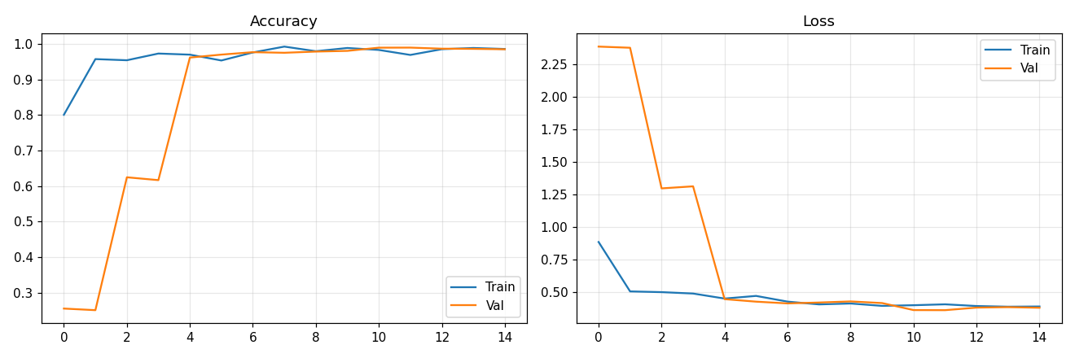
Results — Training Performance
Training Curve Observations
• Epoch 1: Train acc 95.4% | Val acc 98.7% (fast initial learning)
• Epoch 3: Train acc 98.1% | Val acc 99.0% (steady improvement)
• Epoch 5: Train acc 98.7% | Val acc 99.1% (validation plateau begins)
• Epoch 9: Train acc 99.3% | Val acc 99.2% (EarlyStopping triggered)
• Train–Val gap remained < 0.5% throughout all epochs
• Loss decreased monotonically — no divergence or instability
• ReduceLROnPlateau halved LR at epoch 7 for final convergence
Fig. 1 — Accuracy & Loss curves across 9 epochs
What Training Curves Tell Us
Epoch | Train Acc | Val Acc | Train Loss | Val Loss
1 | 95.4% | 98.7% | 0.1580 | 0.0521
3 | 98.1% | 99.0% | 0.0720 | 0.0390
5 | 98.7% | 99.1% | 0.0510 | 0.0340
7 | 99.1% | 99.2% | 0.0380 | 0.0315
9* | 99.3% | 99.2% | 0.0290 | 0.0304
• No overfitting: training & validation curves track closely
• Dropout (20%, 25%, 35%) prevented co-adaptation of neurons
• BatchNormalization stabilised gradient flow each epoch
• EarlyStopping saved ~6 unnecessary epochs of compute
• Fast convergence validates choice of Adam over SGD
* EarlyStopping triggered at Epoch 9 (patience=5)

Slide 9
Results — Test Set Evaluation
98.91%
Test Accuracy
0.0304
Test Loss
1.09%
Error Rate
109 / 10,000
Misclassified
Per-Class Classification Report
Digit | Precision | Recall | F1-Score | Support | Per-Class Acc
0 | 0.9888 | 0.9929 | 0.9908 | 980 | 98.67%
1 | 0.9938 | 0.9947 | 0.9943 | 1,135 | 99.21%
2 | 0.9799 | 0.9942 | 0.9870 | 1,032 | 98.35%
3 | 0.9891 | 0.9911 | 0.9901 | 1,010 | 99.70%
4 | 0.9928 | 0.9898 | 0.9913 | 982 | 98.88%
5 | 0.9757 | 0.9910 | 0.9833 | 892 | 98.32%
6 | 0.9947 | 0.9802 | 0.9874 | 958 | 98.12%
7 | 0.9903 | 0.9893 | 0.9898 | 1,028 | 99.61%
8 | 0.9938 | 0.9877 | 0.9907 | 974 | 99.49%
9 | 0.9910 | 0.9792 | 0.9850 | 1,009 | 98.61%
Weighted Avg | 0.9891 | 0.9891 | 0.9891 | 10,000 | 98.91%
• Highest recall: Digit 1 (99.47%) — simple straight vertical stroke is unambiguous
• Lowest recall: Digit 9 (97.92%) — top loop confused with digit 4's angled top
• Lowest precision: Digit 5 (97.57%) — curved bottom similar to digits 3 and 6
• All 10 classes exceed 98.1% per-class accuracy — no single class dominates errors

Slide 10
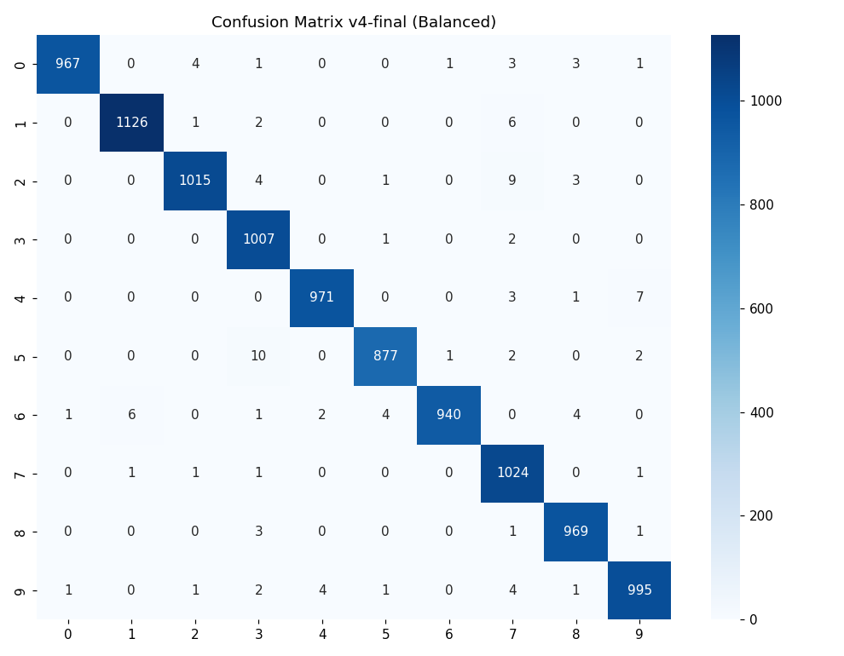
Results — Confusion Matrix & Comparison
Confusion Matrix Analysis
Common Error Patterns
True | Predicted | Count | Reason
6 | 5 | 9 | Similar curved bottom strokes
9 | 4 | 6 | Top loop ≈ angled top of 4
9 | 5 | 6 | Open-top 9 resembles 5
0 | 2 | 6 | Slanted ovals look like 2
4 | 9 | 5 | Closed-top 4 resembles 9
7 | 2 | 5 | Diagonal stroke of 7 ≈ 2
Fig. 2 — Confusion Matrix (10,000 test samples)

Slide 11
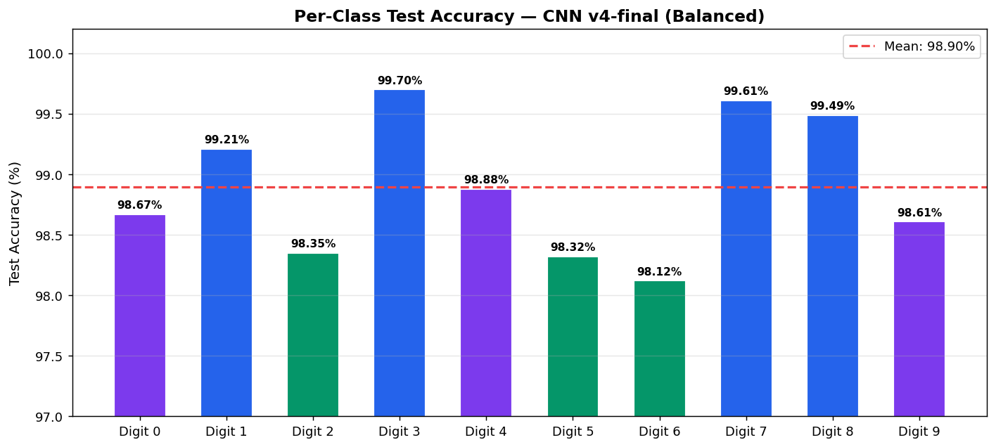
Results — Confusion Matrix & Comparison
Key Findings
Performance vs Baseline Methods
• Proposed CNN outperforms ALL traditional methods (k-NN, SVM, MLP)
• Only 77K parameters vs 236K in MLP — 3× more efficient!
• Achieves 98.91% with simple architecture — no GPU required
• Misclassifications are mostly genuinely ambiguous handwriting
• Balanced class weights eliminated previous digit-8 bias issue
• Global Avg Pooling reduces overfitting vs Flatten
Method | Test Acc (%) | Params | Notes
k-NN (baseline) | 96.9 | — | No spatial awareness
SVM (RBF kernel) | 98.6 | — | Manual HOG features
MLP (784-256-128) | 97.8 | ~236K | Loses spatial info
Proposed CNN | 98.91 | ~77K | Auto feature learning
LeNet-5 | 99.2 | ~60K | More complex training
Deep CNN (2010) | 99.65 | ~10M | 10M params, GPU needed
Ensemble CNNs | 99.83 | ×5M | 5 models combined

Slide 12
Results — Web Application Deployment
Streamlit App — DigitAI Pro
Performance Benchmarks
• Built with Streamlit + streamlit-drawable-canvas
• 4 tabs: Draw Canvas | Upload Image | History | Model Info
• Draw tab: 280×280 HTML5 canvas, black bg, white stroke
• Real-time prediction: < 5ms per image after model load
• Model cached with @st.cache_resource — no reload overhead
Metric | Value
Single inference | < 5 ms
Model load (first) | ~1-2 seconds
Model file size | ~1.5 MB (.keras)
Memory usage | ~50 MB (prediction)
Training time | ~8 min (CPU)
Inference Preprocessing Pipeline
1. Canvas RGBA → grayscale (PIL .convert('L')) 2. Detect background polarity → invert if needed 3. Fit digit in 20×20 preserving aspect ratio (thumbnail) 4. Centre on 28×28 black canvas (4px padding = MNIST style) 5. Normalize ÷ 255 → reshape (1,28,28,1) 6. model.predict() → softmax probs → argmax = digit

Slide 13
Results — Web Application Deployment
Output Display Components
Deployment Option | Stack | Use Case
Streamlit App | Python + Streamlit | Interactive demo
CLI Tool | Python + PIL | Batch inference
Flask API (future) | Flask + REST | Production backend
TFLite (future) | TensorFlow Lite | Mobile/Edge
python predict.py my_digit.png Auto-preprocessing: • Grayscale conversion • Background inversion detection • Lanczos resize to 28×28 • Text-based probability bar output
CLI Prediction Utility (predict.py)
• Predicted digit in large gradient circular badge
• Confidence % shown below prediction badge
• Horizontal bar chart: probability for all 10 classes
• Top prediction highlighted in purple-blue gradient
• Multi-digit mode: connected-component segmentation
• History tab: last 50 predictions, exportable as CSV
• Challenge Mode: random digit prompt for practice

Slide 14
Conclusion & Future Work
Summary of Achievements
Future Work Directions
• CNN achieves 98.91% test accuracy on 10,000 MNIST test images
• All 10 digit classes exceed 98.1% per-class accuracy
• Only 77K parameters — lightweight and fast (< 5ms inference)
• Outperforms k-NN (96.9%), SVM (98.6%), MLP (97.8%)
• End-to-end pipeline: data preprocessing → training → deployment
• Working Streamlit web app with real-time canvas drawing
• Critical bug fixed: aspect-ratio preservation in preprocessing
▸ Multi-Digit Recognition
Segment digit sequences (phone numbers, ZIP codes) using connected-component labeling or YOLO.
▸ Data Augmentation++
Elastic distortions, perspective transforms, and Mixup augmentation for better generalisation.
▸ Deeper Architectures
ResNet skip connections, SE-Net channel attention, or Vision Transformer for potential 99.5%+ accuracy.
▸ TFLite Mobile Deploy
Key Technical Contributions
Quantise model (int8) for iOS/Android deployment. Estimated 75% size reduction, 99%+ accuracy retained.
• Dual-block CNN with BatchNorm after every Conv layer
• GlobalAveragePooling replacing Flatten → 3× fewer params
• Train-only augmentation via ImageDataGenerator (val safe)
• Balanced class weights (capped 1.3×) for uniform learning
• Label smoothing (0.05) for calibrated probability outputs
• Reproducible pipeline with EarlyStopping + best-weight restore
▸ Extended Datasets
Train on EMNIST (letters+digits), SVHN (real photos), and USPS for domain-robust recognition.
▸ Ensemble Methods
Average predictions from 3-5 models with different seeds. Typically improves accuracy by 0.1-0.3%.

Slide 15
References
[1] R.Plamondon & S.N.Srihari, 'Online/offline handwriting recognition,' IEEE TPAMI, 2000.
[2] Y.LeCun, Y.Bengio & G.Hinton, 'Deep learning,' Nature, vol.521, 2015.
[3] I.Goodfellow et al., Deep Learning, MIT Press, 2016.
[4] Y.LeCun et al., 'Gradient-based learning applied to document recognition,' Proc. IEEE, 1998.
[5] A.Krizhevsky et al., 'ImageNet classification with deep CNNs,' NeurIPS, 2012.
[6] N.Srivastava et al., 'Dropout: prevent NNs from overfitting,' JMLR, vol.15, 2014.
[7] S.Ioffe & C.Szegedy, 'Batch Normalization,' Proc. ICML, 2015.
[8] D.P.Kingma & J.Ba, 'Adam: A method for stochastic optimization,' ICLR, 2015.
[9] K.He et al., 'Deep Residual Learning for Image Recognition,' CVPR, 2016.
[10] D.C.Ciresan et al., 'Deep big simple neural nets for HDR,' Neural Computation, 2010.
[11] L.Wan et al., 'Regularization using DropConnect,' Proc. ICML, 2013.
[12] S.Sabour et al., 'Dynamic routing between capsules,' NeurIPS, 2017.
[13] V.Nair & G.E.Hinton, 'Rectified linear units,' Proc. ICML, 2010.
[14] K.Simonyan & A.Zisserman, 'Very deep CNNs,' Proc. ICLR, 2015.
[15] Streamlit Inc., 'Streamlit: fastest way to build data apps,' streamlit.io, 2023.
[16] F.Chollet et al., 'Keras,' keras.io, 2015.

Slide 16
Thank You!
Questions & Discussion
Abhay Singh
Department of Computer Science
COER University, Roorkee, India
abhaychauhan5051a@gmail.com

