Slide 1

Day-1

Slide 2
DBMS contains information about a particular enterprise
  Collection of interrelated data
  Set of programs to access the data
  An environment that is both convenient and efficient to use
Database Applications:
  Banking: all transactions
  Airlines: reservations, schedules
  Universities: registration, grades
  Sales: customers, products, purchases
  Online retailers: order tracking, customized recommendations
  Manufacturing: production, inventory, orders, supply chain
  Human resources: employee records, salaries, tax deductions
Databases touch all aspects of our lives

Slide 3

In the early days, database applications were built directly on top of file systems
Drawbacks of using file systems to store data:
  Data redundancy and inconsistency
    Multiple file formats, duplication of information in different files
  Difficulty in accessing data
    Need to write a new program to carry out each new task
  Data isolation — multiple files and formats
  Integrity problems
    Integrity constraints (e.g. account balance > 0) become “buried” in program code rather than being stated explicitly
    Hard to add new constraints or change existing ones

Slide 4
Drawbacks of using file systems (cont.)
  Atomicity of updates
    Failures may leave database in an inconsistent state with partial updates carried out
    Example: Transfer of funds from one account to another should either complete or not happen at all
  Concurrent access by multiple users
    Concurrent accessed needed for performance
    Uncontrolled concurrent accesses can lead to inconsistencies
      Example: Two people reading a balance and updating it at the same time
  Security problems
    Hard to provide user access to some, but not all, data
Database systems offer solutions to all the above problems

Slide 5

Physical level: describes how a record (e.g., customer) is stored.
Logical level: describes data stored in database, and the relationships among the data.
  type customer = record
  customer_id : string;
  customer_name : string;
  customer_street : string;
  customer_city : string;
        end;
View level: application programs hide details of data types. Views can also hide information (such as an employee’s salary) for security purposes.

Slide 6


An architecture for a database system

Slide 7

Similar to types and variables in programming languages
Schema – the logical structure of the database
  Example: The database consists of information about a set of customers and accounts and the relationship between them)
  Analogous to type information of a variable in a program
  Physical schema: database design at the physical level
  Logical schema: database design at the logical level
Instance – the actual content of the database at a particular point in time
  Analogous to the value of a variable
Physical Data Independence – the ability to modify the physical schema without changing the logical schema
  Applications depend on the logical schema
  In general, the interfaces between the various levels and components should be well defined so that changes in some parts do not seriously influence others.

Slide 8

A collection of tools for describing
  Data
  Data relationships
  Data semantics
  Data constraints
Relational model
Entity-Relationship data model (mainly for database design)
Object-based data models (Object-oriented and Object-relational)
Other older models:
  Network model
  Hierarchical model

Slide 9
Language for accessing and manipulating the data organized by the appropriate data model
  DML also known as query language
Two classes of languages
  Procedural – user specifies what data is required and how to get those data
  Declarative (nonprocedural) – user specifies what data is required without specifying how to get those data
SQL is the most widely used query language

Slide 10
Specification notation for defining the database schema
  Example: create table account (
  account_number char(10),
  branch_name char(10),
  balance integer)
DDL compiler generates a set of tables stored in a data dictionary
Data dictionary contains metadata (i.e., data about data)
  Database schema
  Data storage and definition language
    Specifies the storage structure and access methods used
  Integrity constraints
    Domain constraints
    Referential integrity (e.g. branch_name must correspond to a valid branch in the branch table)
  Authorization

Slide 11

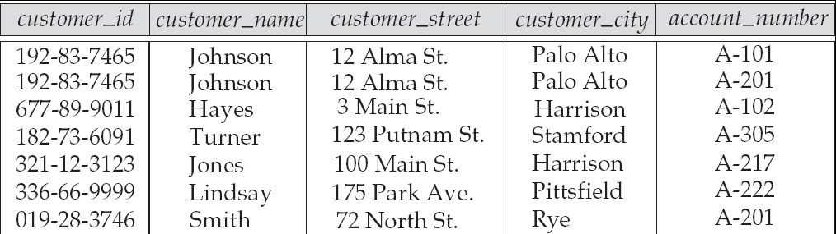
Attributes
Example of tabular data in the relational model

Slide 12



Slide 13

Process of database design and development
Database Design
  Complete, normalized, non-redundant and fully integrated conceptual, logical, and physical database models
Database Implementation
  Database storage structure, loading data, and data management

Slide 14

To maintain data integrity (that is data should be correct and in well formed) we use concept of keys.
There are five types of keys in database which is as follows –
        Super Key
        Candidate key
        Primary Key
        Foreign Key
        Alternate Key

Slide 15
Super Key:
  Super Key is defined as a set of attributes within a table that uniquely identifies each record within a table. Super Key is a superset of Candidate key.
Candidate Key:
  Candidate keys are defined as the set of fields from which primary key can be selected. It is an attribute or set of attribute that can act as a primary key for a table to uniquely identify each record in that table.
Primary Key:
Primary key is a candidate key that is most appropriate to become main key of
the table. It is a key that uniquely identify each record in a table.
Alternate Key
If any table have more than one candidate key, then after choosing primary key from those candidate key, rest of candidate keys are known as an alternate key of that table.
Foreign Key Used for joining purpose

Slide 16
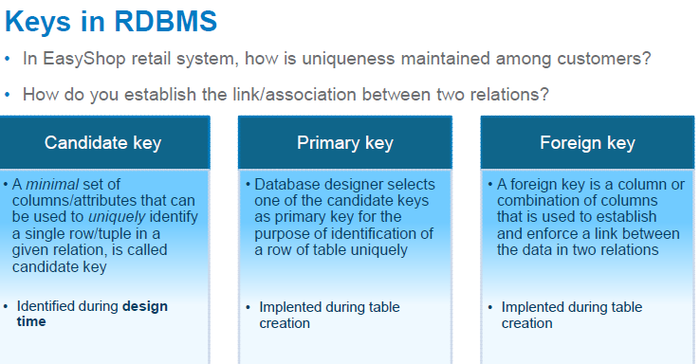

Slide 17

Composite key consists of more than one attributes.
Example: Consider a Relation or Table R1. Let A,B,C,D,E are the attributes of this relation.
R(A,B,C,D,E)
A→BCDE This means the attribute 'A' uniquely determines the other attributes B,C,D,E.
BC→ADE This means the attributes 'BC' jointly determines all the other attributes A,D,E in the relation.
Primary Key :A
Candidate Keys :A, BC
Super Keys : A,BC,ABC,AD

Slide 18

Foreign key – a (simple or composite) column which refers to the primary key of some table in a database.
Foreign and primary keys must be defined on same data type.
A foreign key may be contained in a primary key or another foreign key.

Slide 19

