Slide 1
Marketing & Retail Analytics
Module 1 – RFM Analysis

Slide 2
Content
Topic Slide No.
Problem Statement 3
Summary Of Data 4
EDA 5-12
RFM Analysis 13-14
Inferences 15-18

Slide 3
Problem statement
An automobile parts manufacturing company has collected data of transactions for 3 years. They do not have any in-house data science team. We need to analyze the given data and provide insights on how to retain customers.

Slide 4
Summary about data
Given data have 20 variables and 2747 observations

Slide 5
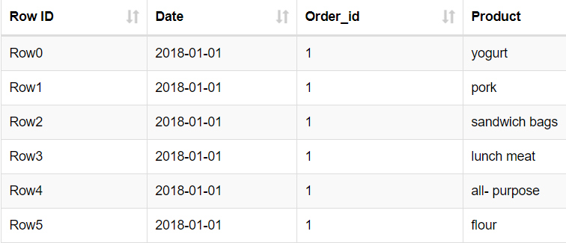
Exploratory data analysis (EDA)
We have 3 columns in data provided namely Date, Order ID and Product as shown in sample image with 20,641 observations.
Order ID is a numeric continuous data.
Date and Product are of nominal data type.

Slide 6
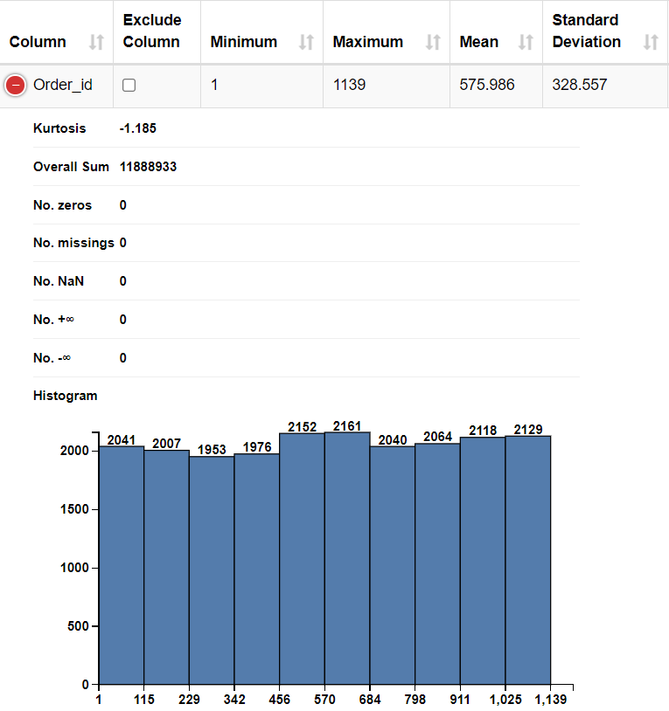
EDA cont.…
None of the variables have missing values or Zero values
There are total of 1139 unique order id’s with mean of 575.99 and standard deviation of 328.56.
Order id’s data is not normally distributed and skewed in nature.

Slide 7
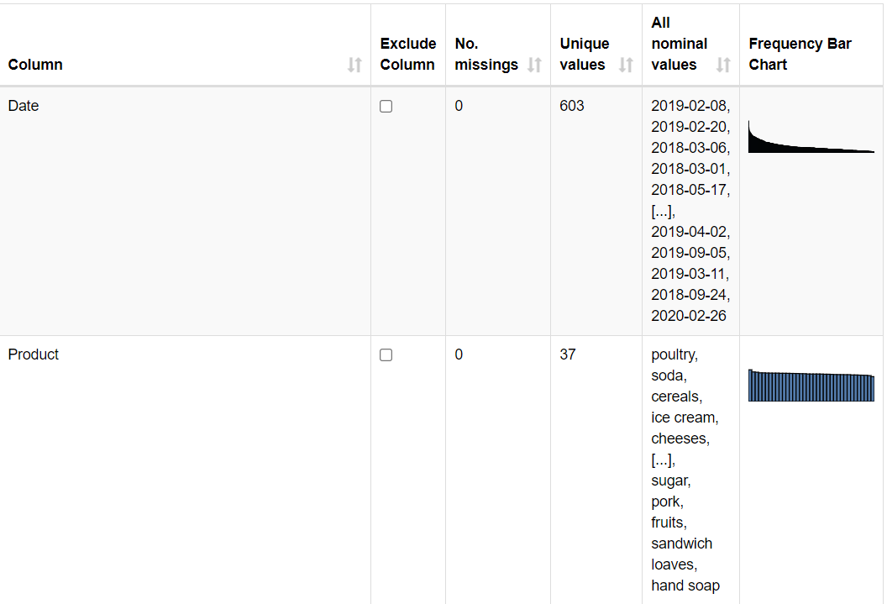
EDA cont.…
There are 37 unique products for which purchase was made on 603 unique dates.
Date and product column are also not normally distributed and skewed in nature.
To get a better categorization of product we have
replaced products into categories of food, kitchen, all,
hygiene and drink using “table creator” and
“cell replacer” node in KNIME.

Slide 8
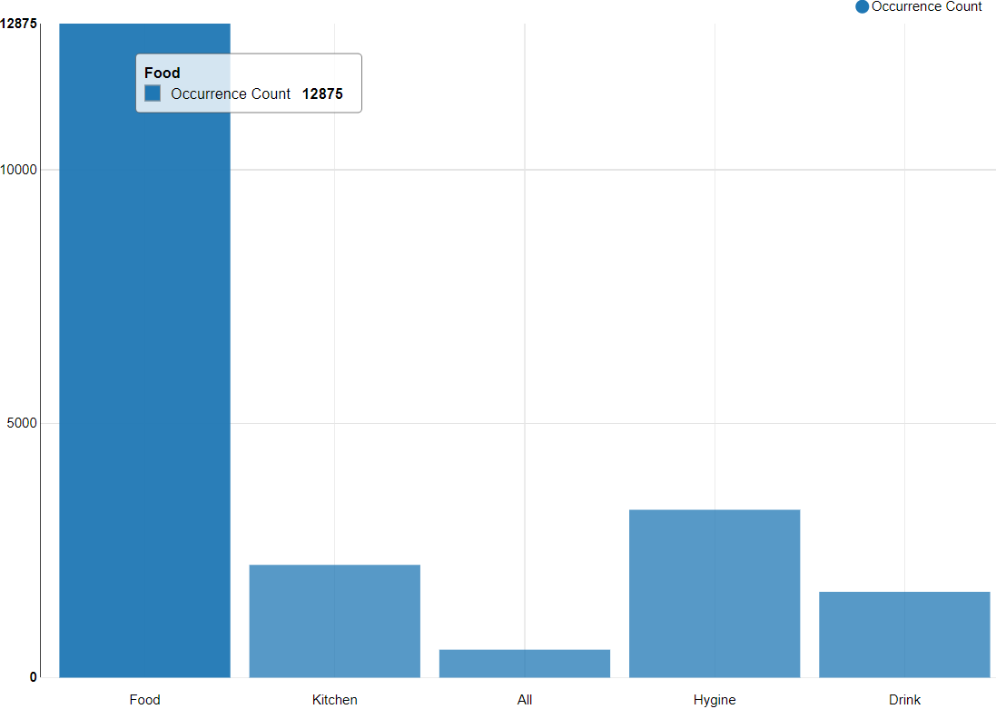
EDA cont.…(Univariate analysis)
Using the “bar chart” node we can confirm that the products of food category are purchased the most.
2nd highest purchase is of Hygiene followed by Kitchen and then drink.

Slide 9
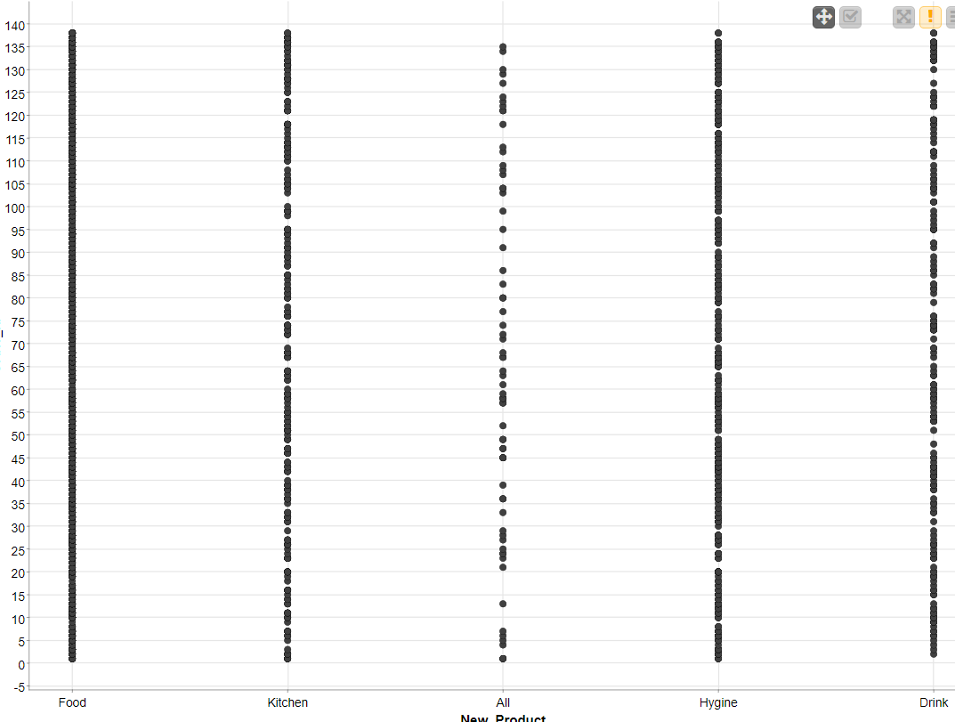
EDA cont.…(bi-variate analysis)
Using scatter plot we see no trend as on time component of data which is purchase date.
We do not see any trend or seasonality on time.
This cannot be a case of time series analysis as we
we do not have continuous time component.

Slide 10
Market Basket analysis
This involves analysis of products often bought together provided the past data. So that we can analyse can combo offers can be rolled out for the same. It’s the probability of buying items together against the total transactions performed.
This analysis helps retail store’s in increasing “customer life time value” (CLV).
CLV is total revenue generated by a consumer during a time period also considering Margin, Retention Cost, Discount Rate and Retention Rate.
This also helps retail stores in managing their stocks.

Slide 11
Association rules
Association Rules are widely used to analyze retail basket or transaction data, and are intended to identify strong rules discovered in transaction data using measures of interestingness, based on the concept of strong rules. 20 of them bought chocolates, 13 bought cake and 9 bought both of them.
This rules designed by IIT helps creating rules which helps in creating rules for a combination of products often bought together.
Association rule is relevant to the given case study as we are helping retail store with most commonly occurring sets and also to advise them with probable combo offers they can introduce.

Slide 12
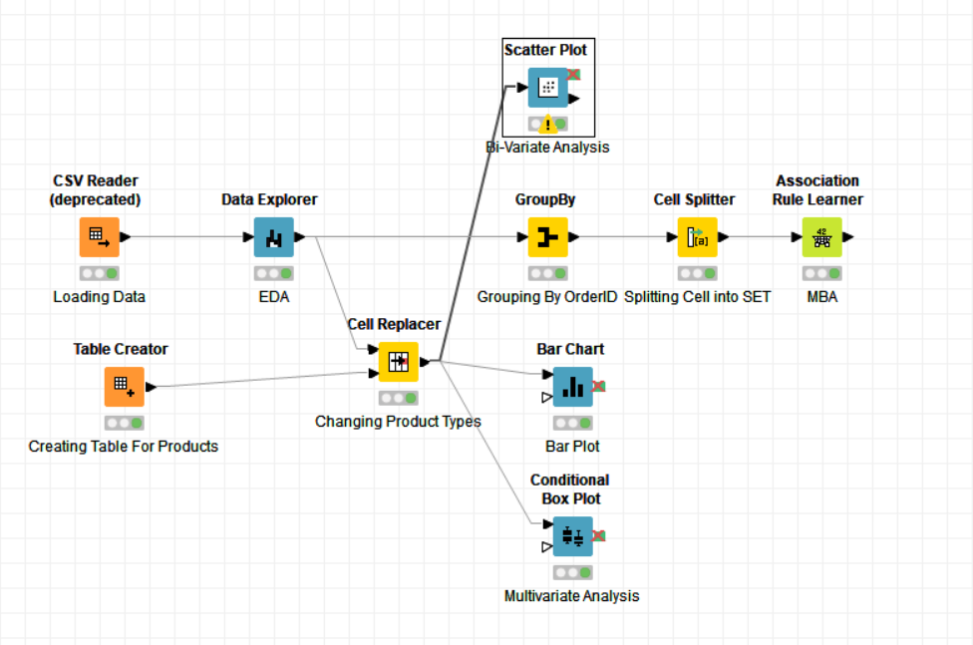
KNIME workflow

Slide 13
Knime workflow description
Used CSV reader node to read the given data into KNIME.
Used DATA EXPLORER node to perform EDA and understanding data.
By using group-by node, we have clubbed data at orderID level.
Created new table using table creator to divide products into groups of Food, Drink, Hygiene and All for better view and understanding of data. However the original product from data is used for creating association rules.
Used scatter plot, bar chart and box plot nodes to perform univariate and bi-variate analysis of data.

Slide 14
Knime workflow description cont.…
We have noticed that products are duplicated and repeated after performing group-by based on unique orderID.
Used cell splitter node to create a set of products for every orderID and avoiding duplication of product.
Created association rules using Association Rule Learner node by setting up an adequate value for support and confidence.
We have used value for support as 0.09 and confidence as 0.5,which gives and output of 48 rules.

Slide 15
Associations identified
With support as 0.09 and confidence as 0.5 we have generated 48 association rules.
Support value is the probability of buying an item out of all the purchase made.
Value of confidence is the ratio of probability product purchased along with other product to the probability of purchasing other product.
Value of lift is ratio of support to its confidence.
Setting up support and confidence value is an iterative process to get better set of association rules. Higher the value of lift better the association rule.

Slide 16
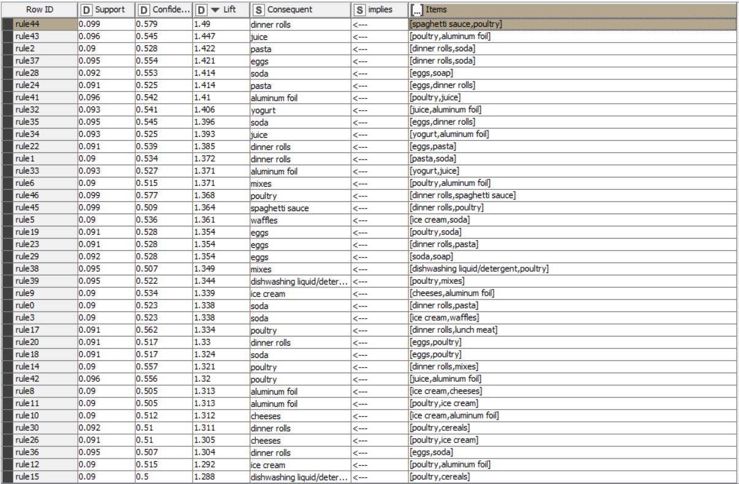
Association table

Slide 17
Describing association rule
After all 48 rules created the rule number 44 shows the highest value of Lift which is 1.49 with support and confidence value of 0.099 and 0.579 respectively.
We understand that higher the value of lift better the association.
Eg:- rule no 44:- the rule showcase that when items spaghetti, sauce and poultry are bought together and dinner rolls can be recommended to them or all these 4 items can be clubbed together can be offered as a combo.

Slide 18
Recommendations
The set of items are in “Items” column are bought together with the items in “Consequent” column.
The items form these two can be sold as combo and can be provided discount on these combos.
Over the e-commerce platform items from “Consequent” can be recommended to consumers buying products from “Items” columns.

