Slide 1

Customer Churn Prediction
Using Machine Learning to Predict and Prevent Telecom Customer Churn
MCA Machine Learning Assignment
Abhay • Anshika • Akshit • Riya
Notes:
Welcome the panel. Introduce the project as a full ML pipeline for predicting telecom customer churn, built by all four team members, from data cleaning to a live Streamlit demo.

Slide 2

Problem Statement
Telecom companies operate in a highly competitive market. Losing a customer (churn) means lost recurring revenue and higher costs to acquire a replacement.
Can we predict, in advance, which customers are likely to leave?
Given a customer's demographics, account details, and subscribed services —
predict whether they will churn (Yes/No)
so the business can proactively retain at-risk customers.
Notes:
Frame the business problem before the technical solution. Emphasize proactive retention is cheaper than reacquiring lost customers.

Slide 3

Objectives
Clean & Preprocess
Explore the Data
Train ML Models
Handle missing values, irrelevant columns, and encode the target.
Visualize churn patterns across customer segments.
Build and compare Logistic Regression and Random Forest.
Evaluate Rigorously
Deploy Interactively
Document Professionally
Accuracy, Precision, Recall, F1 Score, Confusion Matrix.
Serve live predictions through a Streamlit web app.
Clean README, full report, and this presentation.
Notes:
Six objectives covering the full lifecycle: cleaning, EDA, modeling, evaluation, deployment, and documentation.

Slide 4
Dataset Overview
Telco_customer_churn.xlsx
7,043
33
30
19
Customer Records
Original Columns
Encoded Features Used
Raw Predictive Features
Feature Groups
Columns Dropped
Demographics: Gender, Senior Citizen, Partner, Dependents
Account Info: Tenure, Contract, Paperless Billing, Payment Method
Services: Phone, Internet, Security, Backup, Streaming, etc.
Billing: Monthly Charges, Total Charges
CustomerID, Count, Country, State, City, Zip Code, Lat Long, Latitude, Longitude, Churn Score, CLTV, Churn Reason, Churn Value
Notes:
Dataset has 33 raw columns; 13 are dropped as identifiers, geo-data, or target-leaking columns, leaving 19 usable raw features which expand to 30 after one-hot encoding.

Slide 5




Tech Stack
Python
Pandas / NumPy
Scikit-learn
Core programming language
Data loading & manipulation
Model training & evaluation
Matplotlib
Streamlit
Joblib
Charts & visualizations
Interactive web application
Saving model, scaler & features
Notes:
Every tool here is beginner-friendly and widely taught — deliberately no deep learning frameworks, Docker, or FastAPI, to keep the project simple to defend.

Slide 6
System Workflow
1
2
3
4
5
6
7
Load Data
Clean Data
EDA
Encode &
Scale
Train
Models
Evaluate &
Save
Predict in
Streamlit
preprocess.py → train_model.py → app.py
Each stage is a separate, single-purpose script — easy to run independently and explain in a viva.
Notes:
Walk through the pipeline left to right. Mention preprocess.py, train_model.py, and app.py as the three source files, each responsible for one stage.

Slide 7
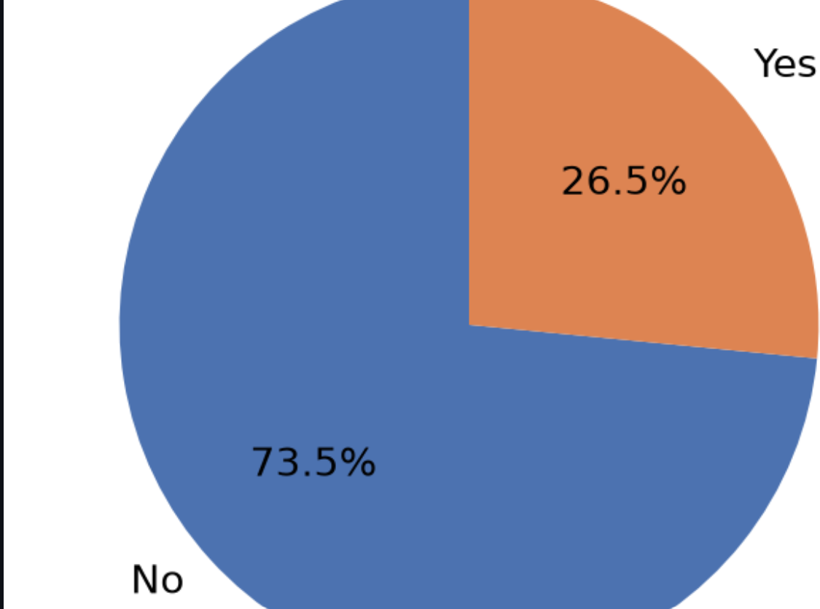
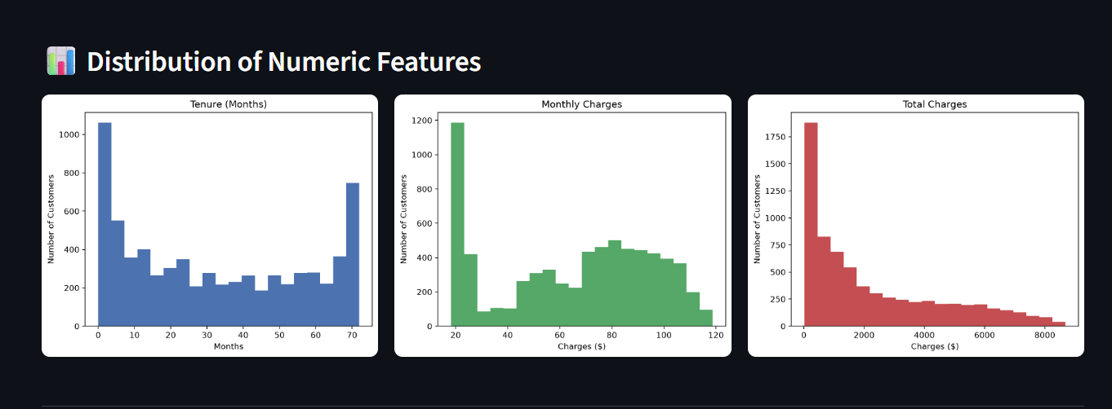
Exploratory Data Analysis
Overall Churn Split & Numeric Feature Distributions
Key Insight
26.5% of customers in the dataset churned, while 73.5% stayed.
This is a moderately imbalanced dataset — one reason our Recall (57.75%) is lower than Precision.
Customers tend to leave either very early (low tenure) or show a second smaller peak near 70 months, likely contract-end churn.
Monthly Charges show two customer clusters: budget users (~$20) and premium bundle users ($70-$100).
Notes:
Both charts are real screenshots taken directly from our running Streamlit app's EDA page, not simulated data.

Slide 8
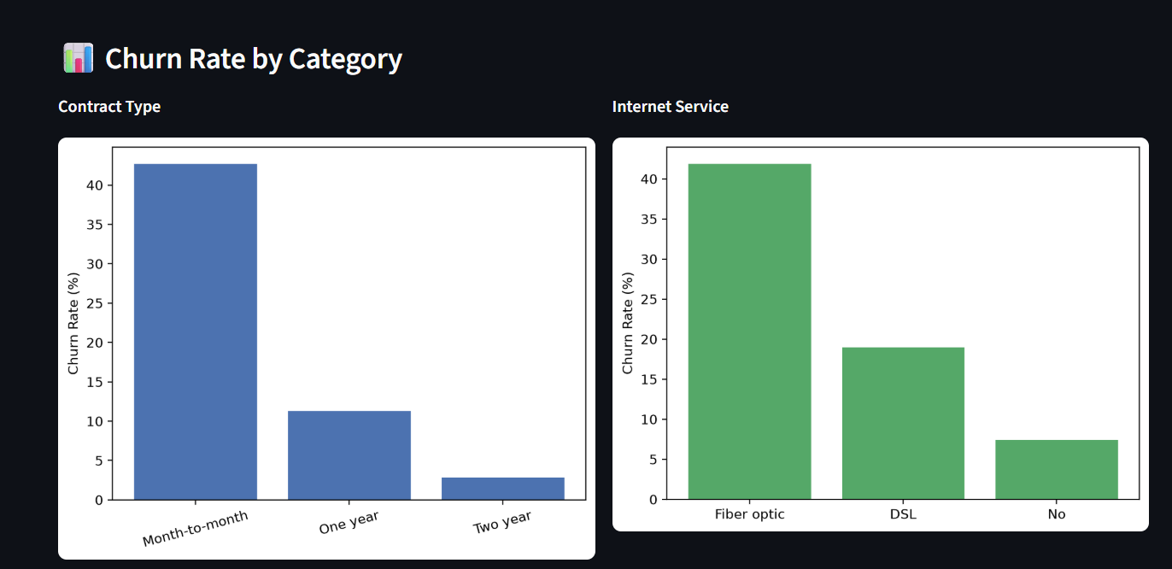
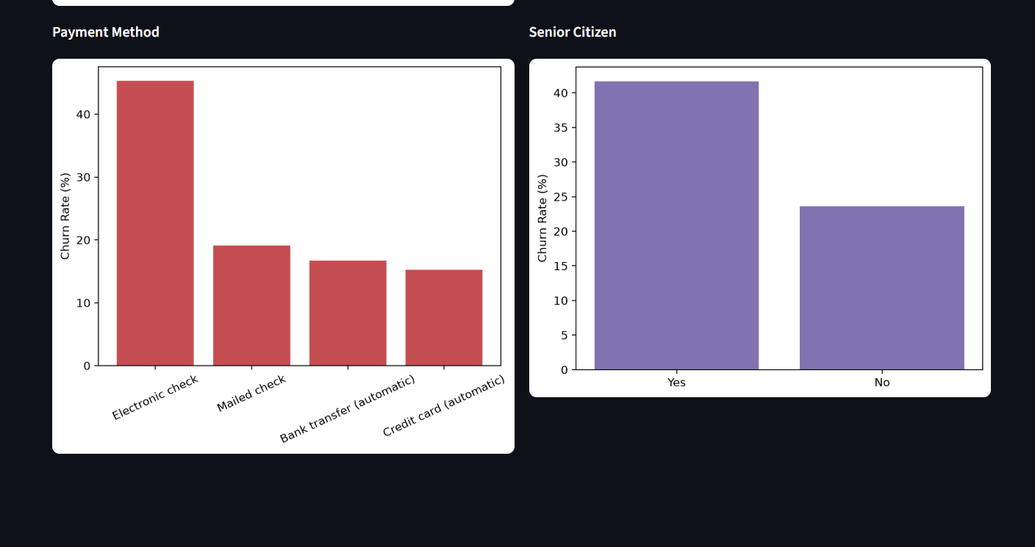
Churn Rate by Customer Segment
Real charts captured from the Streamlit EDA page
Notes:
Month-to-month contracts, fiber optic internet, and electronic check payments show the highest churn rates — these became strong predictive features for the model.

Slide 9
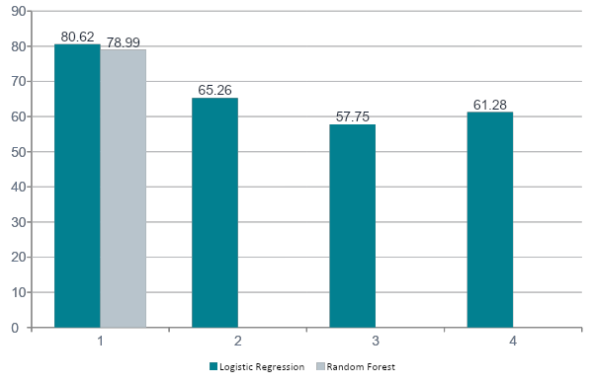

Model Comparison
Selected Model
Logistic Regression
Highest overall accuracy (80.62%)
Simple & fully interpretable coefficients
Fast to train, easy to explain in viva
Notes:
Random Forest was close but slightly behind on accuracy. We chose Logistic Regression for the best balance of performance and interpretability.

Slide 10
Final Results
80.62%
65.26%
57.75%
61.28%
Accuracy
Precision
Recall
F1 Score
Model: Logistic Regression | Evaluated on 20% held-out test set (1,409 customers)
Top Predictive Features
Contract Type (Month-to-month customers churn most)
Tenure (newer customers are higher risk)
Monthly Charges & Internet Service type
Notes:
These four metrics were computed with scikit-learn's classification metrics on the test split. Feature importance came from the model's coefficients.

Slide 11
The Streamlit Application
🏠 Home
📁 Dataset
📈 EDA
Project overview & key metrics
Preview raw data & column info
Pie chart, histograms, bar charts
🧪 Model Performance
🔮 Prediction
ℹ️ About
Metrics, confusion matrix, feature importance
Live churn prediction with probability
Team, tech stack & repository link
Notes:
Demo tip: if live-demoing, walk through Home → EDA → Model Performance → Prediction in that order.

Slide 12

Future Scope
Explore additional models (SVM, Gradient Boosting)
Systematic hyperparameter tuning
Deploy publicly on Streamlit Community Cloud
Customer segmentation & retention strategy suggestions
Planned Capstone Project (Beyond This Assignment)
Agentic AI • RAG • LangGraph • MCP • FastAPI • Vector Databases • Docker • Cloud Deployment
Notes:
Make clear this advanced stack is intentionally NOT part of this assignment — it's a future capstone, so the panel understands the scope was a deliberate choice.

Slide 13

Thank You
Questions & Discussion
github.com/abhay0963/Customer-Churn-Prediction
Notes:
Open the floor for questions. Be ready to explain the encoding trick for prediction and why Logistic Regression was chosen.

