Slide 1
Predictive Modeling and Risk Scoring for Bank Customer Churn
Machine Learning Internship Project
Prepared by:
Abhay Singh

Slide 2
Project Overview
Banking Customer Churn Problem: Customers leaving for competitors leads to immediate revenue loss.
Why Prediction is Important: Acquiring new customers is significantly more expensive than retaining existing ones. Predicting exits allows proactive intervention.
Business Impact: Optimizes marketing budgets by targeting only high-risk cohorts with personalized offers, maximizing ROI.

Slide 3
Problem Statement
Current Challenge: The bank is experiencing customer attrition (~20.37%) but lacks a systematic mechanism to foresee it.
Business Impact: Retention efforts are currently reactive, broad, and resource-inefficient.
Need for Predictive Analytics: A data-driven model is required to identify high-propensity churners before they actually leave.

Slide 4
Project Objectives
Predict Churn: Develop supervised ML models to classify customer loyalty.
Calculate Risk Score: Generate actionable probabilities mapped to Low, Medium, and High-risk tiers.
Support Decision Making: Move from reactive service to proactive management.
Deploy Streamlit Dashboard: Provide an interactive UI for frontline staff.
Provide Business Recommendations: Drive strategies using data insights.

Slide 5
Dataset Overview
Metric / Attribute | Details
Total Rows (Customers) | 10,000
Total Columns | 14
Target Variable | Exited (1 = Churned, 0 = Retained)
Important Features | CreditScore, Age, Tenure, Balance, EstimatedSalary

Slide 6
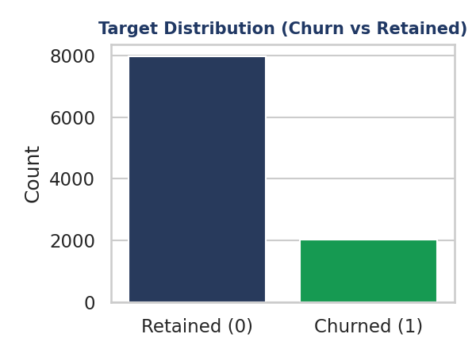
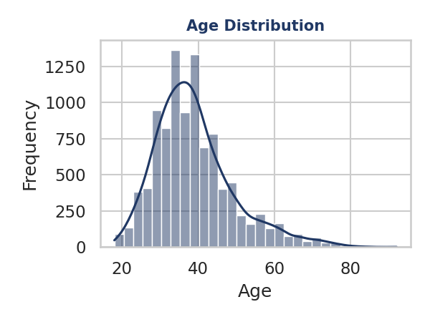
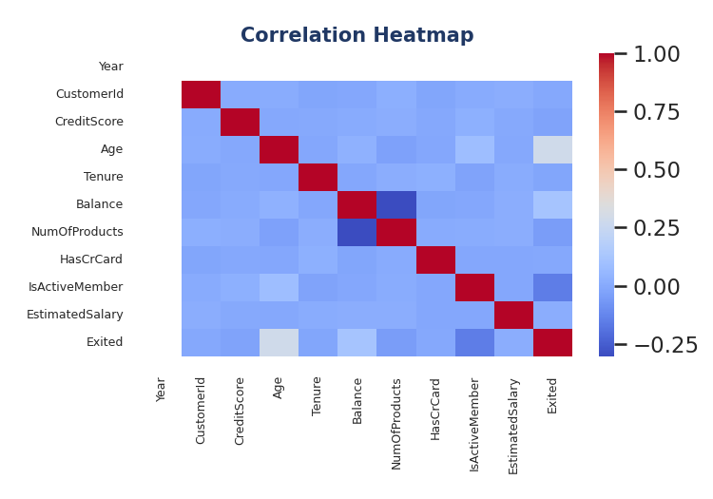
Exploratory Data Analysis
Insights:
• Target: Imbalanced (~20% churn) • Age: Older customers churn more • Features: Require complex non-linear models

Slide 7
Data Preprocessing & Feature Engineering
Data Preprocessing:
Removed Columns: CustomerId, Surname, Year (No predictive value).
Encoding & Scaling: pd.get_dummies() and StandardScaler applied.
Train-Test Split: 80/20 split with stratification (stratify=y).
Engineered Features:
BalanceSalaryRatio: Differentiates active savers from transactional users.
ProductDensity: Products / (Tenure + 1) -> Captures ecosystem entrenchment.
Engagement: IsActiveMember * NumOfProducts.
AgeTenure: Mitigates demographic risk with loyalty history.

Slide 8
Machine Learning Models
Algorithm | Advantages | Disadvantages
Logistic Regression | Fast, highly interpretable | Fails on complex non-linear data
Decision Tree | Intuitive, handles non-linearities | Highly prone to overfitting
Random Forest | Robust, handles variance, high precision | Slightly less interpretable (black box)
Gradient Boosting | Highest predictive accuracy | Prone to overfitting, requires heavy tuning
Chosen Model: Random Forest (Selected for stability, precision, and mitigation of overfitting).

Slide 9
Model Performance: Random Forest
Evaluation Metrics:
Accuracy: 86.55%
Precision: 78.27%
Recall: 46.92%
F1 Score: 58.67%
ROC-AUC: 71.80%

Slide 10
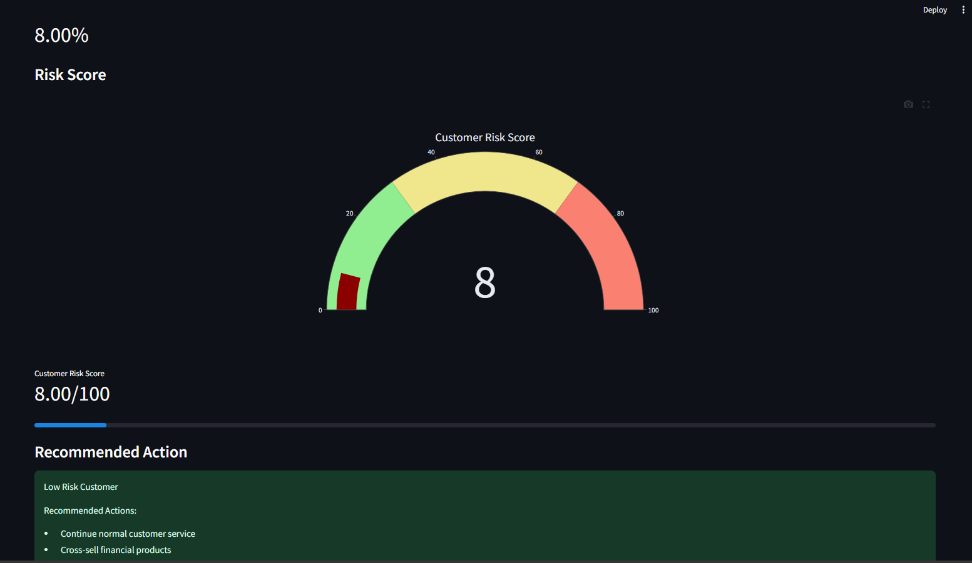
Streamlit Dashboard Deployment
Interactive UI for Business Users:
• Customer Input via Sidebar • Instant Probability & Risk Score Gauge (0-100) • Recommended Action Engine • Real-time Feature Importance • Export Report

Slide 11
Business Insights
Age significantly affects churn: The most critical driver (~19% importance). Older demographics are leaving at an alarming rate.
Customer engagement reduces churn: Inactive members show a much higher propensity to close accounts.
Number of banking products matters: Single-product customers lack switching costs and are a high flight risk. Entrenchment reduces churn.
Financial behavior improves prediction: The Balance-to-Salary ratio effectively distinguishes between core savers and transactional pass-through users.

Slide 12
Strategic Recommendations
Customer Retention Strategies: Develop targeted, high-yield retirement products tailored specifically for the 45+ demographic.
Personalized Offers: Trigger automatic fee waivers or premium rates for customers entering the 'High Risk' gauge territory.
Cross-Selling: Set KPI targets to increase product density by offering incentives for secondary accounts.
Loyalty Programs: Implement usage-based reward programs to maintain active member status and reduce dormancy.
Risk Monitoring: Integrate the model directly into the CRM for automated weekly interventions.

Slide 13
Future Scope
Real-time API Integration: Expose the prediction logic via FastAPI to evaluate live transactions.
Cloud Deployment: Host the dashboard on AWS, Azure, or GCP for robust enterprise access.
Advanced Algorithms: Experiment with XGBoost or LightGBM to squeeze out additional ROC-AUC points.
Deep Learning: Implement neural networks as the dataset scales into millions of records.
Customer Segmentation: Use K-Means clustering prior to classification to build persona-specific retention models.

Slide 14
Conclusion
Project Achievements: Successfully engineered, trained, and deployed a robust machine learning pipeline for churn prediction.
Business Value: Enabled the bank to shift from reactive service to proactive customer retention.
Machine Learning Impact: Random Forest identified the exact drivers of churn (Age, Salary, Credit Score) with 86.55% accuracy and 78.27% precision.
Dashboard Usefulness: Translated raw statistical probabilities into an intuitive Risk Score system, empowering frontline staff without technical overhead.

Slide 15
Thank You!
Questions & Discussion
Prepared by:
Abhay Singh

