Slide 1

CERTIFIED JOB SIMULATION
Deloitte Australia
Cyber Job Simulation
Web Activity Log Analysis & Cybersecurity Breach Investigation
Prepared by: Abhay Pandey
Section: 2CSE34 | Roll Number: 25SCS1003003079
Organization: Deloitte Australia (via Forage)
University: IILM University, Greater Noida

Slide 2
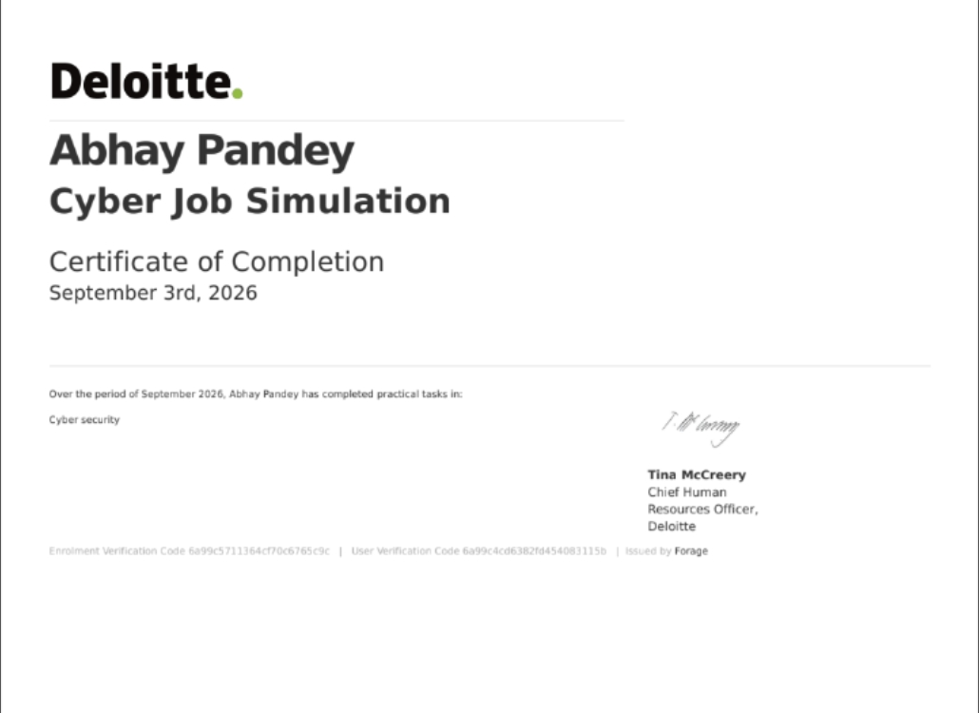
Internship Certificate of Completion
VERIFIED CREDENTIAL
September 3rd, 2026
Deloitte Australia Cyber Job Simulation
Issued by Deloitte & Forage to Abhay Pandey
Practical Task Completed:
Cyber Security — practical tasks in web activity log review and simulated breach investigation
VERIFICATION CODES:
Enrolment: 6a99c5711364cf70c6765c9c
User: 6a99c4cd6382fd454083115b
Countersigned by Tina McCreery, Chief Human Resources Officer, Deloitte.
B.Tech CSE Job Simulation Report • Abhay Pandey • 2CSE34
2

Slide 3


Executive Summary & Objectives
Simulation Objective
Scope & Simulation Context
To support a simulated Deloitte client during a cybersecurity breach by reading and analysing web activity logs, investigating user behaviour, and identifying the user associated with the most suspicious activity.
Conducted through Forage's self-paced virtual workspace, replicating the role of a Deloitte cybersecurity analyst reviewing simulated log data for a client organisation. Focus: applying analytical and cybersecurity concepts to investigate potentially malicious activity.
Why this matters:
Cybersecurity consultants routinely support clients during active incidents by turning raw activity data into a clear, evidence-based account of what happened — the same structured reasoning this simulation was designed to practise.
B.Tech CSE Job Simulation Report • Abhay Pandey • 2CSE34
3

Slide 4
Investigation Structure & Focus Areas
Focus Area
What It Covers
Role in the Investigation
Web Activity Logs
User identifiers, timestamps, page/resource requests, and other recorded activity fields.
Provides the raw evidence base for reviewing user behaviour.
User Behaviour Patterns
Frequency, timing, and nature of requests made by each user.
Establishes what 'normal' activity looks like, so deviations stand out.
Anomaly Indicators
Unusual request volume, atypical timing, or activity inconsistent with a user's role.
Flags entries that warrant closer manual review.
Cross-User Comparison
Side-by-side comparison of activity across all users in the log.
Narrows down which user's pattern is most consistent with the breach.
Investigative Conclusion
The user identified as most likely associated with the suspicious activity.
Forms the basis of the findings communicated to the simulated client.
B.Tech CSE Job Simulation Report • Abhay Pandey • 2CSE34
4

Slide 5



Log Analysis Approach & Key Considerations
Establishing a Baseline
Structured Comparison
Evidence Before Conclusions
Reviewed the full set of log entries first to understand typical activity — normal request volumes, common timing, and expected user behaviour — before attempting to flag anything as unusual.
Compared entries across users systematically rather than in isolation, since a single unusual entry is far less meaningful than a consistent pattern across a user's activity.
Avoided identifying a suspicious user based on a single data point; conclusions were only drawn once multiple, consistent indicators pointed to the same user.
Guiding principle: Every conclusion in this investigation traces back to a specific, observable pattern in the log data — not assumption.
B.Tech CSE Job Simulation Report • Abhay Pandey • 2CSE34
5

Slide 6
Breach Investigation Workflow
Stage
Activity
Purpose
1. Log Review
Read through the full web activity log line by line to understand the fields recorded and the range of user activity.
Builds familiarity with the data before analysis begins.
2. Pattern Identification
Noted timing, frequency, and type of requests for each user represented in the log.
Surfaces candidate anomalies for closer review.
3. Cross-User Analysis
Compared flagged patterns against the activity of other users to check for consistency.
Filters out coincidence and isolates genuine outliers.
4. Conclusion & Reporting
Determined the user most associated with the suspicious activity and documented the supporting reasoning.
Produces a clear, defensible finding for the simulated client.
B.Tech CSE Job Simulation Report • Abhay Pandey • 2CSE34
6

Slide 7




Core Skills Applied
Computer Networking
Interpreting web traffic, user requests, and network-related activity within the log data.
Log Analysis & Data Analysis
Reading, filtering, and comparing log entries across users to draw evidence-based conclusions.
Cyber Security
Web Security
Module Completed
Understanding what constitutes suspicious activity and how it relates to a client breach.
Verified by Forage on behalf of Deloitte Australia, September 3, 2026.
Formal Communication & Planning
Following a structured process and reporting findings clearly and professionally.
B.Tech CSE Job Simulation Report • Abhay Pandey • 2CSE34
7

Slide 8

Skills & Learning Outcomes — Full Mapping
Skill Area
Connection to the Simulation
Data Modeling / Data Structures
Relating user attributes and log fields to one another to build a coherent investigative picture.
Data Visualization Tools
Presenting observed activity patterns clearly to support investigative findings.
Spreadsheet Skills
Organising and reviewing log-related data in a structured, tabular format.
Programming / Python Programming / Software Development
General awareness of how analytical workspaces process log data; specific tools used were not evidenced in the material provided and are marked accordingly.
Accuracy note: This report does not claim the use of Python, Excel, SQL, or Wireshark, as the material provided does not evidence specific tool use during the simulation.
B.Tech CSE Job Simulation Report • Abhay Pandey • 2CSE34
8

Slide 9
Investigative Rigour: What Each Check Was For
Check
Purpose
Goal
Baseline Comparison
Confirms what 'normal' activity looks like before anything is flagged as suspicious.
Reduce false positives
Consistency Across Entries
Verifies that a flagged pattern recurs rather than appearing once by chance.
Reliable evidence
Cross-User Review
Ensures the flagged user's activity is genuinely distinct from their peers.
Correct attribution
Clarity of Reasoning
Ensures the final conclusion can be explained step-by-step to a non-technical client.
Defensible findings
B.Tech CSE Job Simulation Report • Abhay Pandey • 2CSE34
9

Slide 10



Professional & Ethical Practice
Data Privacy & Confidentiality
Objectivity & Evidence-Based Reasoning
Professional Reporting
Simulated client and log data were treated as sensitive throughout, consistent with how a real cybersecurity engagement would handle client information.
Conclusions were based strictly on patterns observed in the log data, avoiding assumptions about any user based on incomplete evidence.
Findings were structured and communicated in a manner appropriate for a client-facing cybersecurity consulting deliverable.
B.Tech CSE Job Simulation Report • Abhay Pandey • 2CSE34
10

Slide 11

Conclusion & Key Takeaways
The Deloitte Australia Cyber Job Simulation, completed via Forage, provided practical, hands-on exposure to the investigative work of a cybersecurity analyst supporting a client through a simulated breach.
Reinforced the discipline of drawing conclusions from evidence rather than assumption.
Strengthened structured, methodical thinking applicable across cybersecurity and data analysis contexts.
Provided a client-facing perspective on how investigative findings are reasoned through and reported.
B.Tech CSE Job Simulation Report • Abhay Pandey • 2CSE34
11

Slide 12
Thank You
Questions & Discussion
Abhay Pandey
Section 2CSE34 | Roll Number: 25SCS1003003079
Deloitte Australia Cyber Job Simulation — via Forage
IILM University, Greater Noida

