Slide 1

Revenue Optimization and Demand Forecasting Analysis of a Dairy Firm
A Presentation for BDM Capstone Project by
Name : Abhay Sahu
Roll No : 23f1001119
IITM BS Degree Program
Indian Institute of Technology Madras, Chennai
Tamil Nadu, India, 600036
1

Slide 2
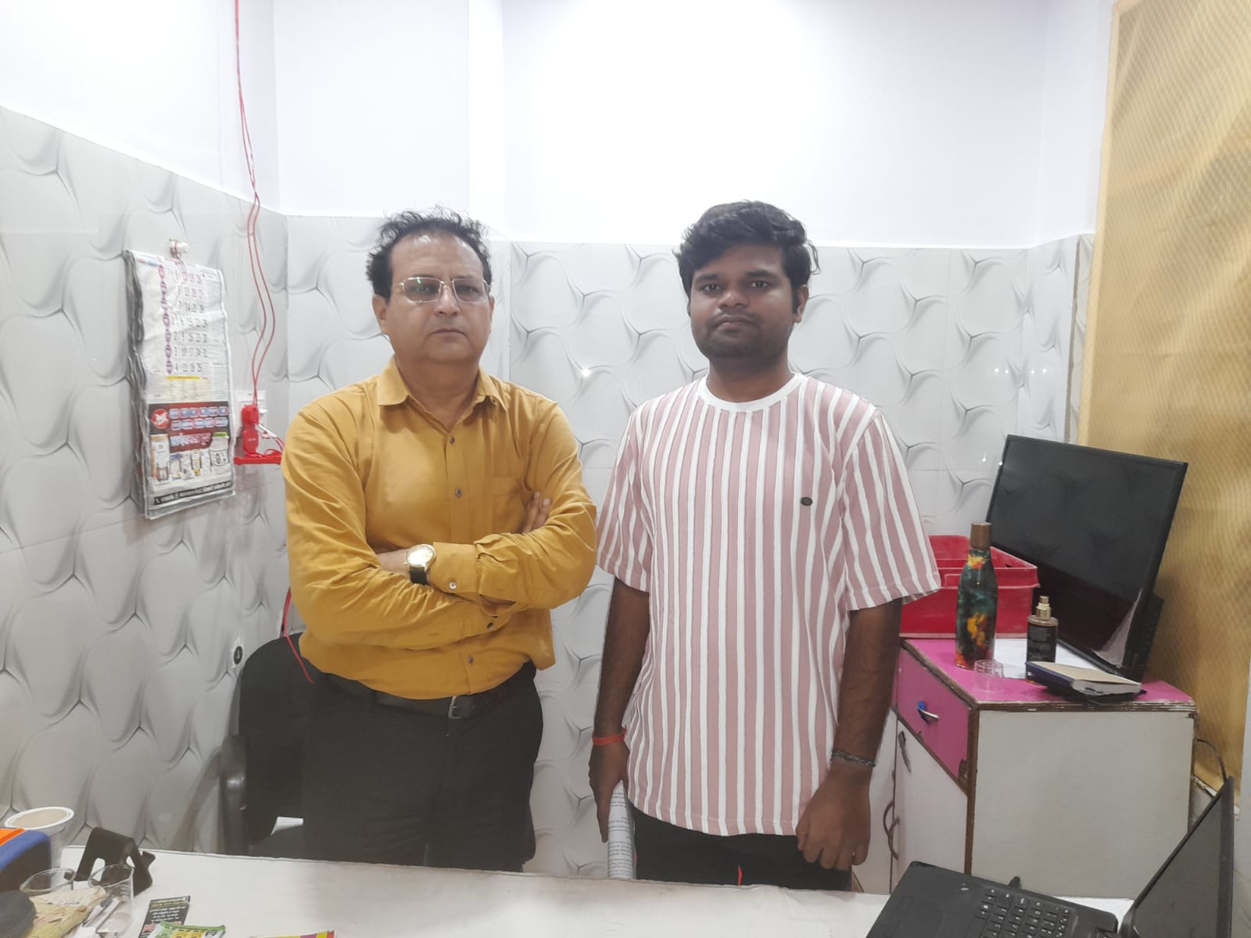
BRIEF OVERVIEW OF SHREE MAA DAIRY
Details
Name : Shree Maa Dairy(APRA MILK)
Owner : Mr. Amitabh Nagaria
Timing : 09 : 00AM to 05:00PM Daily
Location
Yamunotri, Village Naiguan, ghughwa , hansi Tehsil Niwari Jhansi , Uttar Pradesh, 284201
Product
Fresh Milk, Full Fat Milk(500 ml), Neno Milk(200ml), Loose Milk, Sada/Masala Mattha, Lassi Cup, Ghee Tin(15 Kg), Ghee(1 L), Ghee(450 ml), Dahi Cup/Pouch, Srikhand cup, Panner.
2

Slide 3
INTRODUCTION
Data Sources
Primary sales data collected from Shree Maa Dairy’s in the form of invoice records.
Data period : May 2024 – April 2025 (12 months)
Problem Statement
The problem of reaching a large customer base
Spoilage due to overstocking
Seasonal demand fluctuations
Data Cleaning
Data cleaning involves removing duplicates, Handling missing values, correcting inconsistencies, and outlier.
Data Transformation
Converted date fields to monthly format, and
Created derived metrics such as monthly revenue to support time-series analysis and forecasting.
3

Slide 4
SOURCE OF DATA AND DATA CLEANING METHODS
Sources | Description
Primary Data (Sales Records) | Monthly Sales, Particulars, Outward Qty, Price, Revenue collected from Shree Maa Dairy between May 24 to April 25.
Owner Interaction | Regular discussions with the dairy owner to understand : Seasonal demand patterns Inventory practices Spoilage and overstocking issues Distribution limitations
Market Observation | Product demand pattern and price trend were informally observed at nearby dairy retailers Used to understand Competitive pricing Seasonal product demand trends
Handling Missing Values Missing quantity or revenue entries were verified with
invoice records Missing values were filled with zero
only in cases where no transaction occurred.
1
Outlier Treatment
Extreme values were manually reviewed to differentiate genuine demand spikes from data entry errors. Genuine high sales during festivals were retained.
2
Data Standardization
3
Dates standardized to Month–Year format Monetary values maintained in Indian Rupees (₹) Product names standardized across all months.
4

Slide 5
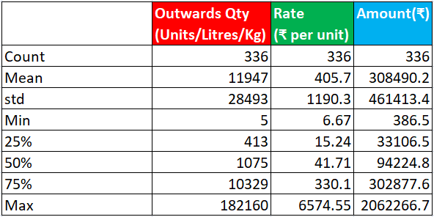
DESCRIPTIVE STATISTICAL ANALYSIS
Outwards Quantity
Avg Qty: 11,947 units, Std Dev: 28,494 units
Max : 1,82,160 units
Selling Rate (₹ per unit)
Avg: ₹405.77, Min: ₹6.67 (Milk / Buttermilk)
Max: ₹6,574.55 (Bulk Ghee SKUs)
Product (Amount ₹)
Avg: ₹3.08 Lakhs, Std Dev: ₹4.61 Lakhs
Range: ₹0.38 Lakhs - ₹20.62 Lakhs
Clear seasonal Trend
High revenue during festival & winter months, low in summer/monsoon season
Fig - 1
5

Slide 6
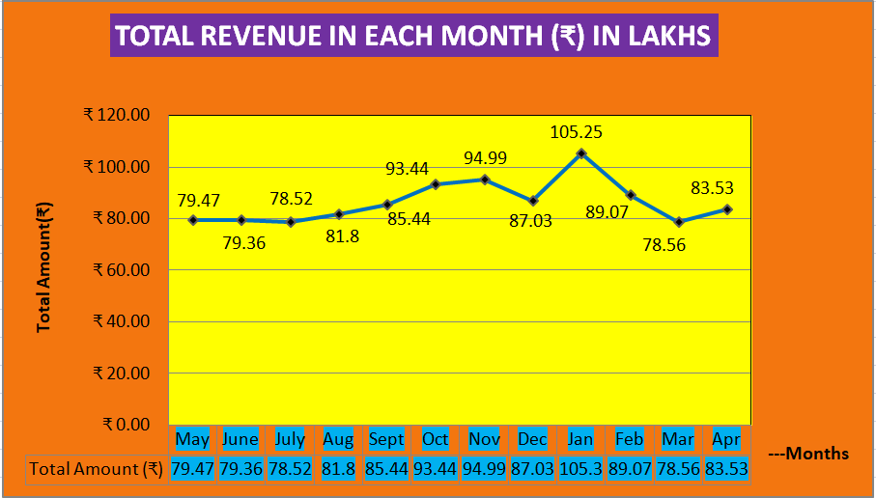
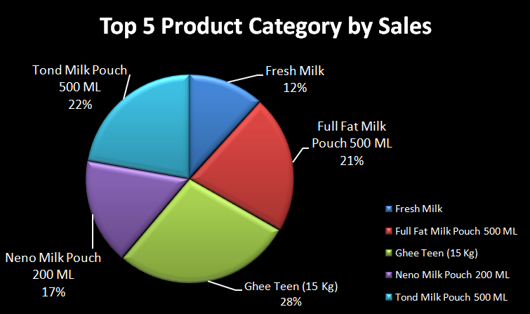
TOTAL REVENUE IN EACH MONTH
Fig - 2
Fig - 3
Top 5 Product Category
• Ghee Teen (15 Kg) is the largest revenue contributor (28%), followed by Tond Milk Pouch 500 ML (22%) and Full Fat Milk Pouch 500 ML (21%).
• Milk-based SKUs together contribute over 70% of total sales, highlighting high dependency on a few core products.
• These products form the backbone of business profitability and must be prioritized in production and distribution planning.
Monthly Revenue Trend
• Revenue exhibits strong seasonality, with a clear peak in January (₹105.25 Lakhs) driven by winter demand and festive consumption.
• Sales remain relatively stable during early months
(May–July) and increase steadily toward the festive period.
• A sharp decline is observed in March followed by partial
recovery in April, indicating post-season demand drop.
• This confirms that revenue is season-driven, requiring seasonal inventory and cash-flow planning.
6

Slide 7
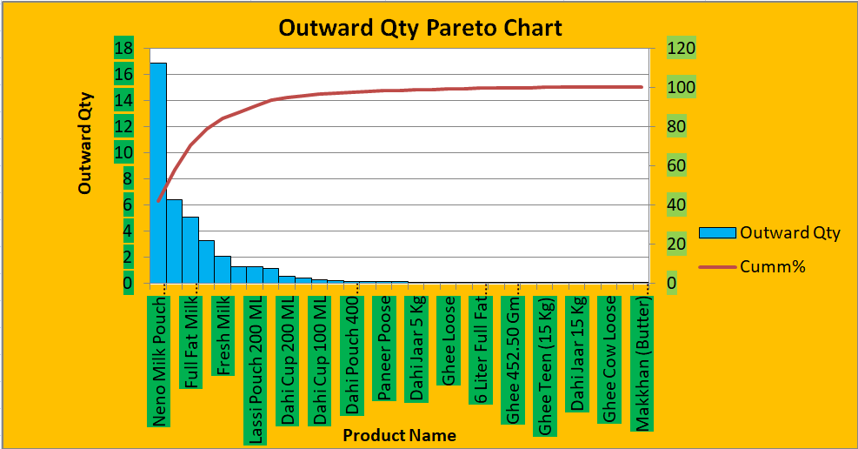
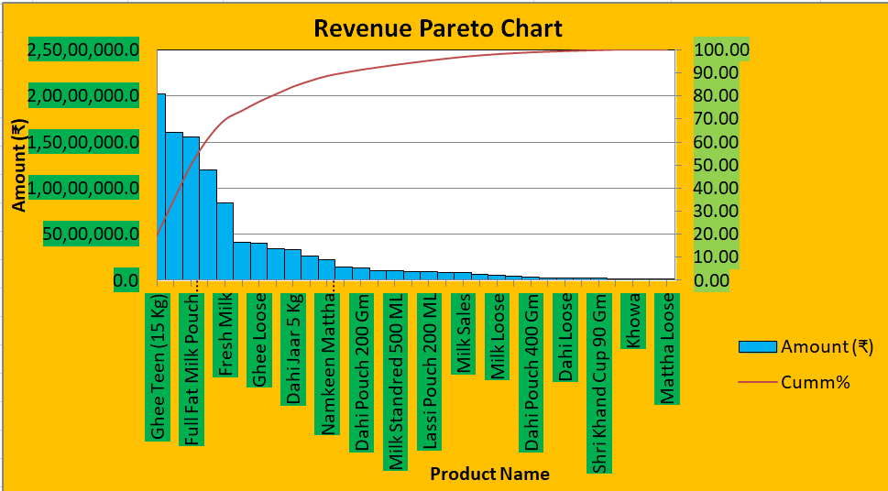
PRODUCT PERFORMANCE AND REVENUE INSIGHT
Fig - 4
Fig - 5
Outward Qty Contribution
• The top 5–6 products contribute approximately 75–80% of total outward quantity.
• Products like Neno Milk Pouch 200ML and Full Fat Milk 500ML require priority in production and inventory planning.
• Several SKUs form a long tail, contributing minimal quantity individually and can be stocked conservatively.
• Efficient production, distribution, and forecasting should prioritize these high-volume products to avoid stockouts.
Revenue Contribution
• Top 5–7 products contribute ~70–75% of total revenue, confirming the Pareto (80/20) principle.
• Milk and ghee SKUs (Ghee Teen, Full Fat Milk, Fresh Milk) are the primary revenue drivers.
• Long-tail products generate limited revenue individually and should be managed carefully to reduce overstocking.
• Focusing inventory and forecasting on these key products can stabilize revenue and reduce spoilage.
7

Slide 8
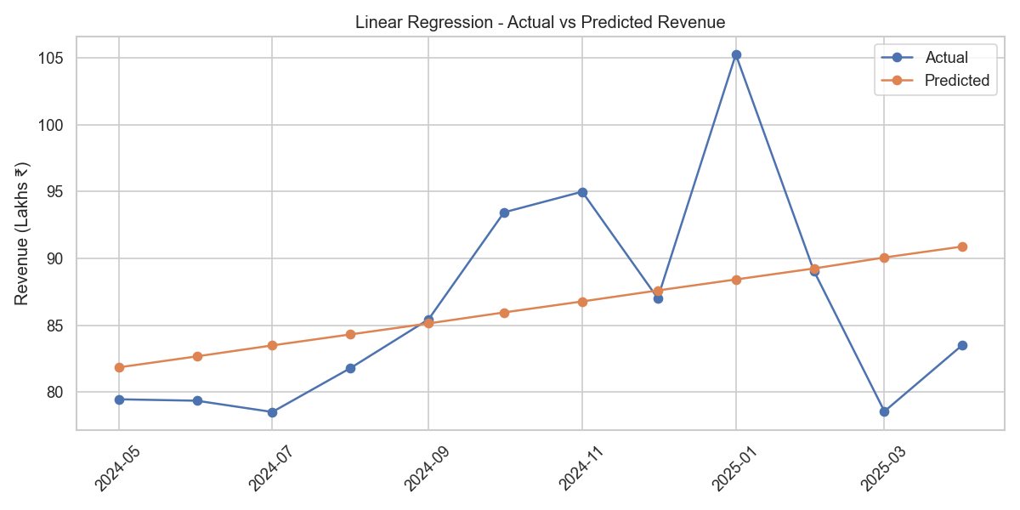
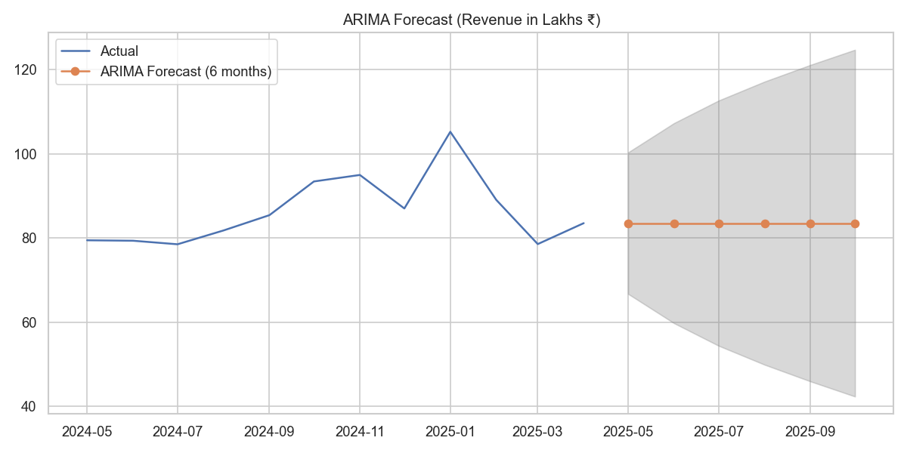
DEMAND FORECASTING
Fig - 6
Fig - 7
LINEAR REGRESSION
• Linear Regression captures the overall upward revenue trend, but it smooths out month-to-month fluctuations.
• It underestimates peak demand during high -season months (January) and overestimates revenue during low-demand periods (March).
• Therefore, Linear Regressopm is suitable for long-term trend analysis, but not ideal for seasonal or short-term forecasting.
ARIMA FORECASTING
• ARIMA effectively captures seasonality and short-term variations present in historical revenue data.
• The 6 months forecast indicates stable expected revenue levels, with the confidence interval reflecting demand uncertainity.
• This makes ARIMA more suitable for operational planning, inventory control, and short-term decision-making compared to Linear Regression.
8

Slide 9
STRATEGIC RECOMMENDATION
• Improve Seasonal Inventory Planning
Stock Ghee, Paneer, and Full-Fat Milk aggressively before Oct–Jan (winter & festive season) and scale down summer inventory to reduce spoilage and holding costs.
• Strengthen Summer Beverage Portfolio
Increase production and visibility of Mattha, Lassi, and Curd during Apr–Jun to stabilize revenue during low-demand months and reduce seasonal volatility.
• Focus on High-Impact SKUs (Pareto Strategy)
Prioritize procurement, quality control, and distribution for top revenue-generating SKUs (Ghee Teen, Fresh Milk, Milk Pouches) which contribute ~75–80% of total revenue.
• Optimize Low-Performing Products
Rationalize low-contribution SKUs through combo offers, repackaging, promotions, or gradual discontinuation to optimize shelf space and costs.
• Strengthen Distributor & Retail Network
Offer seasonal incentives, volume discounts, and loyalty schemes to retailers to ensure consistent off-take and support regional expansion.
• Data-Driven Forecasting & Planning
Use ARIMA and trend-based forecasting to plan monthly production, working capital,
and procurement instead of relying on intuition.
9

Slide 10
CONCLUSION AND IMPACT
Conclusion
• The 12-month sales and Pareto analysis revealed strong seasonality and high dependence on a few core products, especially during winter months.
• Product-level analysis helped identify high-performing SKUs and consistently low-performing items, enabling focused decision-making.
• Forecasting models (Linear Regression & ARIMA) indicated stable long-term growth, despite short-term seasonal fluctuations.
• Overall, the analysis provided a data-driven foundation for inventory planning, production alignment, and strategic expansion.
Impact
• Improved inventory efficiency by aligning stock levels with seasonal demand, reducing wastage and stock-outs.
• Higher revenue potential through prioritization of top-contributing SKUs and better preparation for peak winter demand.
• Reduced business risk by identifying opportunities to diversify revenue beyond a few core products.
• Stronger decision-making capability using predictive forecasting for budgeting, procurement, and working capital planning.
• Clear roadmap for scalable growth, supporting the firm’s long-term objective of achieving their goal.
10

Slide 11
THANK YOU

