Slide 1


SharePoint(SPFx)
Overview
Abhay Kumar Pandey
Senior System Engineer
Infosys Ltd.

Slide 2
Agenda
What is SharePoint ?
Where do we use SharePoint?
Important Terms
Key Features
Advantage of SharePoint
Disadvantage of SharePoint

Slide 3
What is SharePoint
SharePoint is the Microsoft’s browser-based content management system that allows a centralized protected space for document sharing and collaboration.
SharePoint is used to build intranets and store, organize and share information from across the business in one central location.

Slide 4
Important Terms
SharePoint site - A collection of pages , lists ,libraries and related settings
SharePoint sites can be team sites , blog sites , wiki sites and others.
Site collection - Is a collection of sites that contains configuration settings that apply to all the sites in it.
Libarary – A container for holding documents, pictures , lists and dicussions.

Slide 5
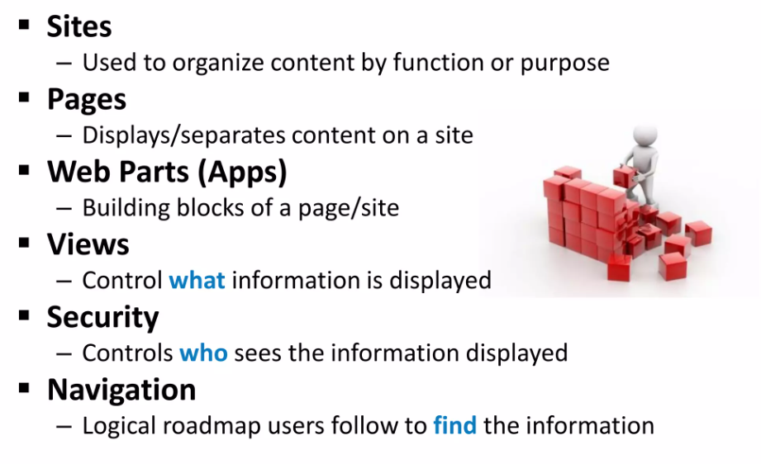
Key Features of SharePoint

Slide 6
Key Advantage of SharePoint
Powerful, reliable server platform - designed to perform for a great
number of applications and services while suffering minimal
downtime.
Powerful, fast search engine — search for docs and via metadata
Flexible web server — serves up documents for different types of end user devices
Scalable infrastructure — build and add apps and services
Managing corporate risk by managing corporate documents and
recording

Slide 7
Disadvantage of SharePoint
Microsoft Release cycles are slow and upgrades are
painful.
Special Search custom options require a lot of
internal customization.
Social networking is separated from the rest of the
intranet.

