Slide 1

PARSHVANATH CHARITABLE TRUST’S
A.P. Shah Institute of Technology
Thane, 400615
Academic Year: 2022-23
Department of Computer Engineering
CLOUD COMPUTING MINI PROJECT
PROJECT TITLE: LAB MANAGEMENT SYSTEM
BY
Madhur Shinde (20102079)
Abhay Sharma (20102065)
Sarvesh Shirwalkar (20102109)

Slide 2
Abstract :
This project is aimed at developing a website named Blood Donor management system for managing and analysing the blood donations and donors information.
The Blood Donor management system refers to the system and process to manage the blood donations and the information of the donors and also analysing it with the involvement of technology.
This system can be used to store the details of the donations, its donors
which can be updated weekly.

Slide 3
Cloud services used :
AWS Elastic Compute Cloud.
AWS Security Groups.
AWS VPC

Slide 4
AWS Elastic Compute Cloud :
Create an Amazon EC2 instance to host the lab management system, choosing an appropriate instance size for the expected workload. Choose an Amazon Machine Image (AMI) that includes the necessary software stack for the lab management system.
Amazon Elastic Compute Cloud (EC2) is a cloud-based computing platform that allows users to run virtual machines (VMs) in the cloud. These VMs are created through the process of virtualization, which is the creation of a virtual version of a computing resource, such as a server or storage device.

Slide 5
Security Groups :
Configure security groups to ensure that the instance is accessible from the internet only via the required ports. You might create a security group that allows access on port 80 (HTTP) and 443 (HTTPS) for web access to the system. Additionally, configure a security group that allows access to port 22 (SSH) for administrative access to the EC2 instance.
Remote Desktop Protocol (RDP) is a widely used protocol that allows users to access a remote desktop or server from anywhere in the world. However, to ensure the security of the remote desktop session, it is important to configure the RDP client with appropriate security measures.

Slide 6
AWS VPC:
Amazon Virtual Private Cloud (VPC) is a virtual network service provided by Amazon Web Services (AWS). It allows users to create an isolated virtual network in the AWS cloud, which is logically separated from other virtual networks and the public internet.
With AWS VPC, users can create and manage a virtual network topology that closely resembles a traditional on-premises network infrastructure. Users can define and control network addressing, subnets, and routing tables, as well as configure network gateways, security groups, and network access control lists (ACLs).

Slide 7
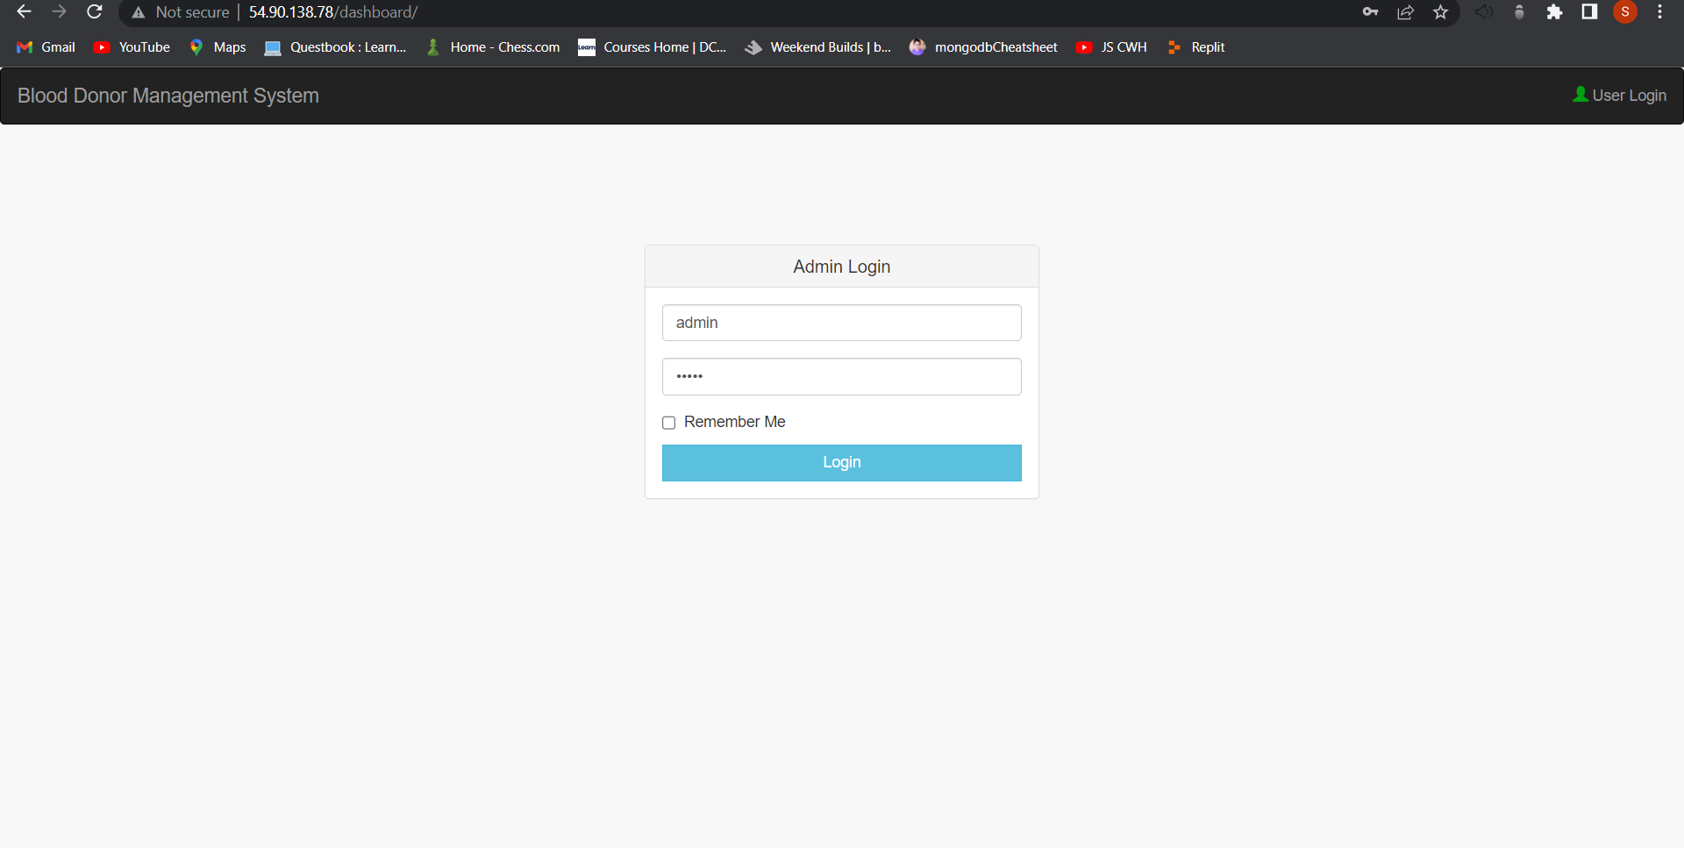
Implementation :
Login page -

Slide 8
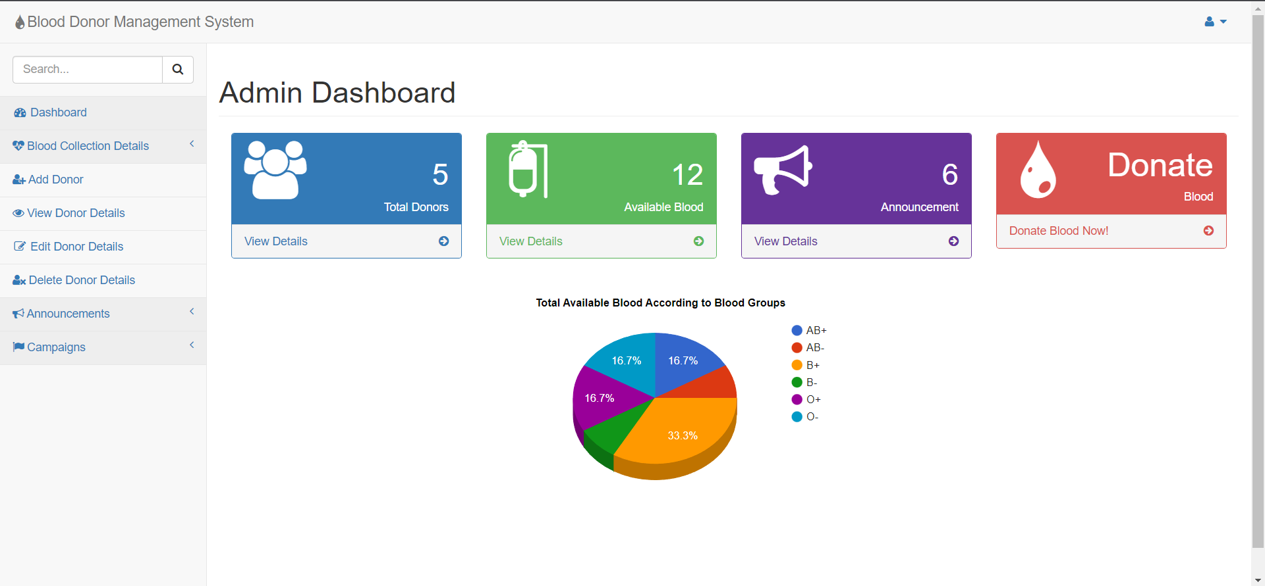
Admin Page -

Slide 9
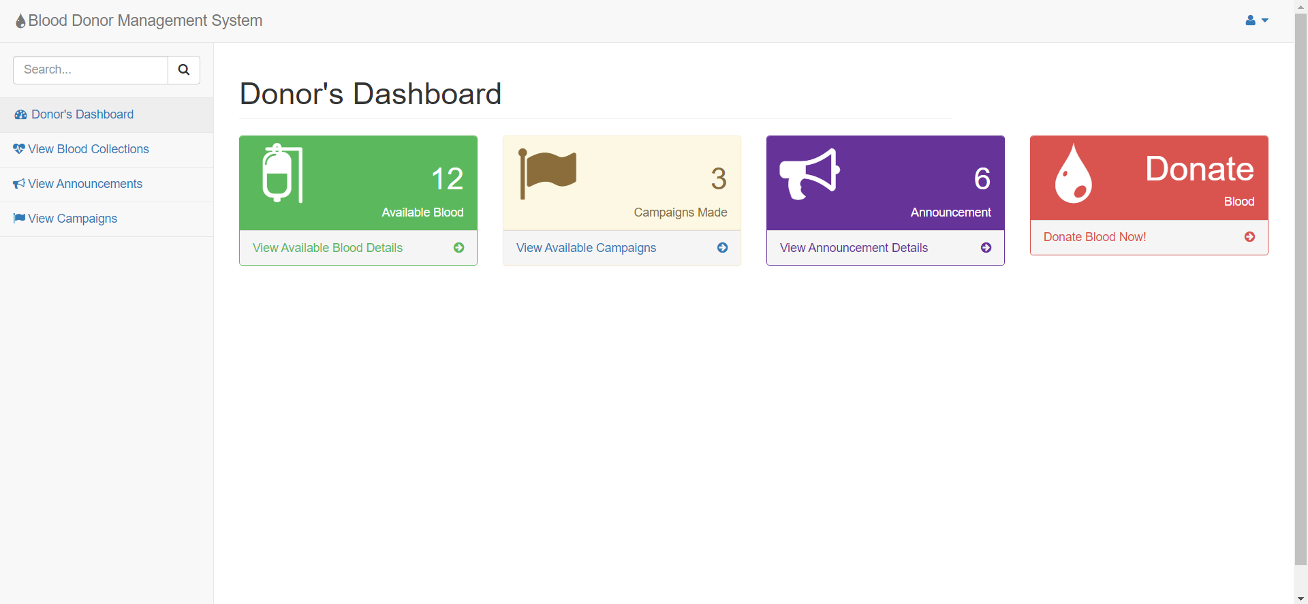
User Page -

Slide 10
Conclusion -
In conclusion, an AWS cloud project using EC2, VPC, and Security Groups can provide a secure and scalable solution for deploying applications in the cloud. EC2 instances can be launched within a VPC, which provides an isolated virtual network environment that can be customized according to specific business needs.
Security groups can be used to control inbound and outbound traffic to the EC2 instances, while VPC network ACLs can be used to provide an additional layer of network security. AWS VPC also provides flexibility to choose the IP address range, create public and private subnets, and configure routing tables to meet specific requirements.

