Slide 1
Nearest neighbor query on uncertain data with uncertain query
Presented by Abhay Mone

Slide 2
Contents
Definitions
Problem definition
Pruning Phase
Execution Phase
Limitations

Slide 3
Definition : 1
Uncertainty region
An uncertainty region of an object O_{i} at time t, is denoted by by U_{i}(t) is closed region such that O_{i} can be only found in this region.
Uncertainty probability density function
It is denoted by f_{i}(x,y,t) is a probability density function of O_{i}’s location (x,y) at time t, that has value of 0 outside U_{i}(t).

Slide 4
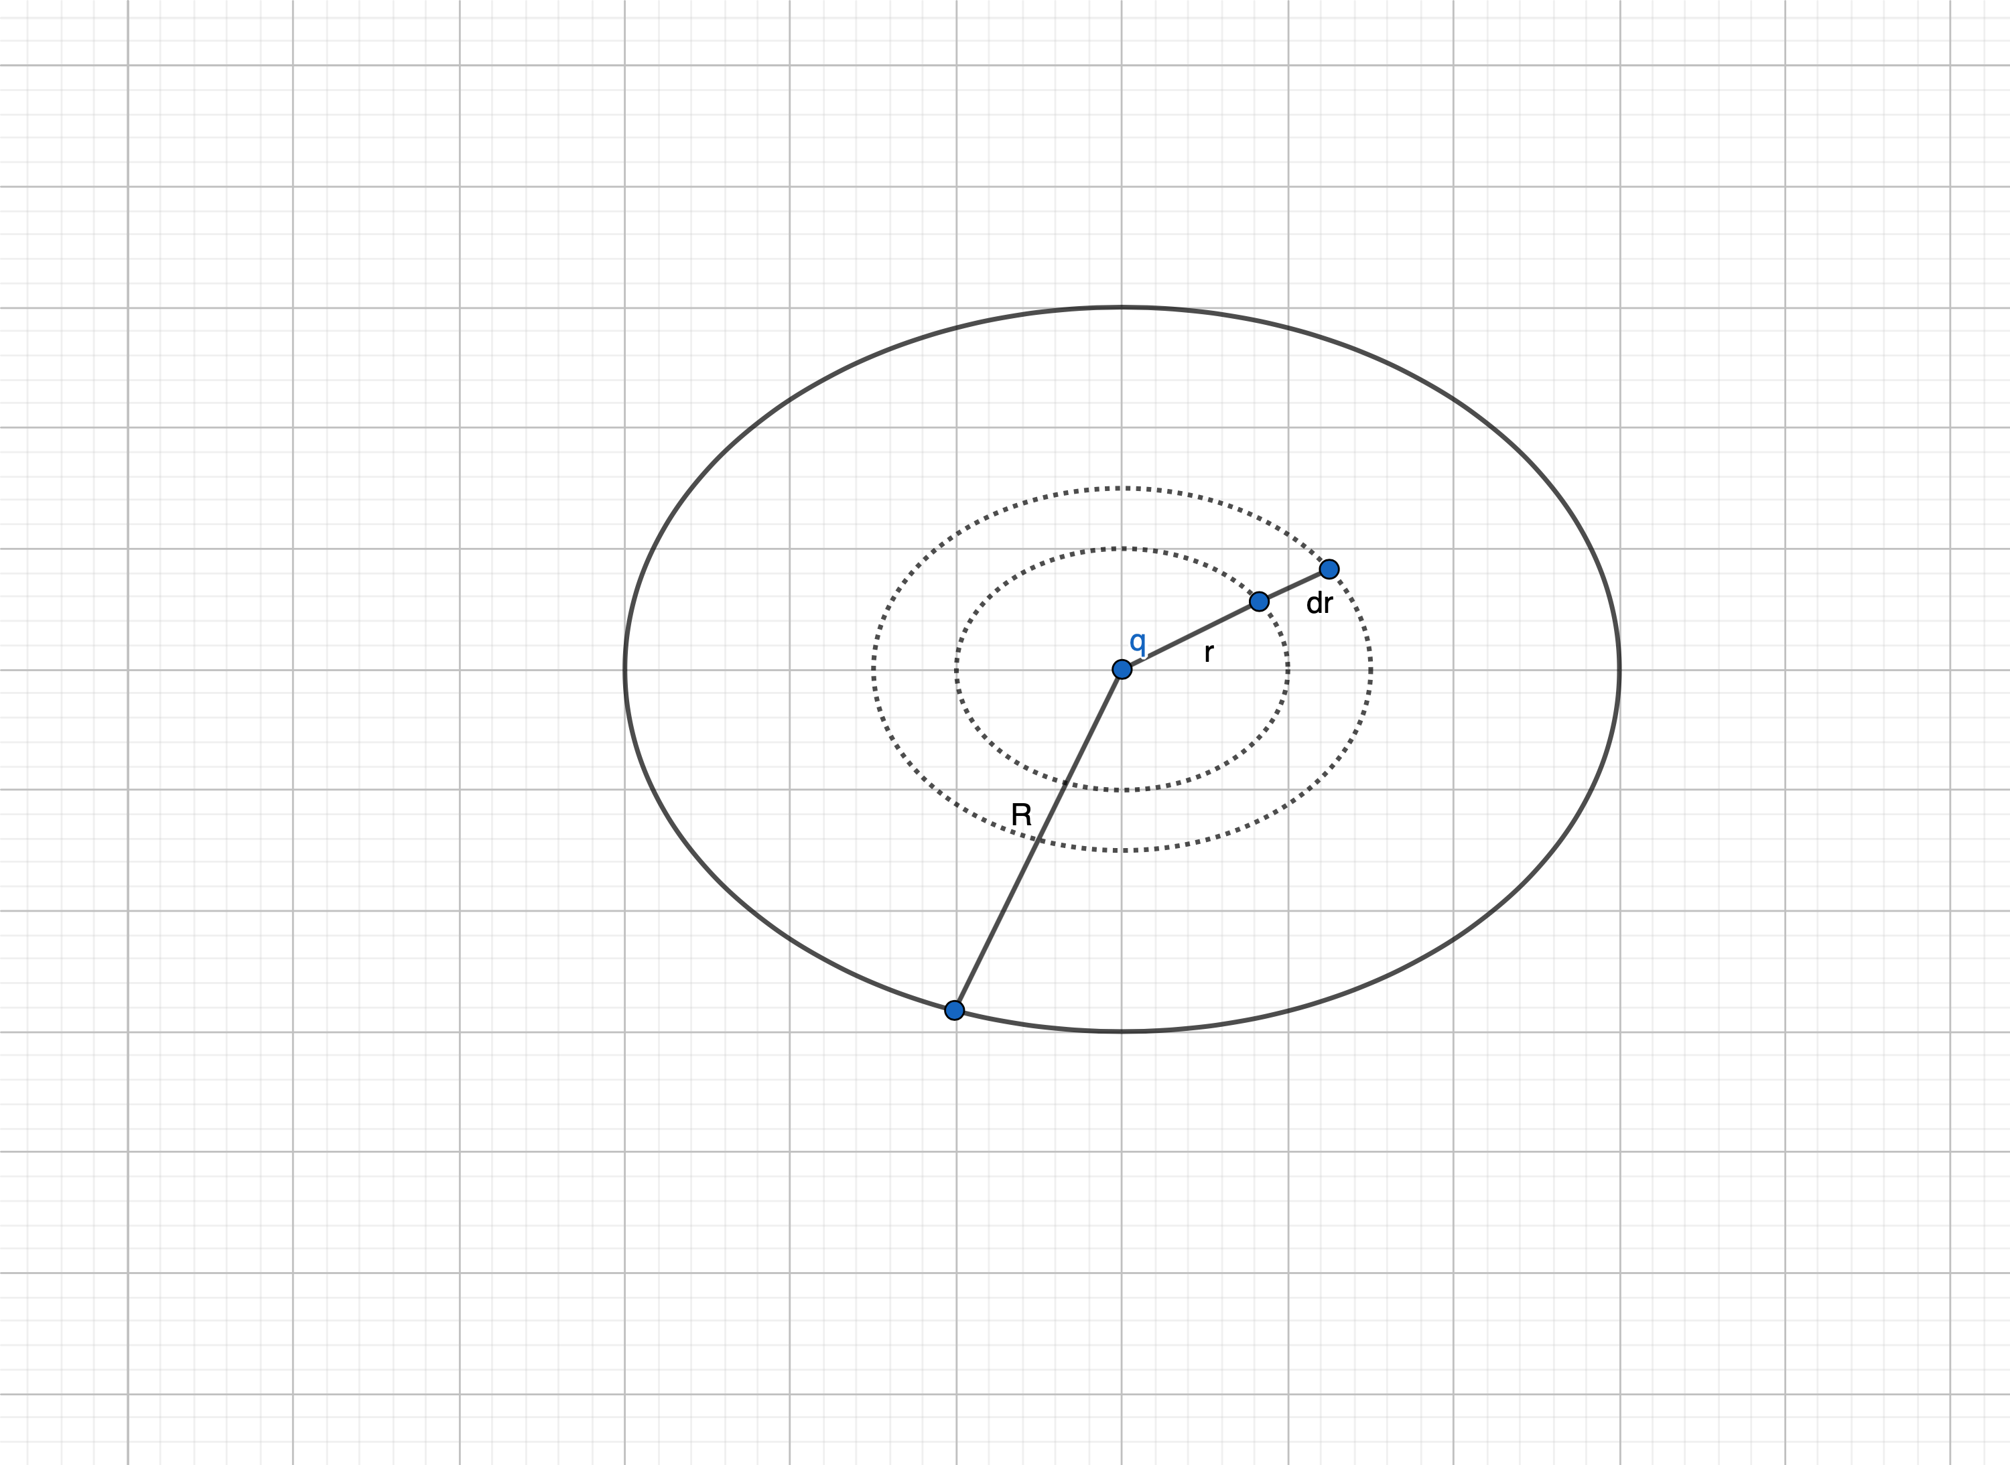
Definition 2 : PDF over circle
Probability that a randomly chosen point will fall between r and r + dr on a circle of radius R, we assume the all points on the circle are equally likely
and is given by pr(r)

Slide 5

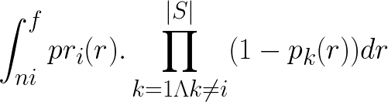
Problem definition
PNNQ
Prob(a point lies inside uncertain query region
.
Prob(O_{i} lies on the boundry of C_{q}(r)).Prob(other objects lie outside C_{q}(r))dr
=
= pr(r).
f = minimum of largest distance
n_{i}= minimum distance from query point to each object
pr_{i}(r) = probability density function of r such that O_{i} is located on the boundry of C_{q}(r)
p_{i}(r) = probability that O_{i} is located inside the circle C_{q}(r)
|S| = object set after pruning phase

Slide 6
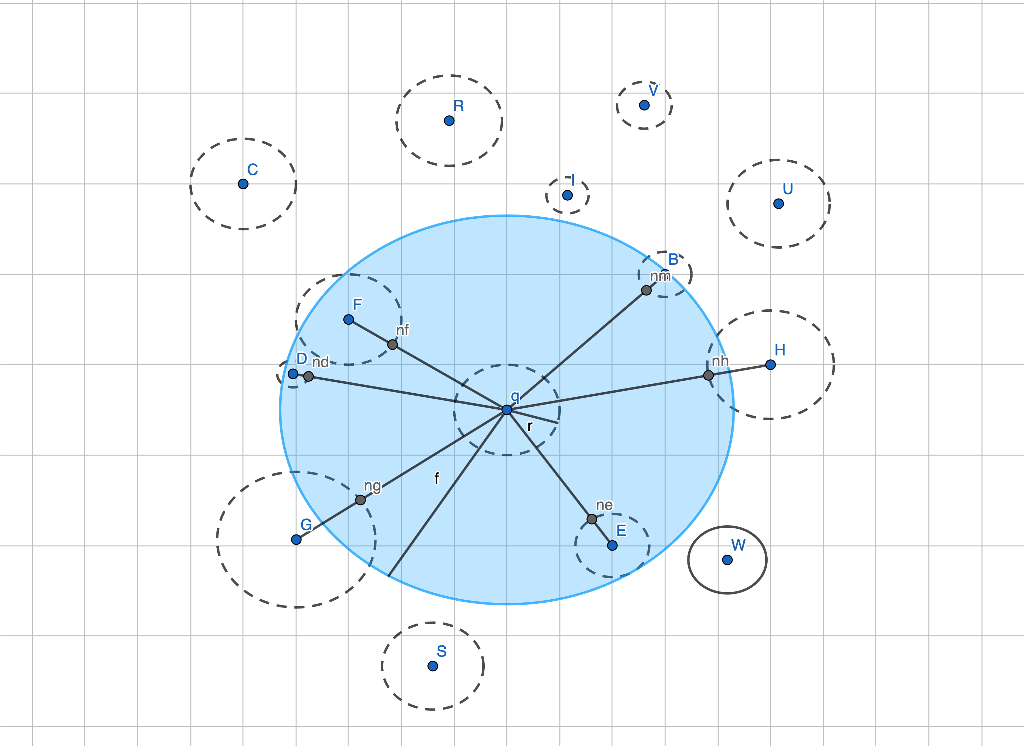
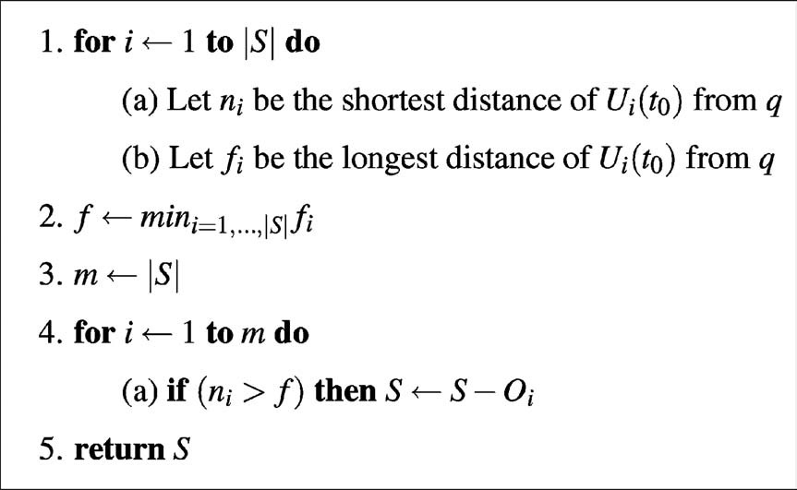
Pruning Phase

Slide 7
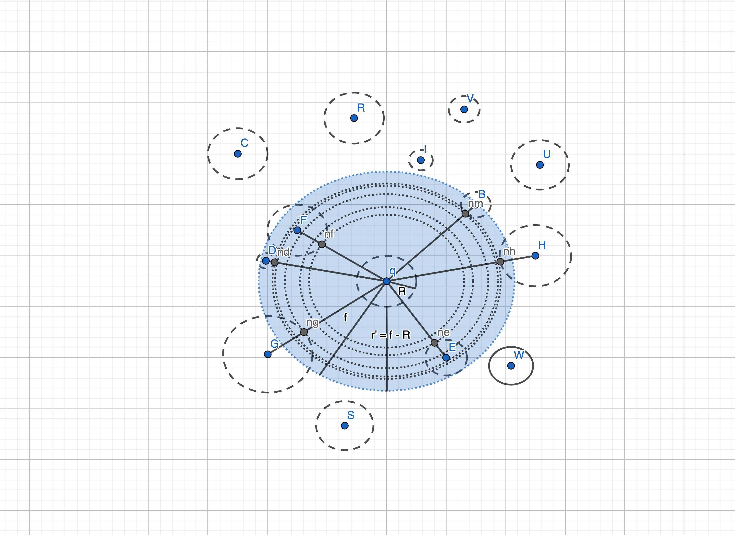
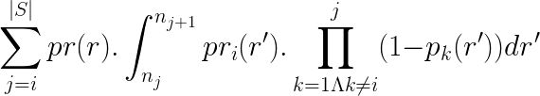
Execution phase
The probability of object O_{i} is being nearest neighbor of q
=

Slide 8
Limitations
The solution is proposed considering we know the probability density function of each object.
Although, in the pruning phase, we don’t need to know the probability distribution(PDF) of objects. However, in the execution phase, given a query point in the uncertain region, I was unable to find nearest neighbor without knowing the probability distribution(PDF) of the query point.

Slide 9
Thank You.

